Slide 1

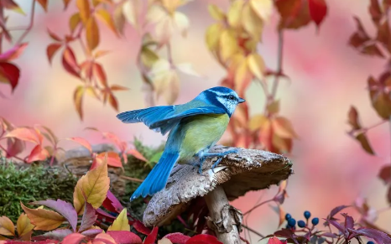
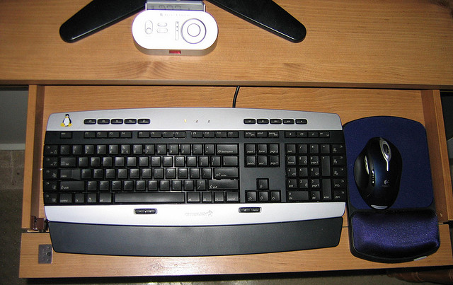
Multi-task
upload text or picture
Model management
trigger verification
watermark verification
result:
Blackdoor trigger result
yes!
setting
Tracing result
Autumn leaves spiral in the breeze, shadows stretching across a quiet path. A bird’s call fades into the distance.
10010101010101010100101010010101000101001011

