Slide 1
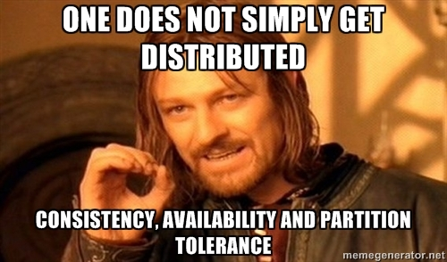
CAP theorem

Slide 2
CAP theorem
Consistency (all nodes see the same data at the same time)
Availability (a guarantee that every request receives a response about whether it was successful or failed)
Partition tolerance (the system continues to operate despite arbitrary message loss or failure of part of the system)

Slide 3
Process-oriented programming & Fredis
Fredis separates the concerns of data structures and the concurrent processes that act upon them.
Data structures reside in Redis cluster and persistent storage (RDBMS/S3/etc) which logically extend single-box memory model to distributed scenario.
Fredis actors are the concurrent distributed processes that act upon the data.

Slide 4
Consistent data model
Worker Nodes
CPU
Any number of ephemeral worker nodes (AWS spot instances, commodity boxes) act upon shared data
Highly available Redis cluster acts as a transport for actors messages and a distributed memory
Structured (Pocos in RDBMS) and unstructured (blobs in S3) distributed persistent storage
Core
Core
L1
L1
L2
RAM (L3)
Swap
Fredis
Redis Cluster (L4)
Persistent Storage (L5)
Redis Node
Redis Node
IPocoPersistor
Replicas
Replicas
IBlobPersistor

Slide 5
Partition tolerance
Ephemeral Worker Nodes
Could die at any point in time
Highly available Redis cluster
Never looses data (replication, multi-AZ deployment) and is always up
Performance is network-bound
Distributed persistent storage
After acknowledging a write operation data is reliably stored (reliably like in S3, epsilon to 100%)

Slide 6
Distributed Collections
System.Collections.Generic on L4/L5 in addition to strongly typed Redis collections.
Work directly with IList<T>, IDictionary<TKey,TValue>, ISet<T> interfaces as with local collections.
Data is locally (entirely/partially) cached in worker nodes’ L3 memory and synchronized across the nodes using Redis PubSub.
Locality = performance.

Slide 7
Distributed Actors
Fredis actors are abstract: they have a definition as a class and a number of instances running on worker nodes.
There is no physical address of an actor: messages are sent to an abstract identity of an actor and are picked up by random instances inside workers cluster.

Slide 8
Continuations
Continuation is an actor (continuator) whose task is to wait for the first actor and pass its result to the second.
In a rare case of continuator death, continuation will be replayed and it will pick available* results from its actors without replay.
When composed, the first continuator becomes the first actor of the second continuator.
(A=>B)=>C
A=>B
A
B
C
* results are cached for a timeout specified in an actor definition

Slide 9
Availability Guarantees
Every messaged will be consumed by a computation even if a worker node dies
If a single computation or any chain of continuations throws an exception:
PostAndGetReply() callers will get the original exception
Post() returns immediately after sending a message, a throwing computation will be replayed and logged

Slide 10
Side effects
If an actor computation doesn’t have a side effect then everything will just work
In rare case of actor death, a computation could be replayed. Therefore, side effects must be safe if they are run twice (e.g. Id/Key existence check before inserts).
Best practice is to put side effects into separate actors, e.g. SavePocoActor<TPoco>.

Slide 11
Throughput Guarantees
Redis is the limit! (which means network speed is the limit).
Each actor could live on its own Redis server – just override Redis connection string property on actor definition.
Pass L5 data references (e.g. RDBMS/S3 keys) instead of actual data to avoid large network load.

Slide 12
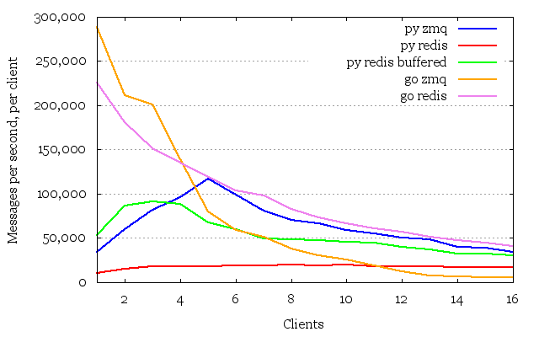
A Tale of Two Queues
Redis is as fast as ZMQ, so you couldn’t expect anything faster
http://blog.jupo.org/2013/02/23/a-tale-of-two-queues/

Slide 13
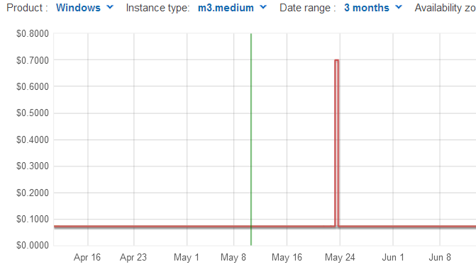
Pricing matters
Fredis could run on Linux (Mono), but with dev + debug time accounted for – the Linux cost could exceed the cost of spot Windows servers:
Spot: 0.072
Win (OD): 0.1337
Lin (OD): 0.077
Win (R): 0.069
Lin (R): 0.03
Spots were knocked out only in one AZ in 3 months in EU.
$100 ~ 100 full days difference per one m3.med: if your pay is $100/H you should spend less than 3.5 hours per machine per year to justify migration to Mono.
If you have 10 machines, a half week of work (35 hours) is justified but not more.

