Slide 1
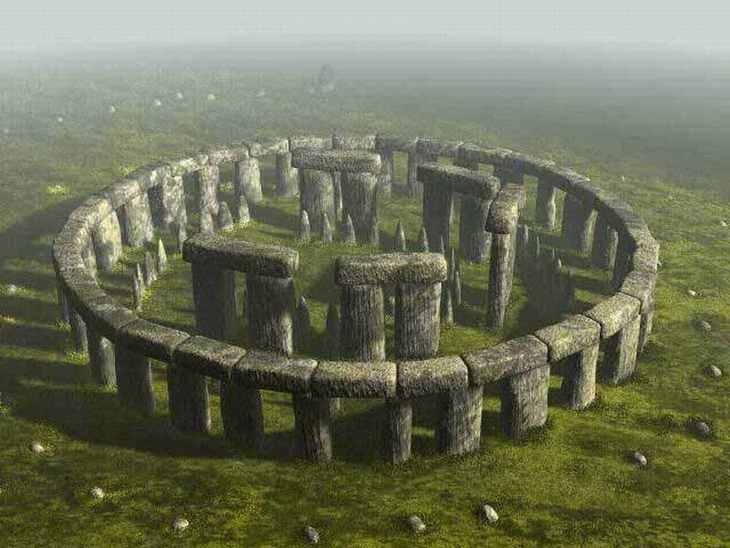
SNAKE
Introduction
It is a well know game that all we played!
In our version of the game, snake grows every time it eat an red apple. Player have to be careful to escape the borders of the canvas and never eat a black(rotten) apple.
The speed of the snake if fixed but the level to hardness comes of the numbers of black apples.
Player have an option to save his/her best score.

Slide 2
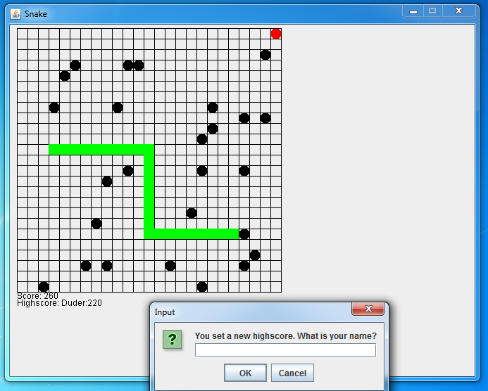

Slide 3
TEAM STONEHeNGe
Members
Aneta Marinova
Angel Djambazov
Ivan Krastev
Adelina Yanakieva
Petar Kanev
Tanya Delcheva
Used materials: BrandonioProduction combined with personal improvements.
All the members had improvements to make it interesting !
Enjoy it!

