Slide 1

A Flexible Multi-PoP Infrastructure Emulator for Carrier-grade MANO Systems
Manuel Peuster, Sevil Dräxler, Hadi Razzaghi, Holger Karl
Paderborn University
Steven Van Rossem,
Wouter Tavernier
Ghent University – iMinds, INTEC

Slide 2
“MeDICINE” Platform Overview

Slide 3
Idea: Multi-PoP Emulation Platform
Prototyping Platform
Execute VNFs
… and service chains
Multi-PoP
Realistic topologies
Integrate with existing MANO systems
MANO
Platform
PoP
VNF
PoP
VNF
10ms

Slide 4
Introducing the “MeDICINE” Platform
Multi Datacenter servIce ChaIN Emulator
Scope in ETSI terms:
NFV Management and Orchestration (MANO)
OSS/BSS
NFVO
EM
VNFM
VNF
VNF
VNF
VNF
VNF
VNF
MeDICINE platform
NFVI
VIM
NFVI
VIM
NFVI
VIM
Notes:
Scope

Slide 5
Background
Based on Containernet
Mininet extension
Adds container support (Docker)
Containers as hosts in emulated network
Allows: Pre-configured VNFs given as containers
Emulator can be executed on developers Laptop
MeDICINE
Containernet
Docker
Mininet

Slide 6
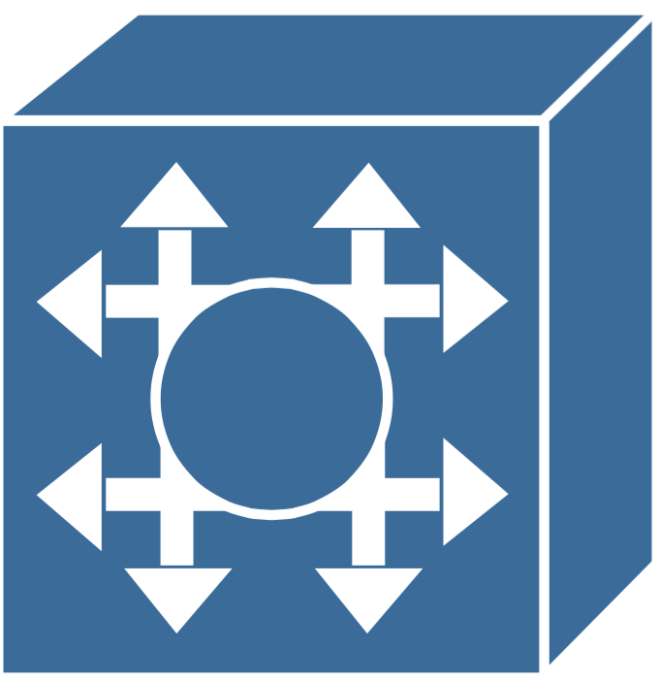

MeDICINE: Workflow
Topology
Emulated multi-PoP environment
2
execute
PoP 2
interact
VNF2
1
MeDICINE
20ms
Arbitrary MANO systems
Standard interfaces to emulated PoPs
“Batteries included” through
SONATA Emulator MANO module
define
s
interact
8ms
manage/control
15ms
develop
PoP 1
15ms
Developer
VNF1
MANO System
t
VNF3
upload
Network Service

Slide 7
MeDICINE: Workflow

Slide 8
MeDICINE: Topology definition I
# create three PoPs
p1 = net.addPoP(“PoP1”)
p2 = net.addPoP(“PoP2”)
p3 = net.addPoP(“PoP3”)
# create two swtiches
s1 = net.addSwtich(“s1”)
s2 = net.addSwtich(“s2”)
MeDICINE
PoP1
PoP2
PoP3
Notes:
Lets focus on the more interesting parts: Topos are completely different from Mininet/Containernet!

Slide 9
MeDICINE: Topology definition II
# interconnect PoPs and switches
net.addLink(p1, s1, delay=“10ms”)
net.addLink(s1, p2, delay=“5ms”, loss=2)
net.addLink(p2, s2, delay=“3ms”)
net.addLink(s2, p3, delay=“3ms”)
MeDICINE
PoP1
PoP2
PoP3
Notes:
Lets focus on the more interesting parts: Topos are completely different from Mininet/Containernet!

Slide 10
MeDICINE: Flexible API endpoints
# add cloud-like interfaces to PoPs
api1 = RestEndpoint(port=5001)
api1.connect(p1)
api2 = OsNovaEndpoint(port=5002)
api2.connect(p2)
api3 = SonataGkEndpoint(port=5003)
api3.connect(p3)
{REST}
MeDICINE
PoP1
PoP2
PoP3
Notes:
Lets focus on the more interesting parts: Topos are completely different from Mininet/Containernet!

Slide 11
Demo Scenario

Slide 12
Demo Scenario with three VNFs
Video flow
Squid
rate limit
no caching
Socat
TCP forwarder
:8899 -> :80
Apache
“CatTube”
video content

Slide 13
Available Demo Flavors

Slide 14
Available Demo Flavors
 | a) HEAT-template | b) SONATA EmuGK | c) SONATA SP | d) OSM (RO-only) | e) OSM (full)
Descriptors | x | x | x | x | x
On-boarding | x | x | x | x | x
Instantiation | x | x | x | x | x
Monitoring | x | x | x | x | x
Service demo | x | x | x | x | x
Multi-PoP instantiation |  | x |  |  | x
MANO management GUI |  |  |  |  | x

Slide 15

This demo is available for download!
https://goo.gl/ordJDu
Manuel Peuster (manuel.peuster@upb.de)
http://sonata-nfv.eu

