Slide 1


SOFTNETWORKING - Service Platform
24rd April 2017 - Thomas Soenen (imec)

Slide 2
Agenda / Content
Service platform overview
Components overview:
Gatekeeper
API
GUI
BSS
Catalogues
MANO Framework
Infrastructure Adaptor
Monitoring

Slide 3
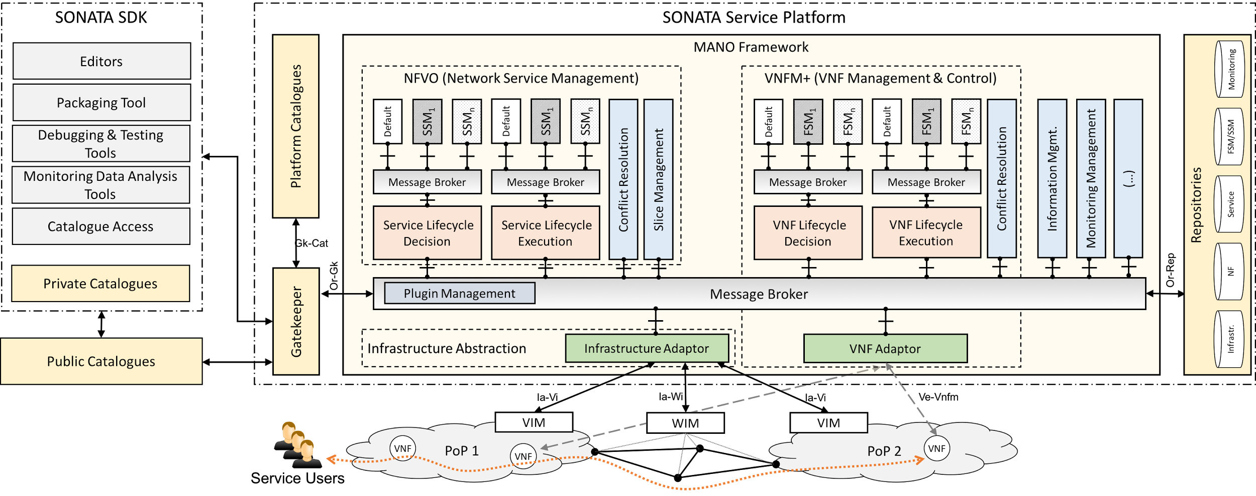
Service platform overview

Slide 4
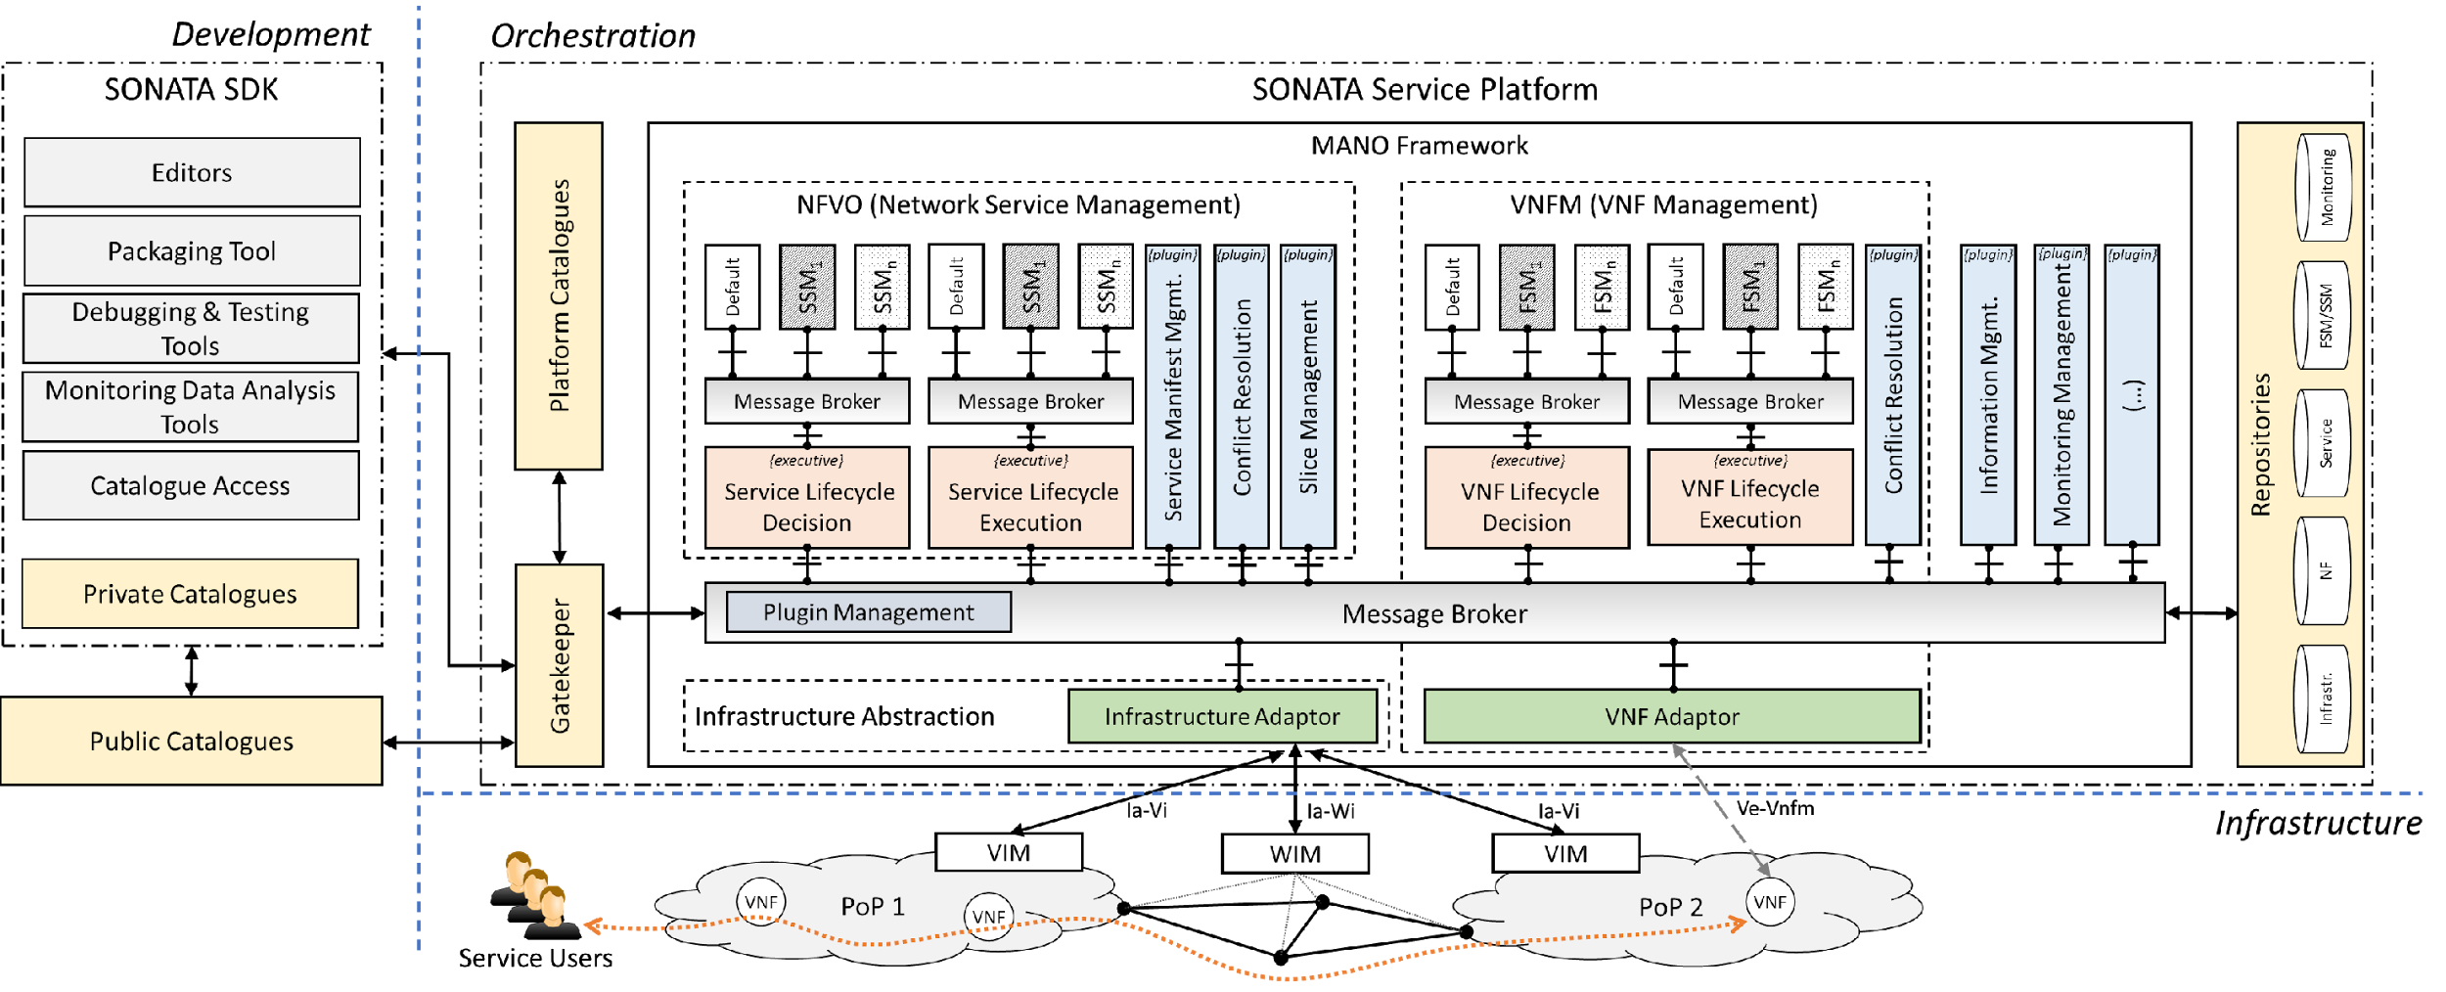
Gatekeeper in the SP architecture

Slide 5
Gatekeeper
To satisfy 5G flexibility requirements, cloud SPs will have to allow access to other parties
3rd party Services and Network Functions available in the Catalogues
3rd party infrastructure To deploy on
Customers requesting the deployment of a service
Developers requiring feedback on the performance of their functions
How can that happen in a secure and controlled way?
By using a ‘central’ component (Gatekeeper), that:
Controls all API accesses to the SP;
Validates any asset that is submitted to the SP;
Authenticates/Authorizes any access;

Slide 6


Gatekeeper
End-User
Admin
BSS
Catalogues
GUI
Repositories
API
Developer
SDK
MANO Framework

Slide 7
Gatekeeper BSS
Services available in the SP’s Catalogues are available for End-Users (Customers) to ‘buy’
This may be a complex process, so this Business Support System (BSS) module abstracts all that complexity, presenting a graphical user interface to:
Retrieve the catalogue available services list
Request new service instances (‘selling’)
Update currently running service instances (when the service has been updated)

Slide 8
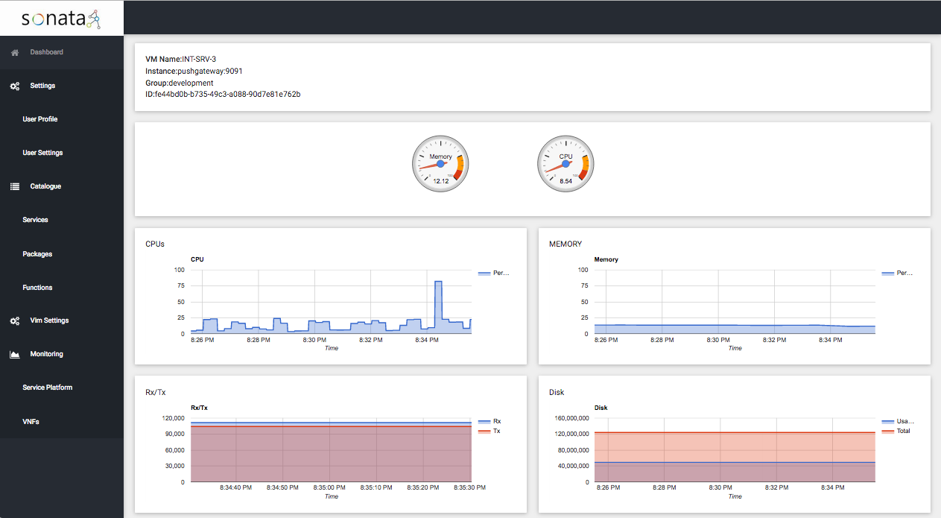
Gatekeeper GUI
The SP provides a GUI connected to it’s API, to show/edit the different processes it is involved in, authorize users, show monitoring data, etc.

Slide 9
Service Platform Catalogues
One storage for all network service catalogue needs
Availability of valid network service and virtual network function descriptors for two purposes
Facilitate network service development
Instantiation of network service on the service platform
Storage of valid SONATA package files for 3rd party developer access

Slide 10





SP Deployment Workflow
BSS
1
SONATA Service Platform
SONATA SDK
3
Gatekeeper
MANO Framework
Repositories
2
Instantiating Network Service in SP
Service Platform Catalogues
1. BSS selects and requests instantiation of an NS
PDs
NSDs
VNFDs
2. Gatekeeper retrieves the descriptors from Catalogues
3. Gatekeeper forwards network service initiation
request to MANO framework.
.son packages
Infrastructure Abstraction

Slide 11
MANO Framework in the SP architecture

Slide 12
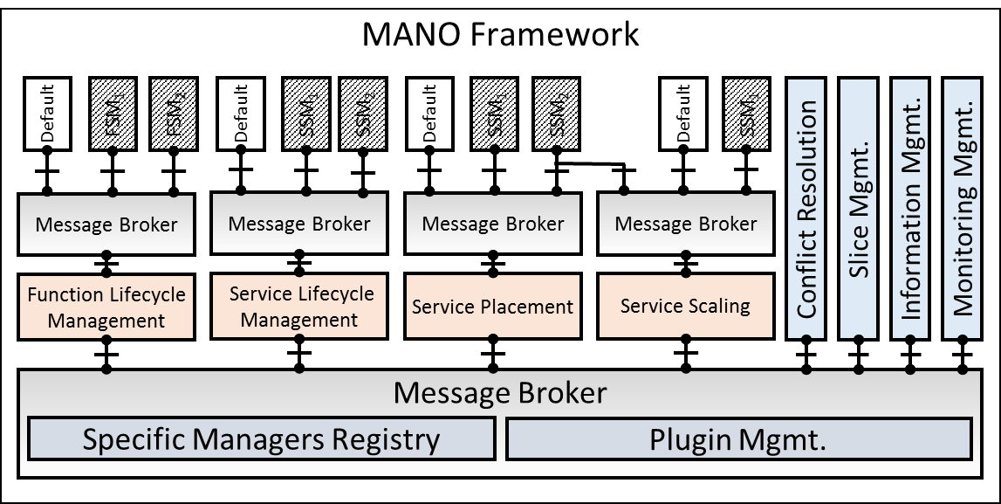
MANO Framework
Extensible management and orchestration framework
Loosely coupled internal structure provides:
Flexible service management for developers
Flexible platform management for operators
Consists of:
Message Broker
Plugins
Specific Managers
Function-/Service-Specific Managers

Slide 13
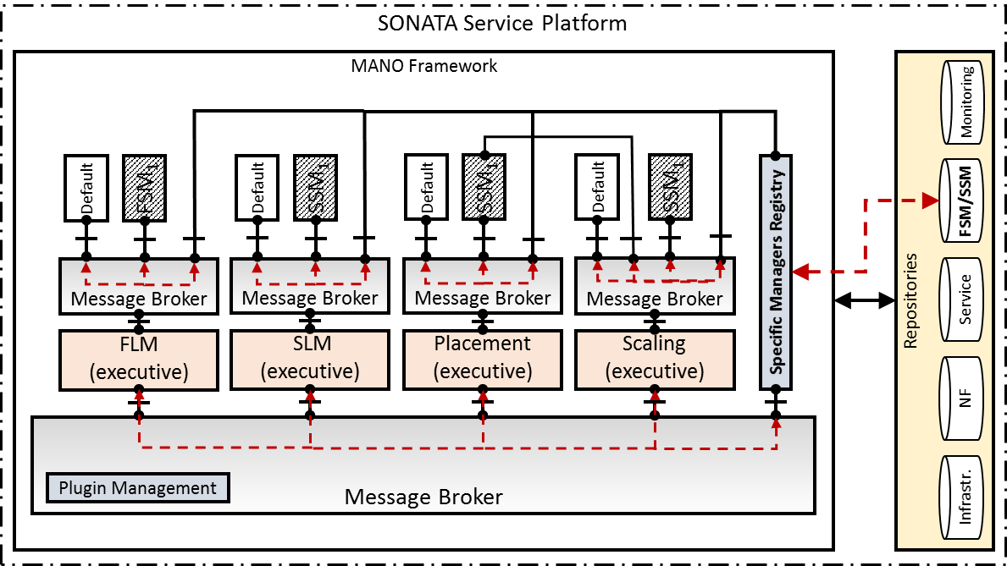
Generic and Customized Plugins
MANO Plugins
The MANO framework is composed out of a set of loosely coupled MANO plugins (microservices)
Each of these plugins implements a limited, well-defined part of the overall management and orchestration functionality.
Plugins Manager
Responsible for keeping track of connected MANO plugins
Function-/Service-Specific Manager (FSM/SSM)
Provide the ability to customize the management and orchestration behavior for single services and network functions

Slide 14
Infrastructure Abstraction in the SP

Slide 15
Infrastructure Abstraction
In 5G scenario, virtual resources will be offered in a distributed way, through a set of management and control entities coming from different vendors and using different technologies.
The Infrastructure Adaptor abstracts this heterogeneous and distributed infrastructure layer

Slide 16



Infrastructure Abstraction
Message Bus
Infrastructure Abstraction
VIM Adaptor
WIM Adaptor
WIM₁
VIM_{A}
WIM₂
VIM_{B}
WIM₃
Net Segment
Net Segment
Net Segment
Net Segment
Net Segment

Slide 17
Monitoring Framework
Offers user-defined, real-time, multi-level data collection (e.g. on networking, storage and computing) and alerting.
Open source, scalable and modular monitoring solution which is compliant with ETSI NFV MANO framework.
Monitoring VMs, Containers, OpenStack, OpenFlow
Customizable monitoring metrics

Slide 18
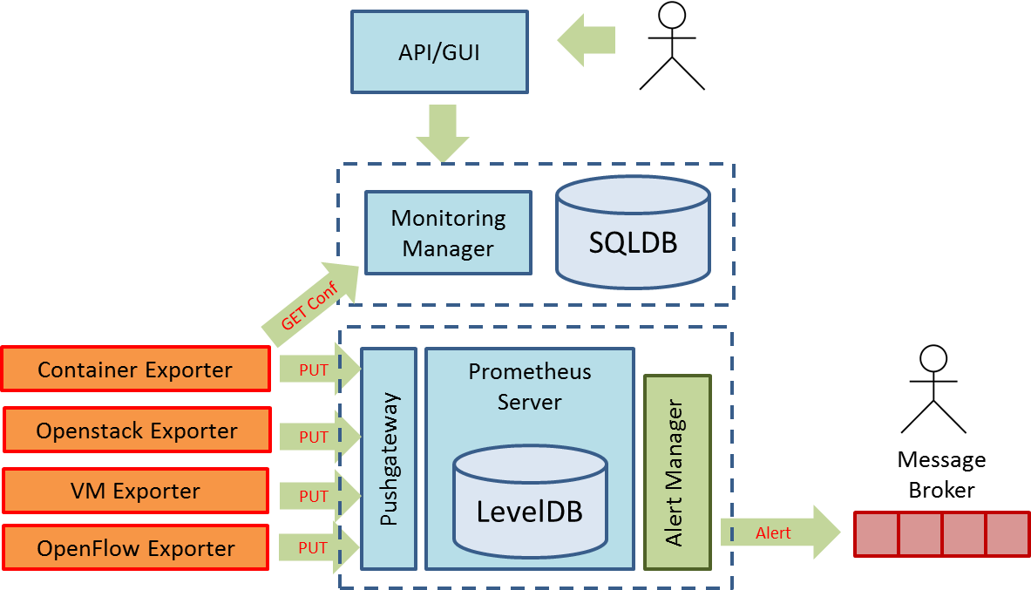
Monitoring Framework: architecture
son-monitor
son-monitor-probe
MANO framework

Slide 19
Use and Contribute
Ensemble of Docker containers
Ansible playbook for the installation: github.com/sonata-nfv/son-install
Contribute to the development: github.com/sonata-nfv/

Slide 20
Thomas.soenen@ugent.be
Thank you!
Questions?

