Slide 1



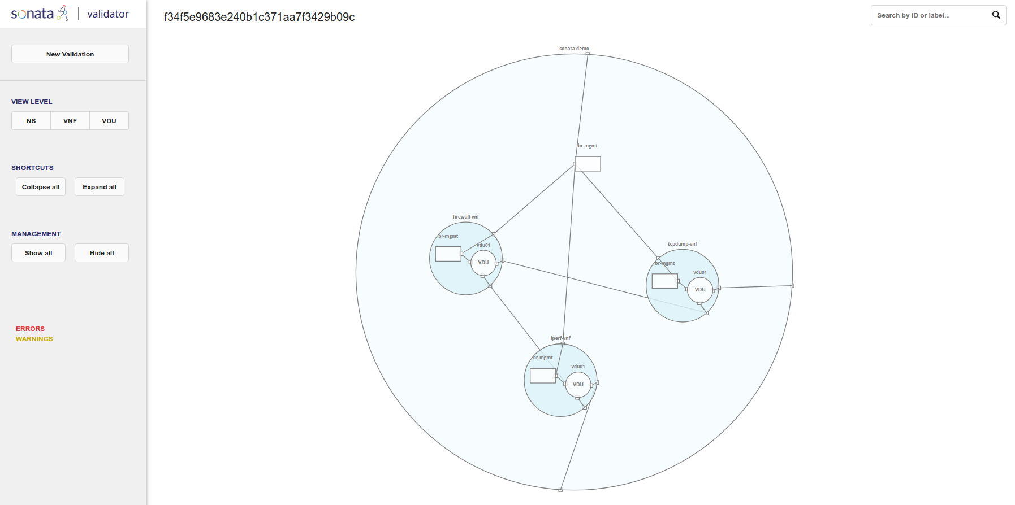
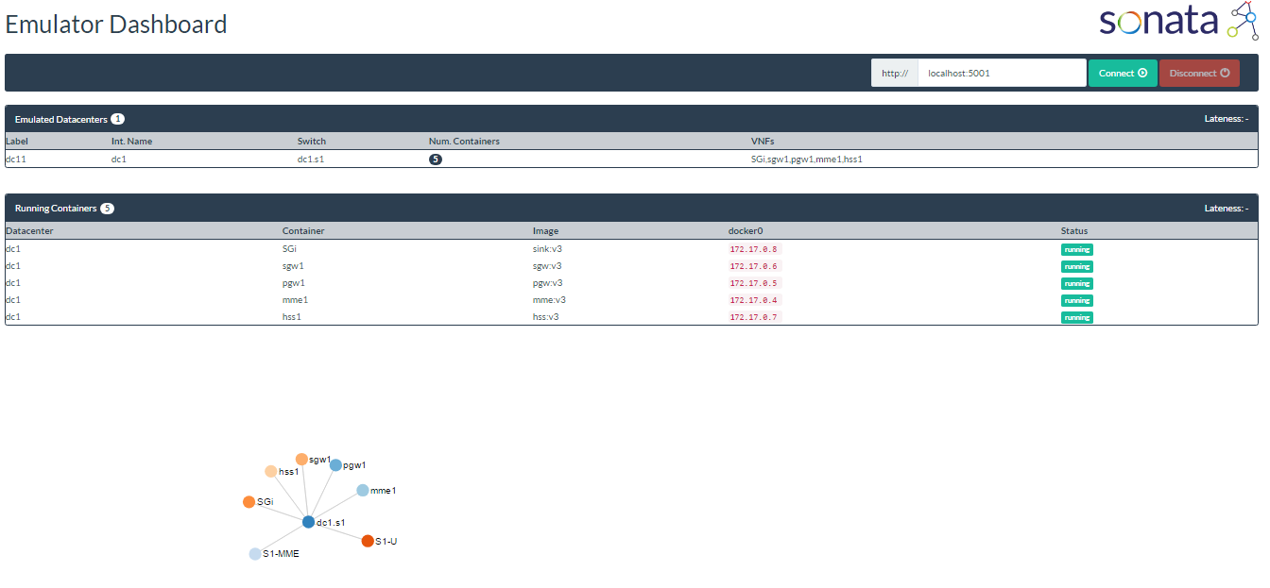
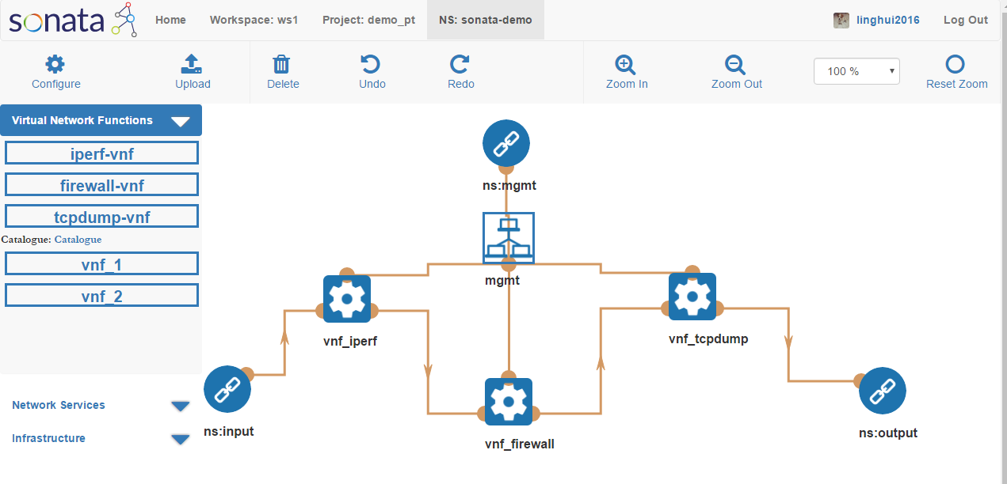

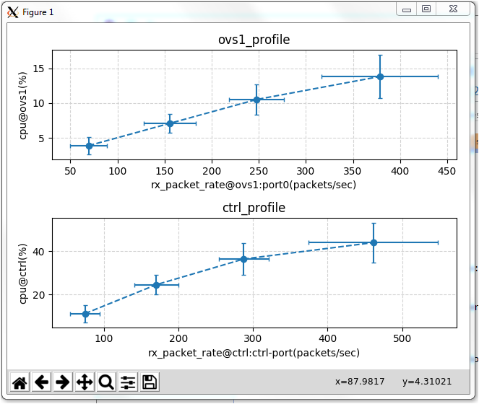
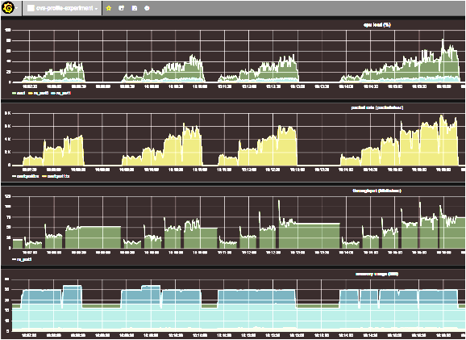









A Network Service Development Kit Supporting the End-to-End Lifecycle of NFV-based Telecom Services
Steven Van Rossem, Manuel Peuster*, Luis Conceicao⁺, Hadi Razzaghi Kouchaksarei*, Wouter Tavernier, Didier Colle, Mario Pickavet and Piet Demeester
Authors are with Ghent University, imec, IDLAB
except *Paderborn University and ⁺Ubiwhere
contact: steven.vanrossem@iugent.be
SDK environment
Pre-deployment
validation
Deploy &
Emulate
Test VNF
Configuration
push to
MANO Platform
(deploy or
update service)
Edit Service
Descriptor
Service
Package
Check
Performance
Monitor & Debug
Functionality
[MeDICINE] M. Peuster, H. Karl, and S. van Rossem, “Medicine: Rapid prototyping of production-ready network services in multi-pop environments.”,
IEEE SDN-NFV 2016
The used software is open-source:
Developed in the European SONATA research project
Available on GitHub
Service Programming and Orchestration for Virtualized Software Networks
https://github.com/sonata-nfv
Part of 5G-PPP initiative:
@sonataNFV
HORIZON 2020:
This project has received funding from the European
Union’s Horizon 2020 research and innovation
programme under grant agreement no 671517.
www.sonata-nfv.eu
Ghent University - imec
IDLab
iGent Tower - Department of Information Technology
Technologiepark-Zwijnaarde 15, B-9052 Ghent, Belgium

