Slide 1
PDE with GNN

Slide 2
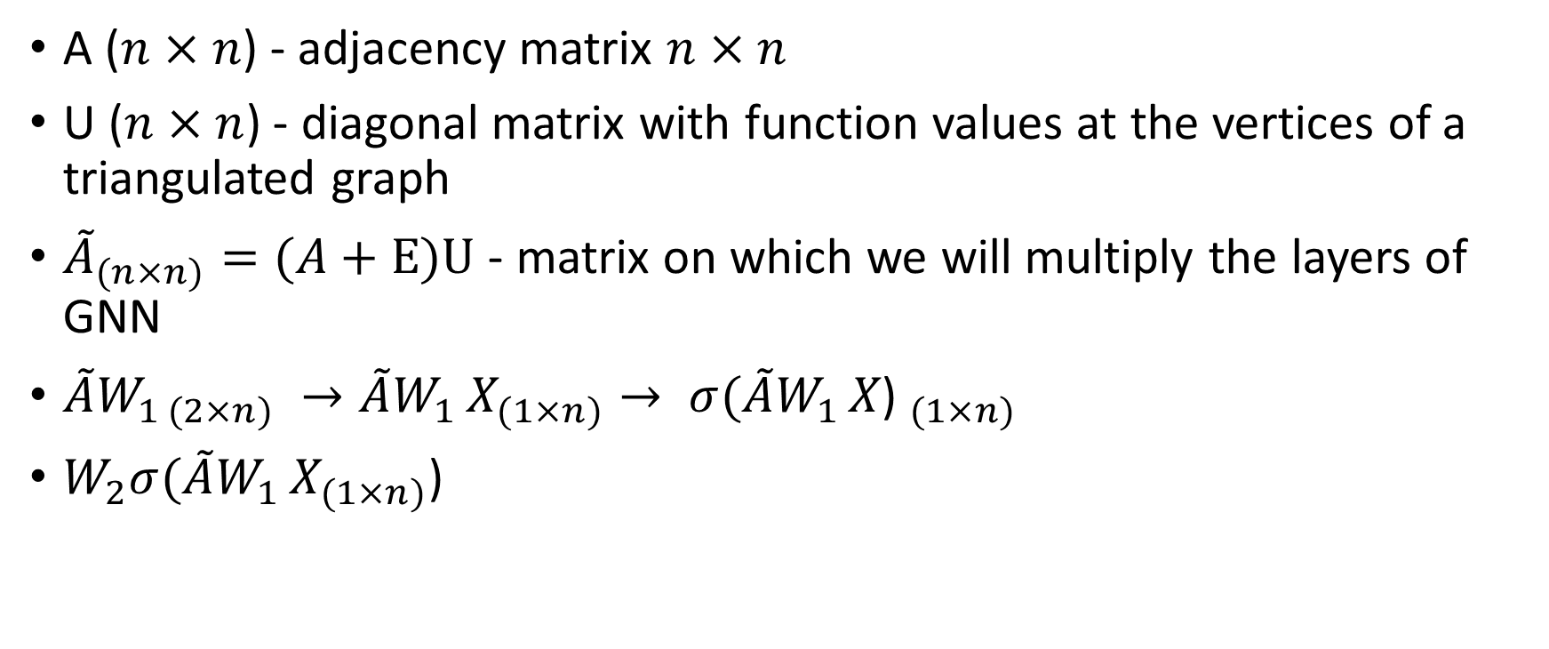
GNN (almost GNN)
A ($n×n$) - adjacency matrix $n×n$
U ($n×n$) - diagonal matrix with function values at the vertices of a triangulated graph
${\tilde{A}}_{(n×n)}=(A+E)U$ - matrix on which we will multiply the layers of GNN
$\tilde{A}W_{1 (2×n)} →\tilde{A}W_{1 }X_{(1×n)}→ {σ(\tilde{A}W_{1 }X\text{) }}_{(1×n)}$
$W_{2}σ(\tilde{A}W_{1 }X_{(1×n)}$)

Slide 3
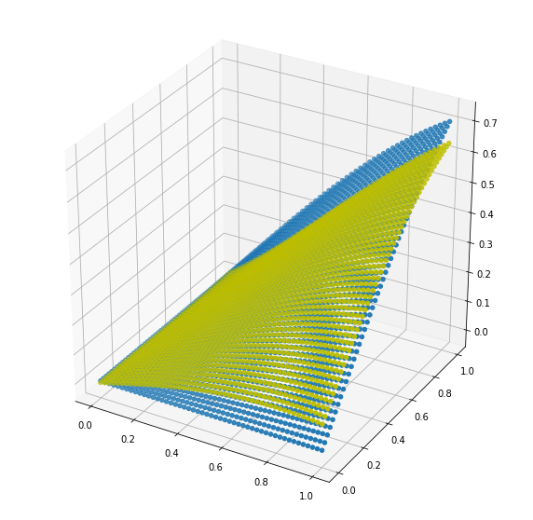

$\left\{\begin{aligned}u_{xx}\text{=} u_{yy} \\ u|_{x=0}=0 \\ \frac{∂u}{∂y}|_{y=0}=\sin{x}\end{aligned}\right.$
$loss{=(u_{xx}\text{-} u_{yy})}^{2}+{(y(x=0))}^{2}+{(y_{y}^{′}\left(y=0\right)−\sin{x})}^{2} →min$
results:

Slide 4
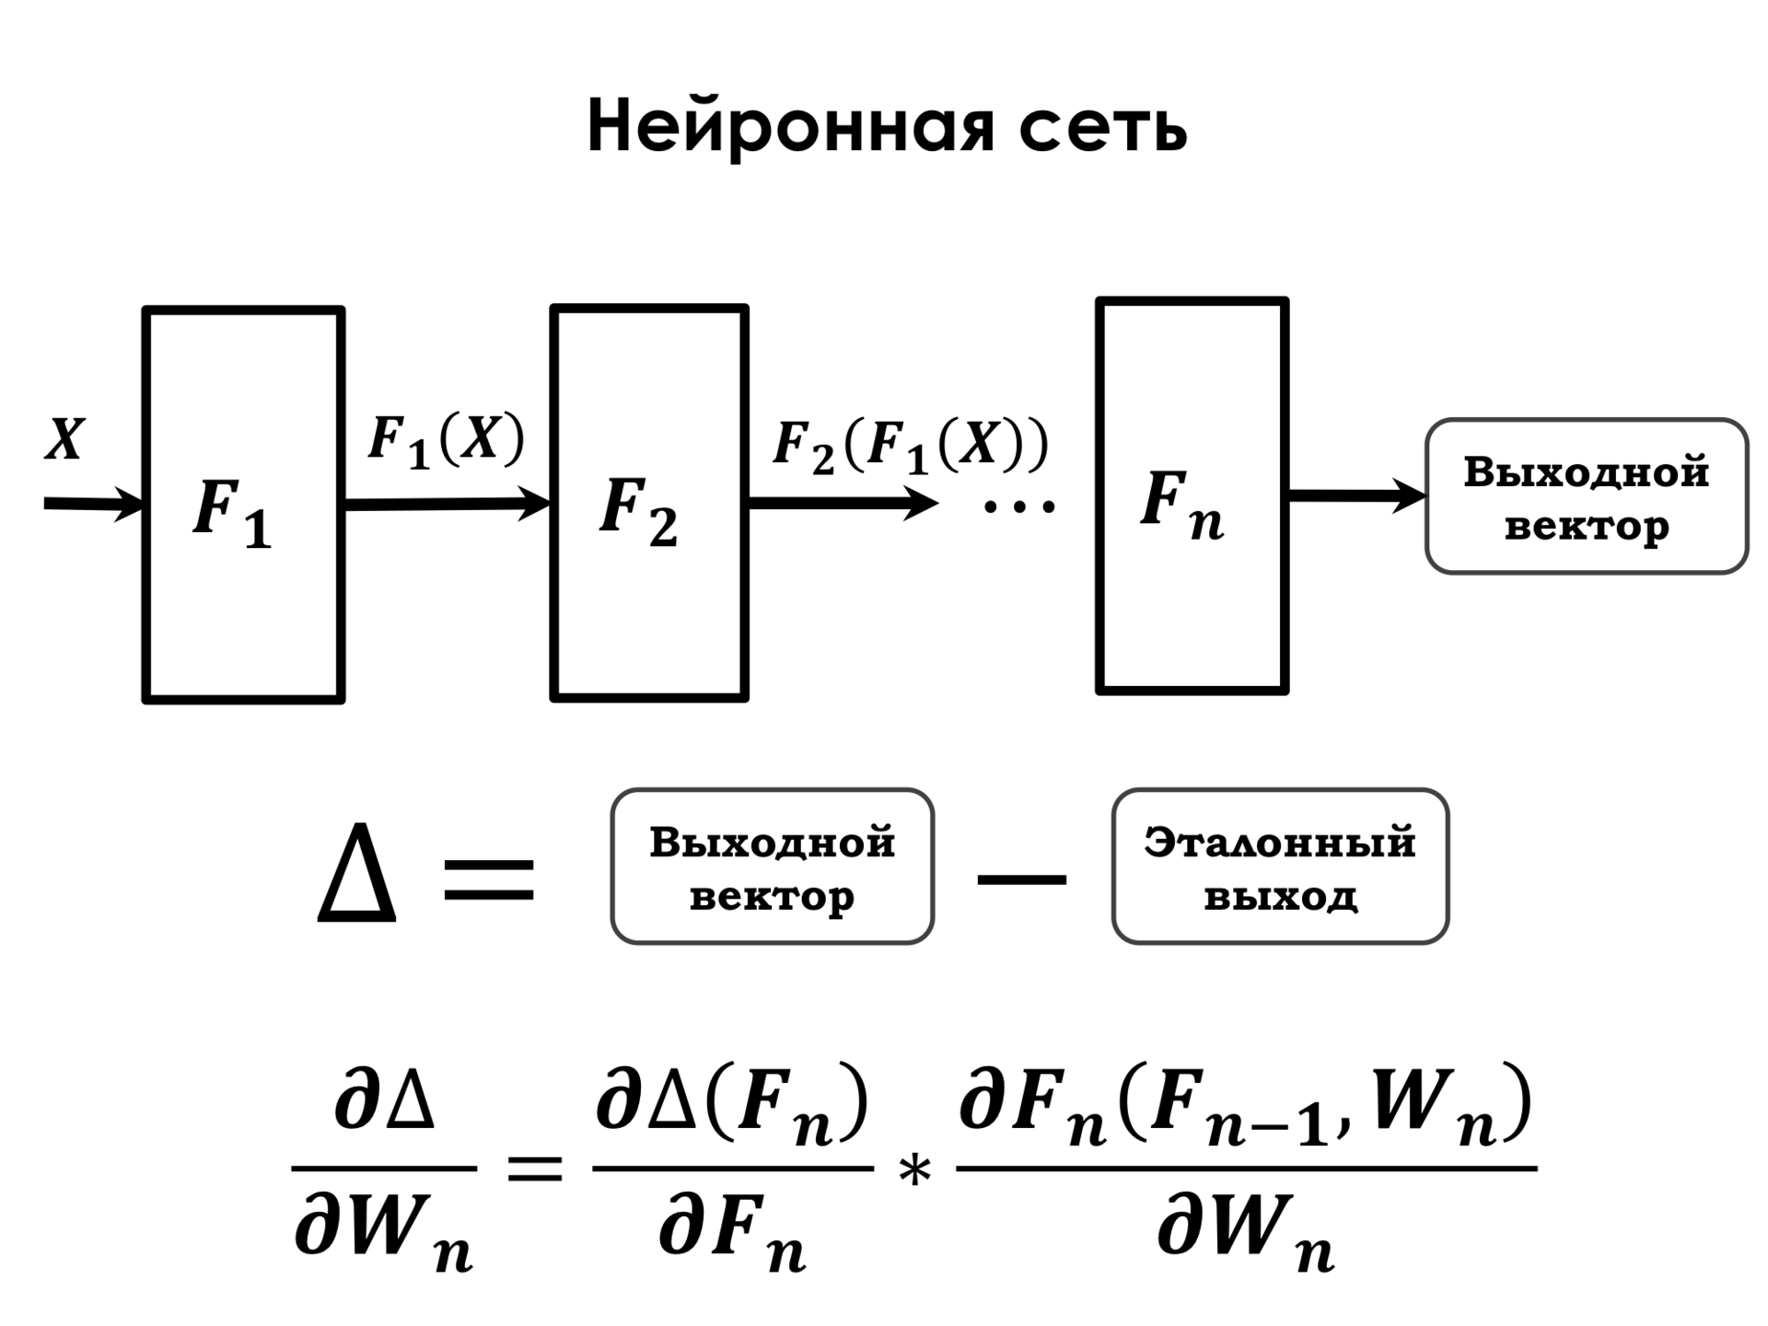
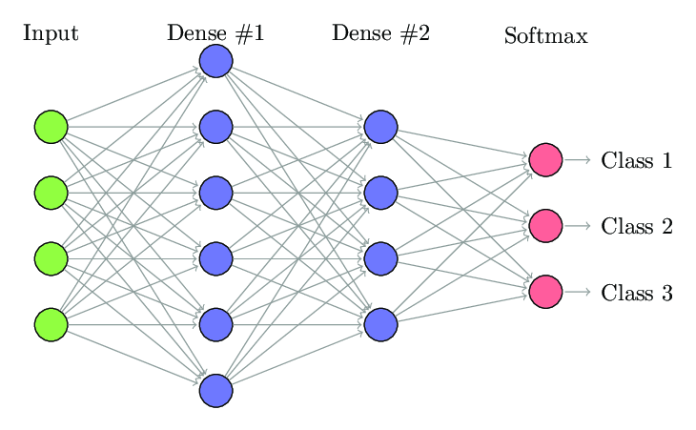
Fully connected neural network
Fully connected neural networks (FCNNs) are a type of artificial neural network where the architecture is such that all the nodes, or neurons, in one layer are connected to the neurons in the next layer.

Slide 5

Universal approximation theorem
Universal approximation theorems imply that neural networks can represent a wide variety of interesting functions when given appropriate weights. On the other hand, they typically do not provide a construction for the weights, but merely state that such a construction is possible.

Slide 6
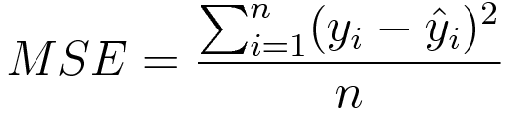
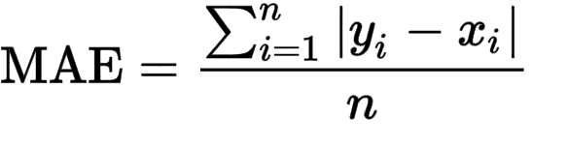
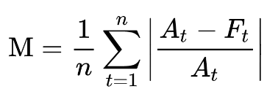
Ordinary loss functions for regression problem

Slide 7

Let’s consider solving differential equation as regression problem. What about loss(not meme). Usually we use MSE or MAE , but can we change object function? IDEA: can we insert a differential equation into loss

