Slide 1
APPLIED DATA SCIENCE · T-786-APDS
A Data Science Approach to
Predicting Property Prices in Madrid
Davíð Rúnar Matthíasson
Iván Luque García
Julian Lorenz
Reykjavík University · May 17, 2026

Slide 2
CHAPTER 1 · INTRODUCTION
Predicting Madrid asking prices
The task
Research questions
Supervised regression: estimate the listed asking price of a Madrid residential property from its structured listing attributes.
The target is what sellers ask, not what buyers ultimately pay — the model is a decision-support tool, not an appraisal.
The project follows an end-to-end ML workflow — preprocessing, model comparison, evaluation, interpretation
1. Which ML model achieves the best predictive performance for Madrid asking prices?
2. How much does the best model improve over simpler baselines — and is the gain worth the added complexity?
Predicting Property Prices in Madrid · APDS T-786
2 / 19

Slide 3
CHAPTER 2 · THE DATA
Madrid Real Estate Market dataset
21,742
58
2020 snapshot
€36k – €8.8M
listings
raw attributes
collection window
asking-price range
Most important variables
buy_price — Listed asking price in € — the regression target
sq_mt_built — Built surface area in m²
n_rooms / n_bathrooms — Structural counts
built_year — Year of construction
neighborhood_id — Raw location string; district number extracted as district_id
Amenity flags — Binary indicators for property features (AC, lift, parking, pool, garden, …)
Predicting Property Prices in Madrid · APDS T-786
3 / 19

Slide 4
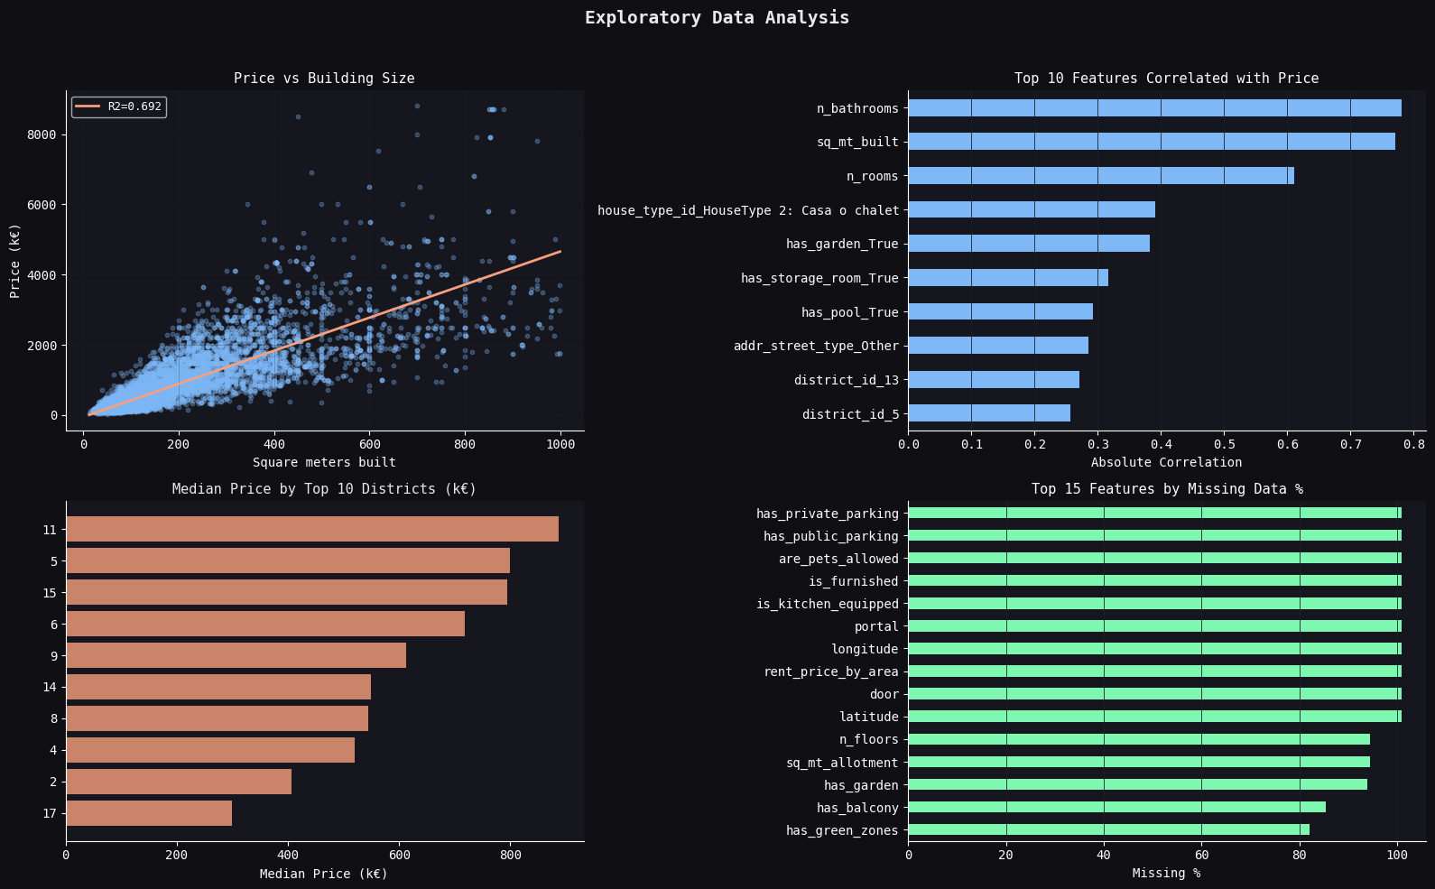
CHAPTER 2 · EDA
Exploratory data analysis
Size and rooms are the strongest predictors
sq_mt_built, n_bathrooms and n_rooms are the three features most correlated with price (R² = 0.692 for a univariate fit on size)
Districts vary, but coarsely
Top-10 district medians span more than a 3× range
Sparse / leaky columns
Several columns with high missingness or price-derived → flagged for removal
Predicting Property Prices in Madrid · APDS T-786
4 / 19

Slide 5
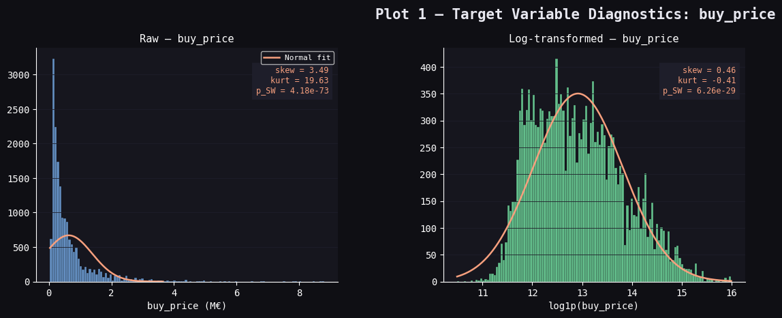
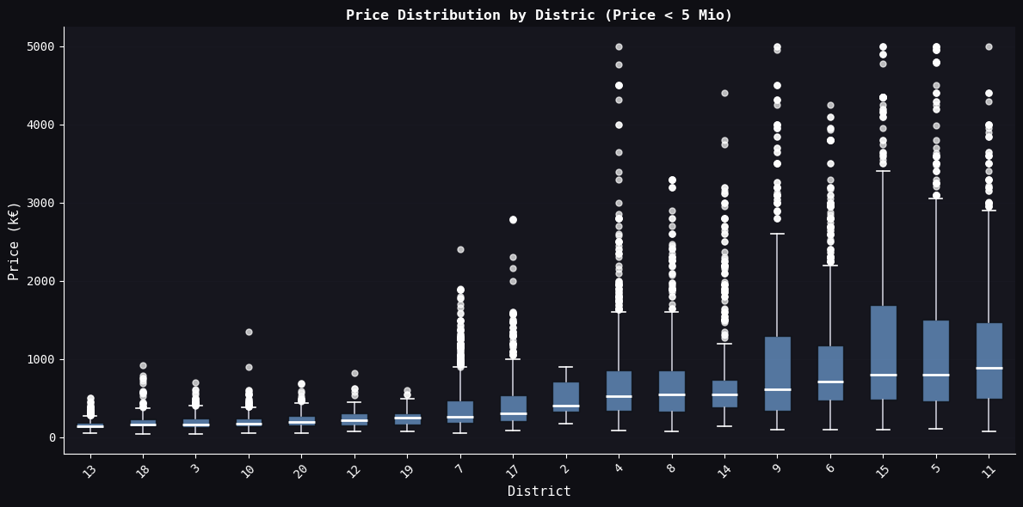
CHAPTER 2 · EDA
Log-transform, and the district problem
Takeaway
Takeaway
Raw buy_price is heavily right-skewed (skew 3.49); a log transform brings it close to symmetric (skew 0.46) and is the form used during training.
Within-district spread grows sharply with median price; a single district dummy captures an average effect, not a precise location premium.
Predicting Property Prices in Madrid · APDS T-786
5 / 19

Slide 6
CHAPTER 3 · DATA ANALYSIS
Preprocessing pipeline & model families
Pipeline (leakage-controlled)
Models
Pre-split
duplicate removal — applied to the raw dataframe before any statistical step
Split
80 / 20 random split, random_state = 42 ( around 17,400 train / 4,300 test)
Post-split (every transform fit on training only)
Imputation — mode for orientation, False for amenities, district-median for built_year
Column curation — drop features > 60% missing
Encoding — drop admin/leakage columns; require non-null core features; extract district_id & neighbourhood_id via regex; one-hot encoding with drop_first
Anomaly removal — Isolation Forest drops 50 most extreme train-set rows
Target transform — log of buy_price
7
models compared
across 3 families
Regularised linear
Bagging
Gradient boosting
Predicting Property Prices in Madrid · APDS T-786
6 / 19

Slide 7
CHAPTER 4 · EVALUATION
Five complementary metrics
R²
Coefficient of determination
Variance explained (on log scale - less variance )
MAE
Mean Absolute Error
Average monetary deviation in €
RMSE
Root Mean Squared Error
Penalises large errors (luxury-segment)
MedAE
Median Absolute Error
“Typical” error, robust to outliers
MAPE
Mean Absolute Percentage Error
Scale-invariant comparison across price segments
Error metrics are back-transformed to euros with expm1 before reporting so they stay directly interpretable.
Predicting Property Prices in Madrid · APDS T-786
7 / 19

Slide 8
CHAPTER 5 · RESULTS
Nested cross-validation performance
Model | R² | MAE (€) | MedAE (€) | RMSE (€) | MAPE
Linear Regression | 0.912 | 163,163 | 50,390 | 459,055 | 20.41%
Ridge | 0.903 | 161,255 | 52,457 | 396,455 | 21.38%
ElasticNet | 0.911 | 164,429 | 50,539 | 464,218 | 20.55%
RandomForest | 0.918 | 132,155 | 48,620 | 299,292 | 19.57%
GradientBoosting | 0.951 | 107,687 | 38,203 | 246,470 | 15.05%
XGBoost | 0.951 | 107,057 | 37,234 | 249,491 | 14.95%
LightGBM | 0.945 | 104,956 | 36,086 | 237,751 | 14.58%
LightGBM wins
≈ 48%
RMSE reduction vs linear baseline
BUT:
Training speed
Inference speed
Complexity/XAI
Significantly improvements
Table 2 · 5-fold outer / 3-fold inner nested CV via RandomizedSearchCV
Predicting Property Prices in Madrid · APDS T-786
8 / 19

Slide 9
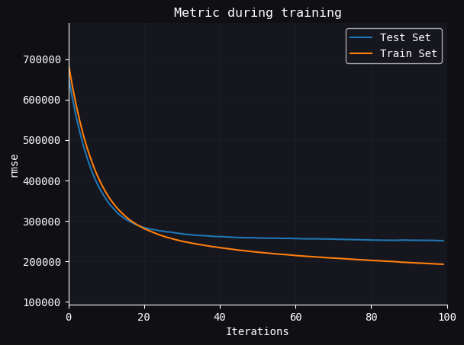
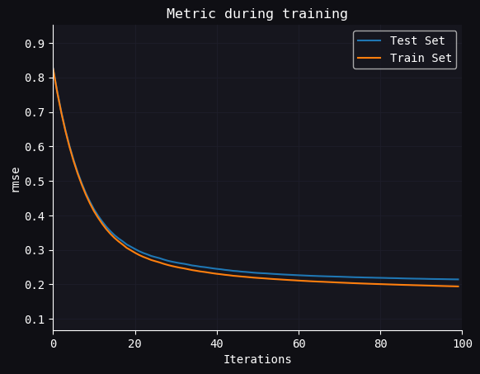
CHAPTER 5 · RESULTS
Learning Curves
Raw Pricing
Log Pricing
Predicting Property Prices in Madrid · APDS T-786
9 / 19

Slide 10
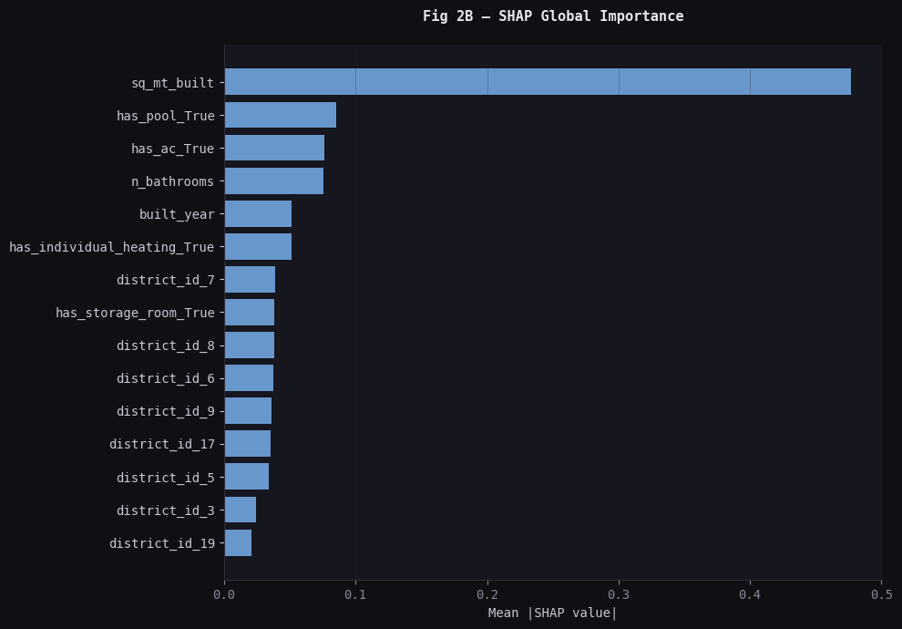
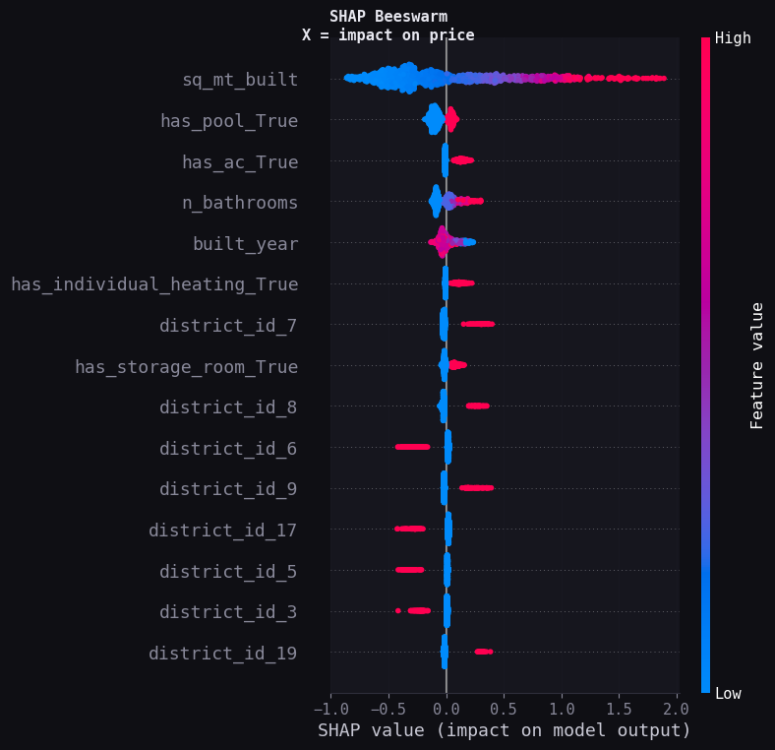
CHAPTER 5 · INTERPRETATION
SHAP: what the model learned
Built surface dominates .
Amenities (pool, AC, heating, storage) Structural variables (bathrooms, build year)
Some high priced districts push predictions down — plausibly a corrective signal on top of size & amenities.
Build Year phenomenon? (Central placing)
Figure 5 · Mean |SHAP|
Figure 6 · SHAP beeswarm
Predicting Property Prices in Madrid · APDS T-786
10 / 19

Slide 11
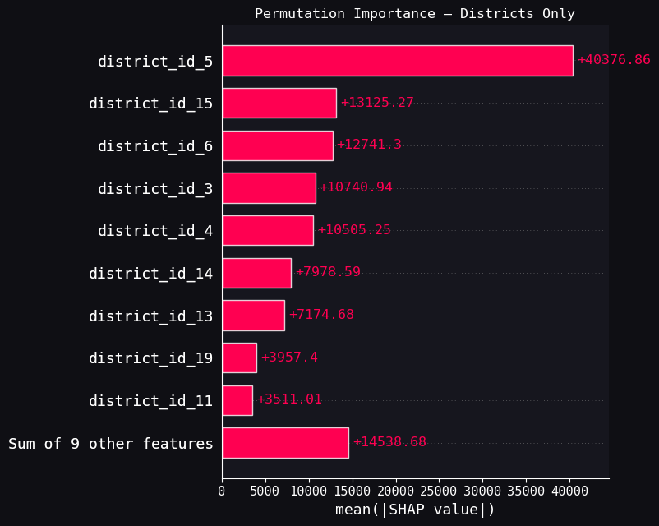
CHAPTER 5 · Feature Importance
SHAP: what the model learned
All boosting/RF models hit a similar error floor → not algorithmic, structural: collapsed interior quality, district-level (not street) location, no time on market, single 2020 snapshot, asking ≠ transaction prices.
Predicting Property Prices in Madrid · APDS T-786
11 / 19

Slide 12
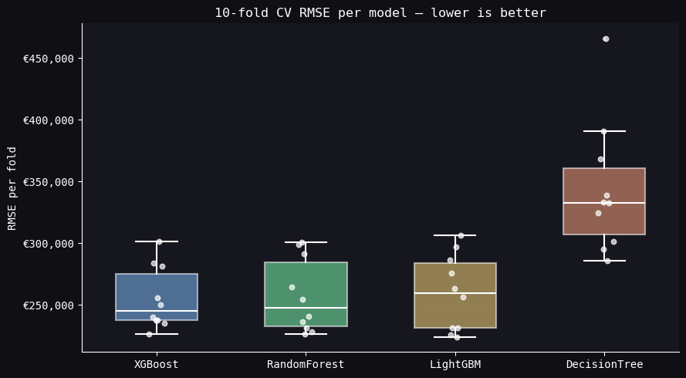
CHAPTER 5 · SIGNIFICANCE & LIMITS
Are the models significantly better?
Paired t-test (untuned models)
LightGBM, XGBoost and Random Forest are statistically indistinguishable. (Ensemble methods)
Only the single Decision Tree is significantly worse.
Plateau ≈ €240K RMSE
→ not algorithmic: collapsed interior quality, (district-level (not street) location, no time on market, single 2020 snapshot, asking ≠ transaction prices.)
Figure 9 · 10-fold CV RMSE per model (untuned)
Predicting Property Prices in Madrid · APDS T-786
12 / 19

Slide 13
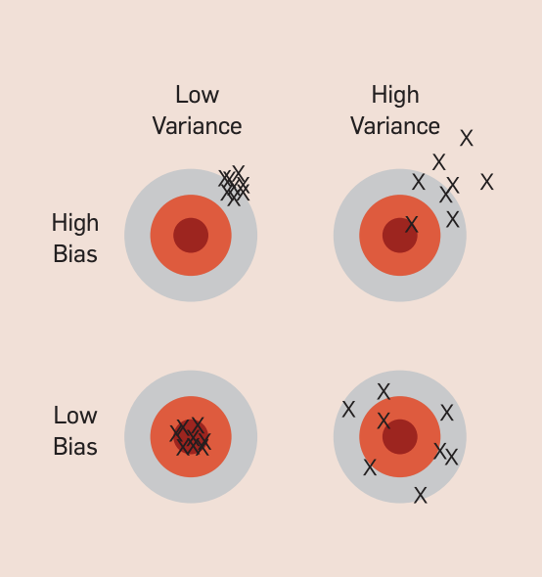
CHAPTER 5 · SIGNIFICANCE & LIMITS
Are the models significantly better?
All boosting/RF models hit a similar error floor → not algorithmic, structural: collapsed interior quality, district-level (not street) location, no time on market, single 2020 snapshot, asking ≠ transaction prices.
10-fold CV RMSE per model (untuned)
Bias-Variance Tradeoff
Predicting Property Prices in Madrid · APDS T-786
19 / 20

Slide 14
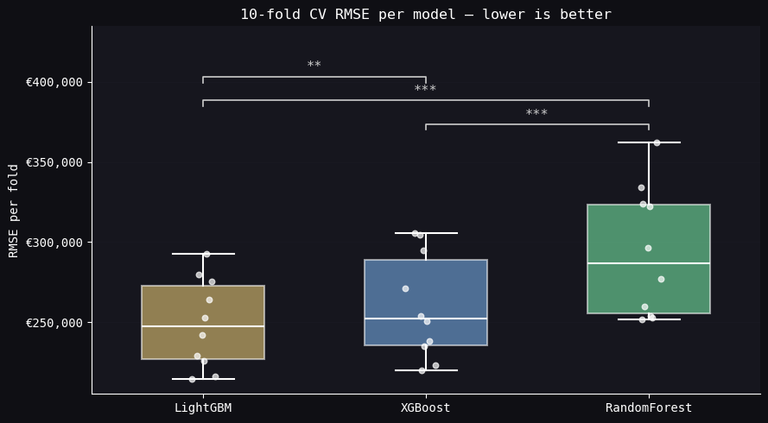
CHAPTER 5 · SIGNIFICANCE & LIMITS
Are the models significantly better?
10-fold CV RMSE per model (tuned)
Predicting Property Prices in Madrid · APDS T-786
13 / 19

Slide 15
CHAPTER 5 · Results
Results
(1): Which machine learning model achieves the best predictive performance?
(2): Is the improvement significant, justify greater complexity (black-box model)?
(1) The best performing model for this regression task is LightGBM -> longest amount of training and testing time. (time-performance) -> … (see report)
(2) LightGBM has with hyperparameter tuning a statistical significantly better performance against XGBoost and Random Forest (But: not without tuning). -> XAI techniques (data investigation, bias considerations)
-> Domain vs. statistical differences
-> … (see report)
All boosting/RF models hit a similar error floor → not algorithmic, structural: collapsed interior quality, district-level (not street) location, no time on market, single 2020 snapshot, asking ≠ transaction prices.
Feature Engineering, Project Management, Complexity is not always better
Predicting Property Prices in Madrid · APDS T-786
14 / 19

Slide 16
CHAPTER 6 · ETHICS
Bias, transparency, and consequences
Selection bias
Omitted variable bias
Societal bias
Only online listings during a short 2020 window — excludes private sales and off-market transactions.
Missing features (interior quality, micro-location, time on market) are correlated with both price and included predictors.
The geographic price gradient the model reproduces is a product of urban planning and demographic sorting, not a neutral fact.
The Five C's
Consent
Clarity
Consistency
Control
Consequences
scraped public listings — ambiguous
advertised, not transaction, price
needs re-training plan (drift)
SHAP for per-prediction transparency
support, never replace, appraisal
Predicting Property Prices in Madrid · APDS T-786
15 / 19

Slide 17
CHAPTER 7 · CONCLUSION
Answering the research questions
RQ1 · Which model is best?
LightGBM — RMSE €237,751, MAE €104,956, MAPE 14.58%, R² 0.945. About a 48% RMSE reduction over the linear regression baseline. Boosting models as a group beat Ridge/ElasticNet and Random Forest, consistent with sequential residual fitting.
RQ2 · Is the improvement worth the complexity?
Conditional yes. The gain over a sensible linear baseline is large, but LightGBM, XGBoost and Random Forest are statistically indistinguishable on the untuned t-test. Deploying LightGBM means weighing its longer training time and black-box character against a fairly modest accuracy gain — XAI tooling (SHAP) does the heavy lifting on transparency.
Predicting Property Prices in Madrid · APDS T-786
16 / 19

Slide 18
CHAPTER 7 · CONCLUSION
Our Proposal of Deployment
Predicting Property Prices in Madrid · APDS T-786
17 / 19

Slide 19
CHAPTER 7 · CONCLUSION
Next steps
Calibrated uncertainty
Replace the fixed MAPE band with per-district residual quantiles or LightGBM quantile regression, reflecting heteroscedasticity.
Asking vs. transaction gap
Either reframe the output as an advertised price, or link to transaction-price data from a public registry.
Fresh data + drift monitoring
Re-collect from current listings; the 2020 snapshot will not remain representative. Schedule periodic re-training.
Predicting Property Prices in Madrid · APDS T-786
18 / 19

Slide 20
Thank you · Questions?
Predicting Property Prices in Madrid · APDS T-786
19 / 19

