Slide 1
Lab assignment
Landmarks Recognition
Created by Ivan Martsilenko MMAI - 1

Slide 2
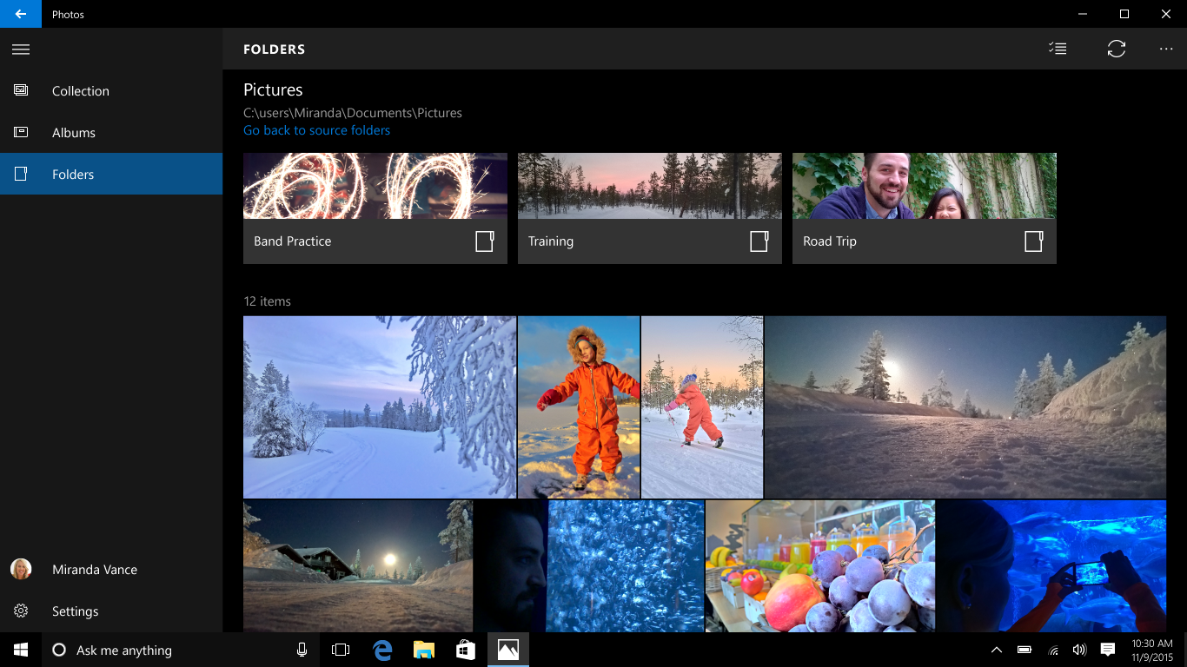
Task background
CSC Summer Hackaton
Sorting photo task

Slide 3
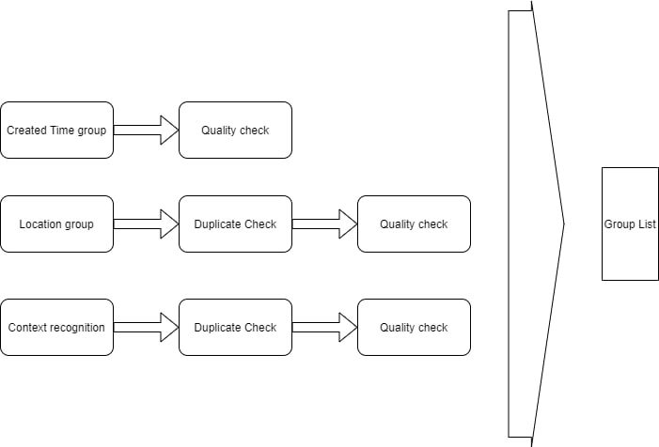
Previous model

Slide 4
Data structure
Train folder have 1580470 images
Submission folder have 10345 images
Inside train folder it’s a three layers of folder 1-f ( as hex numbers)
Image a40d00dc4fcc3a10 located at ../train/a/4/0/ directory
I changed that with python script and now images located in way that
Image a40d00dc4fcc3a10 located at ../train/a40/ directory
With only one layer and it also mean class of images in that directory

Slide 5
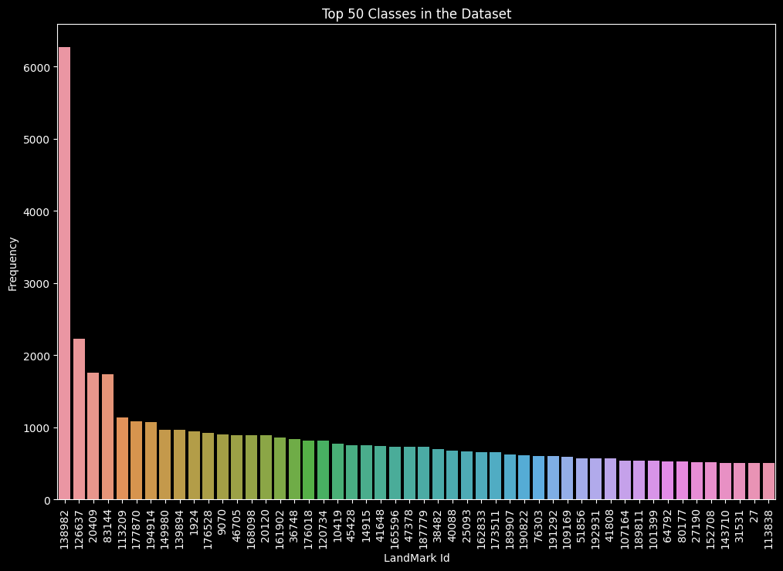
Top 50 classes
Much classes disbalance

Slide 6
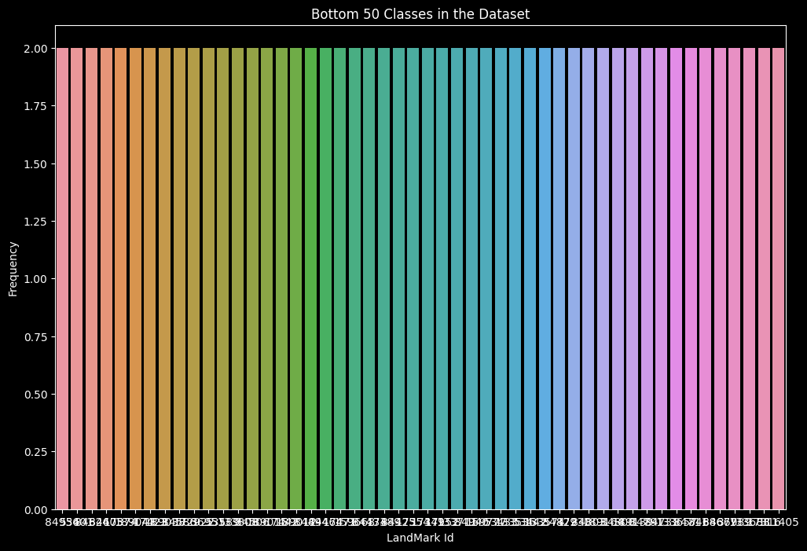
Bottom 50 classes
A lot of classes with only a few members.
Such as example top classes have a thousands of images inside.

Slide 7
MobileNet V2 and V3 modification
MobileNet
AvaragePolling
Dense layer (classes number)
Activation softmax

Slide 8
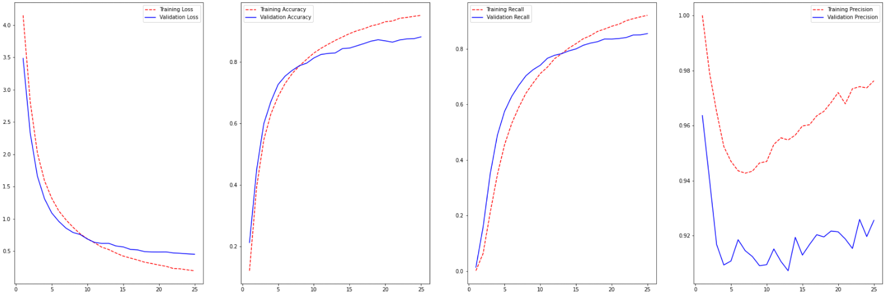
MobileNet v2 results
loss: 0.46386009454727173 accuracy: 0.8755000233650208
precision: 0.9179844260215759 recall: 0.856249988079071

Slide 9
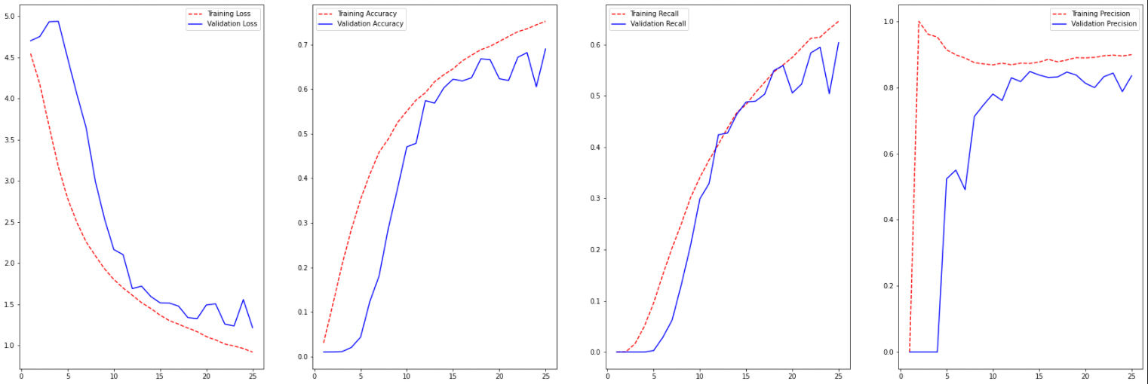
MobileNetv3 25 epochs results
loss: 1.2078657150268555
accuracy: 0.6850000023841858
precision: 0.8452380895614624
recall: 0.6035000085830688

Slide 10
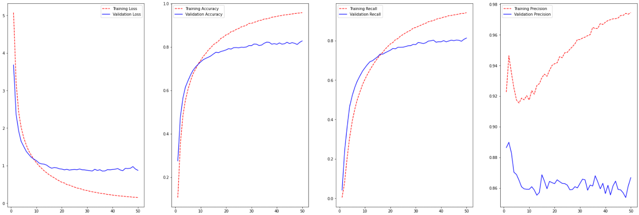
MobileNetv3 50 epochs with more data results
loss: 0.8514732122421265
accuracy: 0.8276875019073486
precision: 0.865370512008667
recall: 0.8123124837875366

Slide 11
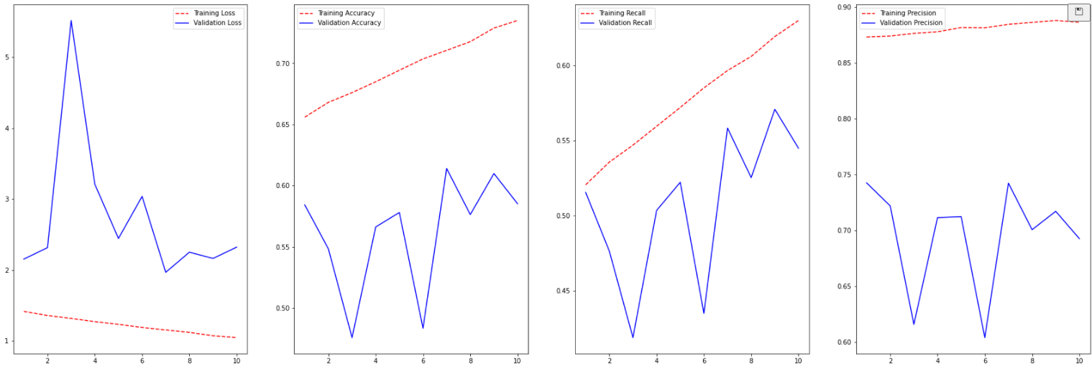
Resnet_50 45 epochs results (last 10 epochs)
loss: 2.3219
accuracy: 0.5852
precision: 0.6927
recall: 0.5447

Slide 12
Total models compare
Model | Metrics
 | loss | accuracy | precision | recall | Time per 16k
MobileNet2 25 epochs | 0.4639 | 0.8755 | 0.9180 | 0.8562 | 0:00:35.759081
MobileNet3 25 epochs | 1.2079 | 0.6850 | 0.8452 | 0.6035 | -
MobileNet3 50 epochs | 0.8515 | 0.8277 | 0.8654 | 0.8123 | 0:00:19.152690
ResNet 50 45 epochs | 2.3219 | 0.5852 | 0.6927 | 0.5447 | 0:01:19.437988

Slide 13
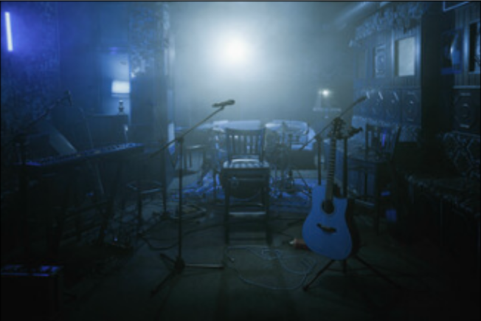
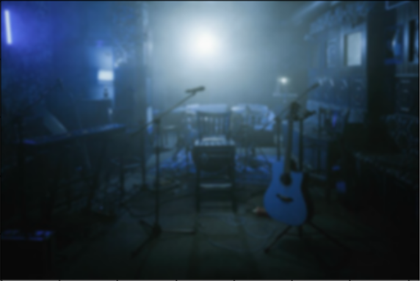


Clarity
Blur

Slide 14
Main idea
Input Image
Feature map
Feature extractor
Calculate difference
Result
Blured image
Feature map
Label

Slide 15
Feature extractor example
Input Image
Output Feature map
Edge
Horizontal
Edge
Vertical
Filters

Slide 16
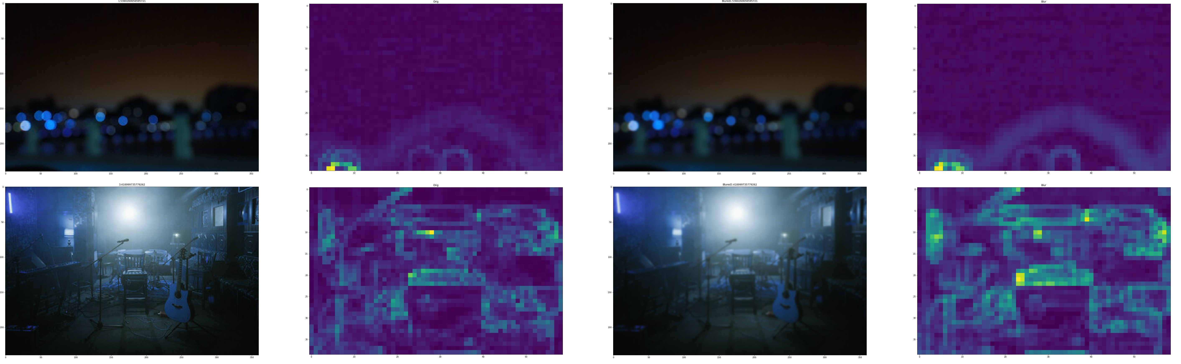
How it looks

Slide 17
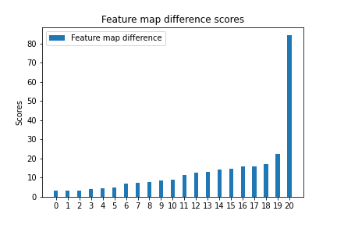
Results clustering

Slide 18
Future steps and variants of modifications
Prepare more data
Experiment with other variants of Feature extractors
Implement classification via density analysis such as DBSCAN, Agglomerative Clustering , OPRTICS, MeanShift or such as K-means
Implement algorithm via c++ for optimization to improve evaluation time
Publish paper

Slide 19
Demo

