Slide 1
SAS Governance and Apache Spark™
Govern and orchestrate Spark Mlib analytical models
Nardini, Ivan – Customer Advisor – Solution Concept and Code
Glazkov, Artem – Pre-sales Consultant – Workflow Concept
Landrò, Matteo – GTP Data scientist – Code
Elnatanov, Alexey – Pre-sales Jr Consultant – Code

Slide 2

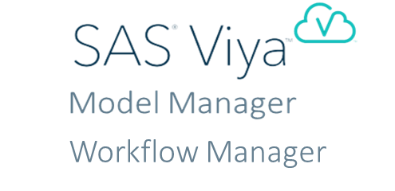

SAS Governance options with Apache® Spark Analytics

Slide 3
Orchestrate Spark Models
Notes:
Please refer to this online write up that mentions the above statement https://www.mckinsey.com/business-functions/mckinsey-analytics/our-insights/ten-red-flags-signaling-your-analytics-program-will-fail

Slide 4
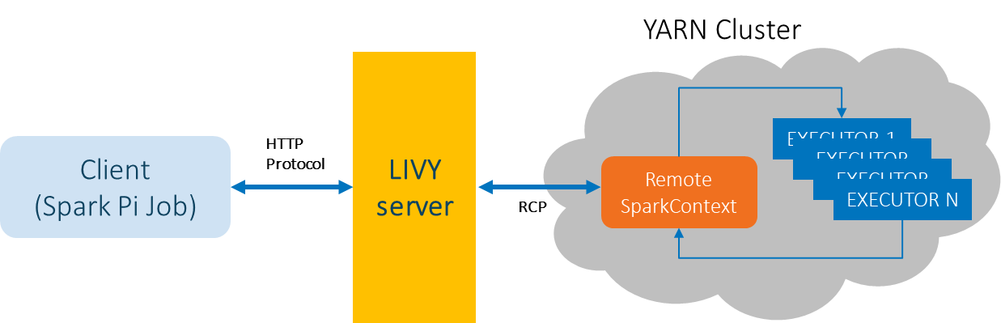
Orchestrate Spark models – What’s Apache Livy?
Apache Livy is a service enables easy submission of Spark jobs or snippets of Spark code, synchronous or asynchronous result retrieval, as well as Spark Context management, all via a simple REST interface or an RPC client library.

Slide 5
Orchestrate Spark models – SAS Workflow Manager and Apache Livy
Like Python Sklearn models, we register the parquet version of Spark Mlib model and (optionally) the scoring code:
Parquet model contains the model metainfo to score new data in the Hadoop/Spark ecosystems.
Scoring code is a REST API recipe will submit from Livy Server to Spark cluster for loading the model and get score back
Then we use SAS Workflow capabilities (Job execution and REST API service) to:
Submit Scoring REST API call
Get back the scoring data
Generate Performance monitoring

Slide 6
Orchestrate Spark models: SAS Workflow and Apache Livy architecture
SAS Model Manager
SAS Workflow Manager
Register into
SAS Viya
Governance Environment
REST API
GUI/REST API
Model Exported to
Apache Livy
PySpark Mlib
Score new data
Spark Development Environment
Spark Production Environment

Slide 7
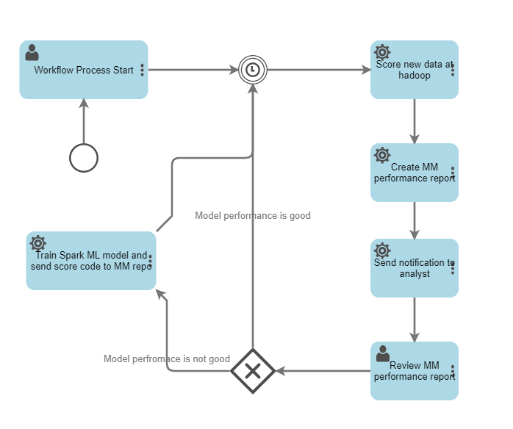
Orchestrate Spark models: The «Livy» Workflow
In this scenario MM/WF Manager acting more like orchestrator of service taska and user reviews.
We utilize build-in viya capabilities for creating Model Manager reports, based on the scored data provided by native spark.

Slide 8
Thanks for the attention

Slide 9
Govern Spark Models
Notes:
Please refer to this online write up that mentions the above statement https://www.mckinsey.com/business-functions/mckinsey-analytics/our-insights/ten-red-flags-signaling-your-analytics-program-will-fail

Slide 10

SAS Governance options with Apache® Spark Analytics

Slide 11
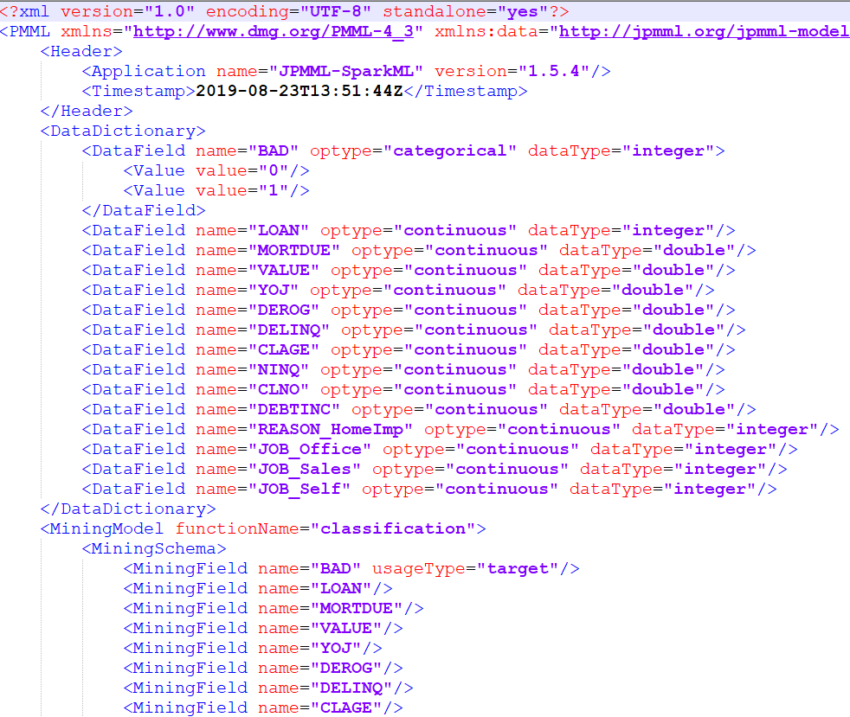
Govern Spark models – Spark PMML
PMML is one of the leading standard for statistical and data mining models.
PMML enables model development on one system
using one application and deploy the model
on another system using another application,
simply by transmitting an XML configuration file.

Slide 12
Govern Spark models – Spark PMML
The JPMML-SparkML library converts Apache Spark ML pipelines to PMML data format. It is written in Java. But the JPMML family includes Python (and R) wrapper libraries for the JPMML-SparkML library.
For Python, we have the pyspark2pmml package that works with the official PySpark interface:
The pyspark2pmml.PMMLBuilder Python class is an API clone of the org.jpmml.sparkml.PMMLBuilder Java class.
The Apache Spark connection is typically available in PySpark session as the sc variable. The SparkContext class has an _jvm attribute, which gives Python users direct access to JPMML-SparkML functionality via the Py4J gateway.
Then in your Spark session, you fit your pipeline and then use PMMLBuilder to create its PMML file.

Slide 13
Govern Spark models: SAS Model Manager and PMML
SAS Model Manager
SAS Workflow Manager
Optional
Register into
SAS Viya
Governance Environment
REST API
SAS Data Connector
GUI/REST API
Exported to*
SAS Spark EP
PySpark Mlib
Score new data
Spark Development Environment
Spark Production Environment
*pmml2sas package for converting PMML

Slide 14
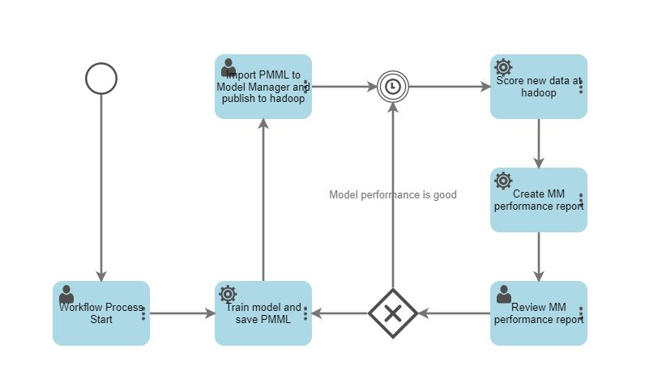
Govern Spark models: The «PMML» workflow
In this scenario we are translate OS model score code to SAS and utilize Embeded Process for Hadoop.
We use build-in viya capabilities for creating Model Manager reports, based on the scored data provided by running of the Embedded process.

Slide 15
Pro and Cons
Comparing solutions
Orchestrate Spark models (Livy)
Govern Spark models (PMML)
PROs:
Native integration (no score code manipulation or conversion)
Smoother User experience
Enhance SAS Viya EDM capabilities (Model performance and Workflow orchestration)
CONs:
3th Party-based solution (Livy server configuration)
PROs:
Best Sales option (SAS Model Manager and In-database technology)
CONs:
Limited technology (Spark Mlib PMML Gradient boosting not supported. Pipeline limitations)
Second best user experience (Score code manipulation. Possible downgrading PMML version)

