Slide 1
Classifying Buenos Aires Neighborhoods by Quality of Life A Data Science project using clustering, PCA, and geospatial data
Author: Ivan Osipov Personal Data Science portfolio
Location: Buenos Aires, Argentina 21.04.2025

Slide 2

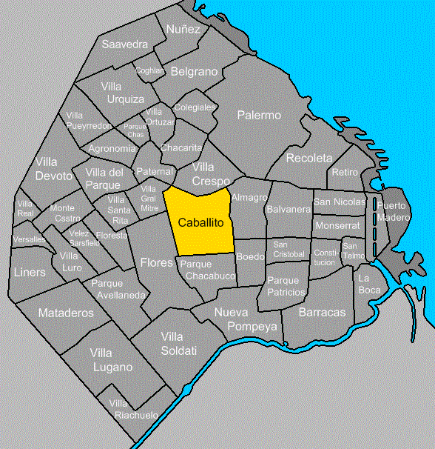

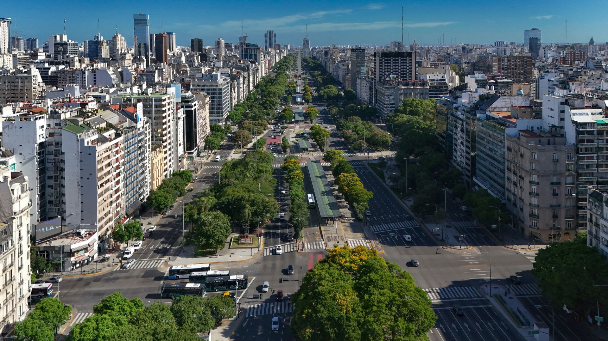
Introduction: Why Classify Neighborhoods?
Buenos Aires is a diverse city with contrasting neighborhoods.
Urban planning, resource allocation, and social programs benefit from zone-based analysis.
Goal: Group neighborhoods into meaningful zones using open data and machine learning.

Slide 3
Data & Features: What Data Did We Use?
Data sources:
BA Open Data Portal
INDEC Population Census
Slum and crime datasets
Features:
Slum density, crime per 1000, green area %, hospitals per 1000, noise levels, schools per 1000, population density, etc.
24 features engineered → 10 principal components (PCA)
Pipeline scheme:
Raw Data → Feature Engineering → PCA → Clustering

Slide 4
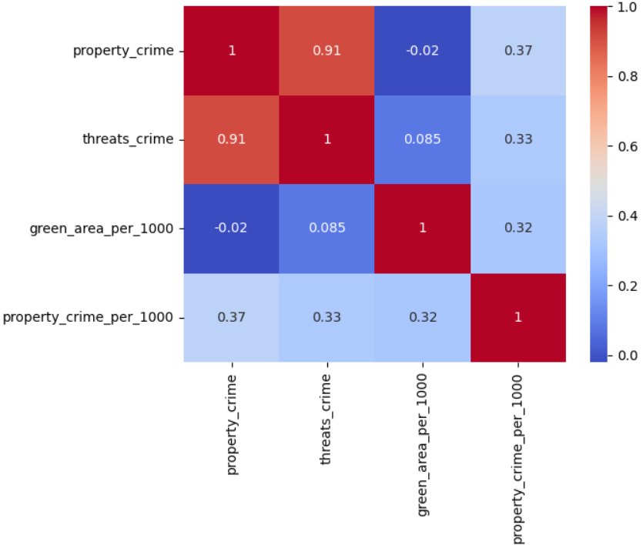
Methodology: From Raw Data to Feature selection.
Standardization of features using StandardScaler to ensure fair comparison between features with different units and scales.
Feature selection begins by computing the matrix of pairwise Pearson correlation coefficients between all standardized features. This allows us identify multicollinearity — features that are strongly correlated (> 0.9). Then drop one feature from each highly correlated pair.

Slide 5
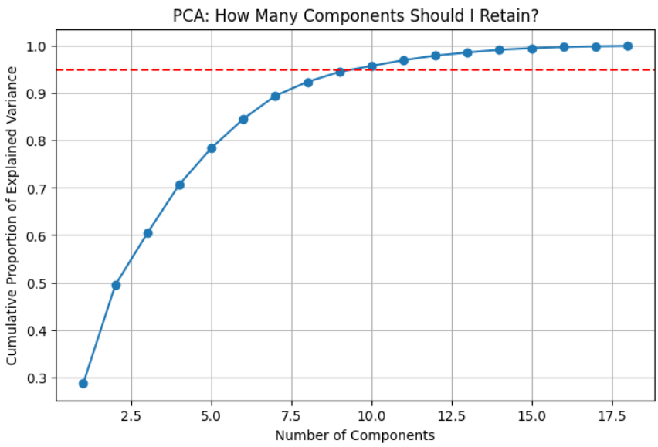
Methodology: Principal Component Analysis
Dimensionality reduction with PCA
Cumulative proportion of explained variance by each principal component
The number of components that explain at least 95% of the total variance in the dataset was selected.

Slide 6
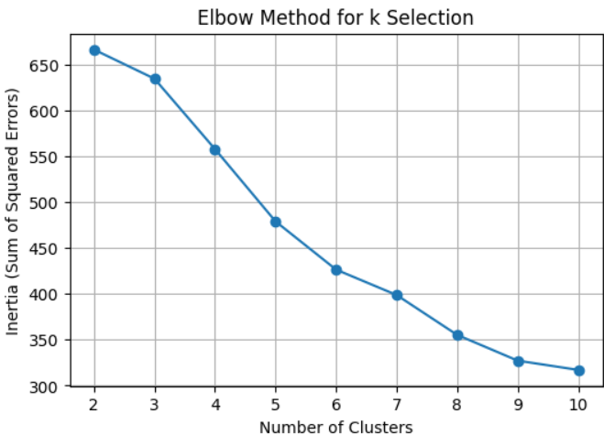
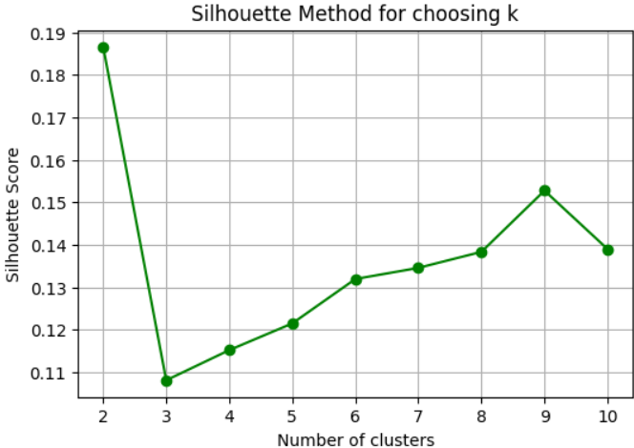
Methodology: Optimal Number of Clusters
Elbow Method
We analyze the inertia to find the "elbow" point — the value of k after which inertia decreases more slowly
Silhouette Method
We calculate the silhouette score for each k — a metric that measures how well each object lies within its cluster

Slide 7
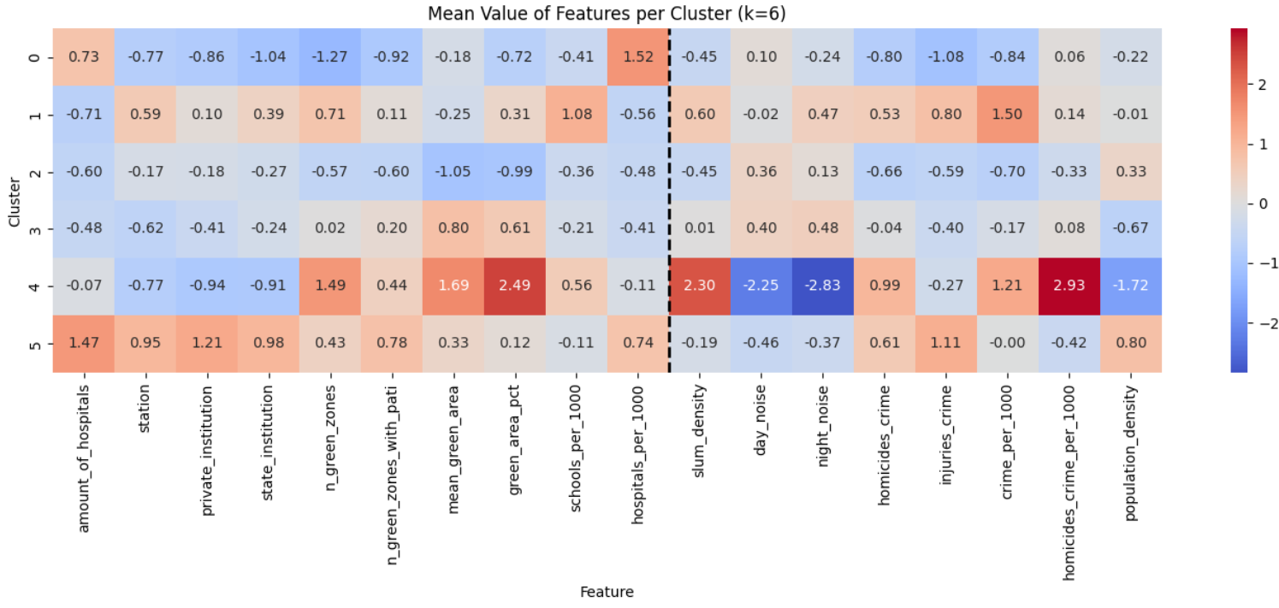
Methodology: Final Clustering with KMeans (k = 6)
Based on the analysis of the Elbow and Silhouette methods, we decided to use k = 6 as the optimal number of clusters for KMeans.
In order to generalize and highlight key traits of each cluster, we compute and visualize the mean values of all features per cluster.

Slide 8
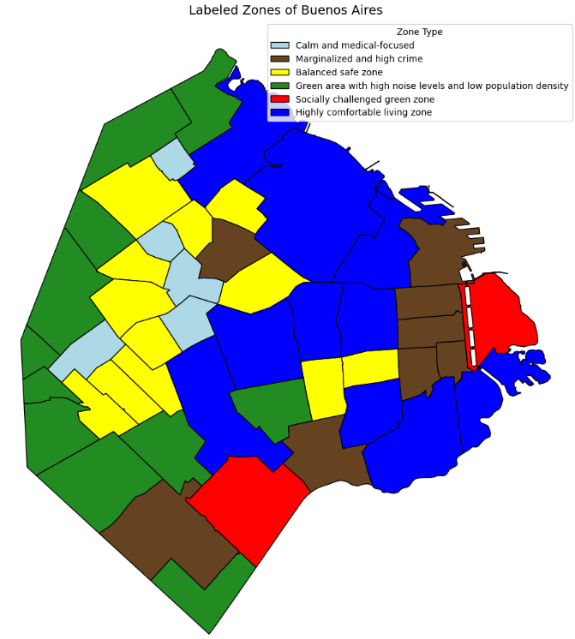
Visualizing the City: Labeled Clusters of Buenos Aires on the Map
Here we are able to see a visual result of our clustering
Map was created using matplotlib.pyplot of manually labeled clusters

Slide 9
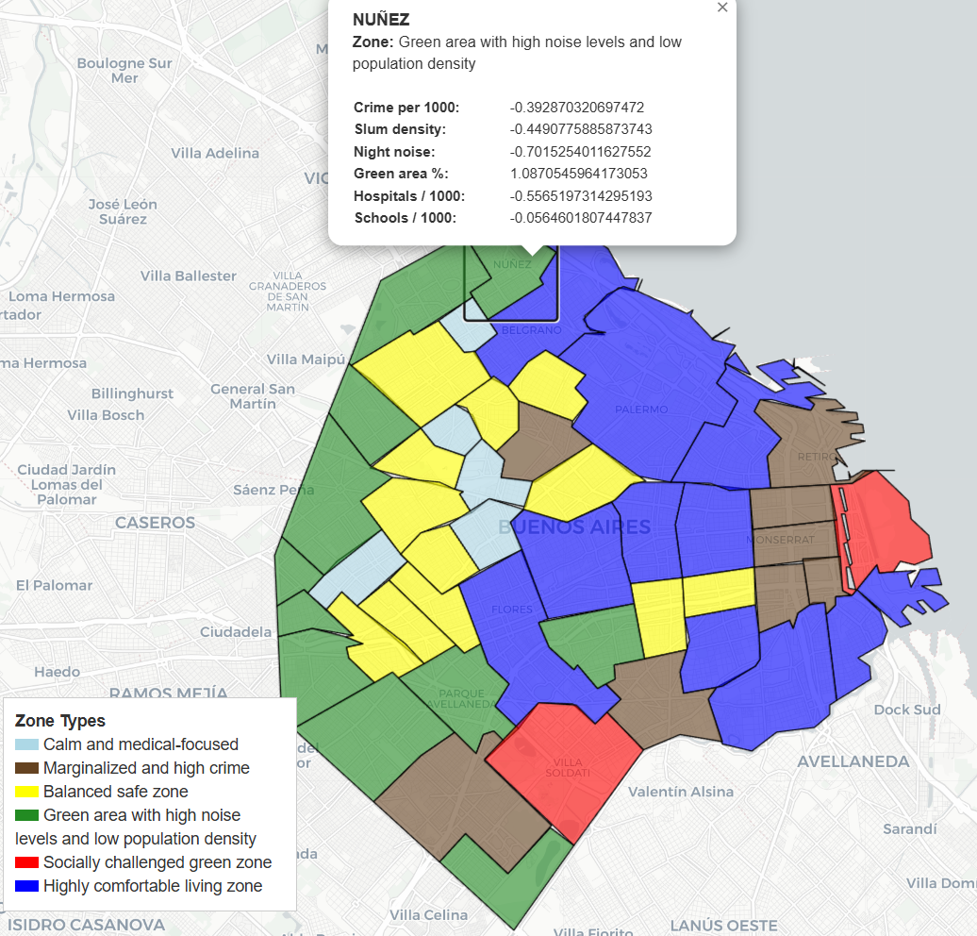
Visualizing the City: Interactive Folium Map
Final map includes clickable neighborhoods
Popups show cluster label + selected indicators
Fully interactive (Folium)
Link to my GitHub with interactive map

Slide 10
Conclusion & Future Work: What Did We Learn?
Data-driven clustering reveals useful city zoning
Socioeconomic and environmental variables align with perceived quality of life
This approach can support urban planning, social research, and public communication
The methodology is scalable and can be applied to other cities

Slide 11
Contact information
LinkedIn
GitHub
Ivan.Osipov.job.mail@gmail.com
Ivan Osipov 23.04.2025

