Slide 1
AI Application
Topic : Movie Recommender
Created by Ivan Ovchynnikov, Ivan Popovych , Roman Ponepoliak

Slide 2
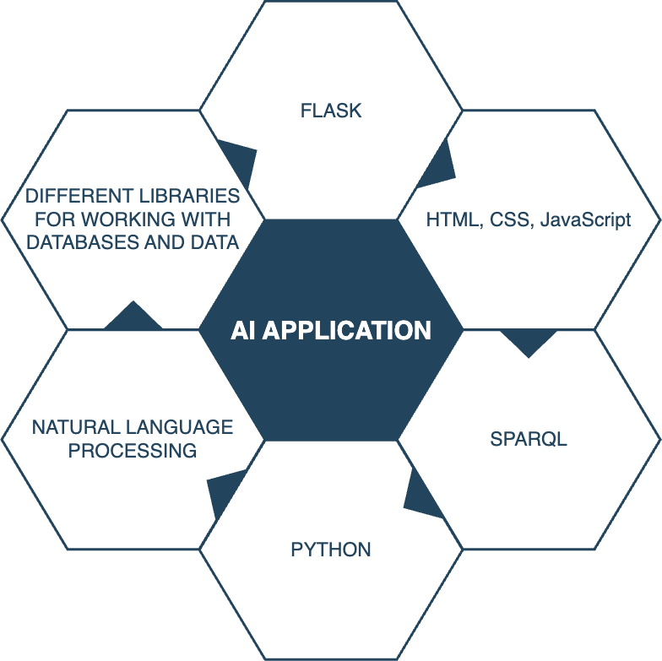
Technologies we used

Slide 3
Preprocessing the data
Text Lowercasing:
Convert all text to lowercase to ensure uniformity and avoid treating words with different cases as distinct.
Stopword Removal:
Eliminate common stopwords (e.g., "the," "is," "and") that don't contribute much to the overall meaning of the text and may introduce noise in similarity calculations.
Special Character Removal:
Remove punctuation, special characters, and symbols to focus on the essential content and enhance the accuracy of similarity measurements.
Vectorization:
Convert the processed text into numerical vectors using techniques like TF-IDF (Term Frequency-Inverse Document Frequency) or word embeddings (e.g., Word2Vec, GloVe). This step transforms text data into a format suitable for machine learning algorithms.

Slide 4
Runtime optimization
To optimize our NLP algorithm's runtime the text data was transformed into numerical vectors using Spacy, and the processed information was stored in a CSV file. However, we encountered issues with the initial CSV file, which lacked formatting and commas. To address this, we utilized the Pandas library for proper formatting and structuring, ultimately resolving the file-related challenges and ensuring smooth integration with our algorithm. This decision led to a significant runtime improvement of around 15-20 seconds, showcasing the efficiency gains achieved through Spacy's vectorization approach.

Slide 5
Conclusion
In conclusion, this project marks our initial endeavor using the technologies we've acquired during the semester. While our movie recommender app may not be perfect, it serves as a starting point for future enhancements. We are committed to refining and improving its accuracy in the near future, and you can track our progress on GitHub. The UI/UX design, crafted by a seasoned professional in the field and overseen by our talented team member, reflects our desire to create an intuitive and visually appealing user experience.

