Slide 1


TypeScript
Fundamentals
MAY 18 2016

Slide 2


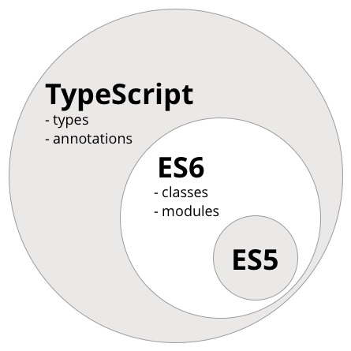
What is TypeScript
JavaScript not a class-based object-oriented language
TypeScript is a strict superset of JavaScript, and adds
optional static typing and class-based object-oriented
programming to the language.
TypeScript familiar with C#, Java and all strong typed languages.
Any browser. Any host. Any OS. Open Source.

Slide 3
Basic Types
Functions
Interfaces
Classes
Modules
Generics
Decorators

Slide 4
Basic Types
Boolean - true or false
String – text
Number – integer or floating point number
Array – collection of types
Object – base object
Enum – enumeration
Any – dynamic types, can be everything
Void – no value
All types in TypeScript are subtypes of a single top type called the Any type. The any keyword references this type. The Any type is the one type that can represent any JavaScript value with no constraints. All other types are categorized as primitive types, object types, or type parameters. These types introduce various static constraints on their values.
The primitive types are the Number, Boolean, String, Void, Null, and Undefined types along with user defined enum types. The number, boolean, string, and void keywords reference the Number, Boolean, String, and Void primitive types respectively. The Void type exists purely to indicate the absence of a value, such as in a function with no return value. It is not possible to explicitly reference the Null and Undefined types—only values of those types can be referenced, using the null and undefined literals.

Slide 5
Functions
Can define the types of the parameters
Can define their return value
Can define typed pointers
Can have optional or default parameters
Can define collection parameters
Can be used as lambda expressions
Can have overloads based on their parameters

Slide 6
Interfaces
Can define properties
Can define optional properties
Can define methods
Can define indexers
Can extend other interfaces

Slide 7
Classes
Can implement properties
Can define getters or setters
Can have constructors
Can have methods
Have this referring to the current instance
Can define private/public parts
Can define static parts
Can extend other classes (super is base)

Slide 8
Modules
Organize your code into subsystems
Created by the module keyword
Define the public parts by export keyword
You can split one module into different files
You can compile them to a single one
Possibility of external modules
Can be used with external libraries

Slide 9
Generics
Provides reusability
Generic functions
Generic classes
Gives you types checking and constrains

Slide 10
Decorators
A Decorator is a special kind of declaration that can be attached to a class declaration, method, accessor, property, or parameter.
Decorators use the form @expression, where expression must evaluate to a function that will be called at runtime with information
about the decorated declaration.
Decorator cannot be used in a declaration file, or in any other ambient context (such as on a declare class).
In the TypeScript source code we can find the signature of the available types of decorators:
Class Decorators - declare type ClassDecorator = <TFunction extends Function>(
target: TFunction) => TFunction | void;
Method Decorators - declare type MethodDecorator = <T>(
target: Object, propertyKey: string | symbol,
descriptor: TypedPropertyDescriptor<T>) => TypedPropertyDescriptor<T> | void;
Property Decorators - declare type PropertyDecorator = (
target: Object,
propertyKey: string | symbol) => void;
Parameter Decorators - declare type ParameterDecorator = (
target: Object,
propertyKey: string | symbol,
parameterIndex: number) => void;
Accessor Decorators - same as Method decorator
Decorator Factory - A Decorator Factory is simply a function that returns the expression that will be called by the decorator at runtime.

Slide 11
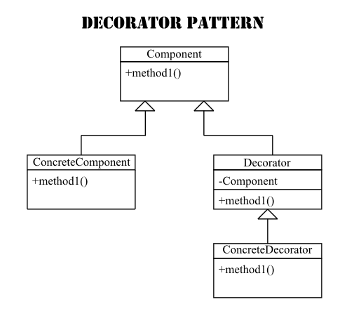
Design patterns
Decorator pattern example with typescript
The point of the decorator pattern is to extend (decorate) behaviour of an object,
without affecting the behaviour of other objects of the same class.
With this pattern, you can statically or dynamically wrap a component in
another component. This pattern is set up in a way so that you can add
multiple layers of decoration to the object, by each time wrapping the
previous component with a new decorator.
The decorator pattern is a structural design pattern.

Slide 12
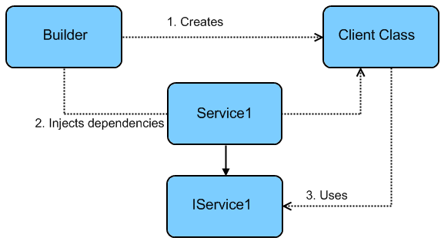
Dependency injection
Basic dependency injection with decorators
Dependency injection is basically providing the
objects that an object needs (its dependencies)
instead of having it construct them itself.
It's a very useful technique for testing,
since it allows dependencies to be mocked or stubbed out.

Slide 13
Thank you !

