Slide 1
Privacy Preserving Information Access — Homework 1
Anonymizing the Google Local
Reviews Dataset
Ivan Radovanovic, Laszlo Kosa, Maxime Henry
Group 5 · Academic Year 2026/2027
Notes:
(~15 s) Hi, we are group 5: Ivan, Laszlo and Maxime. Our homework is about anonymizing the Google Local Reviews dataset, so that it can be published for research without exposing the people who wrote the reviews.

Slide 2
The context
Google Local Reviews (McAuley Lab, UC San Diego): public Google Maps reviews up to Sept 2021
We use Vermont, plus each place's categories and price level
One synthetic attribute: spent, the amount paid during the visit
Typical uses: recommender systems, customer-satisfaction studies
Vermont subset
 | Count
Reviews | 841,978
Users | 288,212
Places | 11,243
Duplicates removed | 10,225
Period | 1999 – Sep 2021
Goal: release the data for research, keep the reviewers private.
Notes:
(~35 s) We used the Google Local Reviews dataset from the McAuley Lab at UC San Diego: public Google Maps reviews up to 2021, one file per US state. We took Vermont: after removing about ten thousand duplicates, almost 842 thousand reviews from 288 thousand users about 11 thousand places. We also generated one synthetic attribute, the amount spent, so we have a financial value to protect. This kind of data is used for recommender systems and customer-satisfaction research, but every row is a real person at a real place. Our goal is to release it while the reviewers stay private.

Slide 3
The data: types of attributes
Attribute | Type | In the released data
name | identifier | removed
user_id | identifier | removed
time of review | quasi-identifier | month only (YYYY-MM)
gmap_id (place) | quasi-identifier | categories, k = 5
rating | quasi-identifier | kept
spent | quasi-identifier / sensitive | 7 values ($0 – $500)
review text, owner reply | sensitive | length class only
photos | sensitive | number of photos only
Notes:
(~40 s) This table is the core of our analysis. The identifiers are the name, usually the real one, and the user_id, which leads to the public Google profile and joins all reviews of one person; both are removed. The quasi-identifiers don't identify anyone alone but do in combination: the time, the place, the rating and the amount spent. The sensitive attributes are the free text and the owner's reply, which can contain names, family or health details, the photos, and again the spending. The last column already shows what we publish for each one; we'll come back to it in the code.

Slide 4
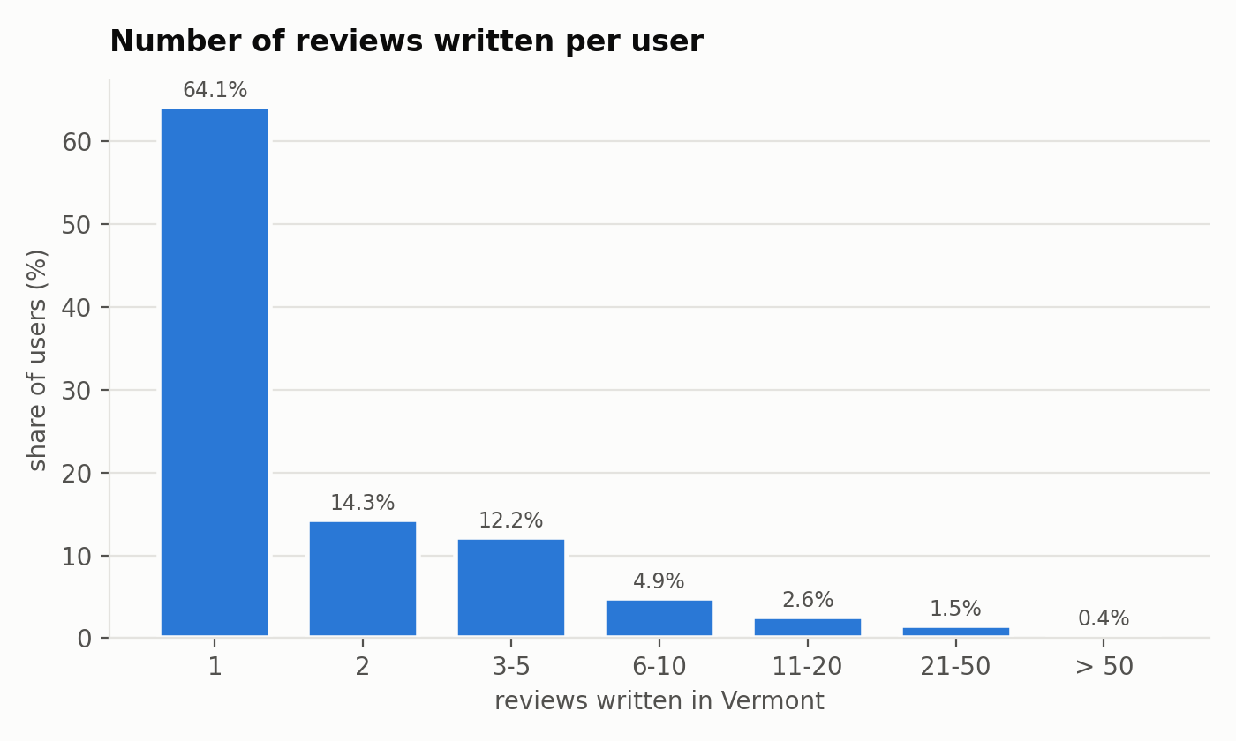
Why re-identification is easy here
64% of users wrote only one review
More than a third of places have fewer than 10 reviews
No two reviews share the same timestamp
Health places (~2% of reviews) and churches reveal sensitive facts
Reviews written per user, Vermont
Notes:
(~30 s) Why is this dangerous in Vermont? Almost two thirds of users wrote just one review, and more than a third of the places have fewer than ten. So the crowd to hide in is tiny. The timestamps are unique, and some places are sensitive in themselves, like clinics or churches. Knowing the place and roughly when someone was there is often enough to find their review.

Slide 5
Adversaries
Who can access the data
How: record linkage
Anyone who downloads the release
Data brokers and profilers
Advertisers, insurers, employers
Someone who knows the victim
user_id → public profile, reviews in other states
name + town + month → social networks, public registers
hotel / home address → rental and property records
The attacker gets stronger over time, and a released copy cannot be erased
Notes:
(~35 s) Once the data is public, anyone can download it: data brokers and profilers, advertisers, insurers or employers, or simply someone who knows the victim. The attack is record linkage. The user_id leads to the public profile and to reviews in other states. Name, town and month can be matched with social networks or public registers. Addresses of hotels or home services can be joined with property records. And the attacker only gets stronger over time, while a released copy can never be taken back.

Slide 6
Utility: do unhappy customers write more?
Share of negative reviews (1–2 stars) by review length
Original data
After anonymization
Length (characters) | Avg rating | Negative
no text | 4.39 | 5.2%
1–49 | 4.48 | 5.3%
50–100 | 4.46 | 6.4%
101–200 | 4.36 | 9.9%
201–500 | 4.13 | 16.9%
501–1,000 | 3.60 | 31.5%
over 1,000 | 2.93 | 48.9%
Length class | Avg rating | Negative
short (< 50) | 4.42 | 5.2%
medium (50–500) | 4.33 | 10.6%
long (> 500) | 3.45 | 35.3%
The pattern survives with only three length classes. ("short" also includes reviews with no text.)
Notes:
(~35 s) As our utility measure we asked: is the length of a review related to its rating? On the original data, clearly yes: short reviews are only about 5% negative, while reviews over 1,000 characters are almost 50% negative. After anonymization we only publish three length classes, and the pattern is still there: 5, 11 and 35% negative. So the main finding survives.

Slide 7
Code: identifiers, date and text
user_id and name are dropped (sanitization). The date and the text are generalized:
# anonymize_v2.py
row.pop('time') # the hour is an explicit time stamp, drop it
row['date'] = row['date'][:7] # generalization: YYYY-MM-DD -> YYYY-MM
# anonymize_v3.py
def length_category(n):
if n is None: return None
if n < 50: return 'short' # carries little information
if n <= 500: return 'medium' # the informative core
return 'long' # verbose outliers
Result: 3,939 distinct days → 177 months; review text and owner reply → short / medium / long
Notes:
(~35 s) Now the code. First, user_id and name are removed. For the date we drop the time of day and keep only the year and month, one step up the generalization hierarchy: 3,939 distinct days become 177 months. The review text and the owner's reply are replaced by a length class: short under 50 characters, medium up to 500, long above. For replies we also keep the delay between the review and the reply.

Slide 8
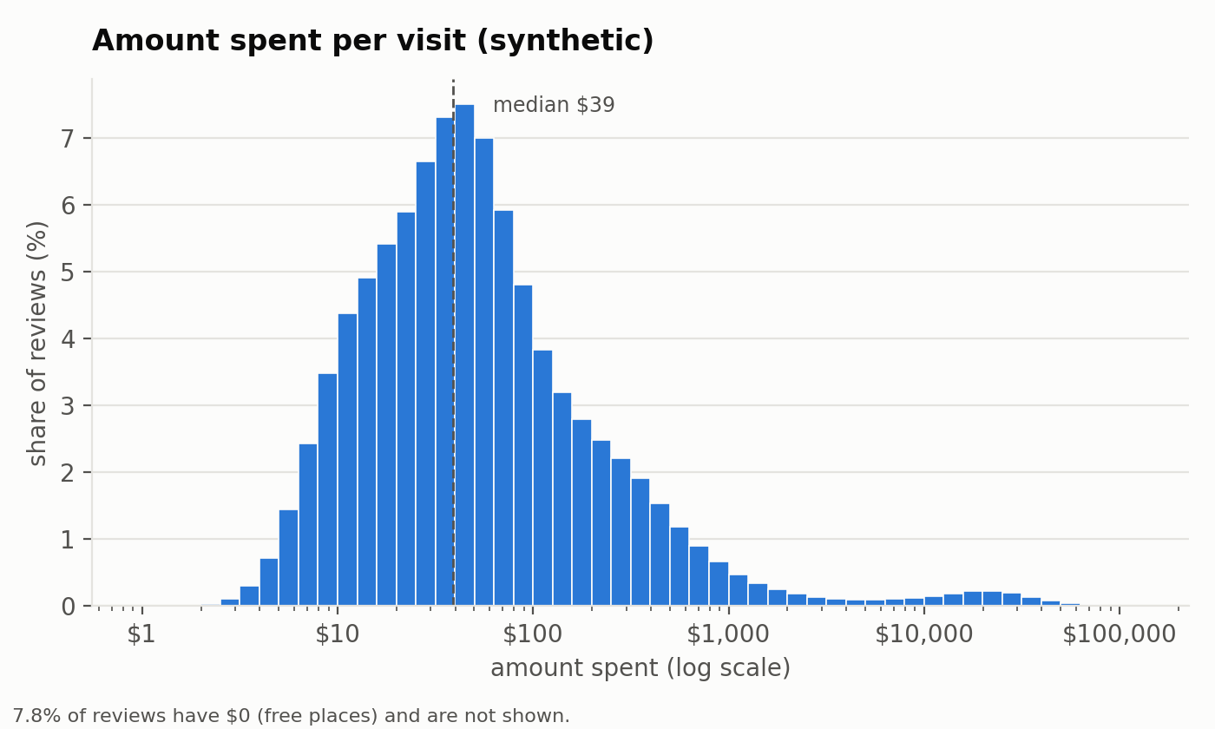
Code: the amount spent
Bottom/top coding per type of place, then rounding to a few published values
# anonymize_v4.py - bottom and top coding
# at the 5%/95% quantiles
def clip_to_quantiles(spent, q05, q95):
return min(max(spent, q05), q95)
# rounding on a ladder of published points
TIERS = [0, 5, 10, 25, 50, 100, 250,
500, 1000, 2000, 5000, 10000]
def round_to_tier(spent):
return min(TIERS,
key=lambda t: abs(spent - t))
Before: synthetic amount spent (log scale)
After: 7 values ($0, 10, 25, 50, 100, 250, 500); median relative error 19.2%
Notes:
(~35 s) The amount spent starts out very spread out, from free parks to car purchases over ten thousand dollars, as the figure shows. Inside each type of place we raise everything below the 5% quantile and cap everything above the 95% quantile, because one huge purchase identifies a review on its own. Then we round to a ladder of tiers and merge tiers with less than 5% of the reviews. Only seven values remain, from 0 to 500 dollars, at the price of a median relative error of about 19%.

Slide 9
Code: k-anonymity on the place (k = 5)
gmap_id is replaced by the place's categories; every published group must contain at least 5 reviews
# kanonymity.py - generalize first, suppress the cell as a last resort
if tuple_rows[category_key(cats)] >= k: # full category list
groups[g] = (sorted(cats), 0)
elif first_rows[cats[0]] >= k: # first category only
groups[g] = ([cats[0]], 1)
else: # local suppression
groups[g] = (None, 2)
99.85% of reviews keep their full category list
1,031 reviews lose the place information (incl. 192 places with no category)
0 reviews deleted; the smallest published group has exactly 5 reviews
Notes:
(~35 s) The most dangerous quasi-identifier left was the place, since many places have very few reviews. We replace the place ID with its categories, and every group we publish must have at least five reviews. The code is a three-step ladder: keep the full category list if five reviews share it, otherwise only the first category, and as a last resort we suppress the place for that review. 99.85% of reviews keep the full list, 1,031 lose the place, and nothing is deleted.

Slide 10
Conclusions and open questions
Summary
Open questions
All reviews kept, direct link to the reviewer removed
Ratings, time trends, spending and owner activity can still be analysed
Next steps: ℓ-diversity and t-closeness
On month + category + rating + spent together, only 48% of reviews are in a group of ≥ 5. Should k-anonymity cover all quasi-identifiers at once?
A group of only health or religious places still reveals that fact. Is ℓ-diversity a must here?
Would an LLM sentiment score keep more utility than the length class, and still be safe?
Thank you!
Notes:
(~40 s) To conclude: we kept every review, removed the direct link to the reviewer, and the analyses we care about still work. Next steps would be l-diversity and t-closeness. Three questions for you. First: k = 5 holds for the place alone, but on month, category, rating and spent together only 48% of reviews are in a group of at least five. Should k-anonymity cover all quasi-identifiers together? Second: a group made only of health or religious places still leaks that fact. Is l-diversity a must? Third: could an LLM sentiment score replace the length class safely? Thank you!

