Slide 1
Privacy Preserving Information Access — Homework 1
Anonymizing the Google Local
Reviews Dataset
Ivan Radovanovic, Laszlo Kosa, Maxime Henry
Group 5 · Academic Year 2026/2027
Notes:
(~15 s) Hi, we are group 5: Ivan, Laszlo and Maxime. Our homework is about anonymizing the Google Local Reviews dataset, so that it can be published for research without exposing the people who wrote the reviews.

Slide 2
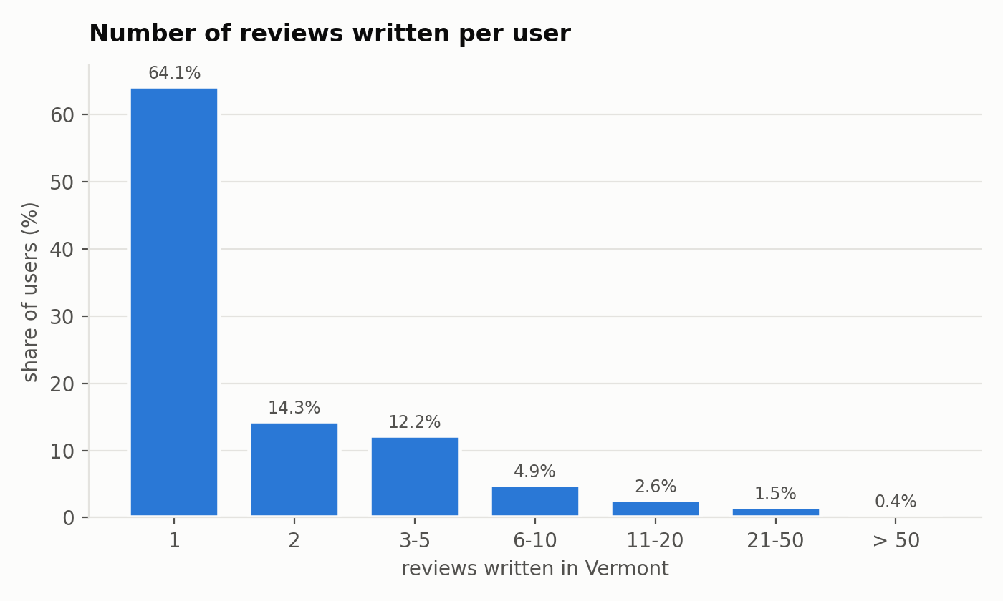
The context
Google Local Reviews: public Google Maps reviews up to Sept 2021
Vermont: 841,978 reviews, 288,212 users, 11,243 places
One synthetic attribute: spent, the amount paid during the visit
Why re-identification is easy
64% of users wrote only one review
1 place in 3 has fewer than 10 reviews
No two reviews share the same timestamp
Reviews written per user, Vermont
Goal: release the data for research, keep the reviewers private.
Notes:
(~40 s) We used the Google Local Reviews dataset: public Google Maps reviews up to 2021. We took Vermont: almost 842 thousand reviews, 288 thousand users, 11 thousand places, and we added one synthetic attribute, the amount spent, to have a financial value to protect. Why is this risky? Two thirds of the users wrote just one review, a third of the places have fewer than ten, and every timestamp is unique. So knowing the place and roughly when someone was there is often enough to find their review. Our goal: release the data for research while the reviewers stay private.

Slide 3
The data: types of attributes
Attribute | Type | In the released data (v7)
name, user_id | identifier | removed
date of the review | quasi-identifier | quarter (2019-Q1)
place (gmap_id) | quasi-identifier | broad group (12 types)
rating | quasi-identifier | kept (1–5 stars)
review / reply length | quasi-identifier | 5 length classes
number of photos | quasi-identifier | 0 / 1 / 2 / 3+
owner reply, reply delay | quasi-identifier | yes / no, 5 delay buckets
review text, reply text | sensitive | removed (only the length class)
spent (synthetic) | sensitive | 7 values ($0 – $500)
Notes:
(~40 s) This is how we classified the attributes. Name and user_id are direct identifiers and are removed. The quasi-identifiers are everything an attacker can know or see on the public review: the date, the place, the rating, how long the review and the reply are, the number of photos, and whether and when the owner replied. The sensitive attributes are the texts, which we remove, and the amount spent. Note that spent is not a quasi-identifier: it is synthetic, so no attacker can know it in advance. It is what an attacker would want to learn.

Slide 4
Adversaries
Who can access the data
How: record linkage
Anyone who downloads the release
Data brokers and profilers
Advertisers, insurers, employers
Someone who knows the victim
user_id → public profile, reviews in other states
name + town + month → social networks, public registers
place + date + rating → the public review on Google Maps
The review can be deleted at some point in time, and a released copy cannot be erased
Notes:
(~30 s) Once the data is public, anyone can download it: data brokers, advertisers, insurers, employers, or simply someone who knows the victim. The attack is record linkage. The user_id leads to the public profile. Name, town and month can be matched with social networks. And place, date and rating can be matched with the public review itself. The attacker only gets stronger over time, while a released copy can never be taken back.

Slide 5
Utility: do unhappy customers write more?
Share of negative reviews (1–2 stars) by review length
Length class | Characters | Original | Released (v7)
very short | < 10 | 5.3% | 5.2%
short | 10 – 49 | 5.1% | 4.9%
medium | 50 – 149 | 7.3% | 7.1%
long | 150 – 399 | 14.1% | 13.8%
very long | 400 + | 31.0% | 30.7%
Long reviews are about 6× more often negative
After anonymization the pattern is practically unchanged
Notes:
(~30 s) As our utility measure we asked: is the length of a review related to its rating? Clearly yes: very long reviews are negative about 31% of the time, short ones only about 5%. We publish the length in five classes, and after the whole anonymization the numbers barely move, from 31.0 to 30.7%. So this finding survives.

Slide 6
The problem we found
First attempt: k = 5 only on the place categories. Every place group had ≥ 5 reviews.
But k-anonymity is about the combination of all quasi-identifiers. On the published data:
Quasi-identifiers combined | Reviews with k ≥ 5 | Unique reviews
category, date, rating | 65.7% | 13.8%
+ review length | 41.0% | 30.1%
+ photos, owner reply | 36.3% | 35.4%
+ reply delay (all) | 34.9% | 40.2%
Main cause: 3,807 different category lists, exact months and exact reply delays.
Notes:
(~35 s) Our first approach applied k = 5 only to the place categories, and every place group had at least five reviews, so it looked fine. But k-anonymity is about the combination. When we check all the quasi-identifiers together on the published data, only 35% of reviews are in a group of at least five, and 40% are completely unique. The main reasons are the categories, there are 3,807 different lists, plus exact months and exact reply delays.

Slide 7
Code: k-anonymity on all quasi-identifiers
Step 1 generalizes every review; step 2 suppresses values only where a group is still smaller than k
# kanonymity_all_qi.py (simplified)
def generalize(row, clen, rlen): # step 1: every review
return [to_broad_group(row['category']), # 3,807 lists -> 12 groups
to_quarter(row['date']), # '2019-03' -> '2019-Q1'
row['rating'], clen, # 5 length classes
cap_pics(row['pics_num']), # 0, 1, 2, '3+'
row['has_resp'], rlen,
delay_bucket(row['resp_delay_hours'])] # 5 buckets
for label, field, how in SUPPRESSION_STEPS: # step 2: least useful first
for i in small_rows(keys, k): # reviews in a group < k
keys[i][POS[field]] = how(keys[i][POS[field]])
Notes:
(~35 s) The new script works in two steps. Step one generalizes every review: the 3,807 category lists become 12 broad groups like food, lodging or health, the month becomes the quarter, photos are capped at three, and lengths and reply delays go into five classes each. Step two handles the few reviews that are still in a group smaller than k: it nulls one field at a time, starting with the least useful one, the reply delay, then photos, and so on, and stops as soon as the review is covered.

Slide 8
Results (k = 5)
Share of reviews in a group of at least 5
Quasi-identifiers combined | Published | Step 1 | Final v7
category, date, rating | 65.7% | 99.8% | 100%
+ review length | 41.0% | 99.2% | 100%
+ photos, owner reply | 36.3% | 96.4% | 100%
+ reply delay (all) | 34.9% | 93.6% | 100%
Suppression changed 1.7% of the values, in 6.4% of reviews
4 reviews removed (0.0005%)
Checked on the written file: smallest group = 5
Notes:
(~35 s) Here are the results. On the published data only 35% of reviews were 5-anonymous. After step one, the generalization, already 94%. After step two, the suppression, 100%, for every combination of quasi-identifiers. To get there we changed 1.7% of the values, mostly reply delays and photo counts, and we had to remove only 4 reviews out of 842 thousand. The script re-reads the written file at the end and confirms that the smallest group has exactly five reviews.

Slide 9
Conclusions and open questions
Summary
Open questions
Released data is 5-anonymous on all quasi-identifiers
841,974 of 841,978 reviews kept
Utility (length vs. rating) unchanged
Reviews were also shuffled to remove link between them
Next: ℓ-diversity on spent, t-closeness
Is k = 5 the right k? With k = 3 we change 4.1% of reviews instead of 6.4%. How do you choose k for public data?
A group of only health or religious places still reveals that fact. Is ℓ-diversity a must here?
Would an LLM sentiment score keep more utility than the length class, and still be safe?
Thank you!
Notes:
(~40 s) To conclude: the released data is 5-anonymous on all quasi-identifiers together, we kept all but four reviews, and the utility we measured is unchanged. Next steps would be l-diversity on the amount spent, and t-closeness. Three questions for you. First: is k = 5 the right choice? With k = 3 we would change 4% of reviews instead of 6%; how do you choose k for data that goes public? Second: a group made only of health or religious places still reveals that fact; is l-diversity a must? Third: could an LLM sentiment score replace the length class safely? Thank you!

