Slide 1
Candidate for the degree of Master of Science:
Eng. Ivan de Souza Rehder
Virtual reality for the human-centred design of assistive devices
Thesis Committee Composition:
Chairperson: Prof. Dr. Luís Gonzaga Trabasso (ITA)
Advisor: Profª. Drª. Emilia Villani (ITA)
Coadvisor: Prof. Dr. Edmar Thomaz da Silva (ITA)
Internal member: Prof. Dr. Christopher S. Cerqueira (ITA)
External member: Prof. Dr. Petter Krus(INPE)
August 4th, 2022

Slide 2
Roteiro
Introdução
Motivação
✔ Fatores Humanos
✔ Carga Mental
✔ Consciência Situacional
✔ Realidade Estendida
Co-design
Objetivos e abordagem
✔ Objetivos
✔ Abordagem
Materiais e Métodos
5 Passos da metodologia
Resultados e discussão
Obj 1
Sub
Sensores
Obj2
Sub
Sensor
Conclusão
✔ Conclusão
Trabalhos futuros

Slide 3
Agenda
1.
Introduction
2.
Objectives and Approach
3.
Materials and Methods
4.
Results and discussion
5.
Conclusion and outlook

Slide 4
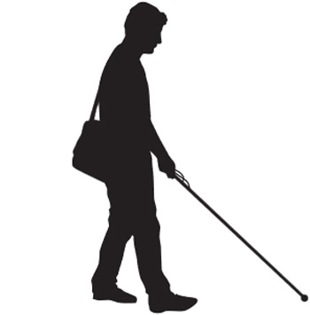
Introduction: Motivations
2.2 billions some visual impairment.
295 million have moderate or severe vision impairment.
43,3 million are blind
Dissatisfaction of the community
COVID-19
WHO recommendations

Slide 5






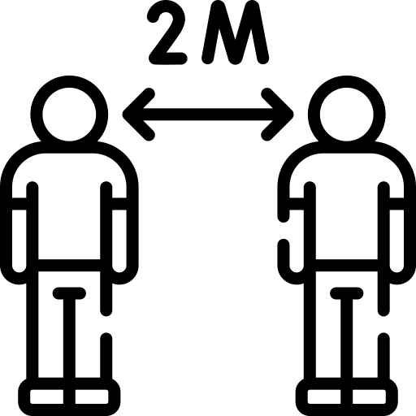
Introduction: Motivations

Slide 6
Introduction: Motivations

Slide 7
Introduction: Motivations

Slide 8
Introduction: Motivations

Slide 9
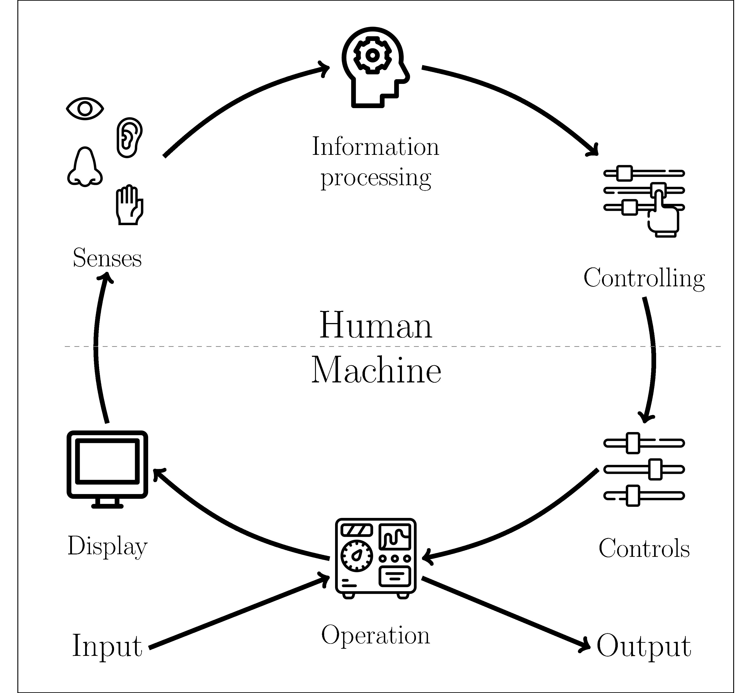





Introduction: Human Factors
Performance shortfalls and failures
Engineering, psychology and physiology
Notes:
• Studies in the area of Human Factors started during the Second World War, motivated by performance shortfalls and failures related to the operation of equipment used by humans.
• The studies showed that these problems could diminish when, engineering, psychology and physiology were considered when designing systems that would be handled by human beings.
• This definition shows that humans and their interaction with systems and devices should be considered during the design process. This need resulted in the proposal of an ISO Standard: BS EN ISO 13407 ”Human-centred design processes for interactive systems”.
• The interaction between humans and machines can be abstracted as illustrated in Figure 2.1. The machine receives inputs from its environment and provides information to the human operator through displays and other monitoring devices. The operator perceives the available information, process it and decides on his/her control actions. Based on the environment’s inputs and operator’s commands, the machine defines its outputs to the environment. • The machine receives inputs from its environment and provides information to the human operator through displays and other monitoring devices. The operator perceives the available information, process it and decides on his/her control actions. Based on the environment's inputs and operator's commands, the machine defines its outputs to the environment.
Humans handle devices, machines and equipment during their daily activities. All of these manipulations are susceptible to accidents or failures that can happen because of the interaction between operator, equipment and environment. Each interface with the operator can be a factor. For example:

Slide 10
Introduction: Human Factors
Performance shortfalls and failures
Engineering, psychology and physiology
Notes:
• Studies in the area of Human Factors started during the Second World War, motivated by performance shortfalls and failures related to the operation of equipment used by humans.
• The studies showed that these problems could diminish when, engineering, psychology and physiology were considered when designing systems that would be handled by human beings.
• This definition shows that humans and their interaction with systems and devices should be considered during the design process. This need resulted in the proposal of an ISO Standard: BS EN ISO 13407 ”Human-centred design processes for interactive systems”.
• The interaction between humans and machines can be abstracted as illustrated in Figure 2.1. The machine receives inputs from its environment and provides information to the human operator through displays and other monitoring devices. The operator perceives the available information, process it and decides on his/her control actions. Based on the environment’s inputs and operator’s commands, the machine defines its outputs to the environment. • The machine receives inputs from its environment and provides information to the human operator through displays and other monitoring devices. The operator perceives the available information, process it and decides on his/her control actions. Based on the environment's inputs and operator's commands, the machine defines its outputs to the environment.
Humans handle devices, machines and equipment during their daily activities. All of these manipulations are susceptible to accidents or failures that can happen because of the interaction between operator, equipment and environment. Each interface with the operator can be a factor. For example:

Slide 11
Introduction: Human Factors
Performance shortfalls and failures
Engineering, psychology and physiology
Notes:
• Studies in the area of Human Factors started during the Second World War, motivated by performance shortfalls and failures related to the operation of equipment used by humans.
• The studies showed that these problems could diminish when, engineering, psychology and physiology were considered when designing systems that would be handled by human beings.
• This definition shows that humans and their interaction with systems and devices should be considered during the design process. This need resulted in the proposal of an ISO Standard: BS EN ISO 13407 ”Human-centred design processes for interactive systems”.
• The interaction between humans and machines can be abstracted as illustrated in Figure 2.1. The machine receives inputs from its environment and provides information to the human operator through displays and other monitoring devices. The operator perceives the available information, process it and decides on his/her control actions. Based on the environment’s inputs and operator’s commands, the machine defines its outputs to the environment. • The machine receives inputs from its environment and provides information to the human operator through displays and other monitoring devices. The operator perceives the available information, process it and decides on his/her control actions. Based on the environment's inputs and operator's commands, the machine defines its outputs to the environment.
Humans handle devices, machines and equipment during their daily activities. All of these manipulations are susceptible to accidents or failures that can happen because of the interaction between operator, equipment and environment. Each interface with the operator can be a factor. For example:

Slide 12

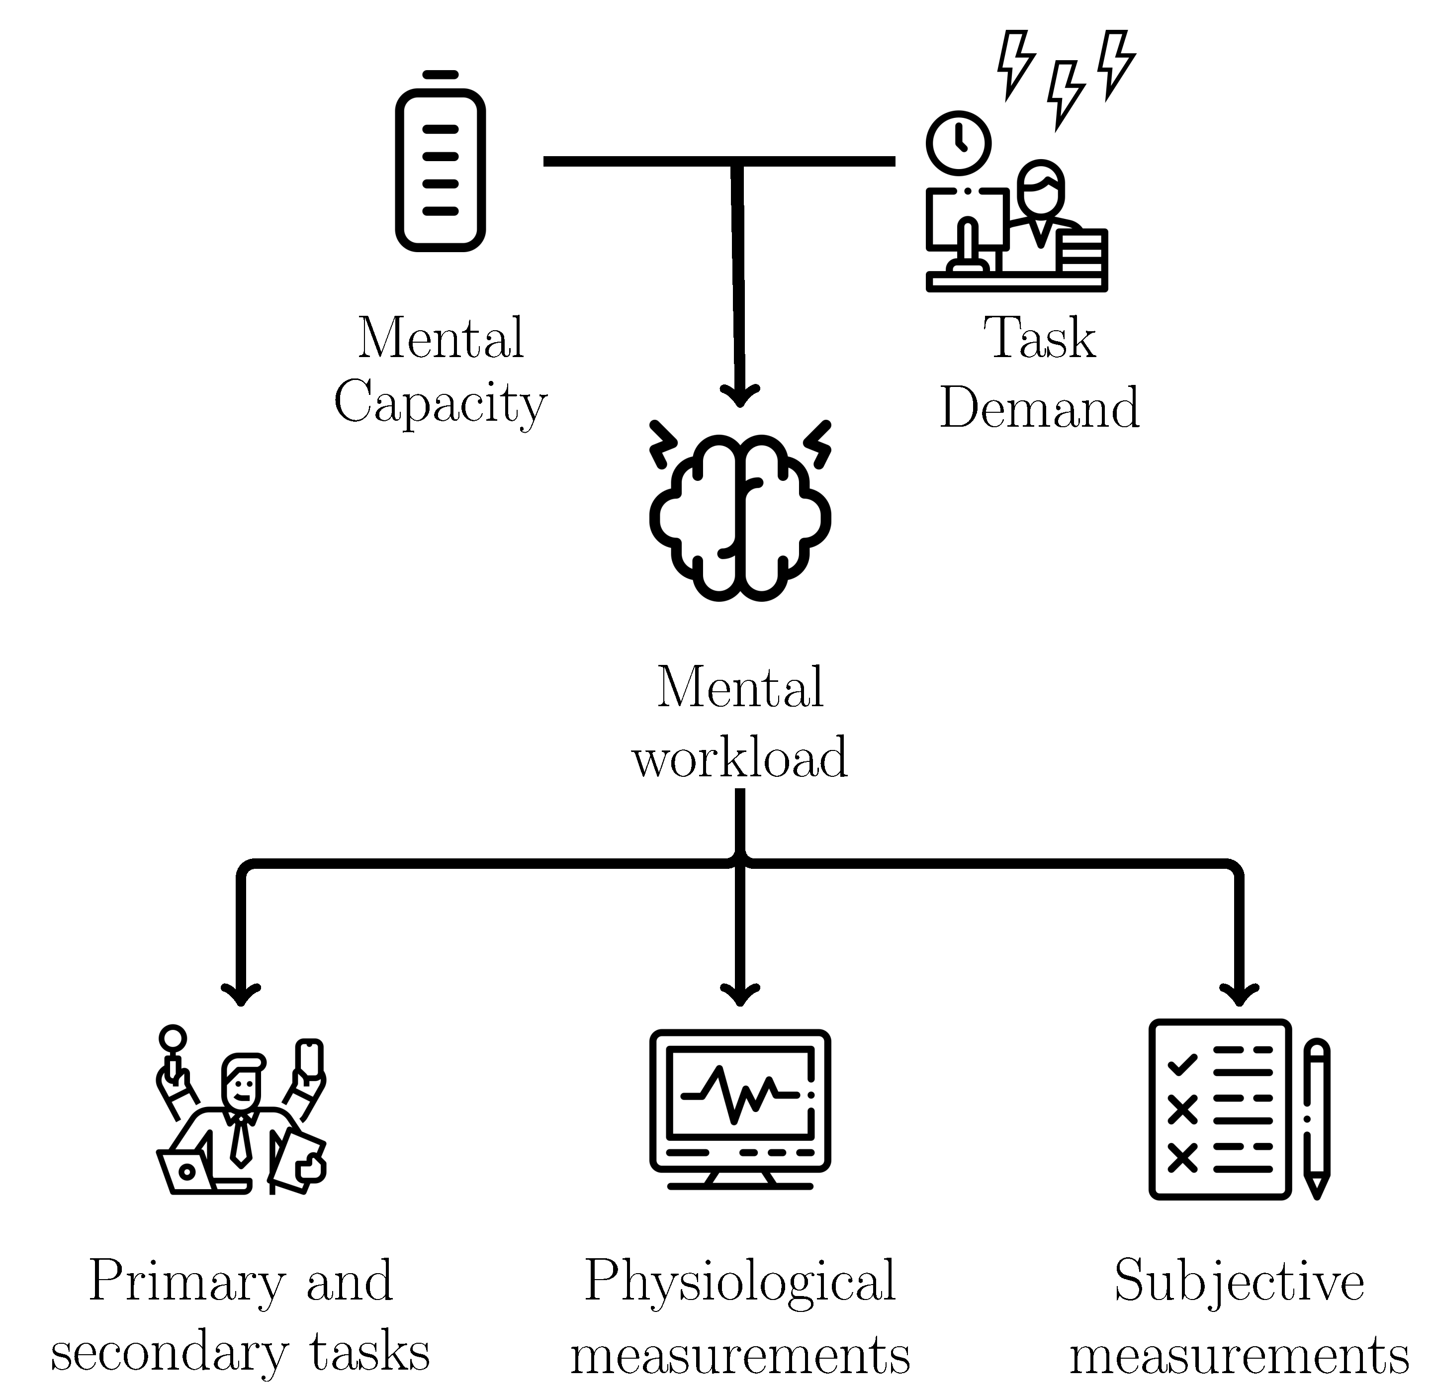
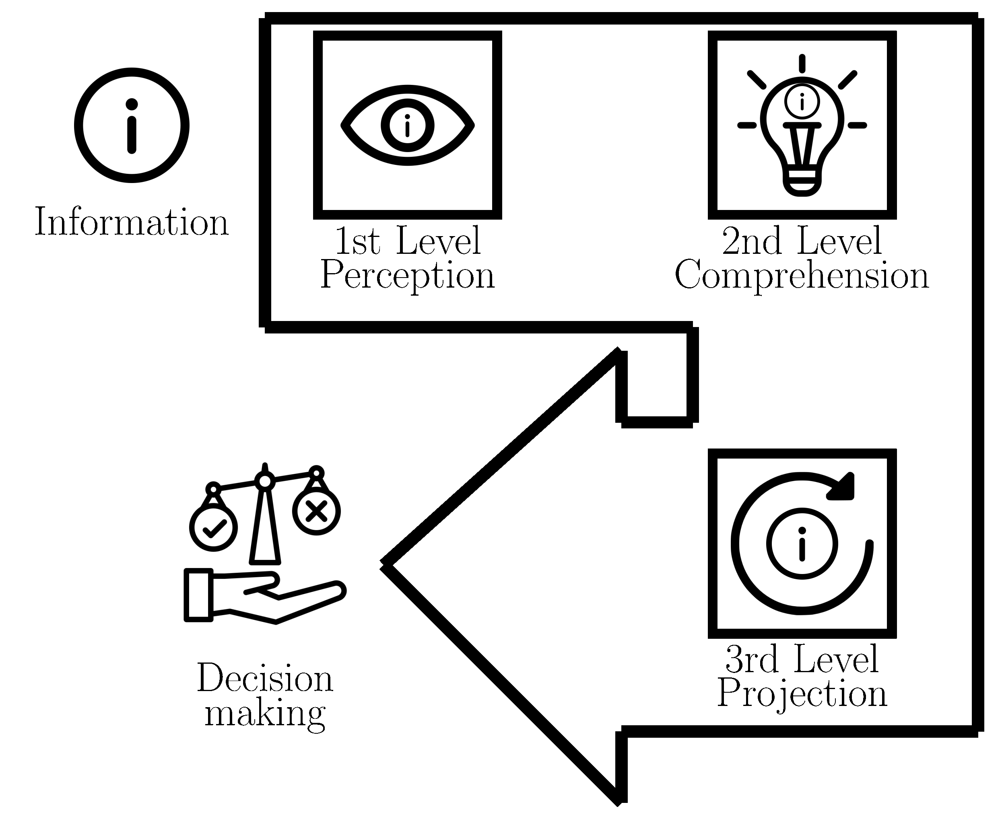
Introduction: Mental Workload and Situation Awareness
Mental Workload
Situation Awareness
Notes:
• Mental workload is one of the main concepts studied in Human Factors (STANTON et al., 2004).
• In order to explain it, Stanton et al. (2004) propose an analogy with the concept of physical workload. When an athlete must lift a dumbbell (one of those gym weights bars), the strength demand from the athlete is proportional to the dumbbell’s mass being lifted. If the dumbbell is lighter than the athlete’s capability, it is easy enough for him to lift it. If the athlete is strong enough to carry the dumbbell, he does not feel a physical demand bigger than his capabilities. In this case, the physical workload of this activity is appropriately fitted for this athlete. Two things can happen if the dumbbell is heavier than the athlete’s capability. Either the athlete adapts to lift the dumbbell using tools (adjust the strategy), or the dumbbell is not lifted completely (performance degrades). This situation corresponds to the case of a operator executing a task, which is not fitted for his capabilities.
• The mental workload is similar to the physical workload but refers to the mental capacity necessary to perform a task. Each human being has a finite mental capacity. When the mental demand is higher than the operator’s capacity, the person needs to adapt to finish the task, or the overall performance of the task is compromised. Otherwise, if the mental workload is too low, the operator may get bored and easily distracted and could also fail or not process the task’s information.
• It is important to say that mental workload is unique within each individual. It is influenced by the operator perception and also by other factors outside the task itself. These factor can be more related to the operator (like its skill, age, education, training) or the environment (like noise, heat and toxicity) (CAIN, 2007; FALLAHI et al., 2016; CARDOSO; GONTIJO, 2012).
• The mental workload is not a quantitative resource or something that one can directly measure, but several different methods have been proposed in the literature to infer it. Figure 2.2 illustrates three different classes of methods used to evaluate mental workload: methods based on task performance, methods based on physiological measures and methods based on subjective questionnaires.
Methods based on task performance • If the mental workload influences the task performance, it would be possible to infer it using the performance’s variation of a task. Because there are cases where the user’s mental capacity is too high for only one task, a common approach is to add a secondary task. In this case, the user is asked to maintain a good performance level and still try to execute both tasks. Both tasks should use the same skills (STANTON et al., 2004; SANDERS; MCCORMICK, 1998).
• For example, an experiment to assess mental workload in a flight simulator may use two tasks. The primary task is to fly the aircraft while maintaining a performance level. The second is something simple, like mentally summing two random numbers that appear on the screen. If the numbers’ sum is odd, the pilot should press the left arrow key on the keyboard, otherwise should press the right arrow key. If the pilot’s performance in the secondary task is too low, it means that the mental demand from the first task is too high to pay attention to the second task (MOHANAVELU et al., 2020).
Methods based on physiological measurements • Many physiological measurements can be used to assess mental workload. The most common ones are heart and brain activity (CHAKLADAR et al., 2020; ORLANDI; BROOKS, 2018), skin conductance, eye movement and pupillary contraction (STANTON et al., 2004; RODR´IGUEZ et al., 2015). These measurements are considered an unbiased assessment method (FALLAHI et al., 2016). It is recommended to evaluate them alongside another method, as they can be influenced by unknown variables and external factors.
• This work uses heart activity, obtained from an electrocardiogram (ECG) sensor, and electrodermal activity, obtained from a galvanic skin response (GSR) sensor, as physiological measurements to assess mental workload.
• The electrocardiogram (ECG) is a recording of the heart’s electrical activity. From it, it is possible to determine the intervals between heartbeats and the corresponding frequency (heart rate, HR). Another common variable is the heart rate standard deviation (heart rate variability, HRV) (CAIN, 2007). The heart activity is controlled by the sympathetic and parasympathetic nervous systems (STANTON et al., 2004). During a task, the heart activity changes with the mental demand of the task. The heart rate is expected to increase with the mental workload, while the heart rate variability is expected to decrease. These are consequences of two reactions in our system when in a mental demand situation (STANTON et al., 2004): a decrease in the parasympathetic nervous system activity and an increase in sympathetic nervous system activity. The ECG is a simple and non-invasive method used in many experiments to evaluate mental workload and other human factors’ (MOHANAVELU et al., 2020; MANSIKKA et al., 2016; ZHANG et al., 2014).
• The skin electrodermal activity is affected by the person’s sweating and the level of moisture in the environment. It can be used to reveal changes in our sympathetic system (NOURBAKHSH et al., 2012; SHI et al., 2007). It has been used in the literature as an assessment method for stress and arousal (NOURBAKHSH et al., 2012; STANTON et al., 2004; SHI et al., 2007), the usability of human-computer systems (SHI et al., 2007) and also mental workload (ZHANG et al., 2014; BORGHINI et al., 2014).
Methods based on subjective questionnaires • The use of subjective questionnaires to assess mental workload has been extensively discussed in the literature (SANDERS; MCCORMICK, 1998; STANTON et al., 2004). They are sensitive to perceived difficulty, automation, concurrent activities and demand for multiple resources. The questionnaires can be unidimensional, which are more straighforward but has only a general workload score.
• It is discussed if one should only use subjective measures to measure MWL (SANDERS; MCCORMICK, 1998; STANTON et al., 2004). They are sensitive to perceived difficulty, automation, concurrent activities and demand for multiple resources. These tests can be unidimensional, which are more straighforward but has only a general workload score (STANTON et al., 2004),or multidimensional. Examples of multidimensional questionnaires are the Subjective Workload Assessment Technique (SWAT) and the NASA Task Load Index (NASA-TLX). SWAT decomposes the mental in three dimensions: time load, mental effort load, and psychological stress. NASA-TLX, a questionnaire created by Hart e Staveland (1988), uses six dimensions, as described in Table 2.1. These questionnaires were proposed to evaluate only one task/activity. If the user has performed two tasks (a primary and secondary task), he/she should be oriented to answer about the primary task, not a combination of both (SANDERS; MCCORMICK, 1998).
• Finally, it is essential to highlight that, to have a comprehensive evaluation of the mental workload, not to choose only one method, but to combine methods from the three classes (task performance, physiological measurements and subjective questionnaires). Mental workload is multidimensional and can reflect partially or differently in each method (SANDERS; MCCORMICK, 1998).

Slide 13
Introduction: Mental Workload and Situation Awareness
Mental Workload
Situation Awareness
Notes:
• Mental workload is one of the main concepts studied in Human Factors (STANTON et al., 2004).
• In order to explain it, Stanton et al. (2004) propose an analogy with the concept of physical workload. When an athlete must lift a dumbbell (one of those gym weights bars), the strength demand from the athlete is proportional to the dumbbell’s mass being lifted. If the dumbbell is lighter than the athlete’s capability, it is easy enough for him to lift it. If the athlete is strong enough to carry the dumbbell, he does not feel a physical demand bigger than his capabilities. In this case, the physical workload of this activity is appropriately fitted for this athlete. Two things can happen if the dumbbell is heavier than the athlete’s capability. Either the athlete adapts to lift the dumbbell using tools (adjust the strategy), or the dumbbell is not lifted completely (performance degrades). This situation corresponds to the case of a operator executing a task, which is not fitted for his capabilities.
• The mental workload is similar to the physical workload but refers to the mental capacity necessary to perform a task. Each human being has a finite mental capacity. When the mental demand is higher than the operator’s capacity, the person needs to adapt to finish the task, or the overall performance of the task is compromised. Otherwise, if the mental workload is too low, the operator may get bored and easily distracted and could also fail or not process the task’s information.
• It is important to say that mental workload is unique within each individual. It is influenced by the operator perception and also by other factors outside the task itself. These factor can be more related to the operator (like its skill, age, education, training) or the environment (like noise, heat and toxicity) (CAIN, 2007; FALLAHI et al., 2016; CARDOSO; GONTIJO, 2012).
• The mental workload is not a quantitative resource or something that one can directly measure, but several different methods have been proposed in the literature to infer it. Figure 2.2 illustrates three different classes of methods used to evaluate mental workload: methods based on task performance, methods based on physiological measures and methods based on subjective questionnaires.
Methods based on task performance • If the mental workload influences the task performance, it would be possible to infer it using the performance’s variation of a task. Because there are cases where the user’s mental capacity is too high for only one task, a common approach is to add a secondary task. In this case, the user is asked to maintain a good performance level and still try to execute both tasks. Both tasks should use the same skills (STANTON et al., 2004; SANDERS; MCCORMICK, 1998).
• For example, an experiment to assess mental workload in a flight simulator may use two tasks. The primary task is to fly the aircraft while maintaining a performance level. The second is something simple, like mentally summing two random numbers that appear on the screen. If the numbers’ sum is odd, the pilot should press the left arrow key on the keyboard, otherwise should press the right arrow key. If the pilot’s performance in the secondary task is too low, it means that the mental demand from the first task is too high to pay attention to the second task (MOHANAVELU et al., 2020).
Methods based on physiological measurements • Many physiological measurements can be used to assess mental workload. The most common ones are heart and brain activity (CHAKLADAR et al., 2020; ORLANDI; BROOKS, 2018), skin conductance, eye movement and pupillary contraction (STANTON et al., 2004; RODR´IGUEZ et al., 2015). These measurements are considered an unbiased assessment method (FALLAHI et al., 2016). It is recommended to evaluate them alongside another method, as they can be influenced by unknown variables and external factors.
• This work uses heart activity, obtained from an electrocardiogram (ECG) sensor, and electrodermal activity, obtained from a galvanic skin response (GSR) sensor, as physiological measurements to assess mental workload.
• The electrocardiogram (ECG) is a recording of the heart’s electrical activity. From it, it is possible to determine the intervals between heartbeats and the corresponding frequency (heart rate, HR). Another common variable is the heart rate standard deviation (heart rate variability, HRV) (CAIN, 2007). The heart activity is controlled by the sympathetic and parasympathetic nervous systems (STANTON et al., 2004). During a task, the heart activity changes with the mental demand of the task. The heart rate is expected to increase with the mental workload, while the heart rate variability is expected to decrease. These are consequences of two reactions in our system when in a mental demand situation (STANTON et al., 2004): a decrease in the parasympathetic nervous system activity and an increase in sympathetic nervous system activity. The ECG is a simple and non-invasive method used in many experiments to evaluate mental workload and other human factors’ (MOHANAVELU et al., 2020; MANSIKKA et al., 2016; ZHANG et al., 2014).
• The skin electrodermal activity is affected by the person’s sweating and the level of moisture in the environment. It can be used to reveal changes in our sympathetic system (NOURBAKHSH et al., 2012; SHI et al., 2007). It has been used in the literature as an assessment method for stress and arousal (NOURBAKHSH et al., 2012; STANTON et al., 2004; SHI et al., 2007), the usability of human-computer systems (SHI et al., 2007) and also mental workload (ZHANG et al., 2014; BORGHINI et al., 2014).
Methods based on subjective questionnaires • The use of subjective questionnaires to assess mental workload has been extensively discussed in the literature (SANDERS; MCCORMICK, 1998; STANTON et al., 2004). They are sensitive to perceived difficulty, automation, concurrent activities and demand for multiple resources. The questionnaires can be unidimensional, which are more straighforward but has only a general workload score.
• It is discussed if one should only use subjective measures to measure MWL (SANDERS; MCCORMICK, 1998; STANTON et al., 2004). They are sensitive to perceived difficulty, automation, concurrent activities and demand for multiple resources. These tests can be unidimensional, which are more straighforward but has only a general workload score (STANTON et al., 2004),or multidimensional. Examples of multidimensional questionnaires are the Subjective Workload Assessment Technique (SWAT) and the NASA Task Load Index (NASA-TLX). SWAT decomposes the mental in three dimensions: time load, mental effort load, and psychological stress. NASA-TLX, a questionnaire created by Hart e Staveland (1988), uses six dimensions, as described in Table 2.1. These questionnaires were proposed to evaluate only one task/activity. If the user has performed two tasks (a primary and secondary task), he/she should be oriented to answer about the primary task, not a combination of both (SANDERS; MCCORMICK, 1998).
• Finally, it is essential to highlight that, to have a comprehensive evaluation of the mental workload, not to choose only one method, but to combine methods from the three classes (task performance, physiological measurements and subjective questionnaires). Mental workload is multidimensional and can reflect partially or differently in each method (SANDERS; MCCORMICK, 1998).

Slide 14
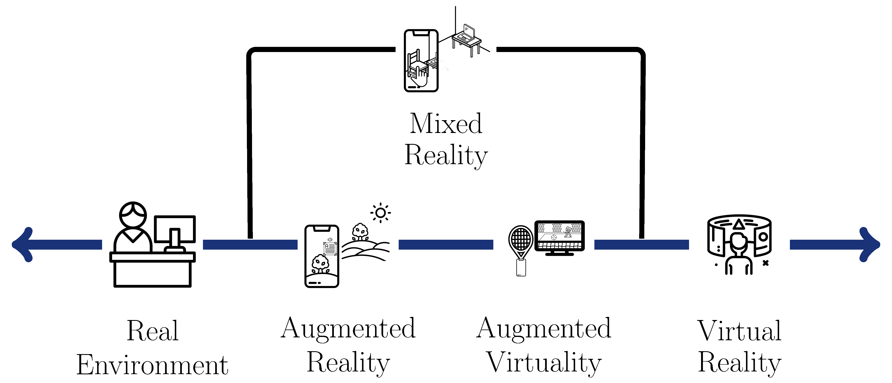

Introduction: Extended Reality (XR)
No element produced by a digital system.
Notes:
• The extreme left means full reality, where the stimuli is not produced by any computer or any other digital system. Along the path to the right, the environment starts to have some digital elements until it reaches the far right, where all the environmental elements have a digital origin. The first step from the ”Real Environment” to ”Virtual Reality” is the augmented reality.

Slide 15
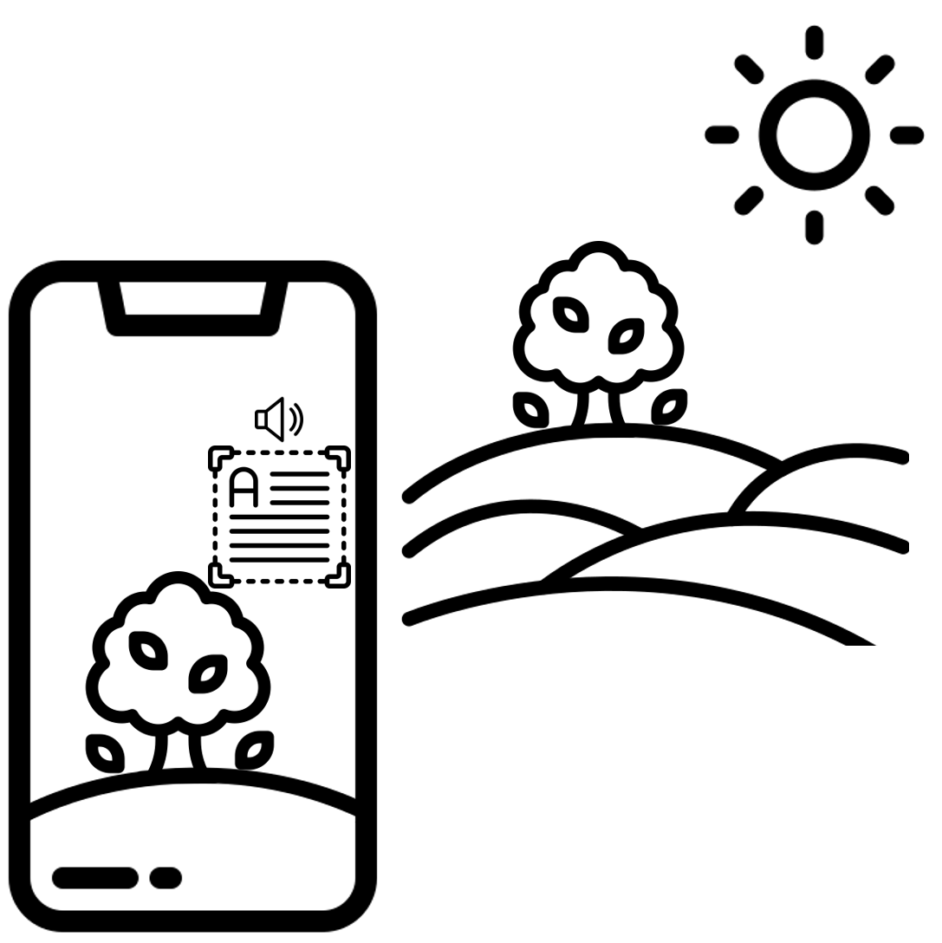
Introduction: Extended Reality (XR)
Some digital elements laid over the real environment.
The elements can not be manipulated
User do not lose the sense of presence.
Notes:
• In the augmented reality system, the user sees some digital elements that are laid over the real environment. without making the user lose his sense of presence in the real world. These elements can be text, images, video, etc. Augmented reality can be used to assist workers in manufacturing and assembly tasks, as well as training (DOOLANI et al., 2020; FARRELL, 2018; MA; CHOI, 2007).

Slide 16
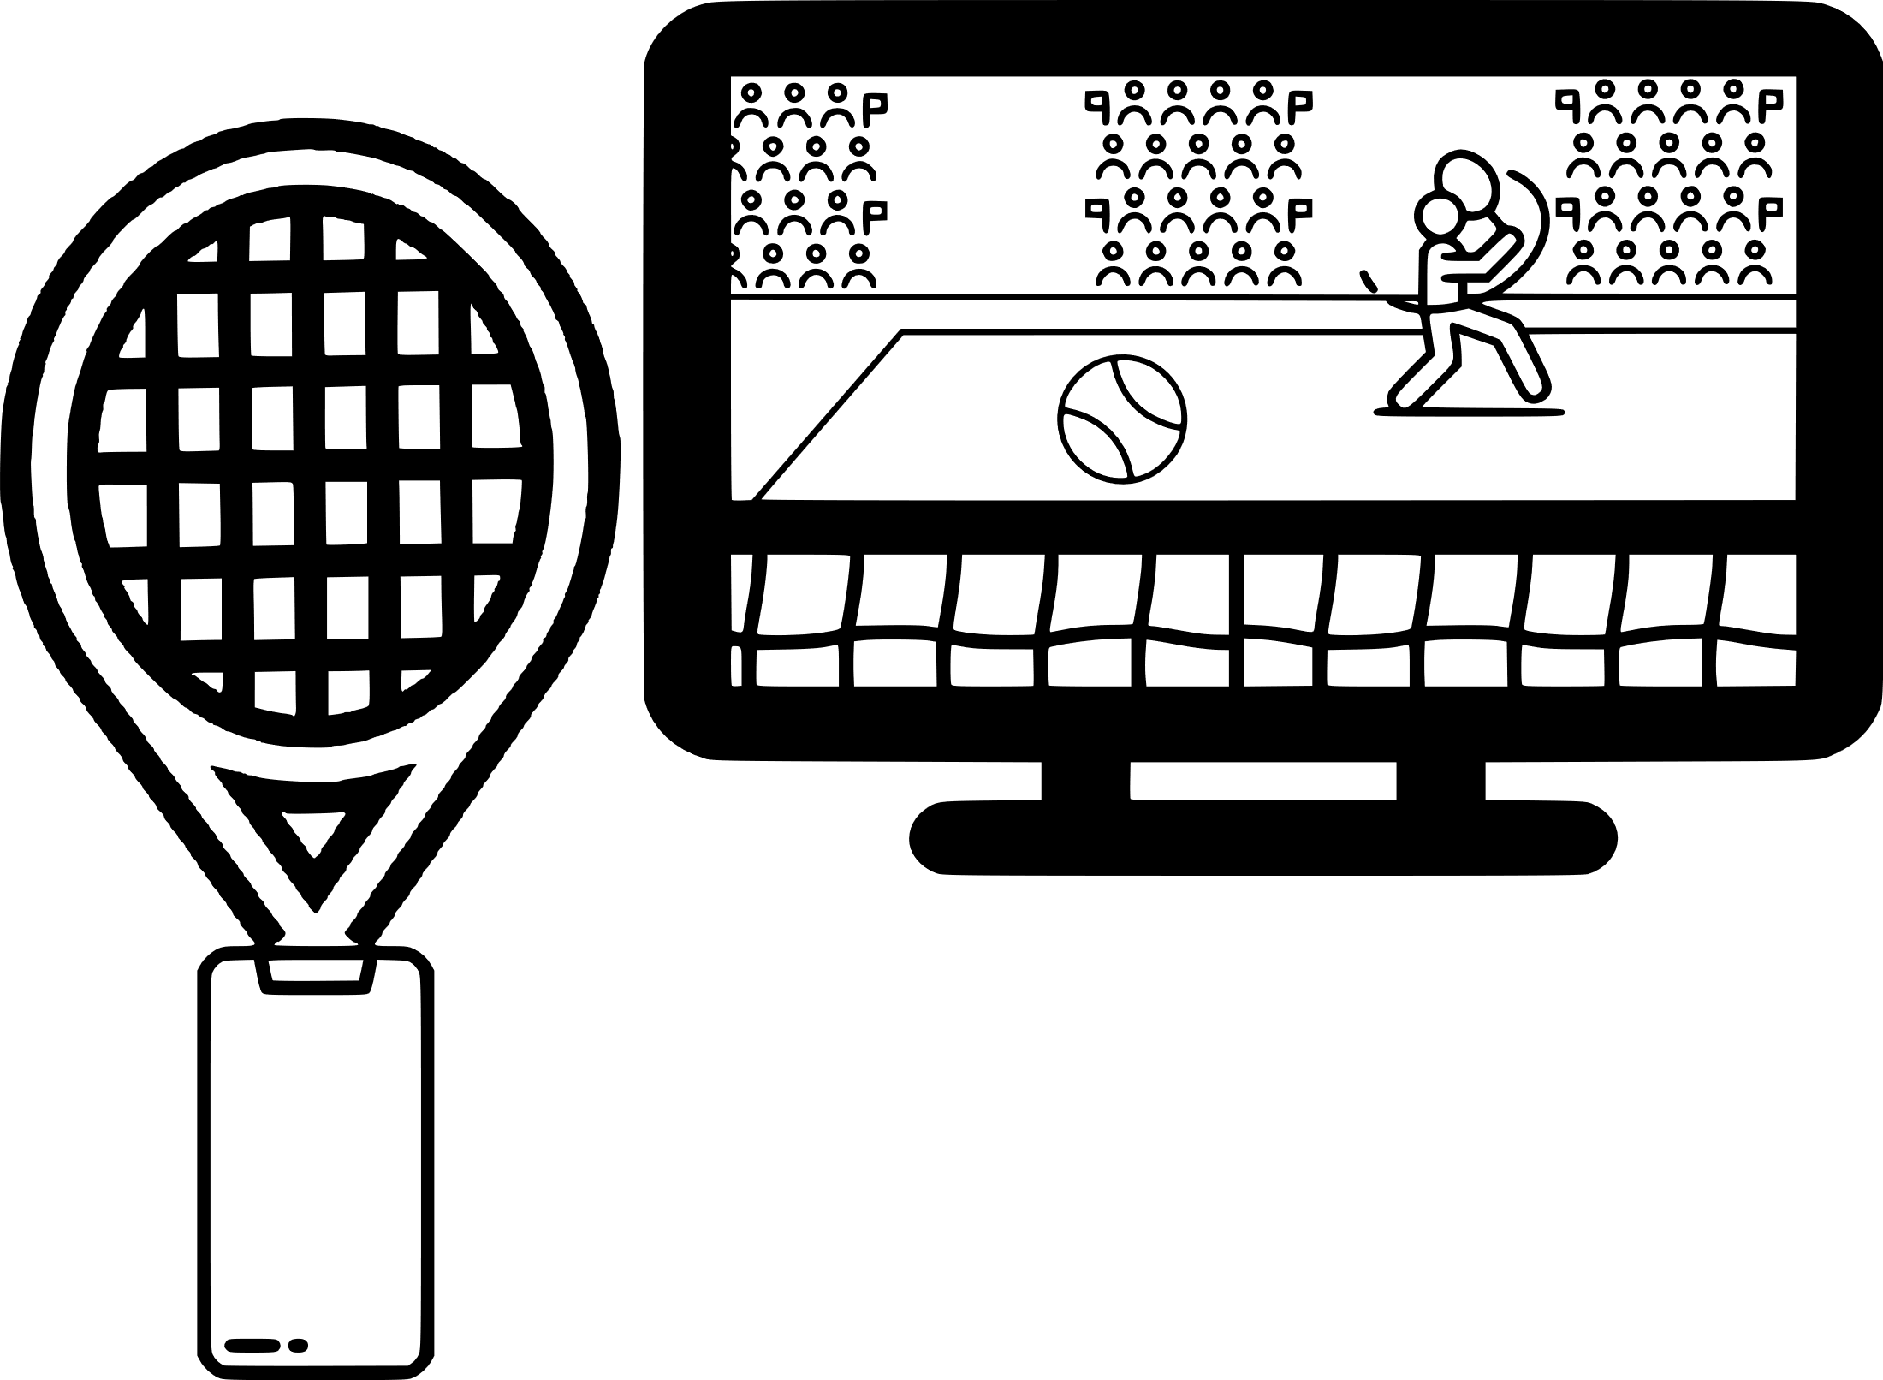
Introduction: Extended Reality (XR)
Background environment made with digital elements.
The elements can be manipulated
User has a feeling of presence inside the virtual environment.
Notes:
• While the augmented reality brings digital elements to the real environment, the augmented virtuality creates an environment that could only exist digitally, such as a fantasy world from games or movies. This scenario is the background of some other activity that is being done by the user in the real environment. An example is to train a pilot in a virtual environment but with an accurate mock-up of the cockpit, which provides physical buttons and inceptors for the pilot to touch and hold (FARSHID et al., 2018). Another example is to play sports, such as tennis, golf or baseball, in a complete digital arena but using the actual equipment with a tracker.

Slide 17
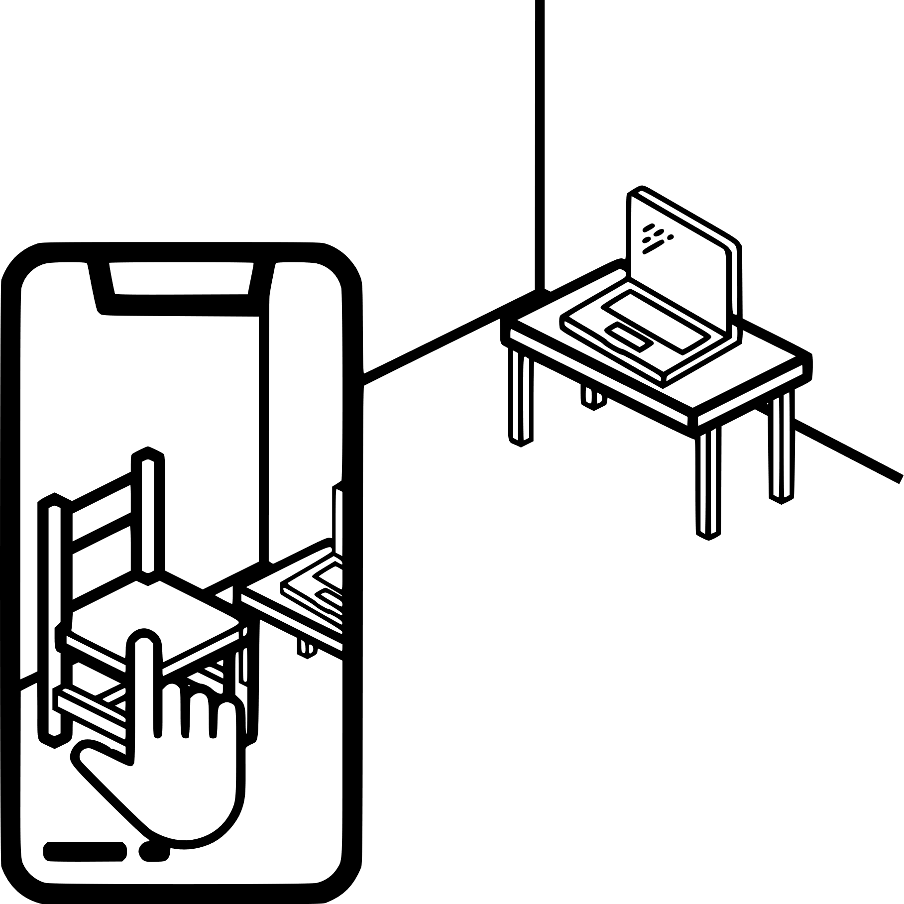
Introduction: Extended Reality (XR)
Some digital elements laid over the real environment.
The digital elements can be manipulated
User do not lose the sense of presence.
Notes:
• The mixed reality stays in between the real and virtual environments. Unlike augmented reality and augmented virtuality, in a mixed reality system the user can manipulate digital elements as if they were inside the real world (DOOLANI et al., 2020). One example is when a client from a furniture store uses mixed reality not only to see how the furniture fits inside his room, but he can also move it and change its color, size and shape before buying or even going to the shop.

Slide 18

Introduction: Extended Reality (XR)
All elements are digital and can be manipulated.
User has a feeling of presence inside the virtual environment.
Notes:
• On the far right of the virtuality continuum, the virtual reality is when the user is the only non-digital element, everything else is digital, immersing the user in a virtual environment, but, of course, inside the physical limits of the real environment (MA; CHOI, 2007). If the feeling of presence inside that environment is well tailored, the user can momentarily forget about the real environment and act and react accordingly to the virtual environment (FARRELL, 2018).

Slide 19
Introduction: Co-Design
Notes:
• Co-design, or collaborative design, refers to a design process in which individuals of the design team have different backgrounds or bring different experiences, which can be essencial for the product under design. It is based on good communication and information sharing among the team (CHIU, 2002). Kleinsmann (2006) provides the following definition:.
”Collaborative design is the process in which actors from different disciplines share their knowledge about both the design process and the design content. They do that to create a shared understanding of both aspects, to be able to integrate and explore their knowledge and to achieve the larger common objective: the new product to be designed.” (KLEINSMANN, 2006).
• This definition emphasizes two critical aspects of co-design: knowledge sharing and integration. According to Kleinsmann (2006) knowledge is the data after the receiver’s understanding or translating process, in a state that is possible to record or register, so that the person can remember and use it later. During the collaborative design, ideas, facts or concepts are exchanged between the actors. This exchange is a fundamental part of the co-design method since it is responsible for the growth of each individual’s knowledge. Once the knowledge is shared among the actors, they can use it when performing their tasks, resulting in knowledge integration (KLEINSMANN, 2006).

Slide 20
Agenda
1.
Introduction
2.
Objectives and Approach
3.
Materials and Methods
4.
Results and discussion
5.
Conclusion and outlook

Slide 21
Objectives and Approach: Objectives
Goal n° 1
Goal n° 2
Compare:
Assistive devices;
Human factors;
Virtual environment.
Main Limitations
non-BVI users:
Deprived of their vision;
Similarly assistive devices as BVI users.
Specific goal n° 1
Select a scenario and develop its virtual environment
Specific goal n° 2
Develop three conceptual assistive devices
Specific goal n° 3
Propose a set of evaluation methods
Specific goal n° 4
Design and execute an experiment

Slide 22
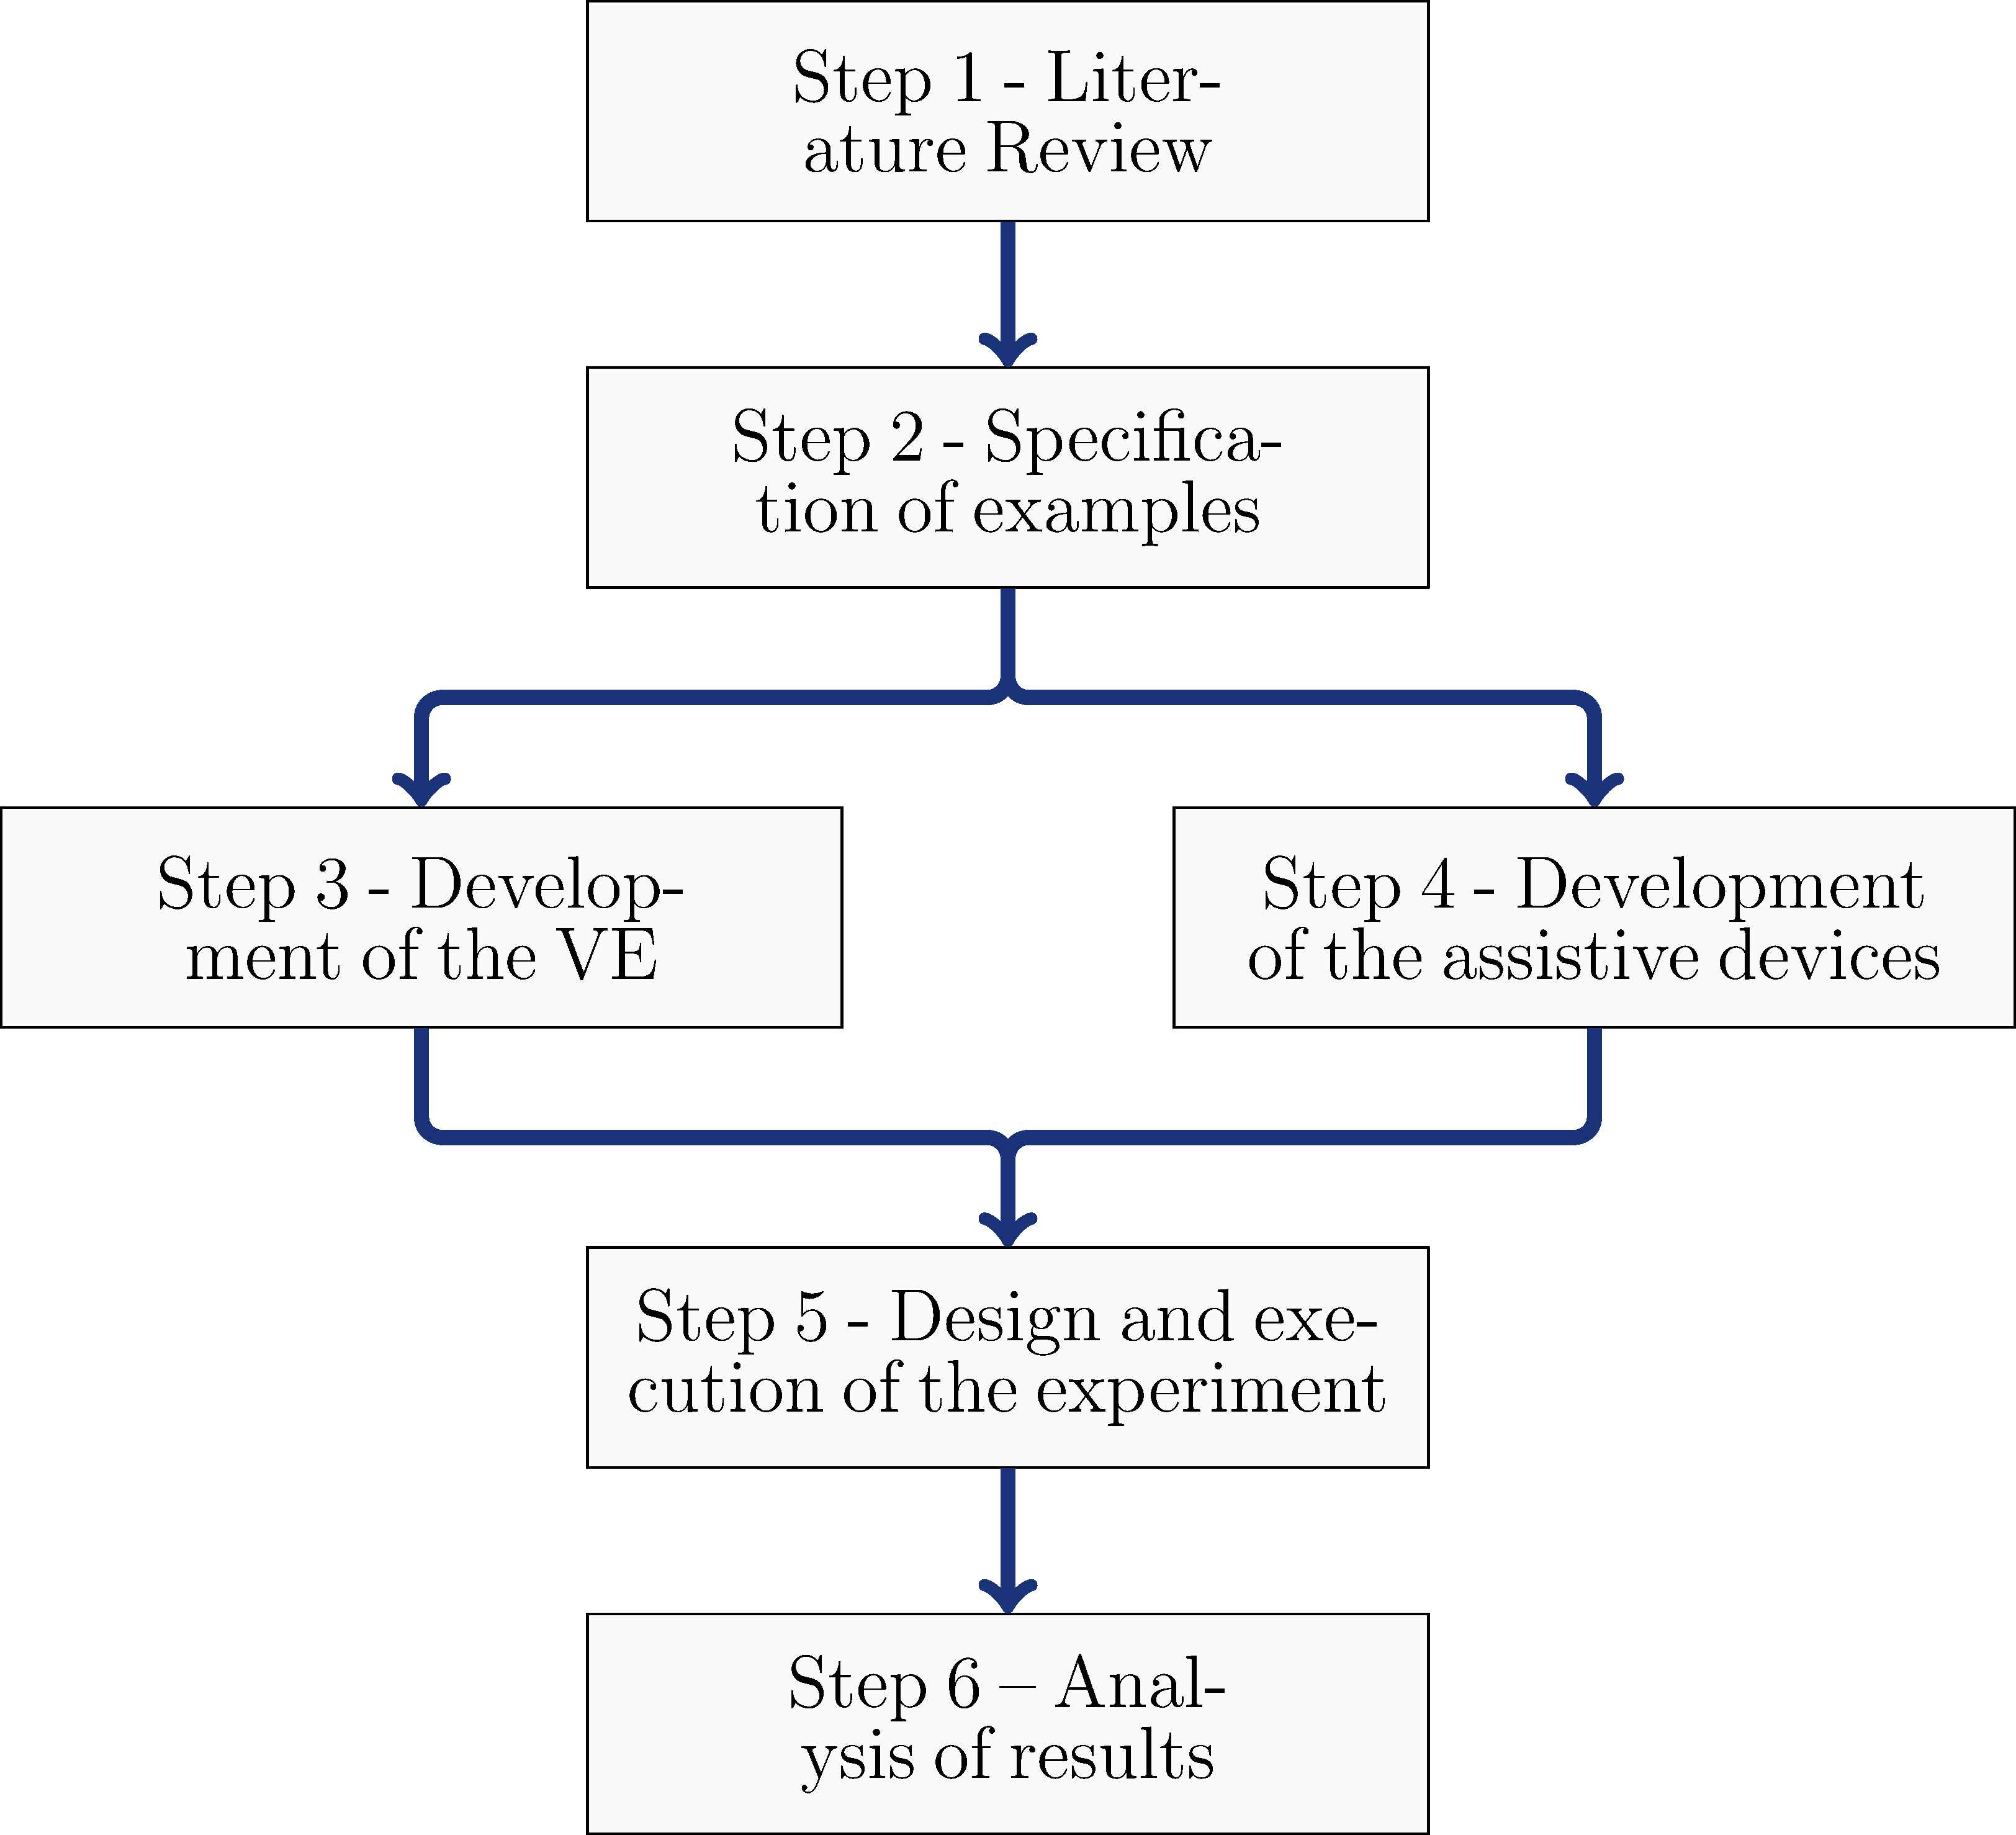
Objectives and Approach: Approach
Notes:
This work adopts an experimental approach to evaluate the proposal of this dissertation and to investigate the questions stated in Section 1.1. The work is organized in the following steps, illustrated in Figure 1.1:

Slide 23
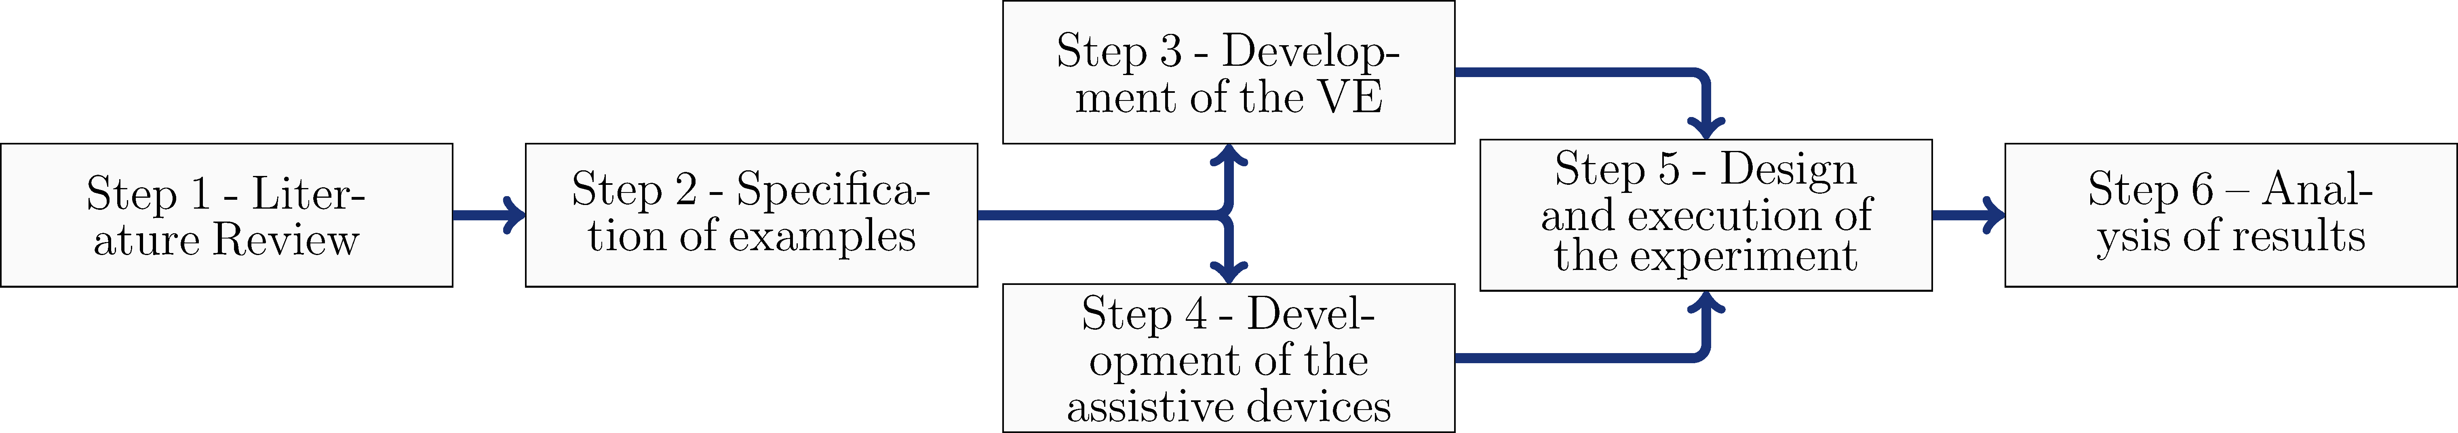





Introduction: Approach
Notes:
• It is composed of two parts. The first is to review the fundamental concept related to the topics covered in this work: human factors and virtual reality.
• The second part aims at contextualizing the dissertation’s proposal. It reviews recently published works on the development and evaluation of assistive devices for BVI people.

Slide 24
Introduction: Approach
Notes:
• It is composed of two parts. The first is to review the fundamental concept related to the topics covered in this work: human factors and virtual reality.
• The second part aims at contextualizing the dissertation’s proposal. It reviews recently published works on the development and evaluation of assistive devices for BVI people.

Slide 25






Introduction: Approach
Notes:
Step 2 – Specification of examples of the virtual environment and assistive devices
• This step consists of specifying one example of a virtual environment and a few examples of assistive devices to test the proposed approach of using virtual reality for evaluating purposes.
• Considering the above-mentioned motivation related to the covid-19 pandemic, the chosen virtual environment is the reception of a health clinic. The assistive devices used as examples are: an audio system, a haptic belt and a virtual cane, which could be used as stand-alone devices or combined.

Slide 26






Introduction: Approach
Notes:
Step 3 – Development of the specified virtual environment
• The virtual environment of a health clinic reception is developed in the Unit3D environment. The HTC VIVE VR Head Mounted Device (HMD) is used as a localizing system to define the user’s position inside the virtual environment.
Step 4 – Development of proofs of concept of the specified assistive devices
• The three examples of devices are developed using low-cost and available laboratory equipment. The audio guide is developed using the audio system of HTV VIVE HMD, while the virtual cane is developed using the HTC VIVE VR hand controller. Finally, the haptic belt is developed using an ESP32 microcontroller, eight vibrating motors 1027 and 3D printed pieces

Slide 27
Introduction: Approach
Notes:
Step 3 – Development of the specified virtual environment
• The virtual environment of a health clinic reception is developed in the Unit3D environment. The HTC VIVE VR Head Mounted Device (HMD) is used as a localizing system to define the user’s position inside the virtual environment.
Step 4 – Development of proofs of concept of the specified assistive devices
• The three examples of devices are developed using low-cost and available laboratory equipment. The audio guide is developed using the audio system of HTV VIVE HMD, while the virtual cane is developed using the HTC VIVE VR hand controller. Finally, the haptic belt is developed using an ESP32 microcontroller, eight vibrating motors 1027 and 3D printed pieces

Slide 28




Introduction: Approach
SAGAT
(ADAPTED)
NASA-TLX
GUIDANCE
Notes:
Step 5 – Design and execution of the experiment
• The proposed experiment is based on the best practices and principles of the Design of Experiment (DoE) discipline. The following techniques and tools are used for evaluating human factors:
a) Questionnaires adapted from the literature, such as NASA-TLX and SAGAT, or explicitly proposed for this work; b) Physiological sensors, such as GSR and ECG, to capture the body’s response.

Slide 29

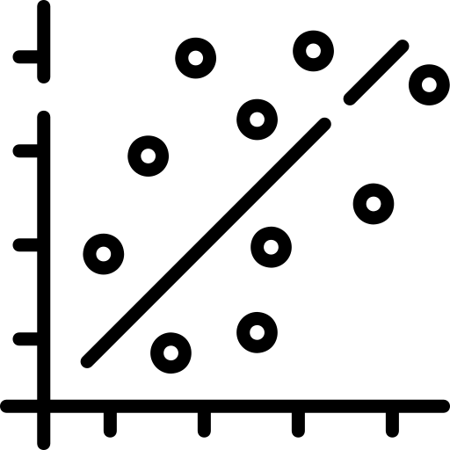

Introduction: Approach
TWO-WAY ANOVA
LSD’S FISHER TEST
P-Value
P-Value
Notes:
Step 6 – Analysis of results
• The results of the experiment are graphically and statistically analysed to estimate the user’s mental workload and situation awareness. In the statistical analysis, the outputs are verified for residual normality and similar variance inside the group is verified using an ANOVA. Finally, when needed, a Fisher’s Least Squared Difference Test is done to verify similarities between pairs.

Slide 30
Agenda
1.
Introduction
2.
Objectives and Approach
3.
Materials and Methods
4.
Results and discussion
5.
Conclusion and outlook

Slide 31

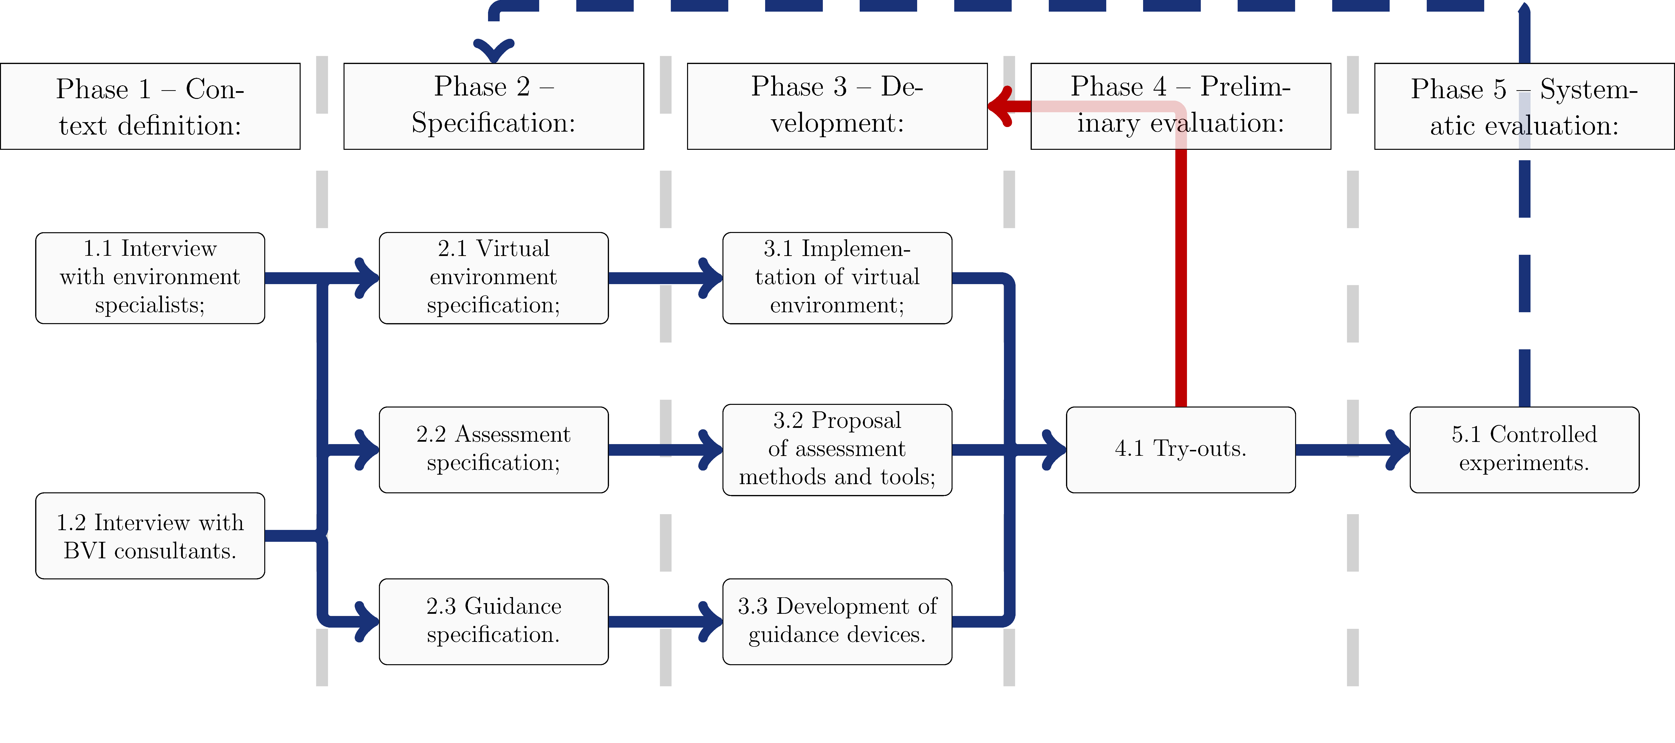

Materials and Methods: Methods
Notes:
As previously stated, the context in which the assistive devices are evaluated is the BVI navigation through a hospital or medical clinic in a covid-19 pandemic situation.
Step 1.1 Interview with environment specialists
• In order to gather information about this context, the first step of Phase 1 consists of interviewing specialists from hospitals to understand the usual hospital procedures and the standard features of this environment. For this work, employees from two hospitals of Sao Jose dos Campos were interviewed (Vivalle Hospital and the Municipal Hospital). They were questioned about the layout of rooms and spaces and the processes that a new patient follows through the hospital, from the check-in until he/she gets in the doctor’s office. According to the interviews, the procedures adopted by patients in both hospitals are similar and are usually composed of the following steps: 1. Enter the hospital; 2. Use the sanitizer to clean their hands; 3. Take a queue number and wait for the call of the receptionist; 4. Go to the receptionist and check in; 5. Sit in the waiting area and wait until the patient’s name is called; 6. Leave the waiting area toward the doctor’s office.
Step 1.2 Interview with BVI consultants One of the motivations of this work is that BVI users are not completely satisfied with the current guidance products. We hypothesize that BVI users are not usually consulted from the early stages of the products’ development. In this work, two BVI acted as consultants for the proposal of guiding methods and the design of a virtual environment that would be familiar to their reality. They had different visual impairments. One of them became blind at the age of 13 years old, while the other was diagnosed with Usher’s disease. The interviews with BVI consultants were critical to understanding how they perceive a medical clinic as they walk in and how they interact with the environment. Among the inputs provided by BVI interviews’ are the importance of including in the virtual environment background noise typical of a reception, such as a keyboard typing and a telephone ringing, as well as a few physical expected objects to interact with (chairs and desk)

Slide 32
Materials and Methods: Methods
Notes:
In Phase 2, the information collected through the interviews of Phase 1 is used to make critical decisions about the virtual environment where the evaluation of the assistive devices will be carried out. It is also used to define which human factors should be assessed. Finally, it contributes to define the guidance methods that should be implemented in the assistive devices.
Step 2.1 Virtual environment specification
Based on the data collected during the interviews, the scenario was defined as the hospital or medical clinic reception. The BVI patient should be able to navigate through the reception hall and reach a reception desk. After he/she is registered, the BVI patient should wait until he/she is called and then goes to his/her doctor’s office. At this step, a preliminary layout of the virtual environment was sketched, combining the elements that were common to the reception of the two hospitals, such as a waiting area with chairs (some of which should remain empty due to covid distancing), a reception desk, an alcohol totem, among others.
One limitation that had to be taken into account in the specification of the virtual environment is the corresponding physical area (real empty room) that should be available so that the BVI could walk through the real world. while he/she navigates in the virtual world. Typical dimensions of a reception are around 15x20m. Due to the limited space available at the laboratory, the reception was scaled down to fit into the available physical space, with an area of 7x10m but maintaining the same elements (reception desk, waiting area, sanitizer, among others)
Step 2.2 Assessment specification Based on the review of the literature and the BVI interviews, the assessment method should include the following dimensions, which were commonly evaluated in previous works: A) Performance evaluation; B) Mental workload evaluation. Additionally, a third dimension was also included, based on lessons learned from the Aeronautics area: C) Situation awareness evaluation. This dimension was included to verify if the BVI user can build a mental map of the environment based on the inputs provided by the devices. Finally, a fourth dimension is included for evaluating the user preferences when comparing the assistive devices. D) Guidance method evaluation.
Step 2.3 Guidance specification
Most current solutions for supporting BVI navigation use sound, vibration or both to communicate relevant information about the environment to the user. Based on the interviews with BVI consults, the three options were selected to be tested in this work (audio, vibration and audio/vibration combination).
Moreover, an exciting property was also evaluated: the effect of information being transmitted with or without the user’s command. This evaluation was applied to the vibration method and resulted in it being split in two variants: one that works around the user and another that works with where he/she decides.
In summarizing, four guidance methods were chosen to be evaluated: A) Audio guidance; B) Vibration guidance with command; C) Vibration guidance without command; D) Mixture of audio and vibration guidance.
It was also pointed out that the assessment should compare these four methods and the familiar guidance method of the BVI participants among them (e.g. white cane) with each other.

Slide 33
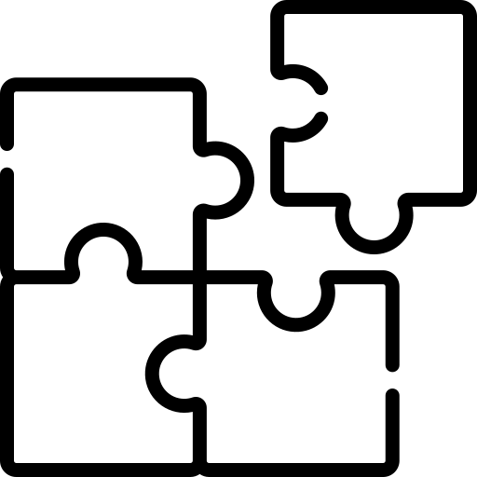

Slide 34
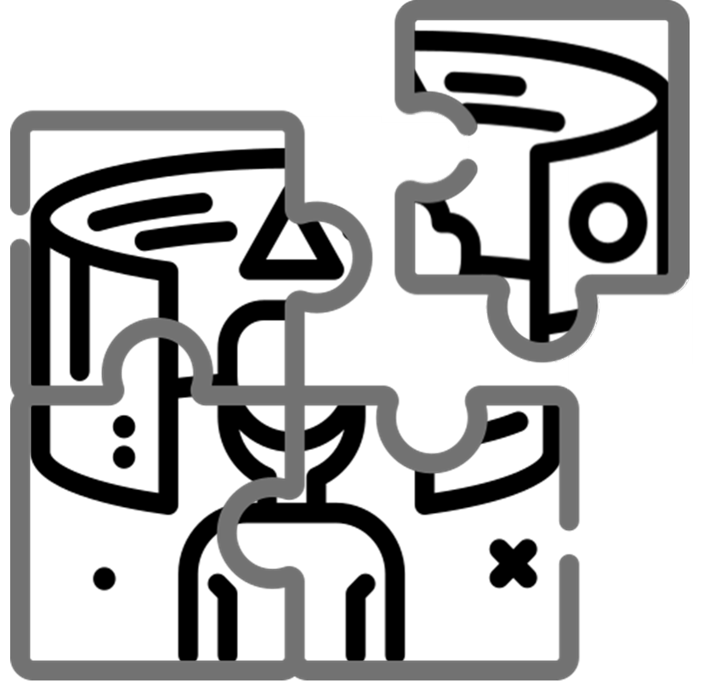
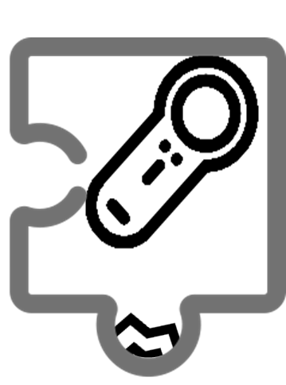
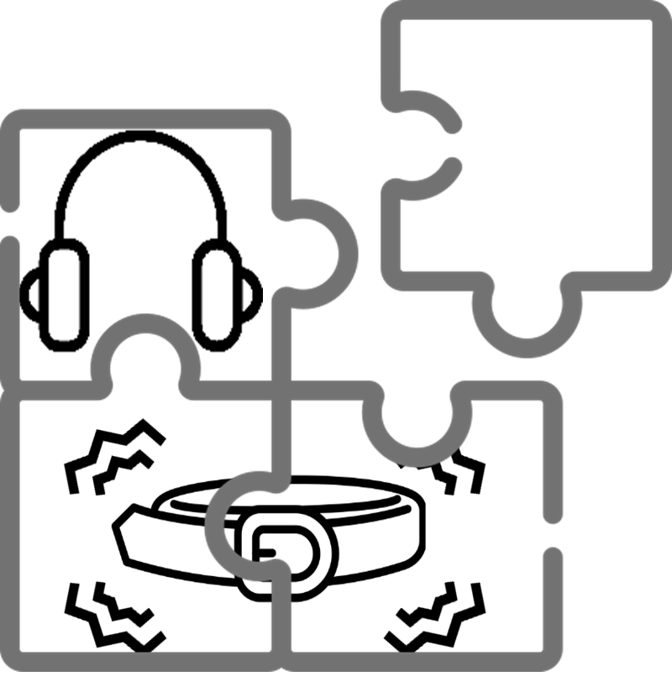
Materials and Methods: Methods
Notes:
In Phase 2, the information collected through the interviews of Phase 1 is used to make critical decisions about the virtual environment where the evaluation of the assistive devices will be carried out. It is also used to define which human factors should be assessed. Finally, it contributes to define the guidance methods that should be implemented in the assistive devices.
Step 2.1 Virtual environment specification
Based on the data collected during the interviews, the scenario was defined as the hospital or medical clinic reception. The BVI patient should be able to navigate through the reception hall and reach a reception desk. After he/she is registered, the BVI patient should wait until he/she is called and then goes to his/her doctor’s office. At this step, a preliminary layout of the virtual environment was sketched, combining the elements that were common to the reception of the two hospitals, such as a waiting area with chairs (some of which should remain empty due to covid distancing), a reception desk, an alcohol totem, among others.
One limitation that had to be taken into account in the specification of the virtual environment is the corresponding physical area (real empty room) that should be available so that the BVI could walk through the real world. while he/she navigates in the virtual world. Typical dimensions of a reception are around 15x20m. Due to the limited space available at the laboratory, the reception was scaled down to fit into the available physical space, with an area of 7x10m but maintaining the same elements (reception desk, waiting area, sanitizer, among others)
Step 2.2 Assessment specification Based on the review of the literature and the BVI interviews, the assessment method should include the following dimensions, which were commonly evaluated in previous works: A) Performance evaluation; B) Mental workload evaluation. Additionally, a third dimension was also included, based on lessons learned from the Aeronautics area: C) Situation awareness evaluation. This dimension was included to verify if the BVI user can build a mental map of the environment based on the inputs provided by the devices. Finally, a fourth dimension is included for evaluating the user preferences when comparing the assistive devices. D) Guidance method evaluation.
Step 2.3 Guidance specification
Most current solutions for supporting BVI navigation use sound, vibration or both to communicate relevant information about the environment to the user. Based on the interviews with BVI consults, the three options were selected to be tested in this work (audio, vibration and audio/vibration combination).
Moreover, an exciting property was also evaluated: the effect of information being transmitted with or without the user’s command. This evaluation was applied to the vibration method and resulted in it being split in two variants: one that works around the user and another that works with where he/she decides.
In summarizing, four guidance methods were chosen to be evaluated: A) Audio guidance; B) Vibration guidance with command; C) Vibration guidance without command; D) Mixture of audio and vibration guidance.
It was also pointed out that the assessment should compare these four methods and the familiar guidance method of the BVI participants among them (e.g. white cane) with each other.

Slide 35
Materials and Methods: Methods
Notes:
In Phase 2, the information collected through the interviews of Phase 1 is used to make critical decisions about the virtual environment where the evaluation of the assistive devices will be carried out. It is also used to define which human factors should be assessed. Finally, it contributes to define the guidance methods that should be implemented in the assistive devices.
Step 2.1 Virtual environment specification
Based on the data collected during the interviews, the scenario was defined as the hospital or medical clinic reception. The BVI patient should be able to navigate through the reception hall and reach a reception desk. After he/she is registered, the BVI patient should wait until he/she is called and then goes to his/her doctor’s office. At this step, a preliminary layout of the virtual environment was sketched, combining the elements that were common to the reception of the two hospitals, such as a waiting area with chairs (some of which should remain empty due to covid distancing), a reception desk, an alcohol totem, among others.
One limitation that had to be taken into account in the specification of the virtual environment is the corresponding physical area (real empty room) that should be available so that the BVI could walk through the real world. while he/she navigates in the virtual world. Typical dimensions of a reception are around 15x20m. Due to the limited space available at the laboratory, the reception was scaled down to fit into the available physical space, with an area of 7x10m but maintaining the same elements (reception desk, waiting area, sanitizer, among others)
Step 2.2 Assessment specification Based on the review of the literature and the BVI interviews, the assessment method should include the following dimensions, which were commonly evaluated in previous works: A) Performance evaluation; B) Mental workload evaluation. Additionally, a third dimension was also included, based on lessons learned from the Aeronautics area: C) Situation awareness evaluation. This dimension was included to verify if the BVI user can build a mental map of the environment based on the inputs provided by the devices. Finally, a fourth dimension is included for evaluating the user preferences when comparing the assistive devices. D) Guidance method evaluation.
Step 2.3 Guidance specification
Most current solutions for supporting BVI navigation use sound, vibration or both to communicate relevant information about the environment to the user. Based on the interviews with BVI consults, the three options were selected to be tested in this work (audio, vibration and audio/vibration combination).
Moreover, an exciting property was also evaluated: the effect of information being transmitted with or without the user’s command. This evaluation was applied to the vibration method and resulted in it being split in two variants: one that works around the user and another that works with where he/she decides.
In summarizing, four guidance methods were chosen to be evaluated: A) Audio guidance; B) Vibration guidance with command; C) Vibration guidance without command; D) Mixture of audio and vibration guidance.
It was also pointed out that the assessment should compare these four methods and the familiar guidance method of the BVI participants among them (e.g. white cane) with each other.

Slide 36
Materials and Methods: Methods
Notes:
• Co-design, or collaborative design, refers to a design process in which individuals of the design team have different backgrounds or bring different experiences, which can be essencial for the product under design. It is based on good communication and information sharing among the team (CHIU, 2002). Kleinsmann (2006) provides the following definition:.
”Collaborative design is the process in which actors from different disciplines share their knowledge about both the design process and the design content. They do that to create a shared understanding of both aspects, to be able to integrate and explore their knowledge and to achieve the larger common objective: the new product to be designed.” (KLEINSMANN, 2006).
• This definition emphasizes two critical aspects of co-design: knowledge sharing and integration. According to Kleinsmann (2006) knowledge is the data after the receiver’s understanding or translating process, in a state that is possible to record or register, so that the person can remember and use it later. During the collaborative design, ideas, facts or concepts are exchanged between the actors. This exchange is a fundamental part of the co-design method since it is responsible for the growth of each individual’s knowledge. Once the knowledge is shared among the actors, they can use it when performing their tasks, resulting in knowledge integration (KLEINSMANN, 2006).

Slide 37
Agenda
1.
Introduction
2.
Objectives and Approach
3.
Materials and Methods
4.
Results and discussion
5.
Conclusion and outlook

Slide 38
Agenda
1.
Introduction
2.
Objectives and Approach
3.
Materials and Methods
4.
Results and discussion
5.
Conclusion and outlook

Slide 39
Conclusion and outlook: Conclusions
Goal n° 1
Goal n° 2
Compare:
Assistive devices;
Human factors;
Virtual environment.
Main Limitations
non-BVI users:
Deprived of their vision;
Similarly assistive devices as BVI users.
Situation awareness
Mental workload
Sound
Furniture position
Collision detection
Physiological sensors
Low number of participants
Notes:
• The example presented in this work showed that it is possible to evaluate both situation awareness and workload using experiments performed in a virtual environment. The tests performed in the virtual environment made possible the comparison of the assistive devices both qualitatively and quantitatively.
• However, some limitations were identified during the development of this work, regarding both the virtual environment and the assessment techniques. One of the most recurrent observations was the unsatisfactory quality of the sound system. According to blind participants, the headphone of the VIVE HMD does not provide sounds with a quality good enough for them to locate the source of a sound. A regular comment was, “I feel like the sound origin is inside my head”. This limitation may be solved by placing a sound source in the real environment and use the HMD only for localizing the participant in the virtual environment.
• Another limitation is the actual position of the furniture. After a first round, the furniture was not precisely aligned with its virtual model. A future solution for this problem would be to use a locator on each piece of furniture.
• Among the main limitations identified during this work, it is worth mentioning the failure to detect collisions in the virtual environment, which could be solved by integrating sensors that monitor the position of each arm and leg of the user.
• Regarding the assessment methods for evaluating human factors, the physiological sensors did not show any systematic difference among the methods under analysis. This result may be due the noise in the sensors’ data, compromising its quality. Another problem is that the low number of participants may compromise the statistical analysis, due to the large variability among users.

Slide 40


Conclusion and outlook: Conclusions
Goal n° 1
Goal n° 2
Compare:
Assistive devices;
Human factors;
Virtual environment.
Main Limitations
non-BVI users:
Deprived of their vision;
Similarly assistive devices as BVI users.
Notes:
• Comparing the results of the experiments performed with blind and sighted participants, some differences were observed. Among the most important, is the relative evaluation of audio and haptic devices. Due to their enhanced sensitivity to sounds, BVI users tend to evaluate audio solutions better than non-BVI. Also, the effect of repeating a task in the same environment, i.e., performing different rounds of the same experiment, may differ between sighted and blind users.
• Generally, the results reinforce the importance of having BVI users involved in the design of assistive devices from the early stages of the specification of requirements.

Slide 41
Conclusion and outlook: Outlook
Notes:
• Comparing the results of the experiments performed with blind and sighted participants, some differences were observed. Among the most important, is the relative evaluation of audio and haptic devices. Due to their enhanced sensitivity to sounds, BVI users tend to evaluate audio solutions better than non-BVI. Also, the effect of repeating a task in the same environment, i.e., performing different rounds of the same experiment, may differ between sighted and blind users.
• Generally, the results reinforce the importance of having BVI users involved in the design of assistive devices from the early stages of the specification of requirements.

Slide 42


Acknowledgments
Thank You!
Ivan de Souza Rehder
ivan@ita.br / (55-12) 3947-5779

