Slide 1
Can a Madrid + Sevilla price model serve Barcelona?
Team ISD · Group Assignment 2 · Airbnb Spain on Databricks Free Edition
Notes:
Good afternoon. We are Team ISD, and our region is Spain.
Our start-up had two clients, in Madrid and Sevilla. For them we built a lakehouse over Airbnb data, a dashboard, a
Genie agent and a model that suggests a nightly price. Then sales signed a third client, in Barcelona, and asked
whether we could have prices there by Friday.
This talk answers one question: is what we built a product, or a prototype that only works on the data it was built on?

Slide 2
The task: price suggestions for two clients, then a third
City A · training
Madrid
Snapshot 2026-09-17
23,109 listings
City B · training
Sevilla
Snapshot 2026-09-25
8,375 listings
City C · new client
Barcelona
Snapshot 2026-09-17
15,236 listings
Week 1: EDA, medallion lakehouse, one job with the city as a parameter, a price model beaten against a fixed baseline, an AI/BI dashboard and a Genie agent, for Madrid and Sevilla.
Week 2: run the frozen pipeline and model on Barcelona, fix what breaks, and explain the gap.
Notes:
The three cities come from Inside Airbnb, the latest snapshot of each:
- Madrid: about 23 000 listings, snapshot from September 17.
- Sevilla: about 8 400, from September 25.
- Barcelona: about 15 000, from September 17.
All prices are in euros per night.
In week one we worked only with Madrid and Sevilla. That covered the analysis, the lakehouse, one job that takes the
city as a parameter, the model, the dashboard and Genie.
Barcelona stayed unseen until we froze that work with a git tag. In week two we ran the frozen pipeline on Barcelona,
fixed what broke, and measured the gap.

Slide 3
Analysis: missing prices mark inactive listings, and two columns are the price in disguise
18.7% / 7.8%
of Madrid / Sevilla listings have no price
Column | Relation to price | Verdict
price_quote_price_per_night | equals price for 100% of rows | leak
estimated_revenue_l365d | = price × occupancy (ratio 1.000) | leak
price_quote_total / raw / dates | the same quote | leak
estimated_occupancy, availability_* | outcomes of the price | excluded
reviews, review scores | listing history | allowed
99%
of inactive Madrid listings (no availability, no recent reviews) have no price
< 1%
priced above 1000 EUR: mostly parked or mistyped prices, flagged not dropped
Notes:
Three findings from the analysis shaped everything after it.
First, prices are not missing at random. 19% of Madrid listings have no price, and 8% of Sevilla's. When we looked
at which listings, almost all of them were inactive: no availability in the next year and no reviews in the last
twelve months. In Madrid, 99% of those inactive listings have no price. So our model is a model of active listings,
and we say so.
Second, outliers. Less than one percent of listings cost more than 1000 euros a night, up to 36 000. Most of them
were never booked; they look like parked or mistyped prices. We flag them instead of deleting them. We train without
them, and we report the error both with and without them.
Third, the leakage review. The 2026 files contain new columns:
- price_quote_price_per_night equals the price in 100% of rows.
- estimated_revenue_l365d is exactly price times occupancy; the ratio is 1.000.
We found them by checking ratios, not correlations; the correlation was only 0.48. Both are excluded, together with
occupancy and availability, which are consequences of the price.

Slide 4
Architecture: one parameterised job turns a raw file into predictions
Volume
raw listings.csv.gz per city and snapshot
Bronze
CSV as text + lineage
Silver
typed, cleaned, flagged; no rows dropped
Gold
metrics, features, predictions
Serve
dashboard + Genie
Job airbnb_pipeline: for each city → ETL; train on train_cities (optional); for each city → score.
The city is a parameter; everything city-specific lives in config/cities.yml. Adding Barcelona was one config entry.
Every write replaces only its own city's rows, so cities re-run independently. Model registered in Unity Catalog (price_model@prod).
Notes:
This is our medallion lakehouse on Databricks Free Edition.
1. Volume. The raw file lands in a Unity Catalog volume, one folder per city and snapshot.
2. Bronze. The CSV as text, plus lineage columns, so nothing can fail on types.
3. Silver. Typed and cleaned. Prices are parsed from strings like "$1,234.00", bathrooms from text. Problems are
flagged, and no rows are dropped.
4. Gold. City and neighbourhood metrics for the dashboard, model features, predictions and metrics.
All of it runs as one job. For each city it does the ETL. Then, if asked, it trains on the training cities. Then, for
each city, it scores.
The city is only a parameter, and everything city-specific lives in one config file. Each write replaces only its own
city's rows, so cities can be re-run independently. It all runs on serverless and costs nothing.

Slide 5
The model beats the baseline by a quarter in both training cities
Notes:
The baseline is the one from the brief: the median price for the same room type and number of guests, computed on
training data.
Our model is gradient boosting on the log of the price. We chose it over a ridge regression by cross-validation on the
training rows only. The test set is 20% of listings per city, picked by a hash of the listing id and set aside before
any choice.
On that test set:
- the baseline is wrong by 66 euros on average, and the model by 50;
- that is 26% better in Madrid and 23% better in Sevilla.
On the right is what drives the predictions:
- number of guests first;
- minimum nights second, because 30-plus-night rentals are much cheaper per night;
- neighbourhood third.
Remember the last two; they matter in a minute.

Slide 6
The new client: Barcelona
“Your pipeline takes the city as a parameter, right?”
Notes:
So, sales asks: "Your pipeline takes the city as a parameter, right?"
We added Barcelona to the config, changed nothing else, and ran the job.

Slide 7
First run: nothing crashed, and the model barely beat the baseline
1 min 52 s
job succeeded; download from Inside Airbnb worked
15,236
rows in bronze, silver and features = source count
68 of 68
Barcelona neighbourhoods unknown to the model, and no warning
Notes:
The good news first: the pipeline ran. The job finished in under two minutes and downloaded the file itself. All
15 236 listings went through bronze, silver and features, exactly the count in the source file. There was no schema
problem and no parsing problem.
The bad news is the number. The model's error in Barcelona was 81 euros, against 50 at home, and the baseline was 85.
So the model was only 5% better than a median, instead of 25%.
There was also a quiet problem. All 68 Barcelona neighbourhoods were unknown to the model, and the pipeline scored the
city anyway, without a single warning.

Slide 8
Why it did not transfer: a price level, a stay mix and neighbourhoods it never saw
 | Madrid | Sevilla | Barcelona
Median price, stays < 30 nights | 157 | 154 | 246
Minimum stay ≥ 30 nights | 12.5% | 1.8% | 33.5%
Neighbourhoods the model has seen | all | all | none
Price spread (IQR / median) | 0.84 | 0.63 | 0.98
The model predicts Madrid prices: it under-prices every expensive Barcelona listing.
Notes:
We found three reasons.
A price level the model never saw. Short stays in Barcelona cost 246 euros at the median, against about 155 in
Madrid and Sevilla. The model predicts Madrid prices. The chart on the right shows the result: below 100 euros the
error is almost zero, and the more expensive the listing, the more the model under-prices it, down to minus 394 euros.
A feature that means something different. Remember minimum nights. In Madrid, a 30-night minimum marks a small
niche. Barcelona has frozen tourist licences, so a third of all its listings are mid-term rentals. The model handles
that third well, with an error of 27 euros. It handles the short stays badly, with an error of 108.
A feature that means nothing. Remember neighbourhood. In a new city every neighbourhood is unknown. We tested it:
the same model trained without neighbourhood does 12 euros better on Barcelona.
And Barcelona is simply harder. Even a baseline built from Barcelona's own prices is wrong by 81 euros, because prices
there are more spread out.

Slide 9
What we changed: one pipeline fix and one model change
Pipeline fix
Scoring now records unseen_<column>_share per city in model_metrics and warns above 20%.
Why: the pipeline should have told us it was scoring a city with 100% unknown neighbourhoods.
Model change
Retrain on the training split of Madrid + Sevilla + Barcelona (job parameter train_cities, no code change). Model v2.
Why: the model had never seen Barcelona's price level, stay mix or neighbourhoods.
Considered, not adopted
Drop neighbourhood (zero-shot 67.4 EUR); a separate price cap for Barcelona.
Why not: with Barcelona data the feature helps again; one cap keeps cities comparable.
Every change is a commit or a job run in the repository; the Barcelona test split was never used for training or for choosing between options.
Notes:
We sorted every change into the two kinds the brief asks for.
The pipeline fix. The pipeline should have told us it was scoring a city where every neighbourhood was unknown. Now
scoring records, for each categorical feature, the share of values the model never saw. It writes that share to the
metrics table and prints a warning above 20%.
The model change. The model had never seen Barcelona's prices, so we retrained it on the training split of all
three cities. That was a job parameter, not new code. The result is model version 2.
Considered and not adopted:
- Dropping neighbourhood for every city. It helps with no data, but with Barcelona's data the feature helps again.
- A separate price cap for Barcelona. One cap keeps the cities comparable.
The Barcelona test split was never used for training or for choosing.

Slide 10
Barcelona's own data cuts the error from 81 to 48 EUR
Training cities after retrain: Madrid 50.15, Sevilla 49.80 EUR (from 49.89 and 49.01).
Barcelona's own-data baseline is 81.16 EUR: the city is harder, its prices are more spread out.
Including prices above 1000 EUR: first run 122.99, after 81.83 EUR.
Notes:
These are the numbers the brief asks for, side by side:
| | MAE |
||:|
| Baseline on Barcelona | 85 euros |
| Our model at home | 50 |
| Our model on Barcelona, first run | 81 |
| After retraining with Barcelona data | 48 |
That is back to the level of the training cities. Madrid and Sevilla got slightly worse, by less than a euro.
So the gap was transfer, not a broken pipeline. With outliers included, the numbers are larger, but the story is the
same.

Slide 11
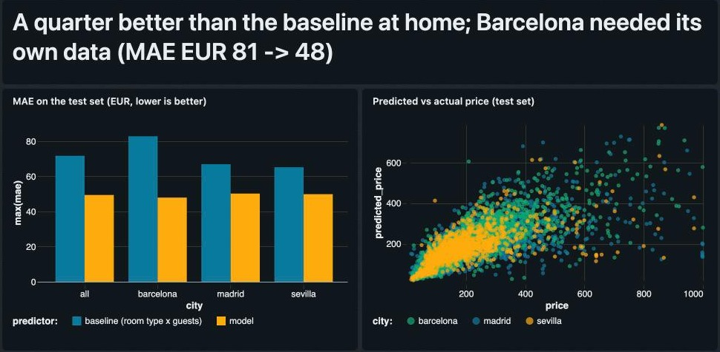
Dashboard and Genie: every page title is a finding; Genie knows what “City A” means
Three pages: City overview, Madrid vs Sevilla, Model (Barcelona added after the C run).
Genie tricks: letters → city names, the sign of error spelled out, test-split filter by default, minimum group size, Unity Catalog column comments, the brief's three questions as example SQL.
All three example questions answered correctly (174 EUR; Alfalfa 938; El Viso −105).
Notes:
Let me show it live.
Dashboard. Every page title states a finding, not a topic.
1. Open City overview: Madrid has almost three times more listings, but the typical night costs about the same.
2. Open Madrid vs Sevilla: the same price level, but a different market. Madrid has more private rooms and
mid-term rentals; Sevilla is mostly entire homes.
3. Open Model: error against the baseline per city, predicted against actual, where the model under-prices, and at
the bottom Barcelona before and after.
Genie. Ask the three questions from the brief:
- "What is the median price of entire homes in City A?" Answer: 174 euros.
- "Which neighbourhoods in City B have the most listings?" Answer: Alfalfa, Santa Cruz, Arenal.
- "Where does the model under-price listings the most?" Answer: El Viso, Castellana and Jerónimos in Madrid.
What made Genie answer correctly:
- The instructions map "City A" and "City B" to the real city names.
- They spell out that a negative error means under-pricing.
- They make accuracy questions use only the test set, by default.
- "Where" questions only rank neighbourhoods with enough listings.
- Every key column has a comment in Unity Catalog.
- The three questions are stored as example SQL.

Slide 12
Challenges, and who did what
Free Edition limits: no bundles in the UI, restricted internet. Fix: the job is created by a notebook; the Volume fallback for raw files.
19-digit listing ids broke the fallback cast on older Spark clients; caught in review before the first Databricks run.
Two 2026 columns leaked the price; found only by checking ratios, not correlations.
Team member | Contribution
(name) | EDA and leakage review
(name) | Pipeline and Databricks job
(name) | Model and evaluation
(name) | Dashboard and Genie
(name) | City C run and report
Notes:
Three things were harder than expected.
Free Edition. You cannot create bundles from the UI, and internet access is restricted. So a notebook creates the
job, and the raw files have a fallback through the volume.
A bug we caught before Databricks did. Airbnb listing ids have 19 digits. Our fallback type conversion for older
Spark clients turned more than half of them into nulls. That would have silently broken the train/test split. A code
review caught it, and now the pipeline fails loudly if any id is missing.
The leaks. They were found only because we checked ratios, not correlations.
(Each member says in one sentence what they did.)

Slide 13
The pipeline is a product. The model is per city.
One config line took Barcelona from raw file to predictions without a failure. A new client still needs its own training data, and now the pipeline says when it does not have it.
Notes:
To answer the question from the start:
The pipeline is a product. One config line took Barcelona from a raw file to predictions without a single failure.
The model is per city. A new client needs its own training data. Now the pipeline tells us when it doesn't have it.
Next, we would:
- keep the metrics history for every model version;
- add a fallback model without neighbourhood for a city that has no prices yet.
Thank you. We are happy to take questions.

