Slide 1
PHP project
Barna Levente
Tahu Szilárd
Tóth Iván

Slide 2

Plan
Create a monopoly game
Help each other
Finish the assignment in time

Slide 3
Work-first weeks
Easy start
Distribution of tasks
Focus on frontend
Detailed coat of arms

Slide 4
Work-Final weeks
Difficulties arose
Increased focus on backend
Work on weekends

Slide 5

Communication
GitHub
Discord
Differnet sleeping habits

Slide 6
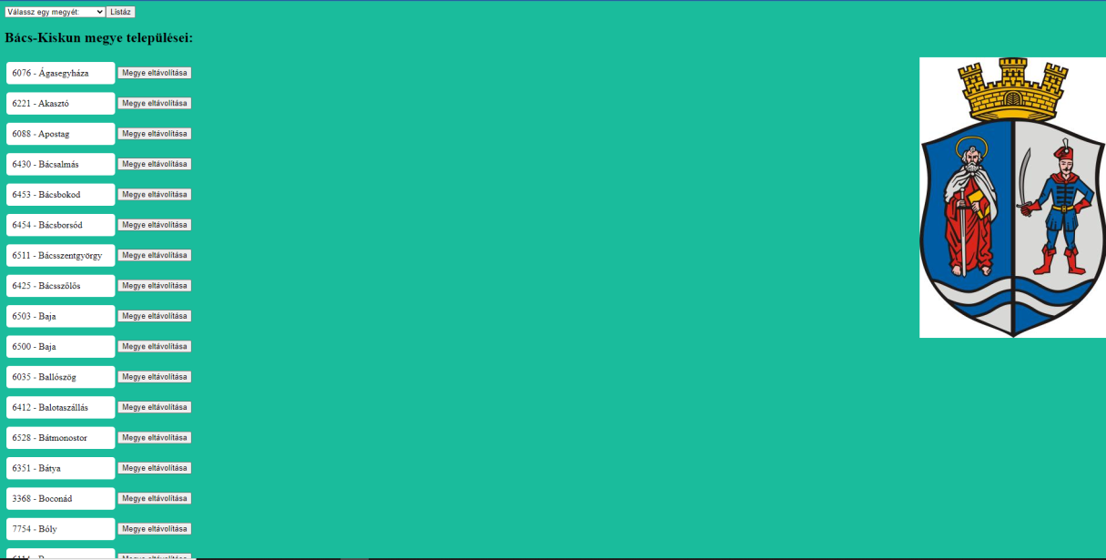
First Version

Slide 7
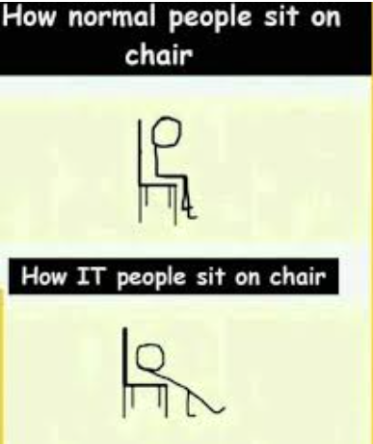
Challanges
Modification
Database
Search by postal code
ABC buttons

Slide 8
Conclusion
Finished in time
Managed to do the assignment
Helped each other
Overcame the problems/difficulties
Worked as a team
Why do PHP developers wear glasses?
Because they can’t C#.

Slide 9
Thank you for your attention!

