Slide 1




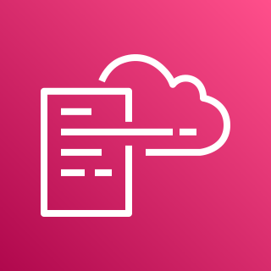





AWS Cloud
Organization Management Account
1.0
Log Archive Account
OU: Security
2.0
Home-region
1.3
Lambda Role
Home-region
1.7
2.1
1.4
1.6
1.1
DLQ
Alarm Topic
AWS CloudFormation
region-1
CloudWatch Log Group
region-2
region-1
2.2
region-n
AWS CloudFormation
region-2
region-n
2.3
1.5
1.2
1.8
Delivery S3 Bucket
Guard Duty
Configuration Topic
Lambda Function
Guard Duty
All Existing and Future
Organization Member Accounts
4.0
Audit Account
OU: Security
3.0
Home-region
region-1
region-1
region-2
4.2
3.3
region-2
region-n
3.1
3.2
region-n
Configuration Role
4.1
Delete Detector Role
AWS CloudFormation
Delivery KMS Key
3.4
Guard Duty
Guard Duty

