Slide 1

PET project
Railway ticket office
Project author:
Ivan Volchenko, email: volchanter98@mail.ru

Slide 2

PROJECT TASK
Creation of a web application with
3 main roles for a Spanish transport company
2

Slide 3
ROLE FEATURES
GUEST
Can search for routes between stations that interest him.
As well as he is able to check route information.
CUSTOMER (USER)
He’s the registered user who has profile with his personal information.
Customer can buy a ticket for the selected route.
ADMINISTRATOR
Can:
add,
delete,
edit
the list of stations and railway routes between them.
3

Slide 4
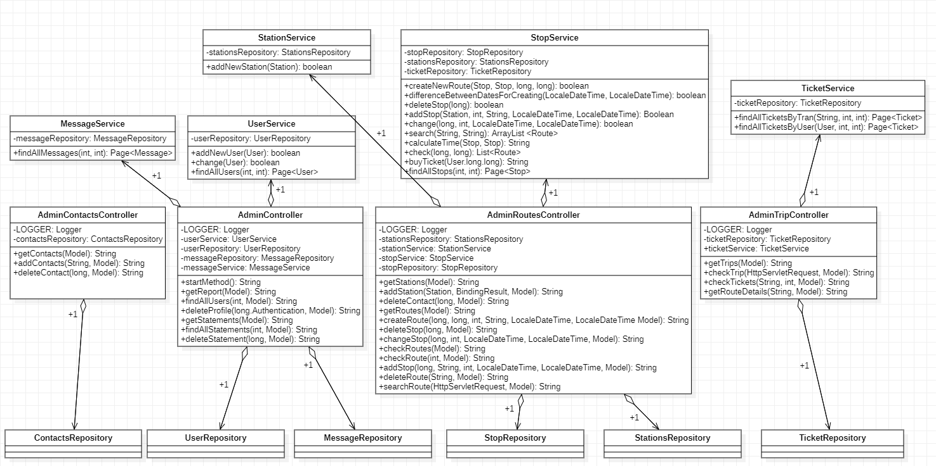
PROJECT ARCHITECTURE
4

Slide 5
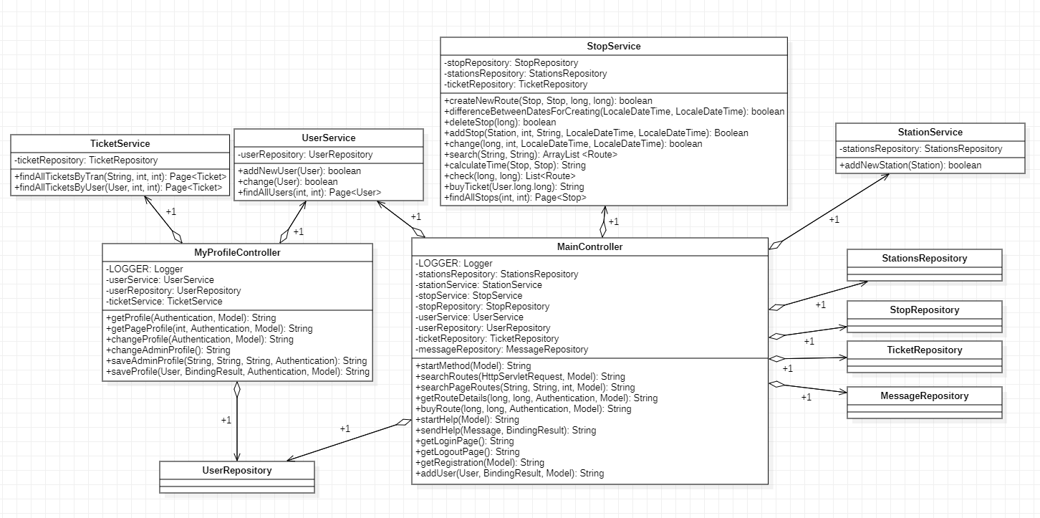
PROJECT ARCHITECTURE
5

Slide 6

USED TECHNOLOGIES
Thymeleaf and Thymeleaf Security
Bootstrap
Data jpa
Hybernate (validator)
Logback
Spring Boot
Spring Security
MySQL
Spring Resource Bundle
Unit and Integration tests
Git
6

Slide 7
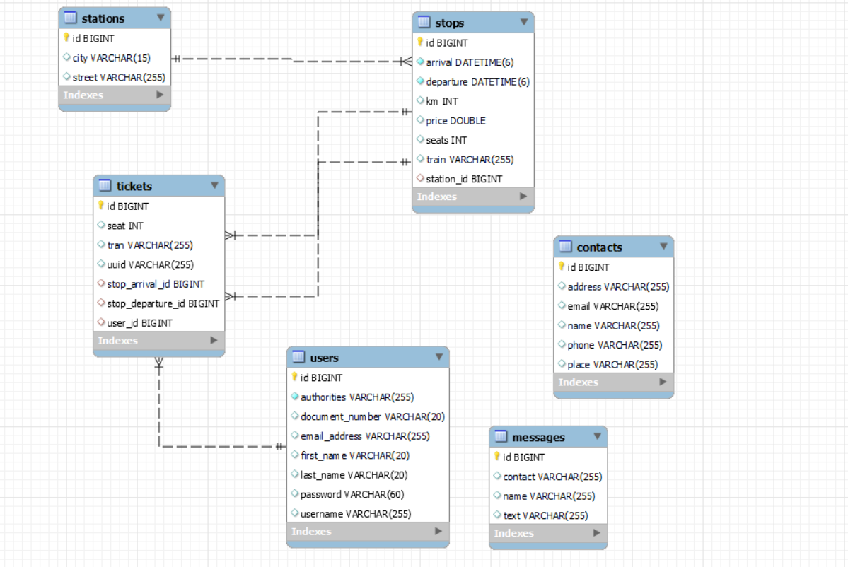
MySQL
7

Slide 8
Thank you!

