Slide 1


FDM Employee Portal
Requirements Elicitation

Slide 2
Introduction
Requirements Elicitation overview:
Discuss key requirements for FDM employee portal
Our presentation covers the use-case diagram, functional and non-functional requirements
Address risk assessment and mitigation strategies

Slide 3
Key Functional RQ
1. Secure Login and User Authentication
  Employees must securely log in using unique usernames and passwords or email and password combinations.
2. Announcements
  The Employee Portal shall feature an announcement section for management to broadcast monthly updates, news, and announcements.
3. Real-time Notifications
  The system shall provide real-time notifications to employees for any internal updates, policy changes, or HR processes.
4. Update Personal Information
  All employees must be able to update their personal information without HR intervention.
5. Employee Self-Service Tasks
  Employees should have the capability to perform self-service tasks such as booking annual leave, updating personal information, and enrolling in training programs.
6. Internal Communication Tools
  The portal shall facilitate direct messaging for employees to communicate with each other, HR, or management.
  Video conferencing functionality for virtual meetings and discussions.

Slide 4
7. Task Management for Consultants
  Consultants should be able to submit timesheets for the projects they are working on.
  Ability for consultants to manage and report any work-related expenses through the portal.
8. Recruitment and HR Management
  Internal staff, particularly HR, should be able to add new employees to the system for access to necessary resources and tools for their role.
  Manage recruitment process through the portal, including posting job openings, reviewing applications, and scheduling interviews.
9. Training and Skill Development
  Trainers should be able to assign training to employees and track compliance through the portal.
  Provide e-learning resources for employees to improve their skills through the portal.
  Gather and analyze feedback on training sessions for continuous improvement through the portal.
10. Project Selection and Feedback
  Employees should have the capability to select preferred projects or assignments within their region or globally.
  A project feedback module where employees can rate and provide reviews for projects they've completed.
11. Security and Access Control
  Access to sensitive reports, such as financial or HR-related data, shall be restricted to authorized users listed on a management access control list.
12. Helpdesk and Support System
  The portal shall feature a help desk or support system for quick resolution of common issues or questions.

Slide 5
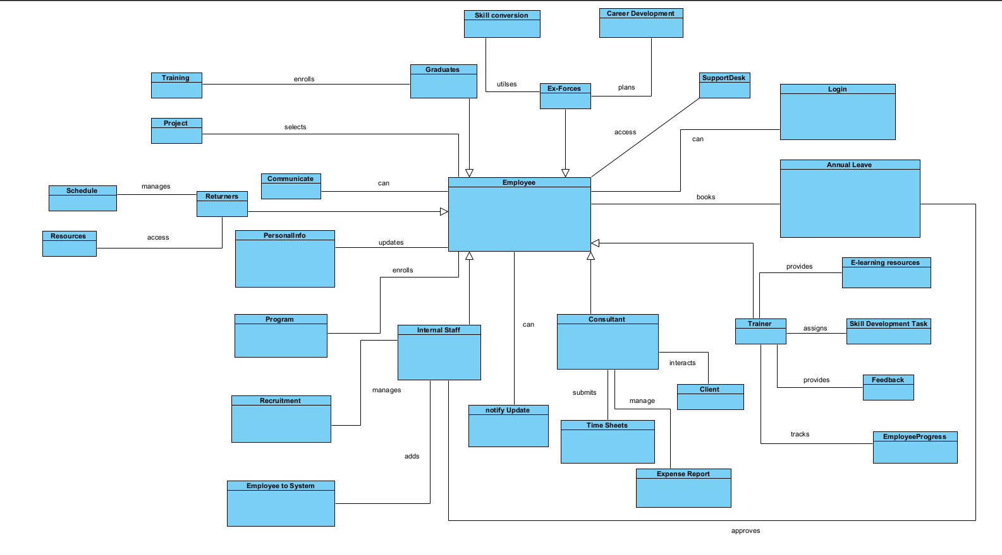
Domain Model

Slide 6
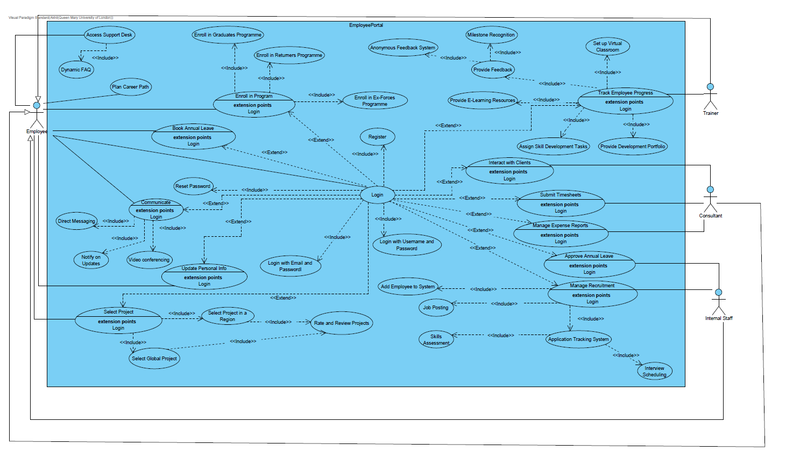
Use-Case Diagram

Slide 7
Were the actors in the diagram the same as the identified actors in the domain document? If not, did the group explain the reasons for change?
Mostly same, but removed the need of returners, Ex-forces and graduates in use case diagram
Domain model unchanged
Graduates, Returners, Ex-forces all fall under consultants for FDM(learnt from previous presentation)
Use case diagram is useful in showing the functional RQ of a system visually and breaking down use cases such as login also adds to granulation and decomposition to understand system better and understand multiple ways to login and like show actors and what tasks they can perform.

Slide 8
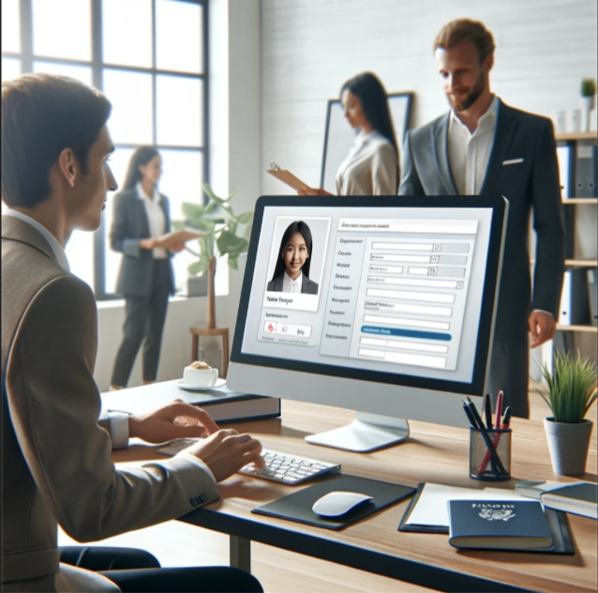
Key Use Case 1- Add Employee To System
Actor – Internal staff
Basic Flow:
Internal staff logs into the system.
Internal staff enters employee details.
System adds new employee to the system.
Alternate Flows:
System fails to add new user to the system.
An employee with matching details is already on the system.

Slide 9

Key Use Case 2- Assign Skill Development Tasks
Actor – Trainer
Basic Flow:
Trainer logs into the system.
Trainer selects development tasks.
System alerts the relevant users that a new task has been set.
System sends a confirmation message to the trainer.
Alternate Flows:
System fails to allocate the tasks into the employees’ task lists.
Employees are not notified that they have new tasks.

Slide 10

Non-Functional RQ
Capacity:
The EP will be able to support 5000+ sessions.
We see this as a core priority requirement, as it is stated that FDM has around 5000+ employees.
Performance:
The EP can allow users to login within 5 seconds.
Core priority, because to access full features of EP employee must login.
Availability:
The EP shall be available 24/7 every day of the year
Allows employees from around the world in different time zones to be working when required. Keeps FDM running smoothly.

Slide 11

Non-Functional RQ
Reliability:
The EP must have a mean time to repair that does not exceed 2 hours
Means that if the software does go down it won't be so long that it affects the performance of FDM
Process:
The software should be completed within the given 6 weeks
The cost should be free, we are using software such as AWS which provide a 12-month free trial
Compatibility:
The EP should be able to work on different OS and browsers
Meaning it should work on Linux, Windows, google etc..

Slide 12
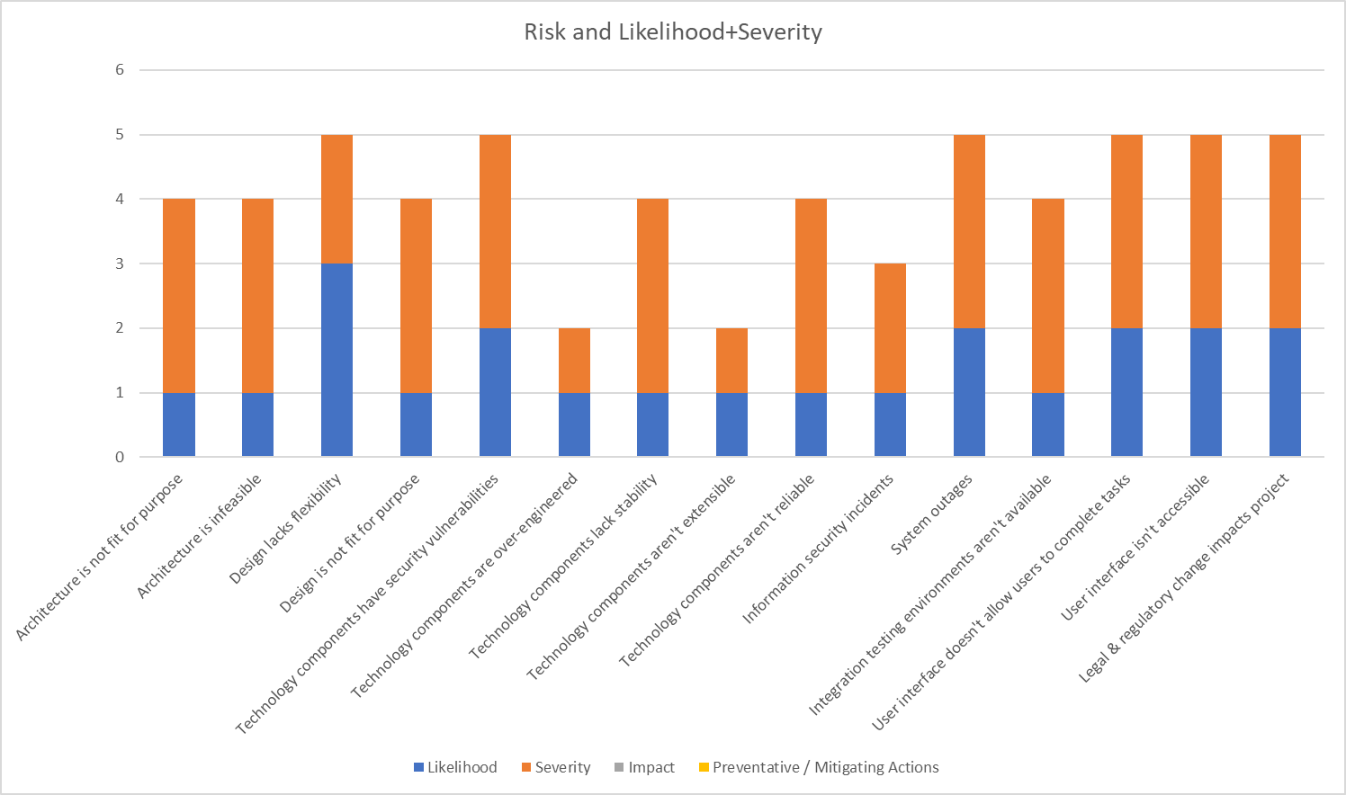
Risk Assessment

Slide 13
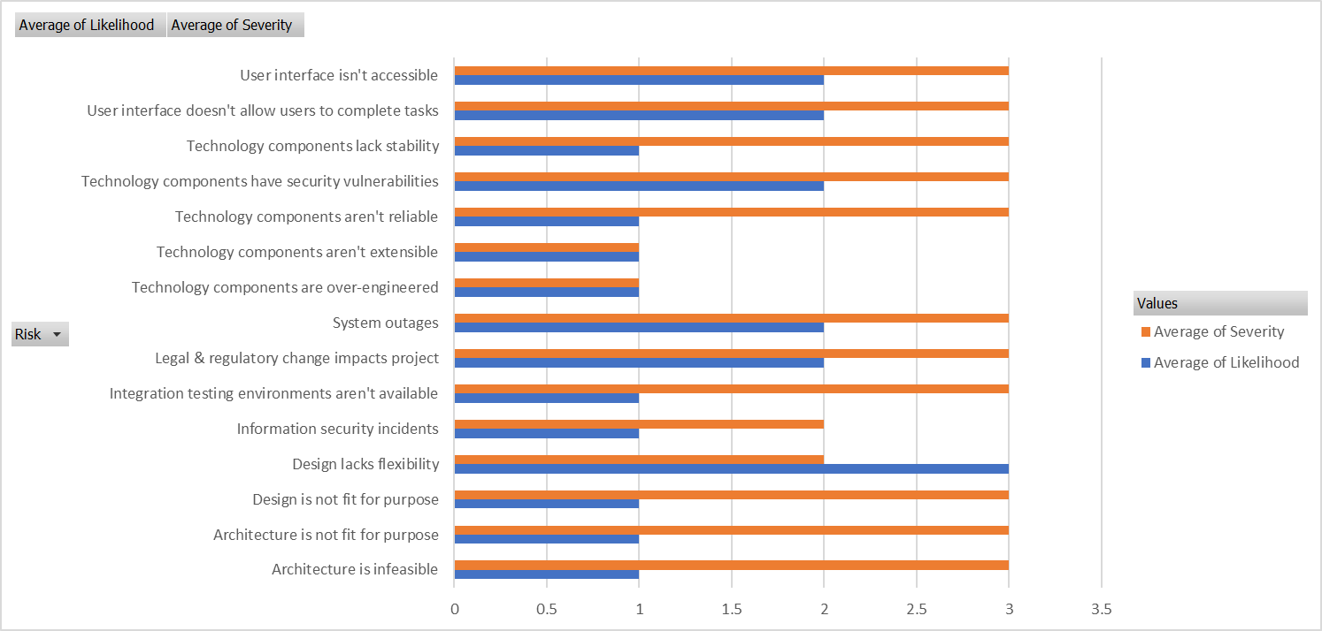

Slide 14
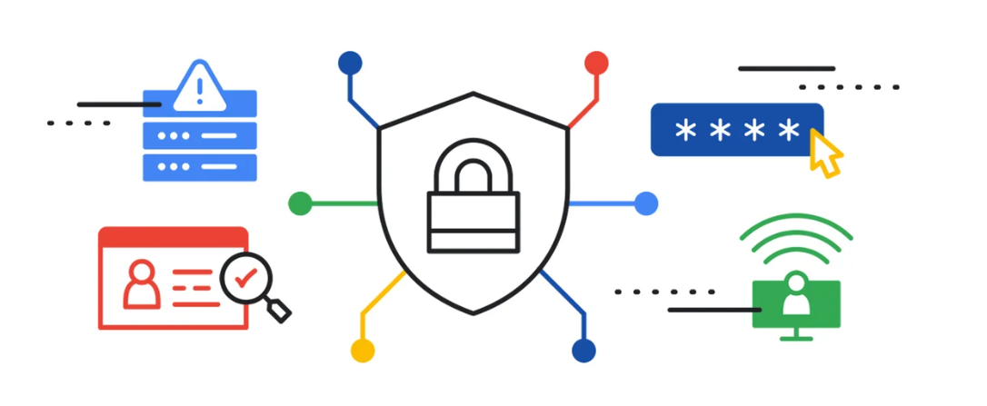
Security
Information security incidents
Likelihood – low
Severity – High
Impact – Personal data leaked
Prevention – Only trusted developers have access to the application, implement HTTPS

Slide 15
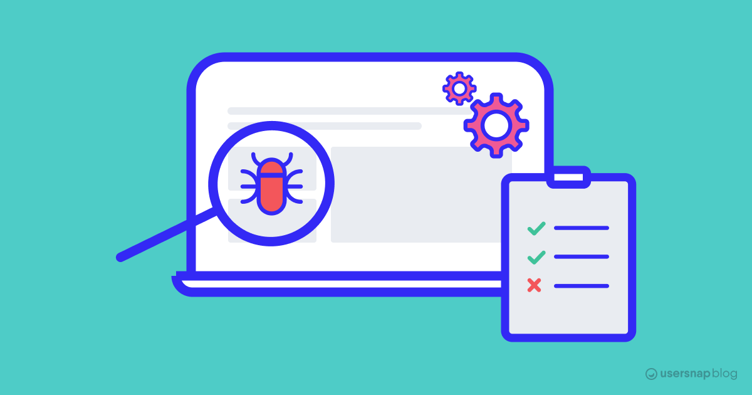
Testing
Likelihood – low integration testing environments aren't available
Likelihood – Low
Severity – High
Impact – hard to debug and change
Prevention – Use a TDD (Test Driven Development) practice

Slide 16

Technology Components
Technology components are over-engineered
Likelihood – Low
Severity – Low
Impact – Too many unnecessary details added
Prevention – Receive feedback throughout group meetings to ensure everyone is on task

Slide 17
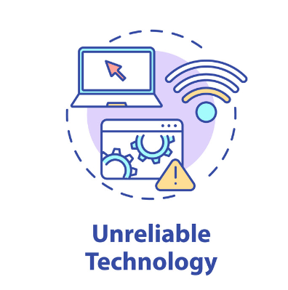
Technology Components
Technology components aren’t reliable
Likelihood – Low
Severity – High
Impact – Unusable / Unstable product
Prevention – Research and test the components

Slide 18


Health & Safety
Members are unable to work due to eye fatigue or RSI
Likelihood – Medium
Severity – Medium
Impact – The whole group falls behind schedule
Prevention – Take frequent breaks and do hand stretches
Health / Personal issues
Likelihood – High
Severity – Medium
Impact – Unfinished or low-quality product
Prevention – Have frequent meetings to check up on member's progress.

