Slide 1
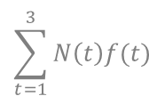
Jury's census with homogeneous population distributed in a uniform way in the territory
Survey scheme
Progressive count population (closed, with b=0.3 and d=0.1)
25%
50%
25%
144
9
9
Questions:
Avg, Middle point and Census count
Influence of survey scheme
In which point of time we must put the estimation?
120
18
7.5
7.5
7
7
100
15
14
25
23
20
25
22.5
20
50
45
41
+30
+36
50
80
116
$$\sum_{t=1}^{3}{N\left(t\right)f(t)}$$

