Slide 1
1.2
Grand-
parents
1.3
1.6
1.5
Older
uncles
Parents
Younger
uncles
3.1
0.2
1
0.5
2.8
Cousins
Older siblings
Ego
Younger siblings
Cousins
0.1
0.3
0.1
Nephews
Children
Nephews

Slide 2
0.8
Grand-
parents
0.8
1.4
1.2
Older
uncles
Parents
Younger
uncles
2.8
0.1
1
0.5
2.3
Cousins
Older siblings
Ego
Younger siblings
Cousins
0.1
0.3
0.1
Nephews
Children
Nephews

Slide 3
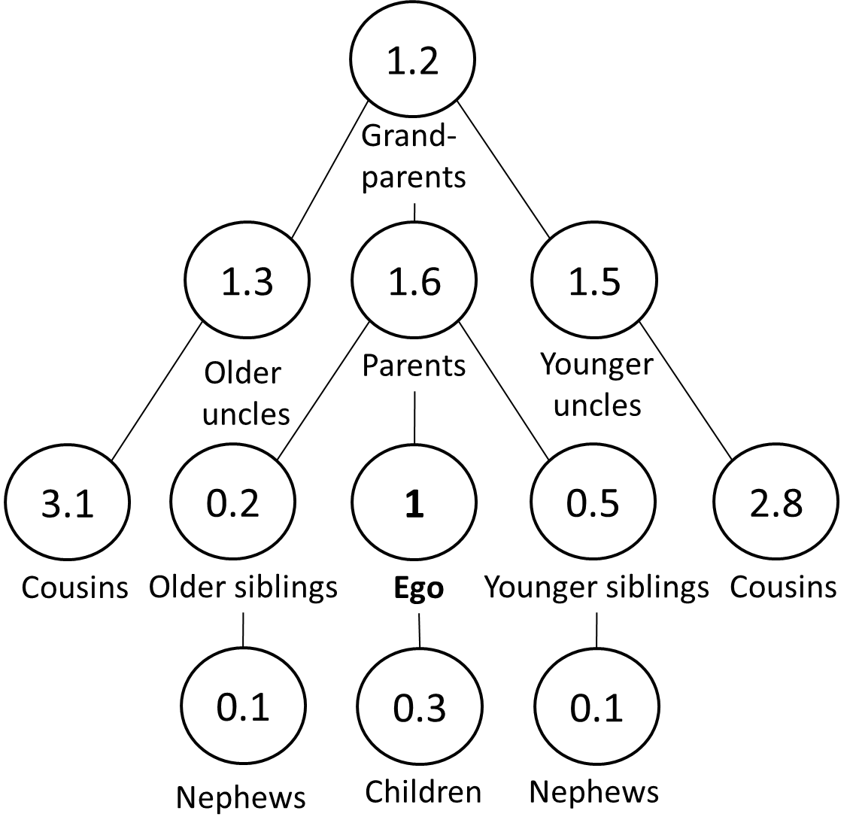
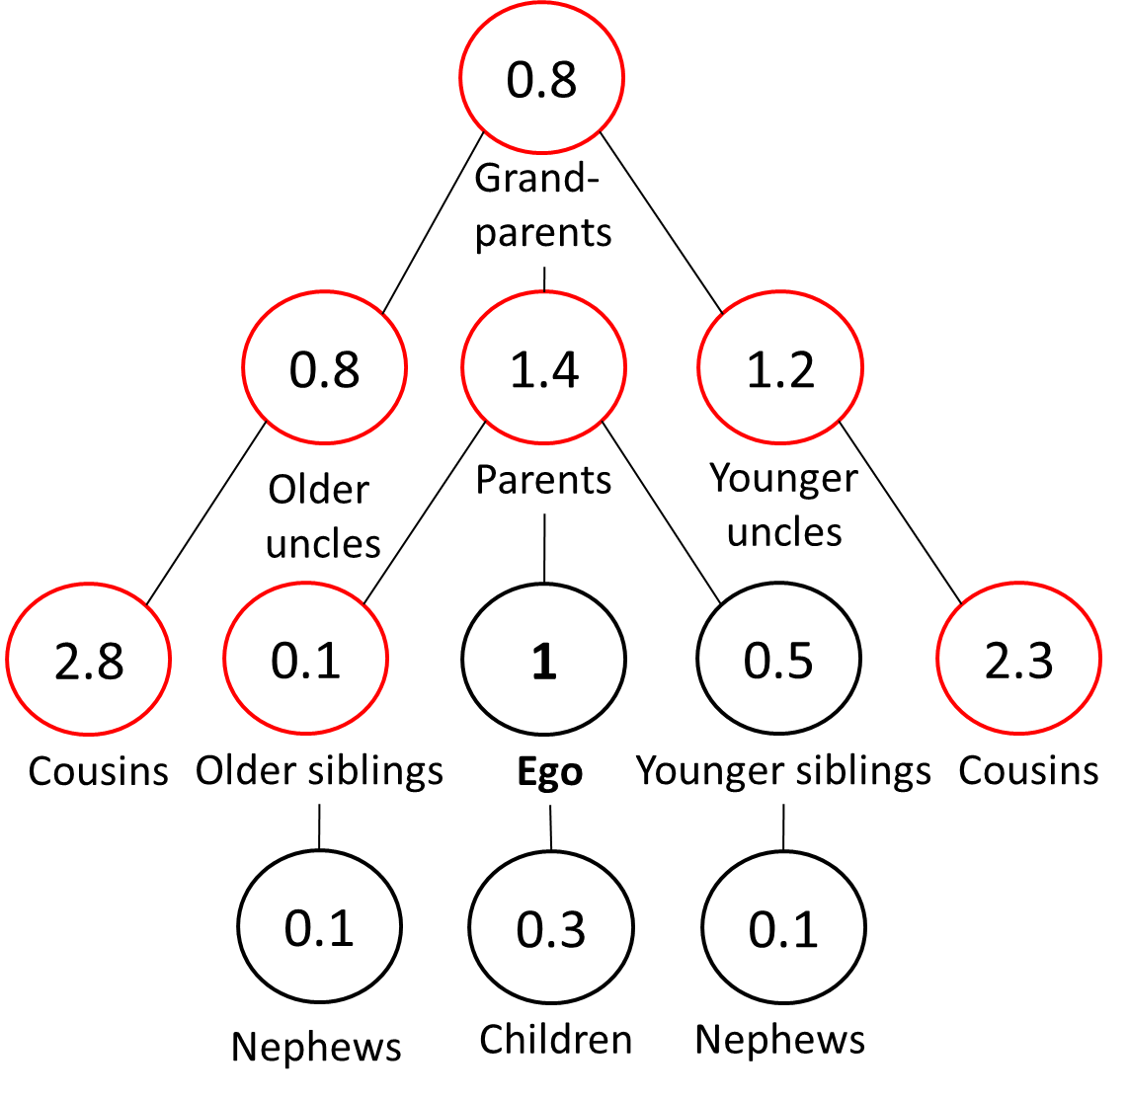
Covid-19 excess mortality
Counterfactual (non-Covid-19)
With Covid-19 excess mortality

