Slide 1

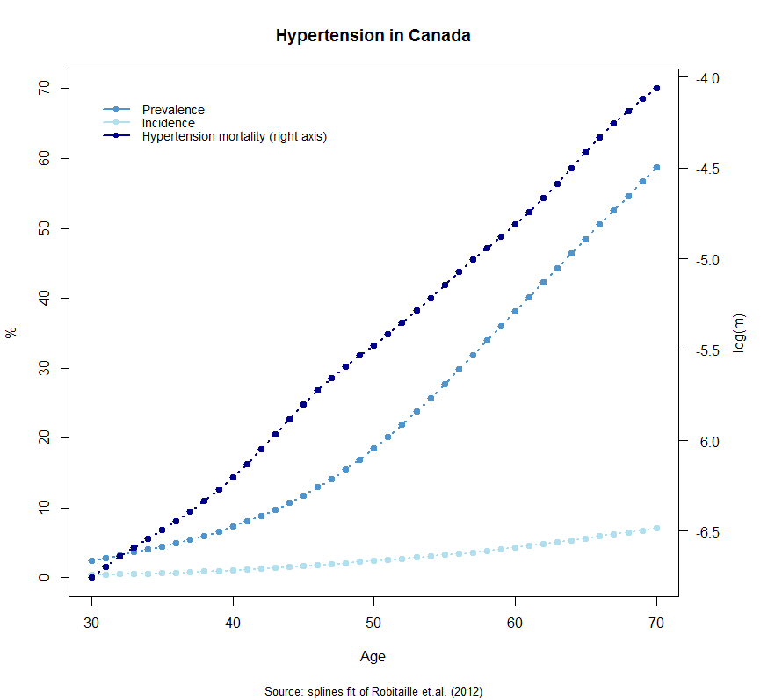
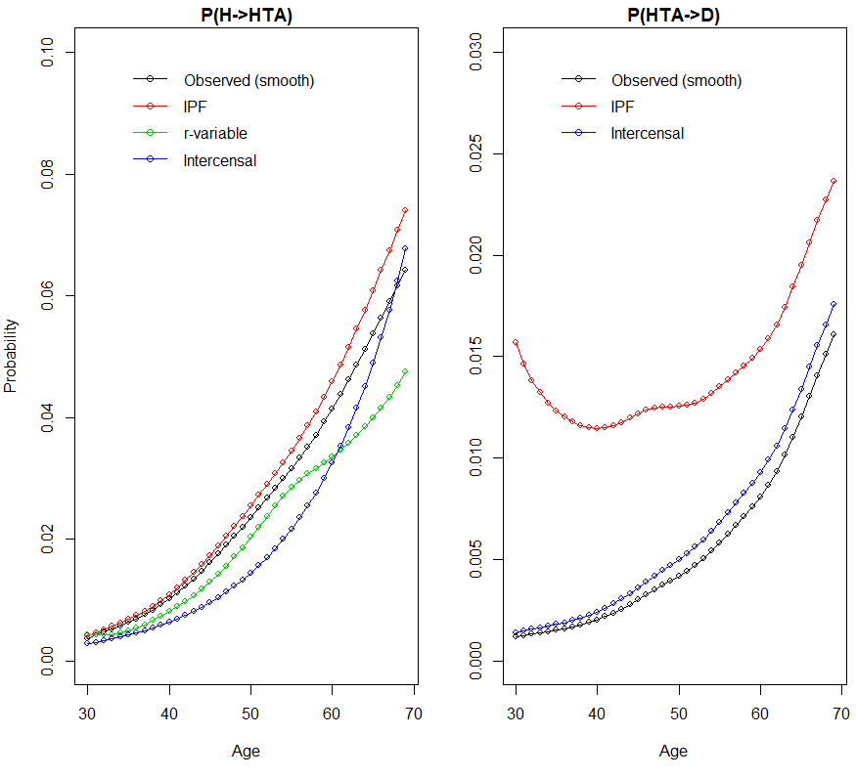
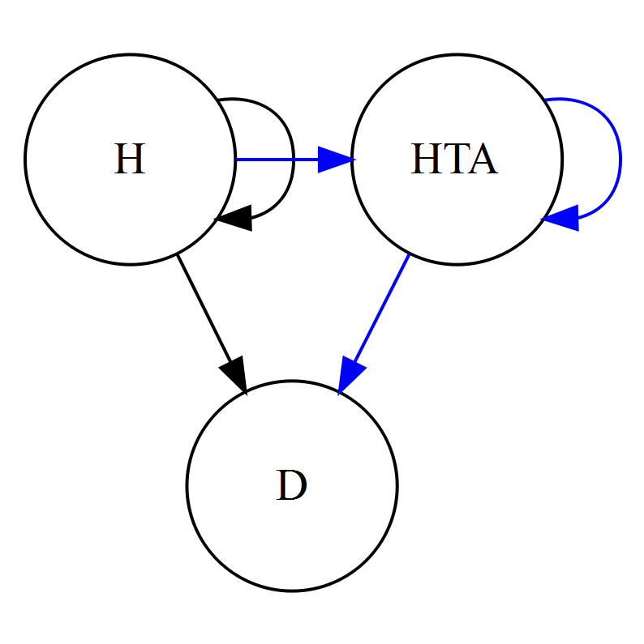
Indirect Estimation of Transitions in Hypertension A first approach of demographic techniques in chronical diseases
Iván Williams
PhD student in Population Health Laboratory
Introduction and Objective
Results
Chronical diseases
65% of global deaths in 2010
Recently declining age specific rates but overcompensated by aging
Cardiovascular diseases represents 30% of these deaths
Hypertension (HTA) is the major cardiovascular risk factor with highest prevalence: 30–45% among adults and up to 70% in elderly population (Andrade, 2015).
For prevention purposes follow tendencies is relevant in transition rates, that can not be catched by prevalence meassures which contains a mix of cohort experiences.
There is a lack of longitudinal or panel information (gold standard) in many countries (Health Ministery of Argentina, 2013).
Objective and question
Test different methods to indirectly estitmate transitions in HTA.
In this context: What means a “suitable“ method?
Data
Canada: follow-up study with administrative data (Robitaille, 2012)
Age 30-70 selected: incidence prevention and monotonic increase in rates.
Methodology
This study
General Framework
Focus on 2 progressive living states, common in diseases like diabetes or hypertension.
Multi-state model (closed population and Markov assumption)
Identification problem: 3 variable and 2 equations
Use only prevalence data in 2 points of time. Try to avoid assumptions about:
Homogeneus mortality
Stationary behaviour
More information please!
Relationship between magnitudes of probabilities in each age
Relationship between ages for the same transition
First Results
Mean Absolute Percentage Error (MAPE) of models
Model In blue the objective transitions
H: healthy HTA: hypertension D: death
Methods applied
IPF: find successive row and column factors that replicate marginals (solution to a log-linear models with total constraint and without second order effect) (Schoen & Jonsson, 2003).
r-variable: change in prevalence can be decomposed into a intra-cohort effect, (incidence but not remission), and extra-cohort effects (only death in our case) (Schmertmann, 2002). Incorporate relative risk, as is suggested in the paper, would resolve the algebraical problem, so we apply the method only for incidence estimation.
Intercensal: give a parametric shape (exponential) to transition rates, set bounds and optimize (Guillot & Yu, 2009).
Conclusions
Replicating prevalence could be done in multiple (infinite) ways.
The resulting error is greater in mortality than in incidence (scale issue may be influent).
In parametric assumption there is a trade-off between prevalence fit and general coherency.
Future directions
Parametric assumption preserve previous knowledge about the disease. Better understanding of implicit shapes can be a better practical before any modeling.
More research in mixing non-parametric and constraints can improve flexibility and preserve previous knowledge.
Proccedure
Fit splines to initial prevalence, incidence and relative risk of mortality. Estimate prevalence in t+1
2) Apply each method for 1-year probabilities at each age.
3) Measure the goodness of fit of transitions in HTA.

