Slide 1
HW

Slide 2
Big-Endian/Little-Endian
Assuming that the data 0xabcdef12 is stored at address 100 of a little-endian / big-endian machine respectively, please give out the memory layout on these two machines.
ENDIAN\ADDR | 100 | 101 | 102 | 103
BIG ENDIAN | ab | cd | ef | 12
LITTLE ENDIAN | 12 | ef | cd | ab

Slide 3
2. X86/Y86
Please transform the following X86 instructions to Y86 instructions and their binary codings. Note that one x86 instruction may be translated to multiple Y86 instructions.
X86 Instructions:
(1) incl %ecx
(2) leave
(3) movl (%ebp, %eax, 2), %ecx
(1) Irmovl &1, %eax 30 F0 01 00 00 00
addl %eax, %ecx 60 01
(2) rrmovl %ebp, %esp 20 54
popl %ebp B0 5F
rrmovl %eax, %edx 20 02
addl %edx, %edx 60 22
addl %ebp, %edx 60 52
mrmovl (%edx), %ecx 50 12 00 00 00 00

Slide 4
3. HCL
Please give out the HCL code to describe a circuit that can output the maximum of two 2-bit input data A and B. Note that you can Only use ``&&’’, ``||’’ and ``!’’ in the HCL code.
Int Max2 = [
(A1&&!B1) || (A1&&B1&&A0&&!B0) ||(!A1&&!B1&&A0&&!B0) : A;
1 : B;
]

Slide 5
The new Y86 instruction leave will be a one byte instruction as follows:
C0
And jmp rel8 will be a two bytes instruction as follows, rel8 means the one byte displacement which is relative to next instruction:
70 XX
Fill out the following form to describe what needs to happen during each stage of this new instruction.
 | leave
Fetch | icode:ifun <- M₁[PC] valP <- PC+1
Decode | valA <- R[%ebp] valB <- R[%ebp]
Execute | valE <- valB+4
Memory | valM <- M₄[valA]
WriteBack | R[%esp] <- valE R[%ebp] <- valM
PC Update | PC <- valP
 | Jmp rel8
Fetch | icode:ifun <- M₁[PC] valC <- M1[PC+1] valP <- PC+2
Decode
Execute | valE <- valP + valC
Memory
WriteBack
PC update | PC <- valE

Slide 6
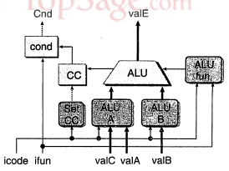
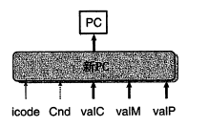
ii. If the Y86 ISA supports the new instruction, then modify the HCL expressions show below to support your new instruction. You can assume that the symbols ILEAVE and IJMPR are defined to represent the icode for this new instruction. Your HCL must reflect the actions you listed in your table (from part i.) to be considered correct! The HCL listed below is not complete (some controls are not shown) – just modify the ones listed below, don't worry about any that are not listed.
If not, please add new hardware which could support our new instruction. But just show the HCL expressions of the new hardware.
valE form Execute stage-> PC
Int new_pc = [
icode == ICALL : valC;
icode == IJXX && Cnd : valC;
icode == IRET : valM;
icode == IJMPR : valE;
1 : valP;
];
valP form Fetch stage -> ALUB
int aluB = [
icode in { IRMMOVL, IMRMOVL, IOPL, ICALL,
IPUSHL, IRET, IPOPL } : valB;
icode in { IRRMOVL, IIRMOVL } : 0;
icode == IJMPR: valP;
# Other instructions don't need ALU
];

Slide 7
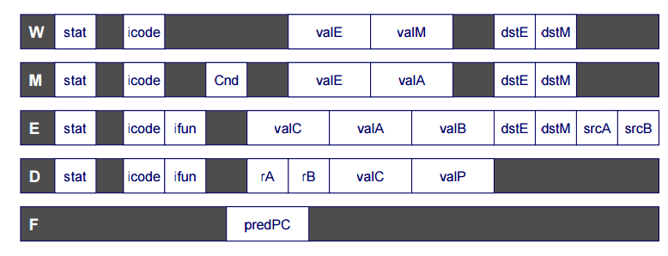
What’s the execution result of the instruction popl %esp ?
mrmovl 0(%esp), %esp
Show it in Y86 architecture pipeline.

Slide 8
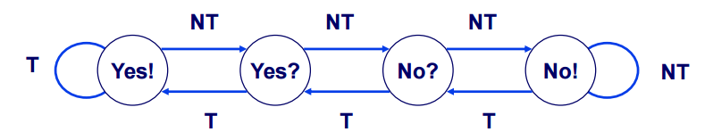
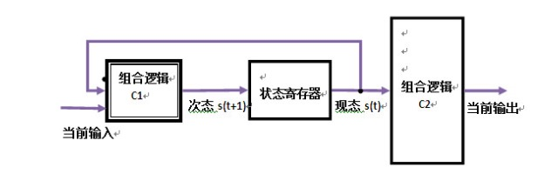
Describe Branch Prediction Algorithm (page 27 of class6-wrapup.pdf page) using HCL language.
Each time branch taken, transition to right. When not taken, transition to left.
Each time branch taken, transition to right. When not taken, transition to left.
有限状态自动机五元模型 M=(Q, Σ, δ, q0, F)
· 其中，
– Q——状态的非空有穷集合。∀q∈Q，q称为M的一个状态。
– Σ——输入字母表。
– δ——状态转移函数，有时又叫作状态转换函数或者移动函数，δ：Q×Σ→Q，δ(q,a)=p。
– q0——M的开始状态，也可叫作初始状态或启动状态。q0∈Q。
– F——M的终止状态集合。F被Q包含。任给q∈F，q称为M的终止状态。

Slide 9
Lab4

Slide 10
Part A

Slide 11
Part B

Slide 12
Part C
Code unrolls
Jump table
forwarding

