Slide 1

Bike rent business analysis
by Ivan Yanishevskyi

Slide 2

Introduction
In this presentation, we will examine the analysis of the bicycle rental business, exploring the following key questions:
How temperature affects on sales?
Rental differences between weekdays and weekends.
Quantitative sales depending on the season.
And also, we will explore sales predication model.

Slide 3

Dataset
Dataset I took contains information on the sales of a product or service, taking into account the date, day of the week, whether the day is a weekend or a weekday, a holiday or a regular day, and the air temperature on that day (it has more factors but I used these).

Slide 4
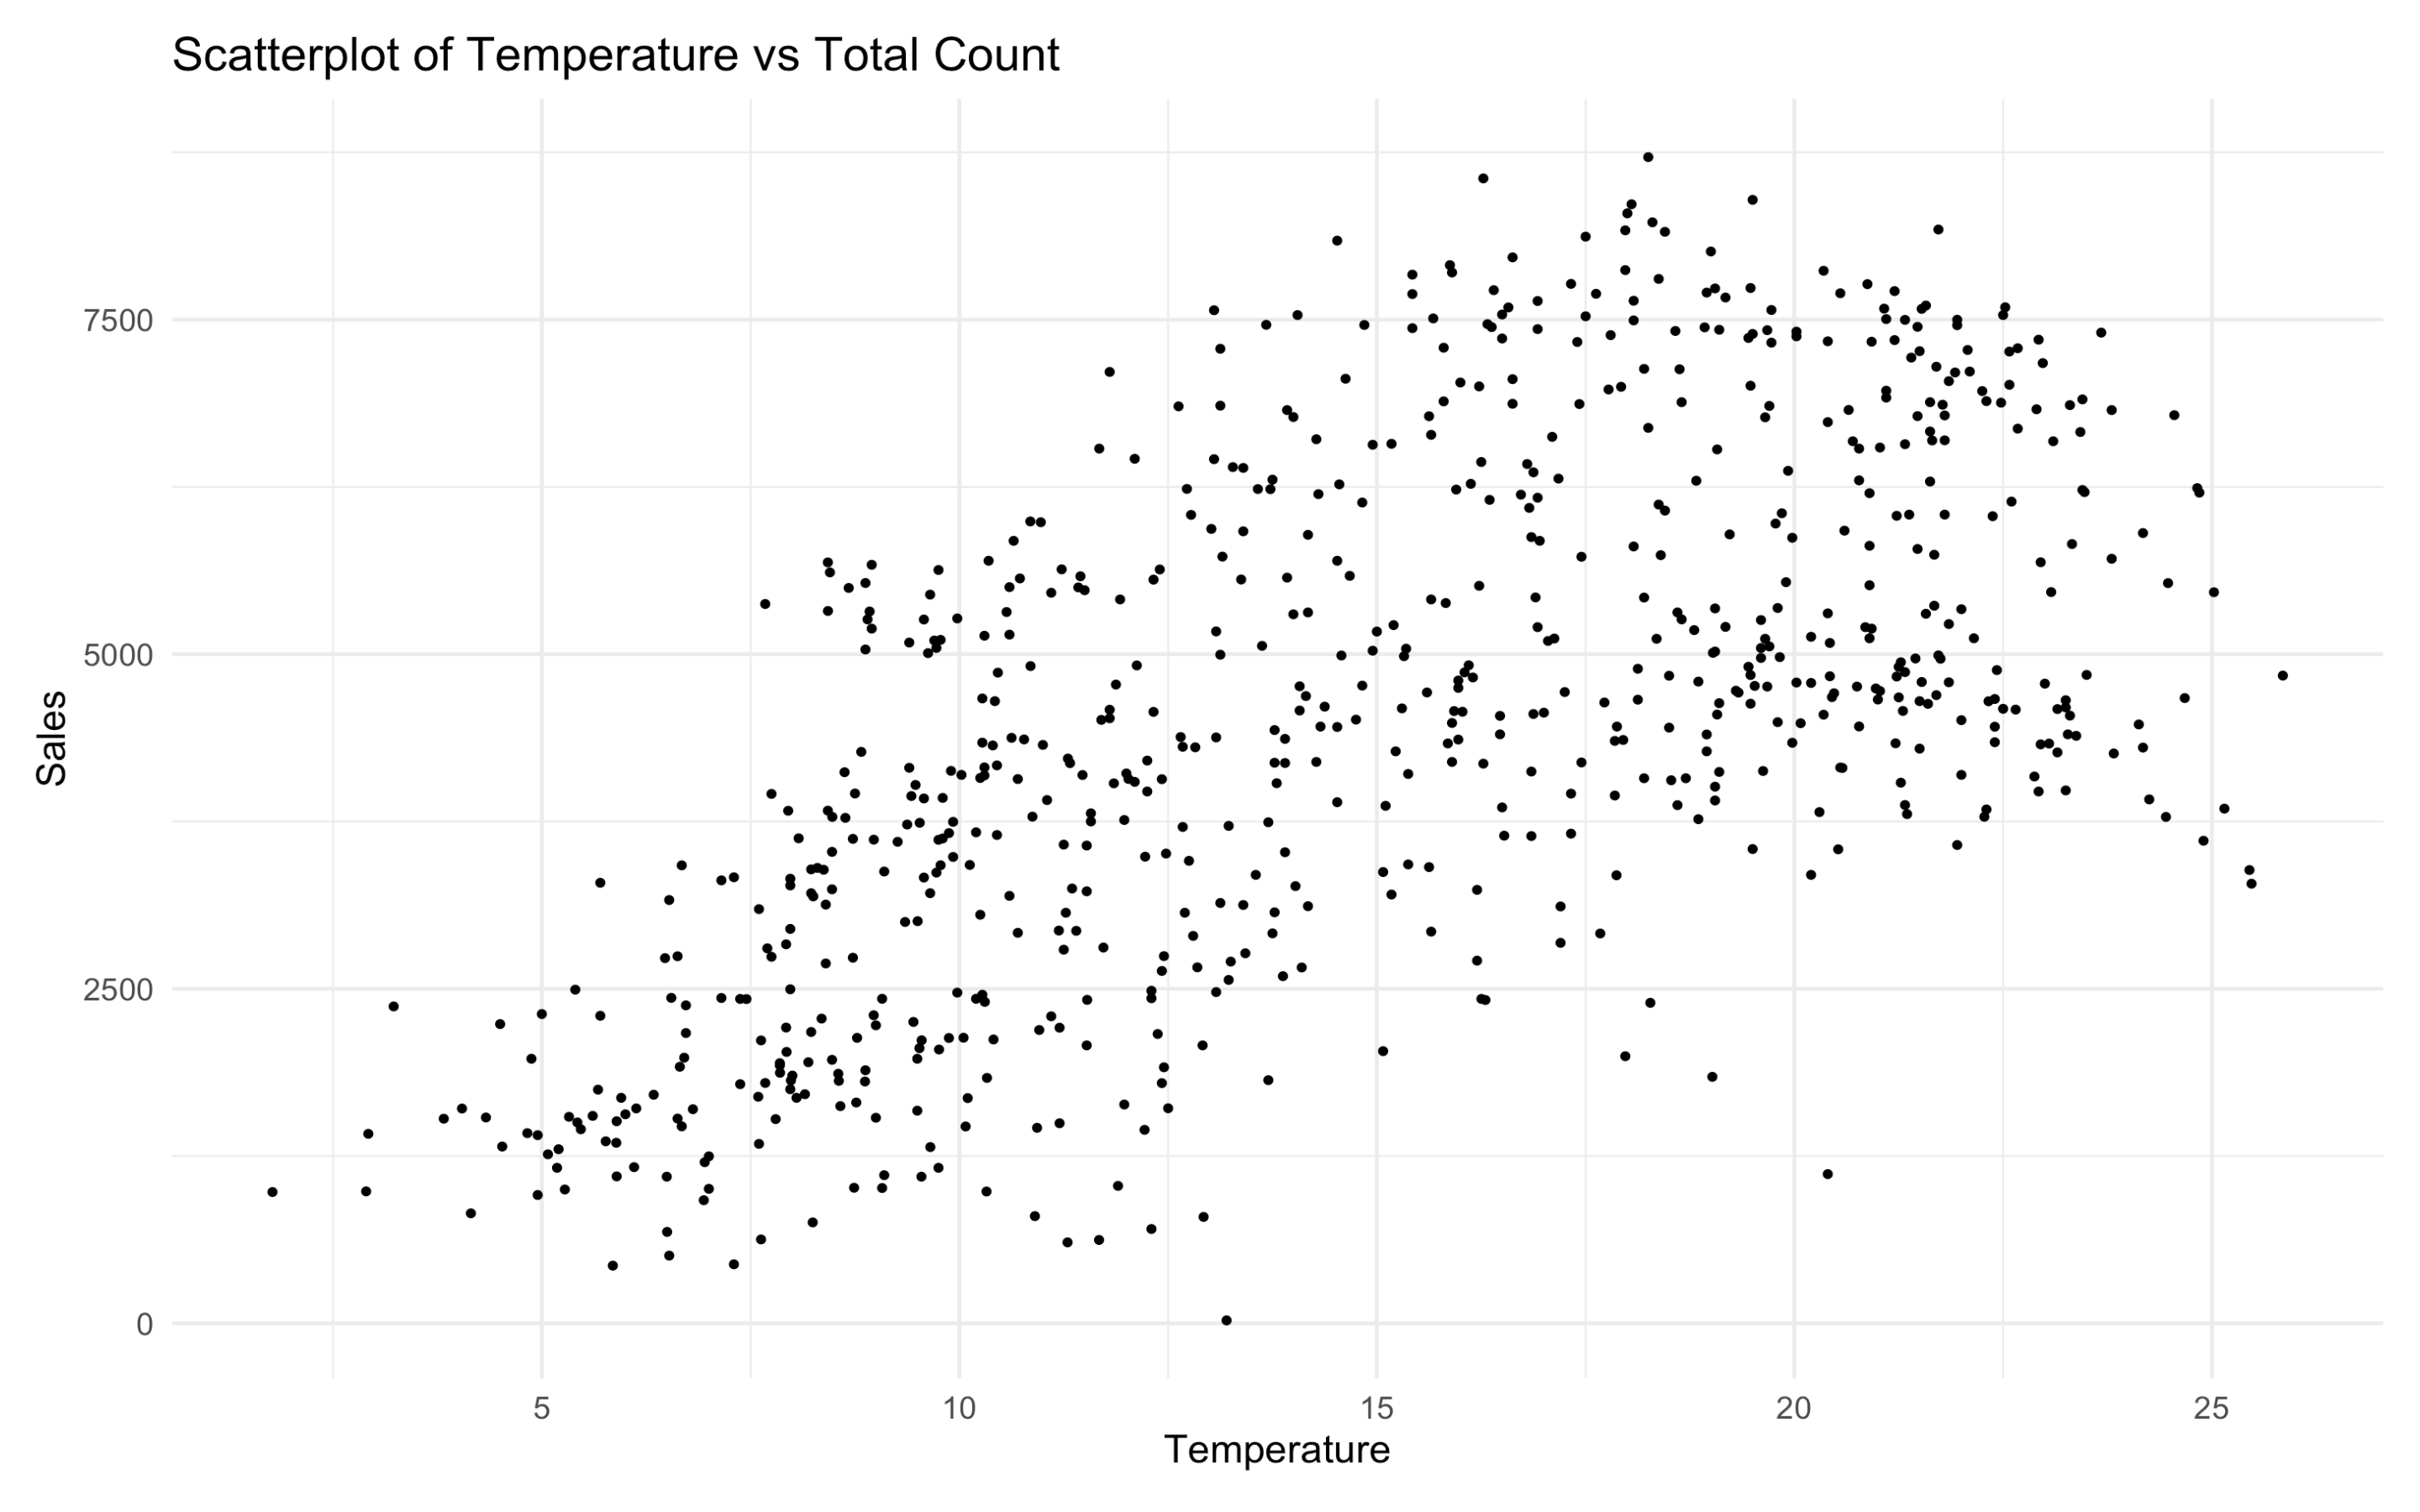

Slide 5

Analysis of Sales Dependency on Temperature:
There is a direct correlation between air temperature and the number of rented bicycles. As the temperature increases, the number of bicycle rentals also increases.

Slide 6
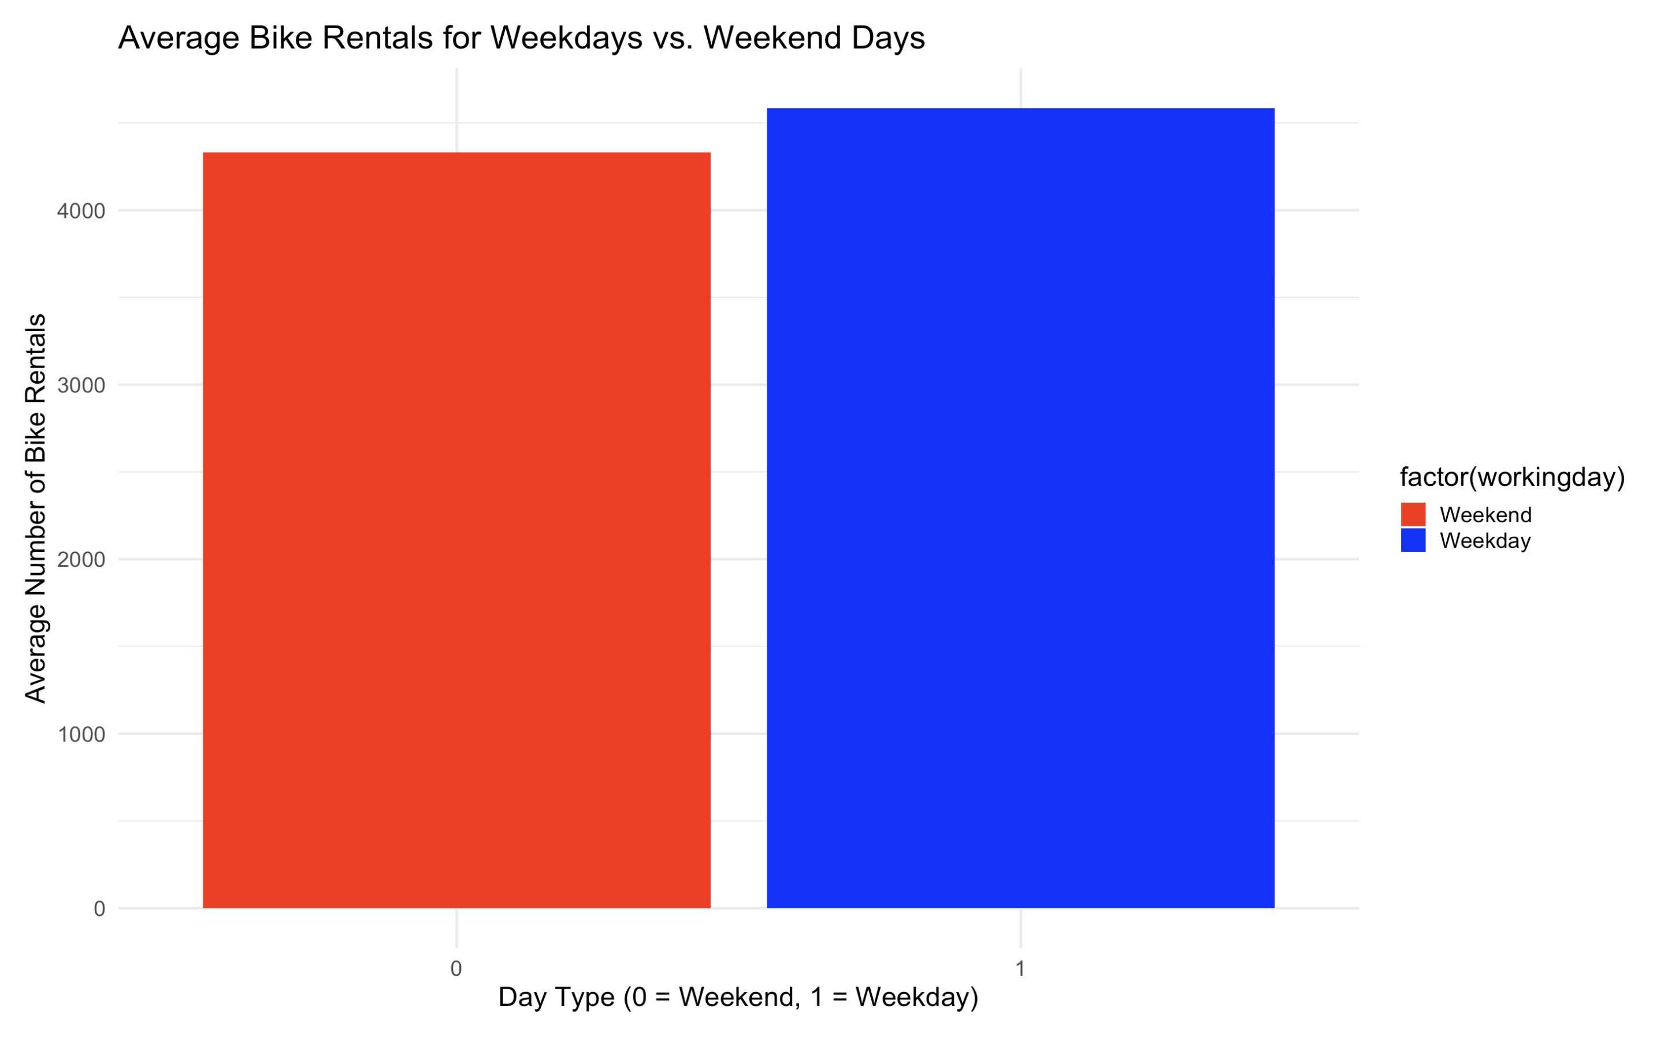

Slide 7

Analysis of Bicycle Rentals on Weekdays and Weekends
It turns out that weekday bicycle rentals are higher than weekend rentals. This is to the use of bicycles for commuting to work or school.

Slide 8
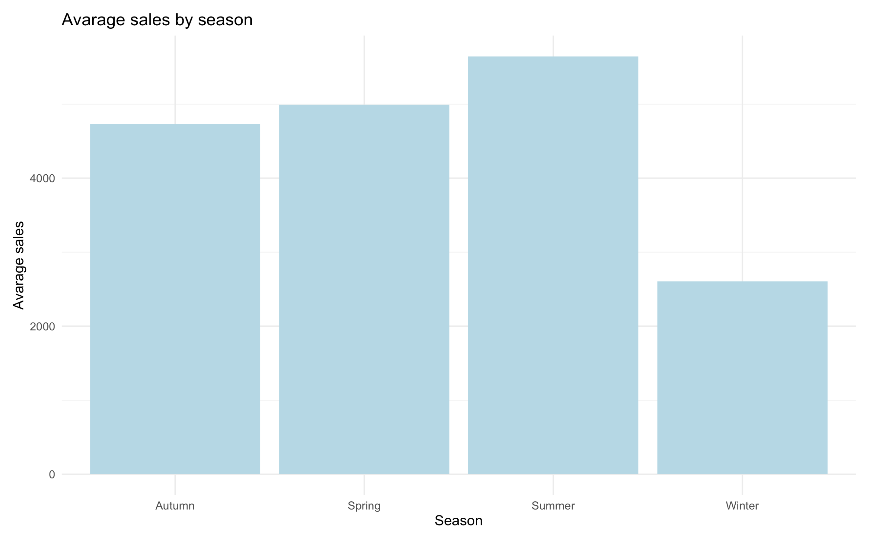

Slide 9

Sales Quantity Depending on the Season:
Exploring this, I see that much more sales are made in summer, because of temperature and data we received is equal with an analysis of temperature to sales.

Slide 10
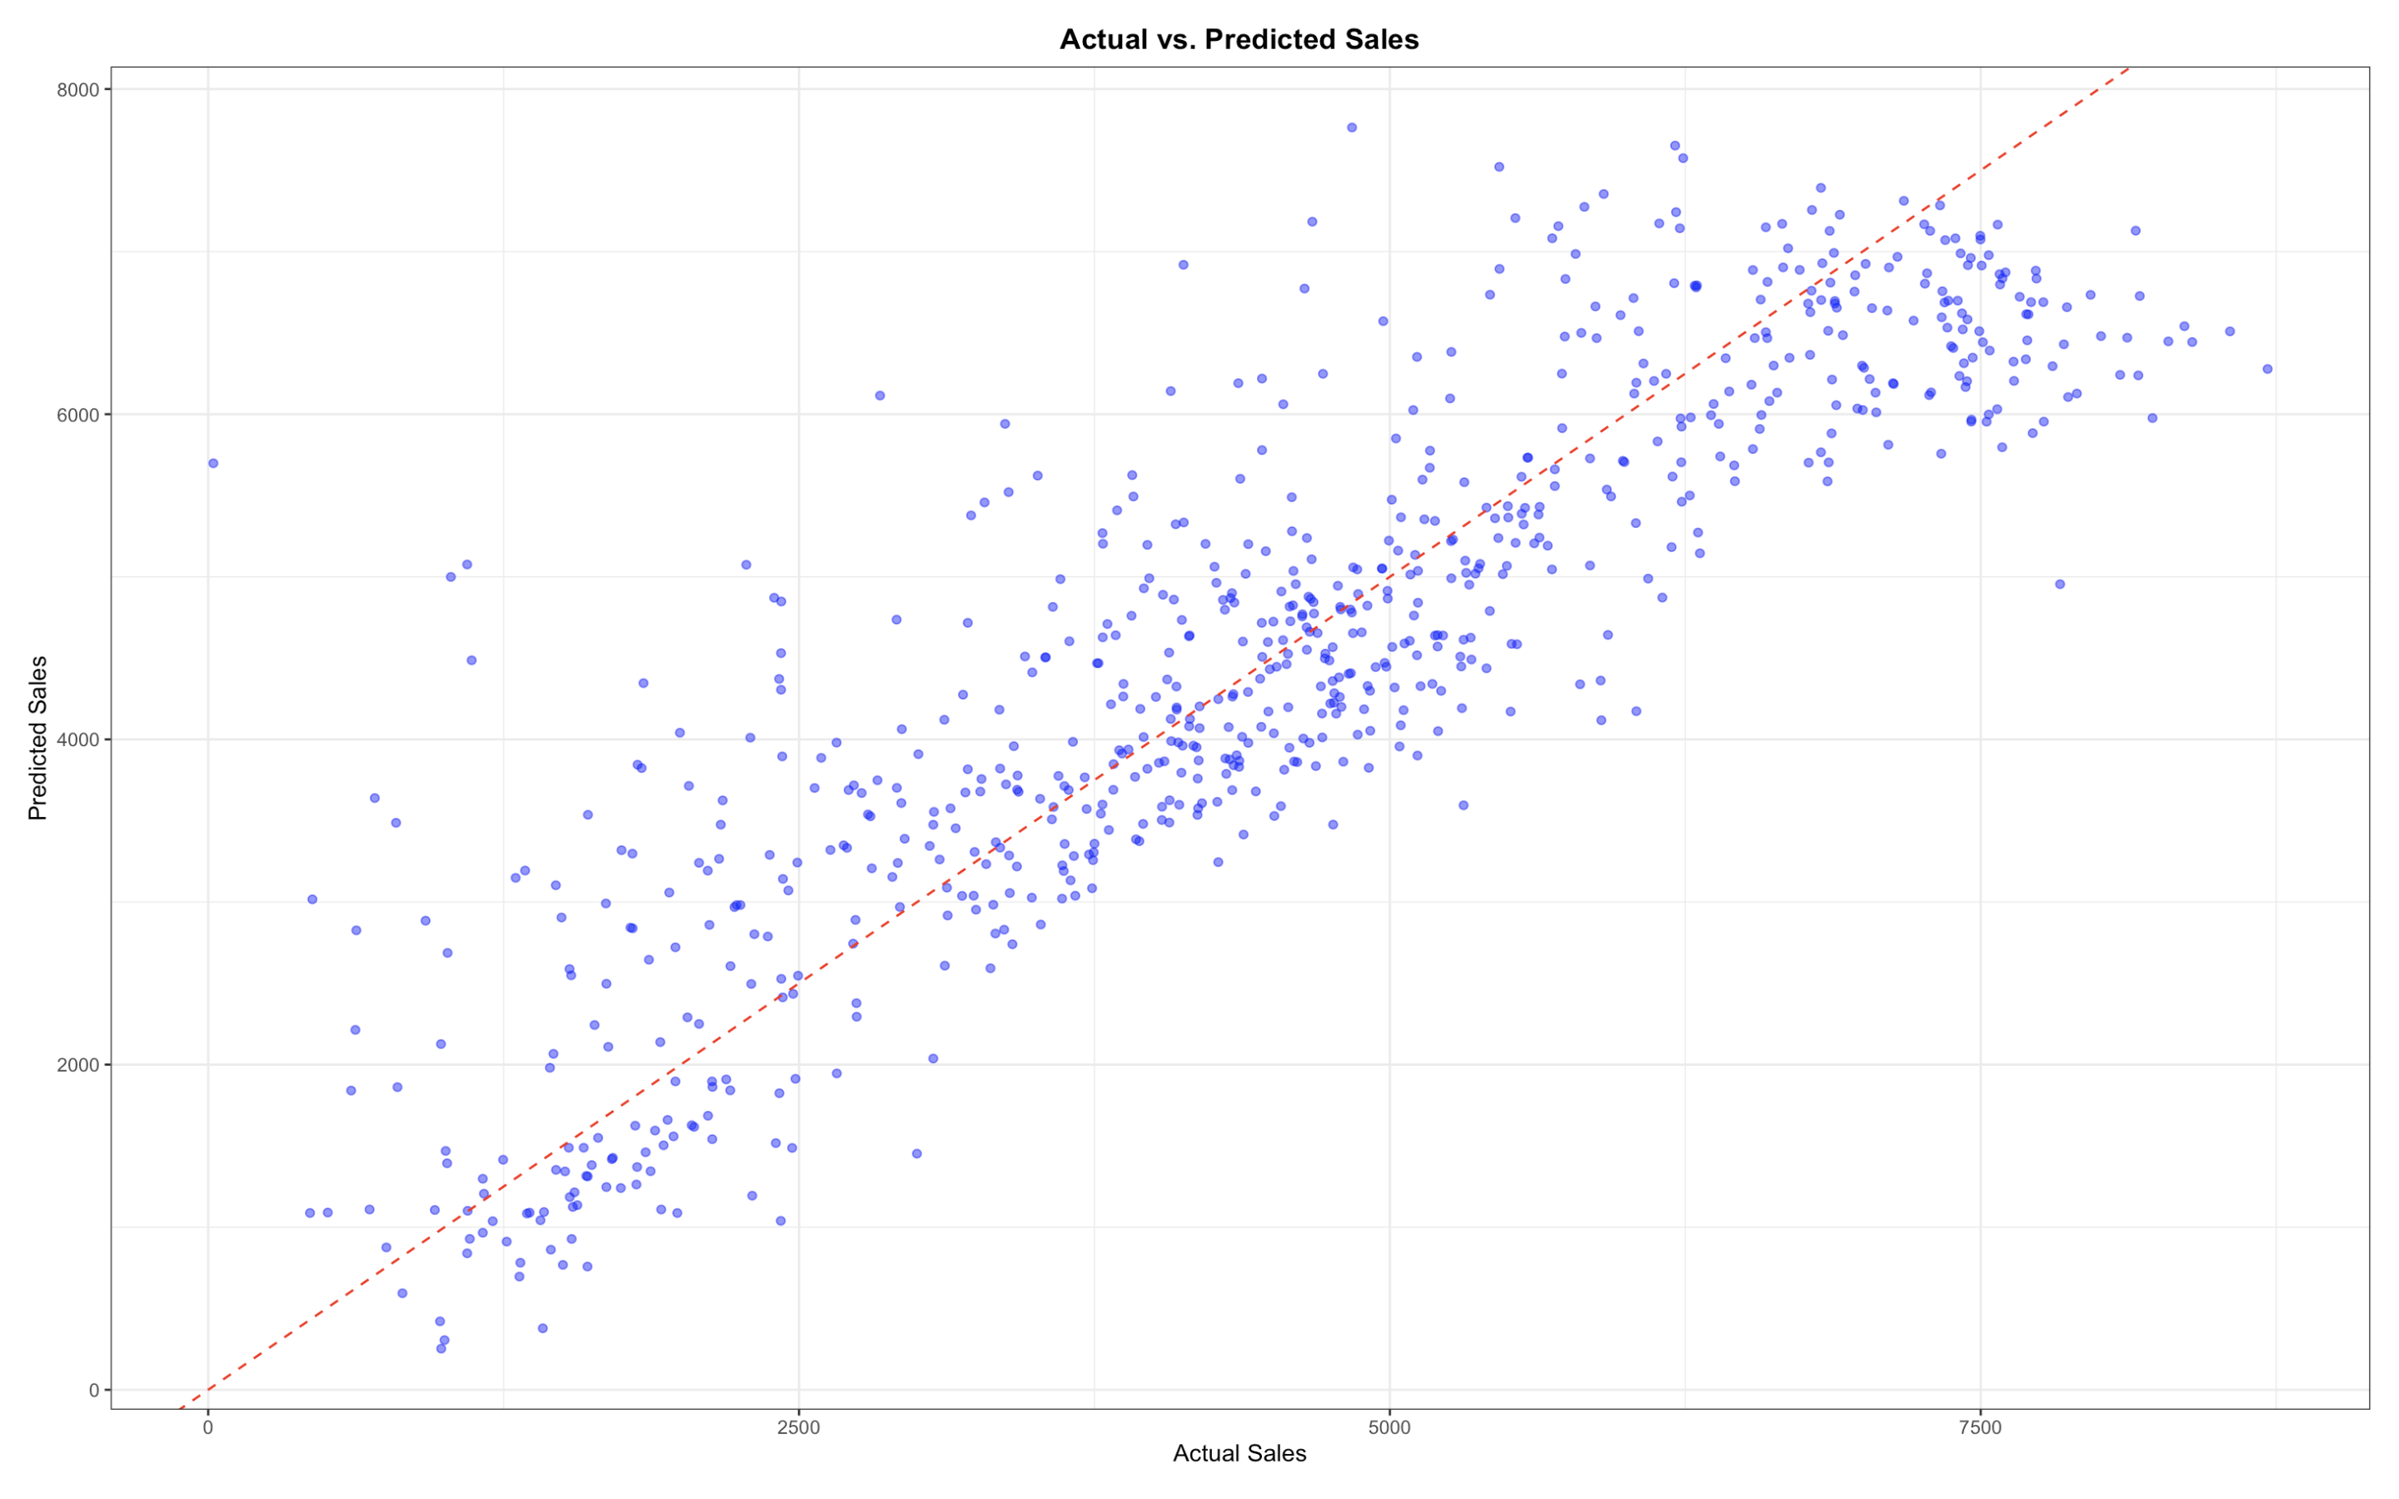

Slide 11

Conclusion
In the course of analyzing the bicycle rental business, we found that sales correlate with temperature, weekdays have more rentals than weekends, and sales change depending on the season. We also developed a model for predicting sales. These results can be used to optimize business strategy and improve marketing campaigns.

