Slide 1

Bike rent business analysis
by Ivan Yanishevskyi
1

Slide 2

Introduction
Key questions:
How temperature affects on sales?
Rental differences between weekdays and weekends.
Quantitative sales depending on the season.
Difference between registered and casual users?
More tourist at the summer?
Sales predication model.
2

Slide 3

Dataset
Dataset contains information on the sales of a product or service, taking into account the date, day of the week, whether the day is a weekend or a weekday, a holiday or a regular day, and the air temperature on that day (it has more factors but I used these)
3

Slide 4
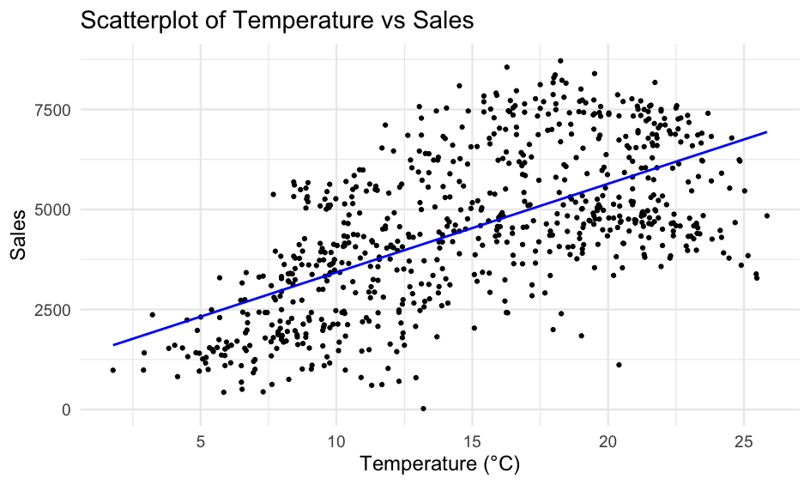
- Direct correlation between air temperature and the number of rented bicycles
4

Slide 5
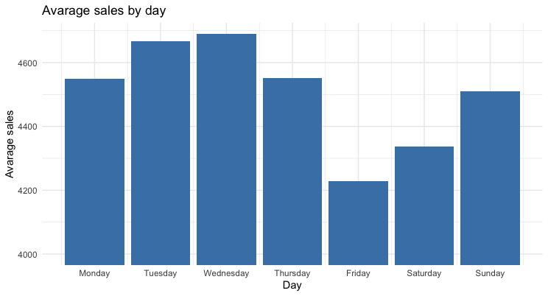
- Weekday bicycle rentals are higher than weekend rentals
5

Slide 6
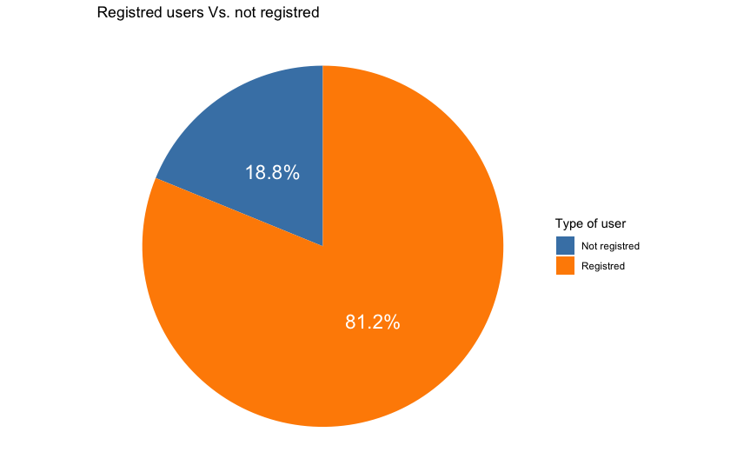
7
Pie diagram of registered and not registered users. Mostly all the users are registered

Slide 7
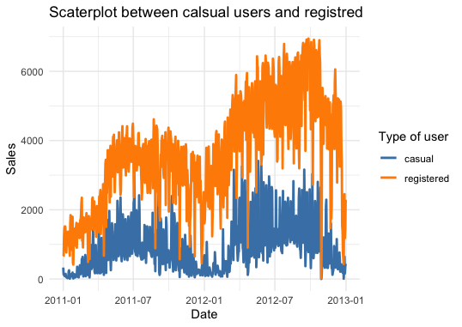
Difference between registered and casual users through the time,
The hotter season – more tourist, so casual amount of users increases
8

Slide 8
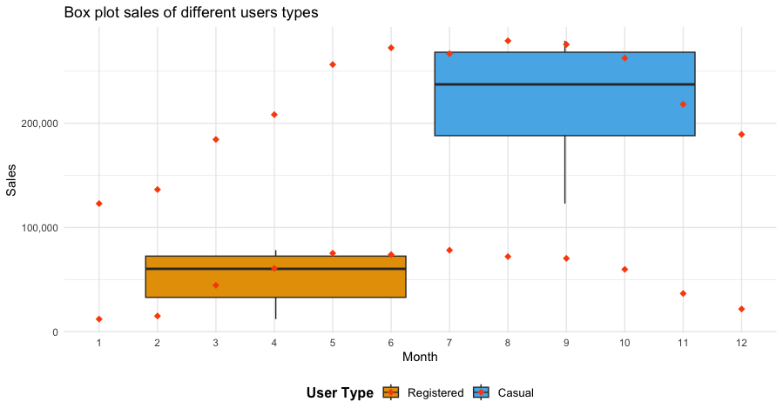
9
-

Slide 9
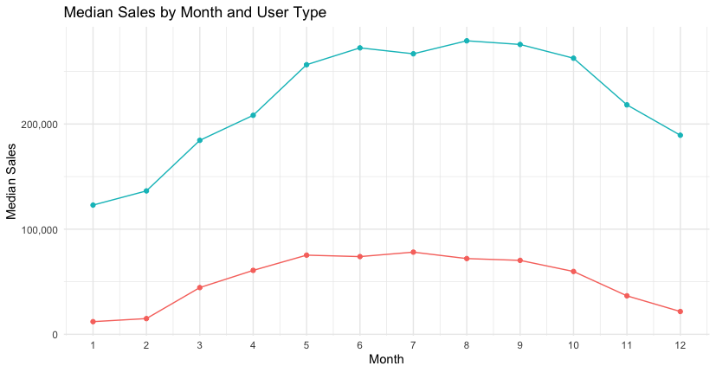
-Sales of registered users far exceed those of casual users throughout the year
-Sales of registered users have a more pronounced tendency to grow over time,
especially during the summer, while sales of casual users grow less intensively.
9

Slide 10
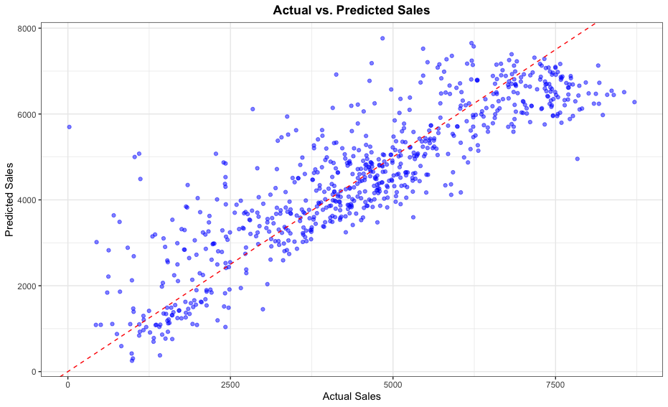
Correlation between predicted and actual sales :
-The chart shows us positive correlation with p-value of 0,83
10

Slide 11

Conclusion
1. Temperature is the key factor
2.Business is seasonable
3.Weekdays are more profitable
4.Mostly registered users
5.More tourists at summer
11

