Slide 1

Bike rent business analysis
by Ivan Yanishevskyi

Slide 2

Introduction
Key questions:
How temperature affects on sales?
Rental differences between weekdays and weekends.
Quantitative sales depending on the season.
Difference between registered and casual users?
More tourist at the summer?
Sales predication model.

Slide 3

Dataset
Dataset contains information on the sales of a product or service, taking into account the date, day of the week, whether the day is a weekend or a weekday, a holiday or a regular day, and the air temperature on that day (it has more factors but I used these).

Slide 4
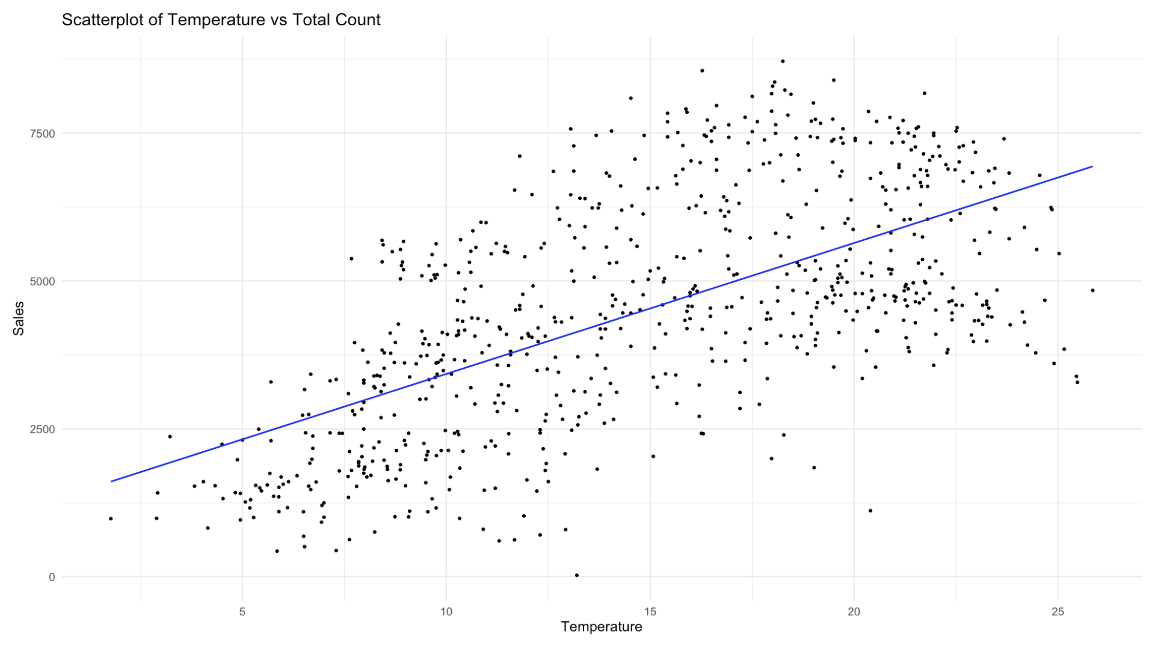
- Direct correlation between air temperature and the number of rented bicycles.

Slide 5
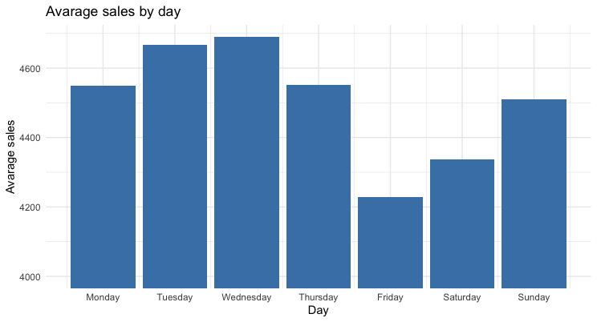
- Weekday bicycle rentals are higher than weekend rentals.

Slide 6
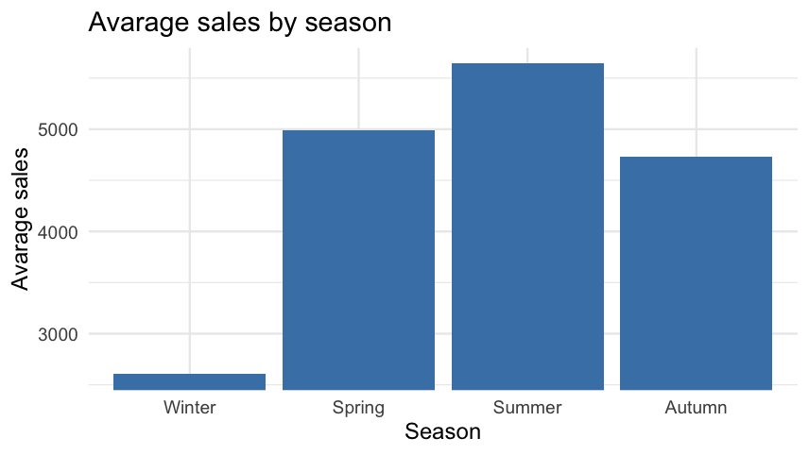
-Sales by season of year, positive correlation, and verification by other plots.

Slide 7
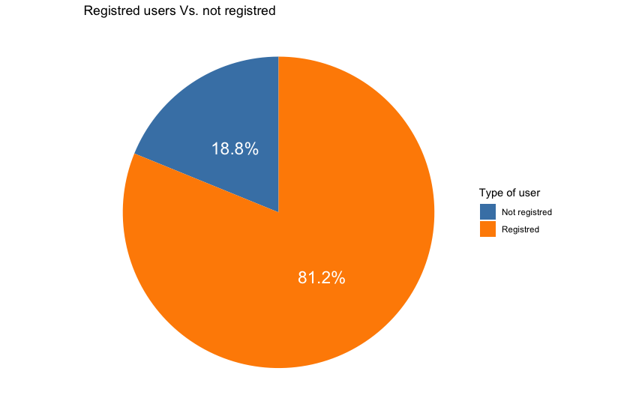
Pie diagram of registered and not registered users. Mostly all the users are registred.

Slide 8
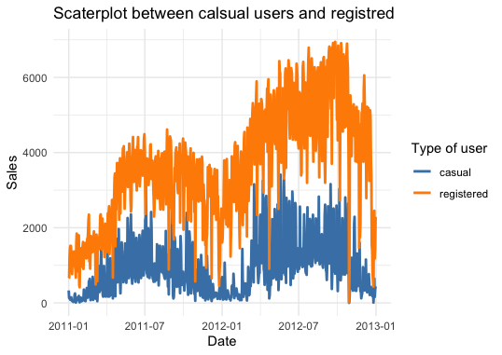
Difference between registered and casual users through the time,
The hotter season – more tourist, so casual amount of users increases.

Slide 9
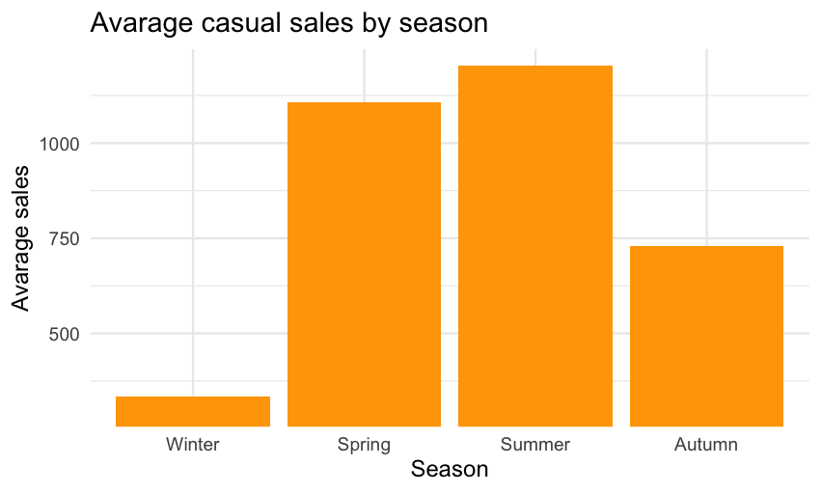
Difference by season. Most – summer and spring.

Slide 10
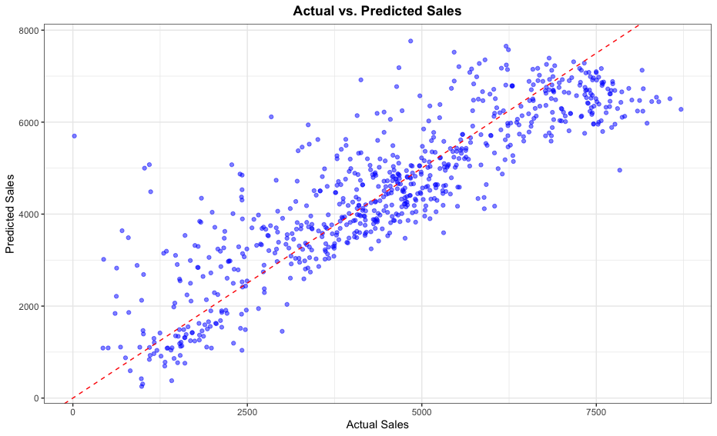
Correlation between predicted and actual sales :
-The chart shows us positive correlation with p-value of 0,83.

Slide 11

Conclusion
1. Temperature is the key factor.
2.Business is seasonable.
3.Weekdays are more profitable.
4.Mostly registered users.
5.More tourists at summer.

