Slide 1



Adaptive-Triathlon-ui
Student: Ivana Gerchakova
Index : 210226
University: Goce Delchev University – Faculty of Computer Science – Robotics and Intelligent Systems
Subject:: Advanced Interactive Technologies
Professor: Prof. Dr. Natasha Koceska
18 June, 2025

Slide 2

PROJECT
OBJECTIVE
👉 Developed a smart triathlon web assistant that adjusts its interface based on detected emotions (happy, sad, neutral).
👉 The adaptation influences:
Background color and style
Suggested workout program
Recommended music (YouTube links)
Motivational quotes
Practical tips for training or recovery

Slide 3

TECHNOLOGIES AND TOOLS USED
🔹 HTML / CSS / JavaScript
🔹 face-api.js (real-time facial emotion recognition)
🔹 Webcam API (camera access)
🔹 VS Code (development)
🔹 YouTube (music suggestion links)
🔹 Local hosting with Live Server

Slide 4

MAIN APPLICATION COMPONENTS
🧱 HTML:
<video> element for webcam
<audio> for background music
Emotion display + suggestions + motivational content
📜 JavaScript:
Load face-api.js models
Detect emotions every 3 seconds
Update UI (background, music, image, tips)
🎨 CSS:
Responsive design
Smooth transitions
Emotion-based styles

Slide 5
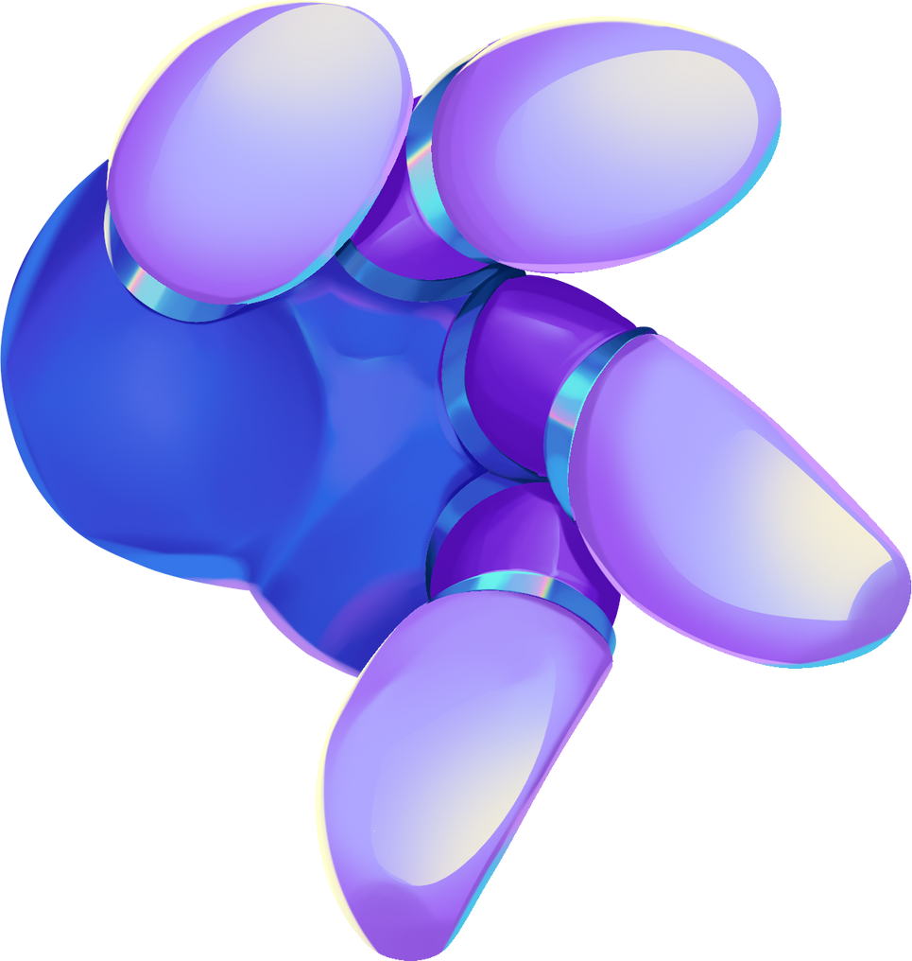
EMOTION PROCESSING (JAVASCRIPT LOGIC)
✅ Uses:
TinyFaceDetector for face recognitionface
ExpressionNet for emotion analysis
⏱ Every 3 seconds:
Reads dominant emotion
If confidence > 0.4 and emotion is new:
➡️ Updates:
Background color
Music (autoplay audio or clickable link)
Workout recommendations
Motivational quote and training tips

Slide 6

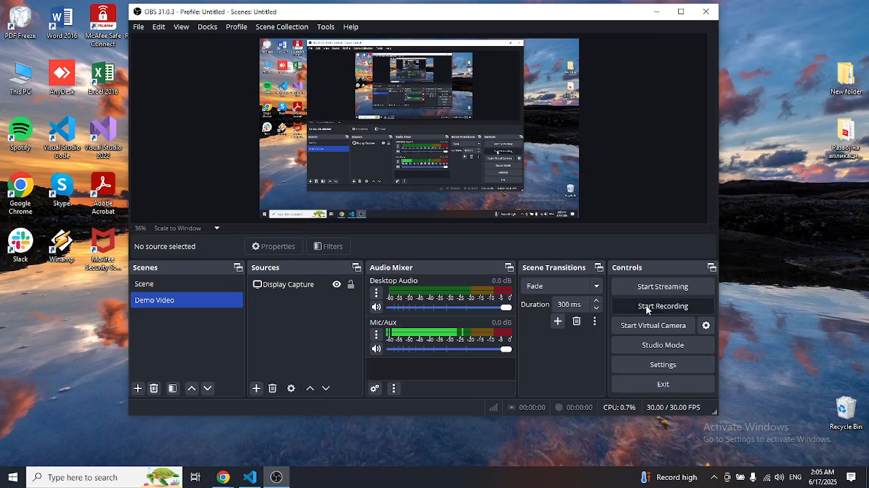
🎥 WATCH THE DEMO VIDEO

Slide 7

THANK YOU FOR YOUR ATTENTION!

