Slide 1
AETA Earthquake Prediction
AI Algorithm Competition

Slide 2

PART 01
Introduction
PART 02
Method
PART 03
Summary

Slide 3
01
PART ONE
Introduction

Slide 4
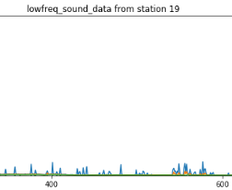
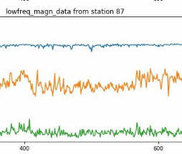
01
背景简介
赛题简介
"AETA Earthquake Prediction AI Algorithm Competition" aims at mining the correlation between precursor observation data and earthquake three elements through innovative algorithms, discovering abnormal signals and features related to impending earthquakes, and building earthquake prediction models based on historical observation data and earthquake catalogue, in the hope of promoting the solution of scientific problems of earthquake prediction and forecast.
赛题分析
Raw data is a typical time series data, and a large amount of information is hidden in its structure, which is not only reflected in its numerical value to construct new features, but also to find the strong features is one of the difficulties in the competition。

Slide 5
02
PART TWO
Method

Slide 6
02
Method——Model Overview

Slide 7
02
Method——Data Label
By region：Sichuan and Yunnan province are divided into eight sub-regions according to seismic fault zones。
By time：One week before the earthquake event.
By magnitude：According to statistics, the number of historical earthquakes in the above areas in the past three years is between 3 and 6, so it is divided into four grades according to the scope of impact and frequency of earthquake magnitude.
地区 | 时间范围 | 震级 | label
sub-regions1 | One week before the earthquake event | 0~3.4 | 1_0 | 0
 |  | 3.5~4.5 | 1_1 | 1
 |  | 4.6~5.5 | 1_2 | 2
 |  | 5.6~8.0 | 1_3 | 3

Slide 8
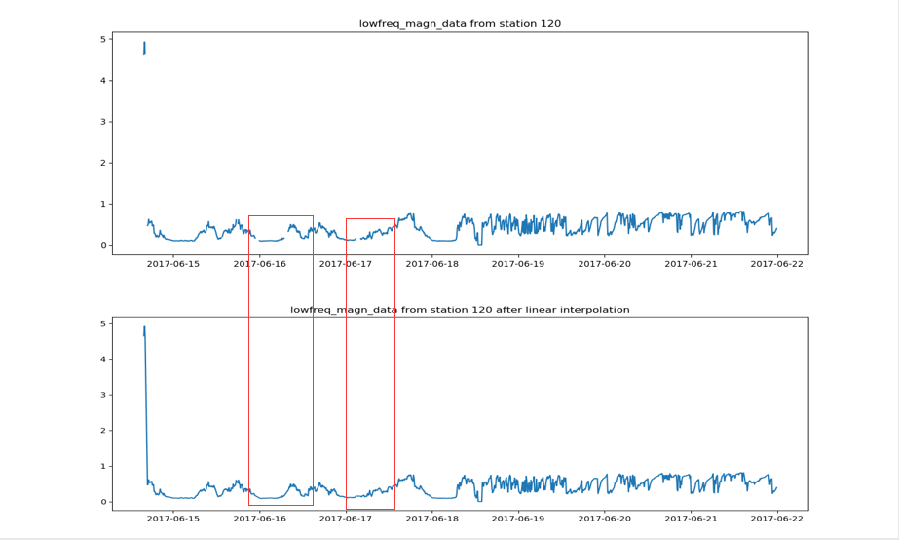
02
Method——Data Interpolation
线性插值
10% of the one-day data is taken as the threshold value. If the data is missing less than 10% in a row, linear interpolation method will be used to complete the missing data. If the data is missing more than 10% in a row, a large error will be introduced into interpolation and the data of the current day will be deleted.

Slide 9
02
Method——Feature Extraction
Derivative characteristic
The proximity difference between electromagnetic and geoacoustic data, the existence and amplitude of DAILY SRSS wave and so on are calculated.
Statistical characteristics
The maximum value, minimum value, mean value, variance, skewness, kurtosis, root mean square, waveform factor, peak factor, pulse factor, margin factor, difference between maximum and minimum value, sliding quartile, and coefficient of variation of derived and basic characteristics of electromagnetic and geoacoustic data in one day.
Additional feature
The top 50 features of feature importance were selected by the feature importance screening method of random forest, and the new features were obtained by cross-multiplying in pairs.
Notes:
本方案采用了时序数据异常检测的方法和统计方法，构造了一些特征，按照他们的生成的方式分为三类，利用一些领域知识构建的特征为衍生特征，包括。。利用统计方法构造的特征，如最大值最小值等。本方案为了找到强特征，采用随机森铃的方法，这些就是额外衍生特征。

Slide 10
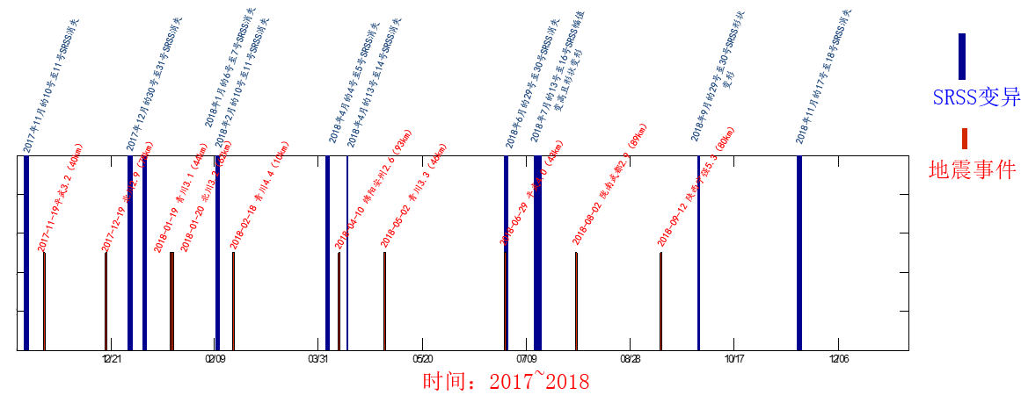
02
Method——Feature Extraction
SRSS
SRSS waveform has certain correlation with earthquake, SRSS wave and its variation are important signal of impending earthquake.The figure shows a partial example of the correlation between SRSS wave variation and earthquake at FANGshi Town AETA station in Qingchuan.
Notes:
在参考资料中了解到，SRSS波与地震发生有一定的相关性，所以本方案对整体数据进行SRSS波的检测，确定其有无。

Slide 11
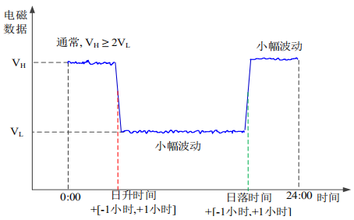
02
Method——Feature Extraction
SRSS
Definition For SRSS：
Daily data, if the maximum value (VH) of the previous hour is significantly higher than the maximum value (VL) of the next hour by 2 times or more, it is considered that SRSS wave exists on the current day.
SRSS波-Extraction：
1. Day as the sliding window of the scope, data standardization.
2. Filter data conforming to SRSS baud points, defined as SRSS wave "templates".
3. Detection of SRSS wave.
Notes:
首先，SRSS波的定义，如右图所示，本方案在检测SRSS波之前以每个台站一天的数据

Slide 12
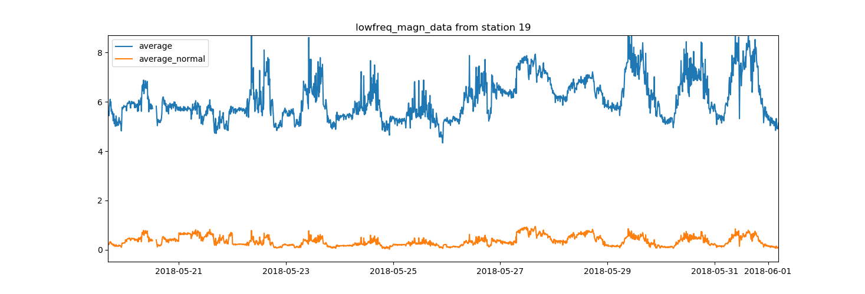
02
Method——Feature Extraction
SRSS pre-processing
Max-min standardization：
Taking day as the window unit, the maximum and minimum values in daily data are used to standardize the time series in the window.

Slide 13
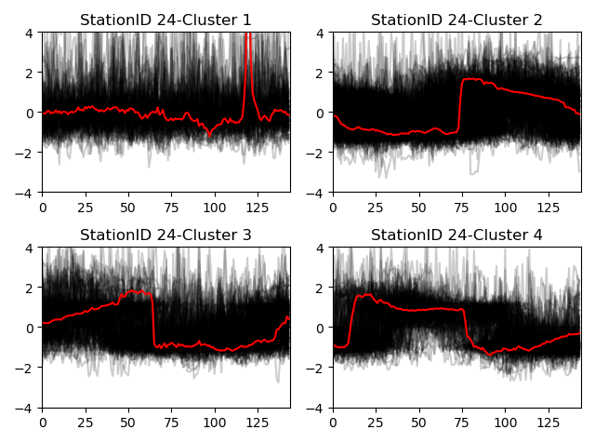
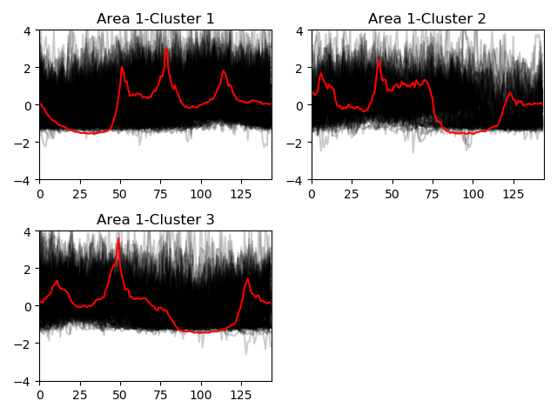
02
Method——Feature Extraction
Definition- SRSS
Analyze data in a sub-regions -> Define SRSS wave templates
Notes:
台站数据分析：
以天为窗口范围，利用K-shape，对某区域内的每个台站的数据，按照轮廓相似的程度进行聚类。
断裂带数据分析：
以天为窗口单位，利用K-shape，对区域内内的所有数据，按照轮廓相似的程度进行聚类。
定义SRSS波模板：
筛选符合SRSS波特点的质心，将其定义为SRSS波模板。
而不是幅度和阶段的不同。

Slide 14
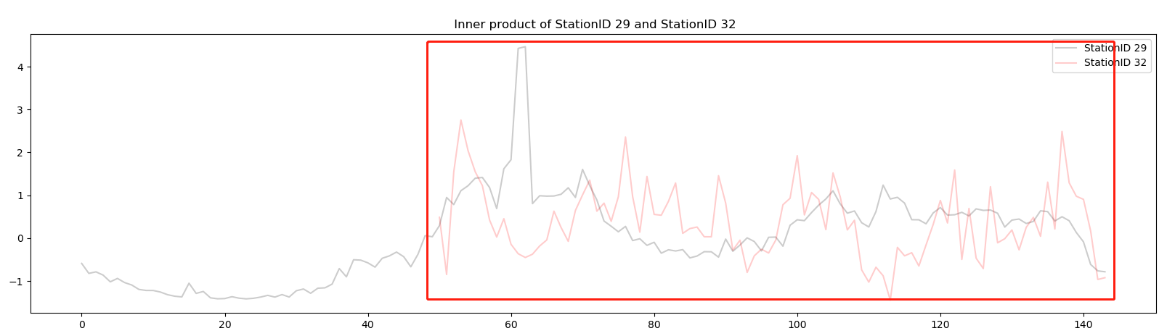
02
Method——Feature Extraction
Detection SRSS
The sliding inner product between each sequence and the SRSS wave template was calculated in days, and its maximum inner product was used as the correlation measure of the two sequences.

Slide 15
02
Method——Classification
Stacking
Modeling was done using Stacking methods, the first layer base model was LightgBM, random forest and CatBoost, and the second layer was logistic regression.
Notes:
最终得到的预测结果是，数据属于什么标签，按照标签确定其区域额震级。

Slide 16
02
Method——Classification
Label | Region | Magnitude
1 | Sub-regione 1 | 3.5-4.5
Classification：
Latitude and longitude | Magnitude
The latitude and longitude of the center of the Sub-regione 1. | 4.0
Prediciton：
Notes:
N是震级大于M的地震总数,零级以上地震的累积频度 a ，b 指震级和频度关系式中的比例系数( 斜率) ，代表一定区域内不同大小地震频数的比例关系，N = 1 时的震级 Mmax=a / b。a / b 值大表示地震活动性增强，即发生大地震的概率大; 反之，值小表示发生大地震的几率小。b 为一组地震样本中大小地震的比例，
η 为基于 G-Ｒ 回归线得到的均方差和，ΔM 为最大观测到的地震与最大预测地震之间的差值，T 为最后一次典型地震与第一次典型事件发生的间隔时间，μ 为典型事件发生的平均间隔时间，c 为 μ 的变化系数，d E1 /2为地震能量的平方根变化率，Mmean为 n 次地震事件的平均值，C 为地震事件分类。如果地震事件在预测范围内的最大震级 Mj，大于或等于预定阈值 Ms，则 C = 1，反之 C = 0
按月组织数据，使用在每个断裂带地区内每个月发生3.5级以上地震的作为特征地震，使用这些特征地震来求取以上八个特征值。
预测：统计后可知，在四川云南地区多发生3.0到4.0以内的地震，所以地震事件的预测主要内容是，在断裂带内，每个月发生3.5级以上地震的可能性。

Slide 17
03
PART FOUR
Summary

Slide 18
05
Summary
Feature Extraction
Based on the processing methods of statistics and time series data, new features are constructed, and on this basis, additional derivative features are constructed by fusion of features to enrich feature space.
Interpolating missing data
Using the physical characteristics of the data, the missing data is finely completed.
Model
A hierarchical fusion of LightgBM, random forest, and CatBoost on which a sub-learner is trained (logistic regression) is used to organize the answers using the base learner. In situations where the relationship between data characteristics and data labels is unclear, Stacking can be used to effectively mine the relationship between data and categories.

Slide 19
Thank you for your attention！

