Slide 1



Decouverte_power_bi_master
View in Power BI
Last data refresh:
04/10/2023 12:28:58 UTC
Downloaded at:
04/10/2023 14:11:54 UTC

Slide 2
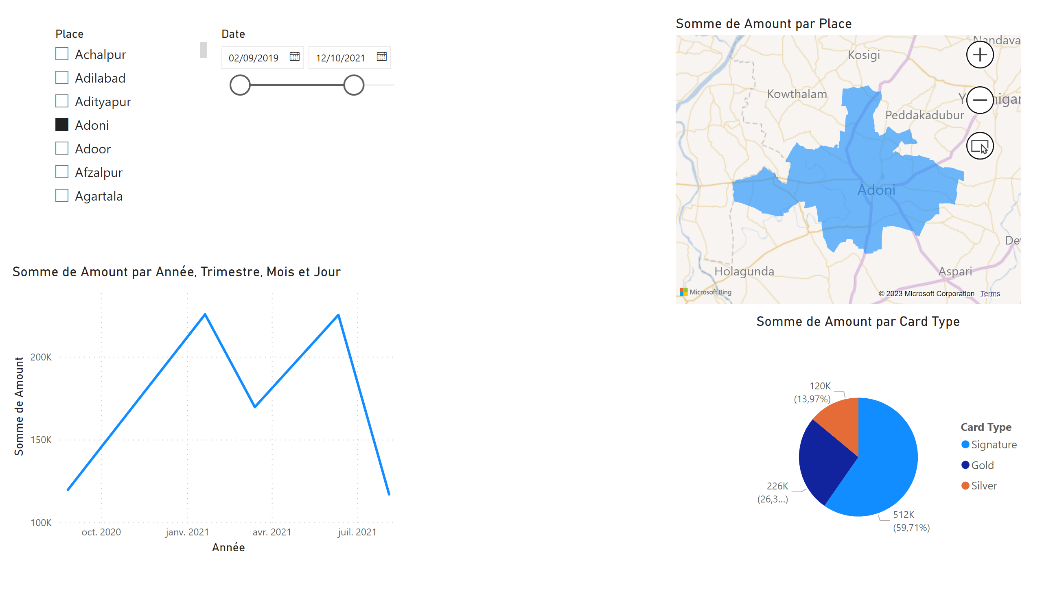
Page 1
Notes:
lineChart
No alt text provided
pieChart
No alt text provided
slicer
No alt text provided
slicer
No alt text provided
filledMap
No alt text provided

Slide 3
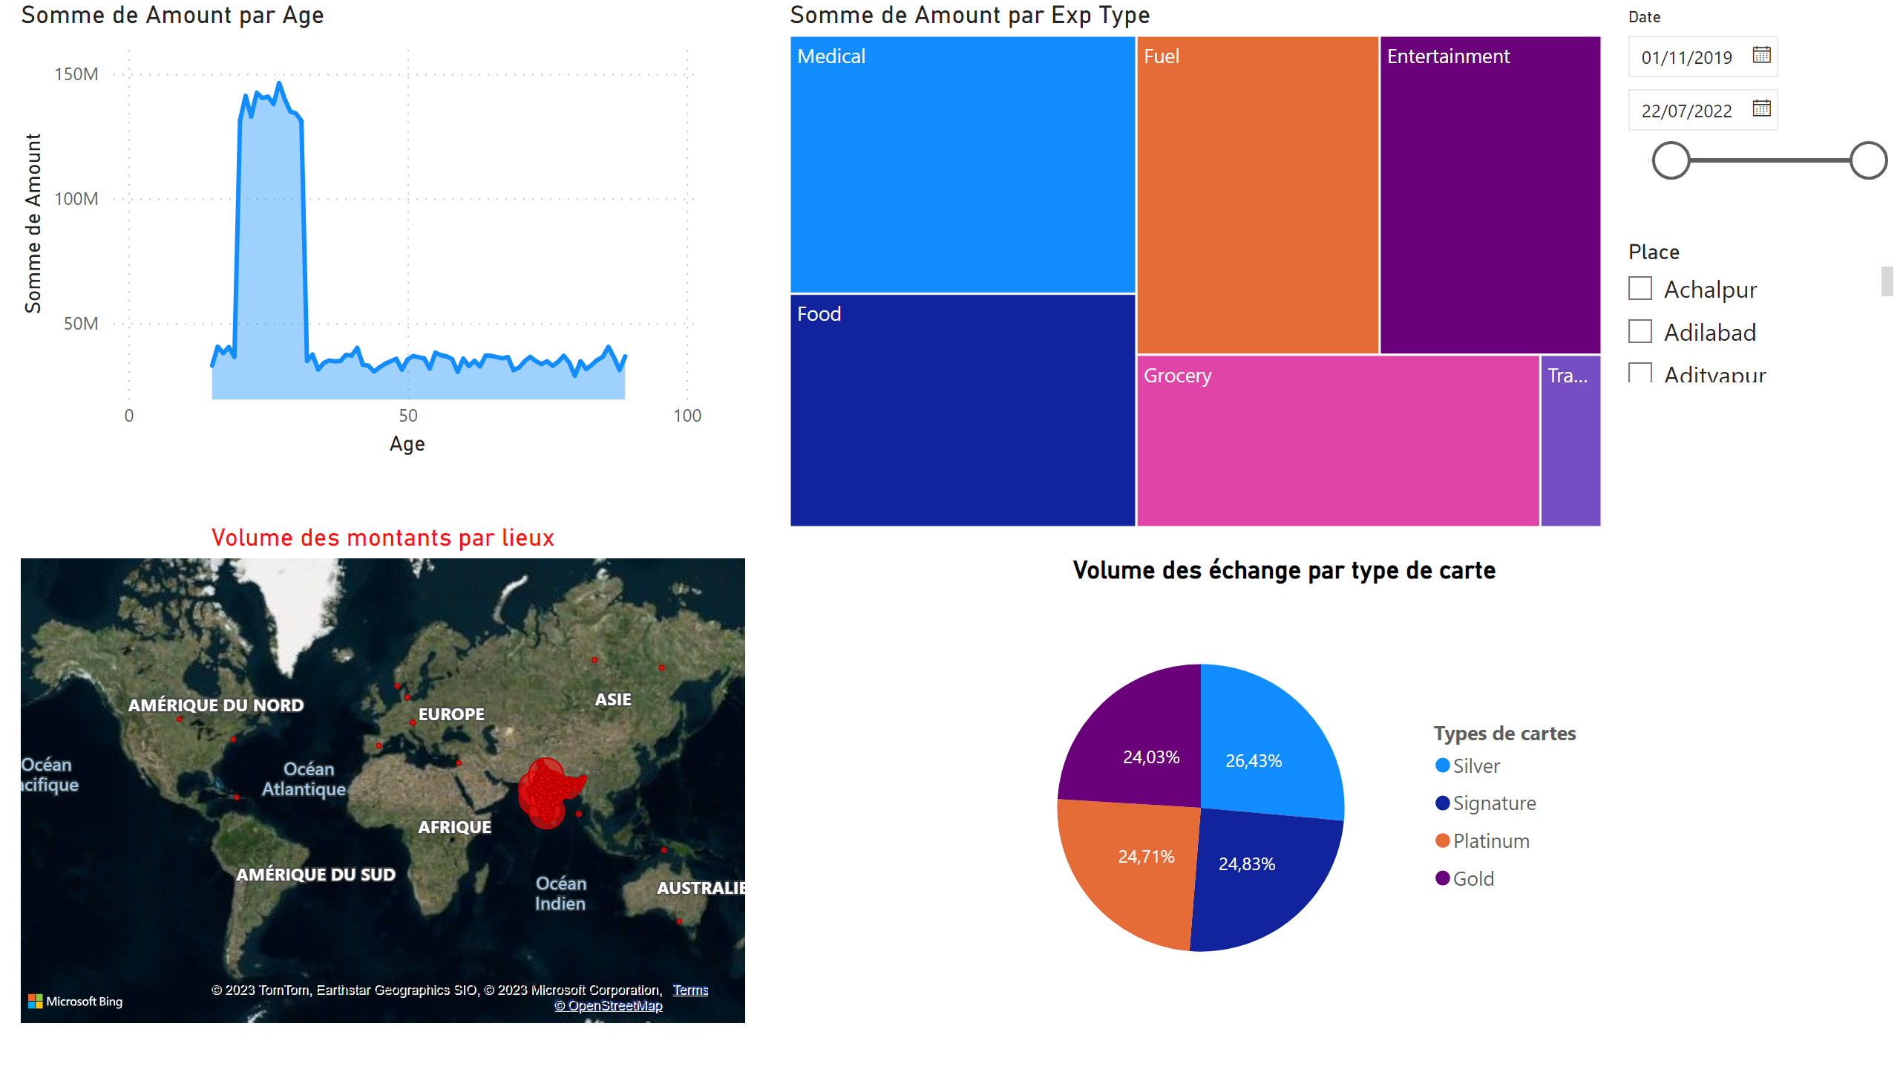
Page 2
Notes:
slicer
No alt text provided
slicer
No alt text provided
Volume des échange par type de carte
No alt text provided
treemap
No alt text provided
Volume des montants par lieux
No alt text provided
areaChart
No alt text provided

Slide 4
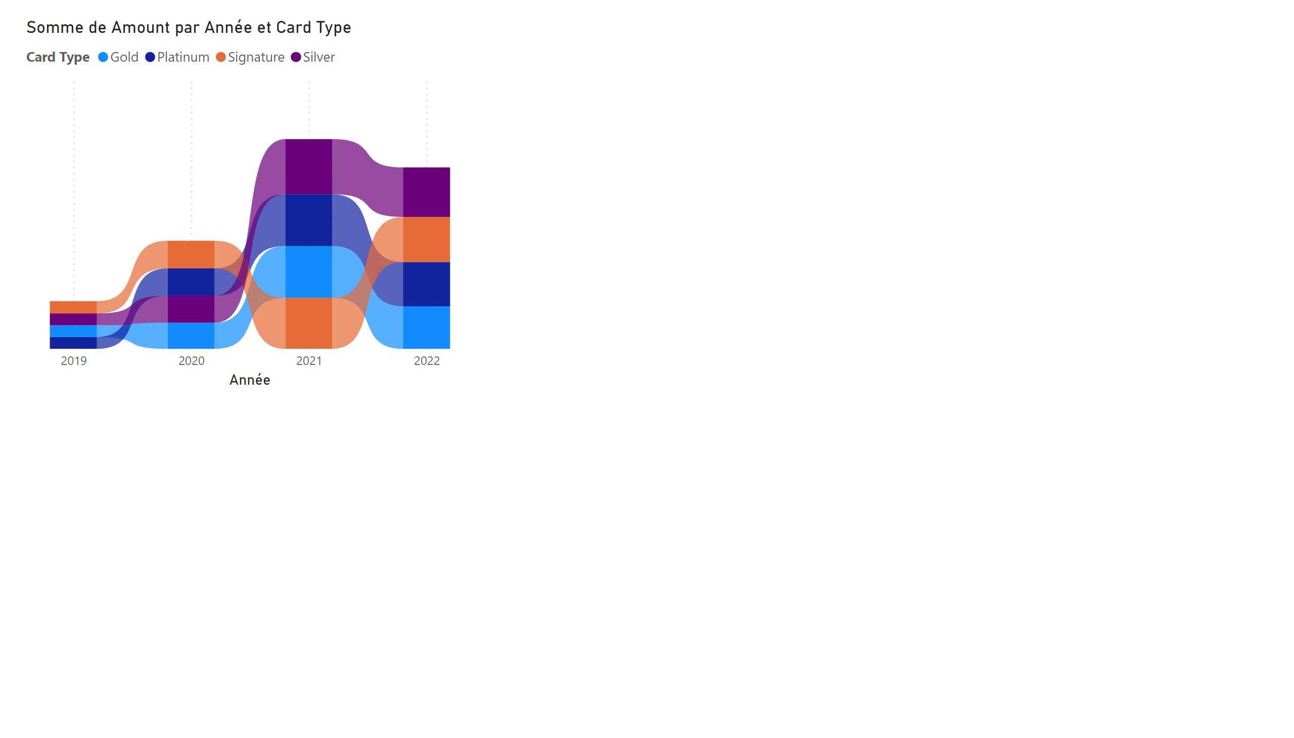
Page 3
Notes:
ribbonChart
No alt text provided

