Slide 1
Mid Project review Deck
DEVELOPER: Lingjun Chen

Slide 2
Highlights
Explored whole dataset, checked distribution of variables as well as labels (No unbalanced problem found), treated NA problems
Looked at correlation matrix, and made dummies variables for variables with many levels such as location
Built logistic regression, KNN, random forest and xgboost models and ran hyper-parameter tuning with 10-fold cross validations on them to select best models.

Slide 3
Review Progress
During this sprint, I completed the following stories:
Story 1: Data Preparation and Story 2: Data Exploration in Epic 1 :
Clean datasets by removing/imputing NA values, treating outliers and influential points and removing duplicate records; treat potential unbalanced outcome class problem
Explore data by calculating descriptive statistics (mean,min,max etc.) and plotting them for important covariates; check skewness of covariates and fix them if exist; engineer features such as breaking address into city and states to create more aggregated and meaningful features
Story 1: Model Initialization and Story 2: Model Tuning in Epic 2:
Random split datasets into 80% training and 20% testing
Build Logistic Regression, KNN,Random Forest, XGBoost
Perform Random Search to tune hyper-parameters and performed 10-fold cross validation to select the best model

Slide 4
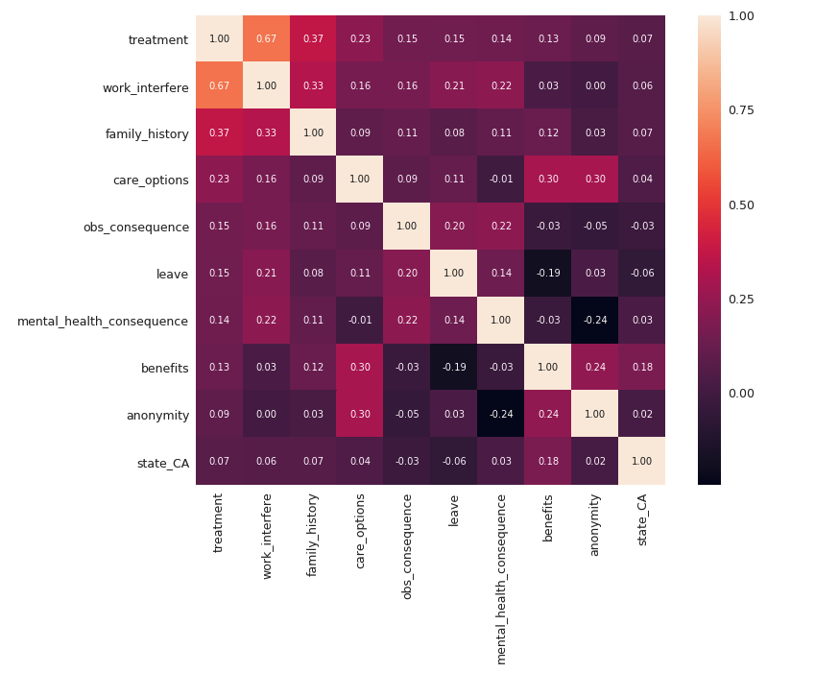
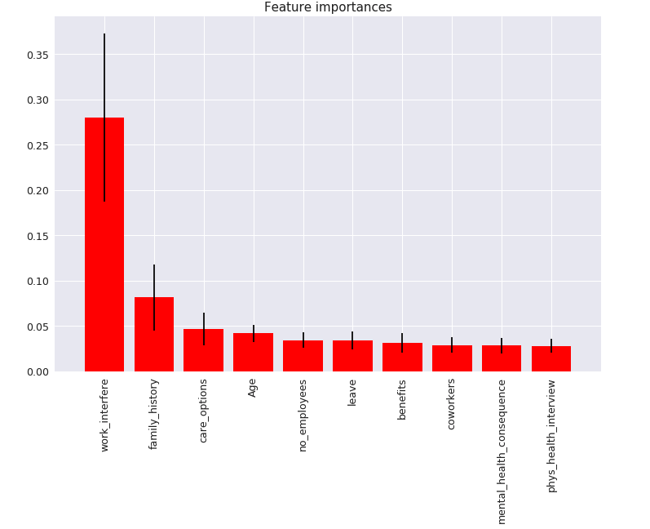
Visualizations
The figure on the left showed the correlation between some variables and the response (treatment), work interfere is moderately correlated with treatment
The figure on the right showed variable importance from XGBoost model

Slide 5
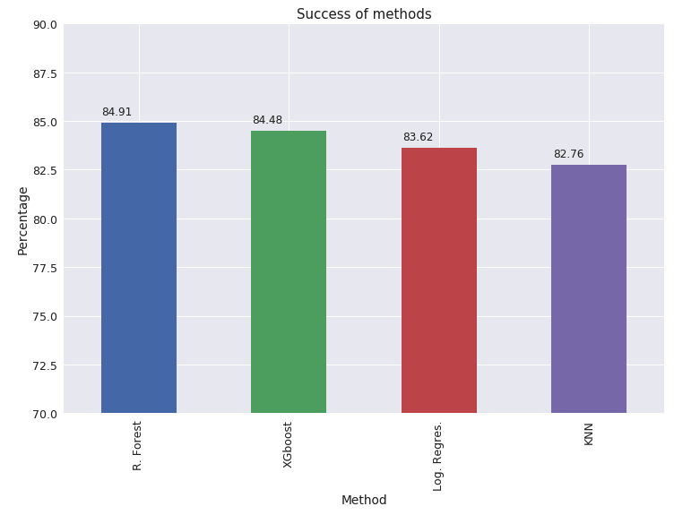
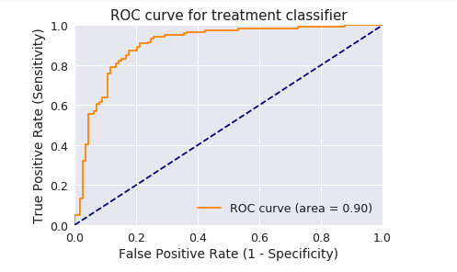
Demo
Figure on the left showed accuracy for different models after 10-fold cv, Random forest seems to be the best model in this case
Figure on the right is the ROC curve for Random Forest model

Slide 6
Lessons learned
The most important variables to cause whether one is likely to have mental issues are actually whether your work gets interfered by your supervisors. Location of where the person is are least important, which was surprising because I originally thought people in NY or SF would have so much more stress than people in the Midwest.
The response (treatment) distributes evenly ( roughly 50% of people report they have mental issues), which was surprising because the percentage is way higher than what I have originally thought of
During model tuning, I did not write the tuning process as a function, which requires a lot of code changes when switch models and parameters led to inefficiency in the pipeline. So I rewrote a large chunks of my code and packed the process into functions and now I can run the evaluation script and it will find the best parameters for me

Slide 7
Recommendations
The following stories should be finished in the next sprint:
Write unit test and model reproducible test and pass them locally
Transition all dependencies to AWS environment
Write flask backend and design frontend web interface
Final deployment on AWS

