Slide 1
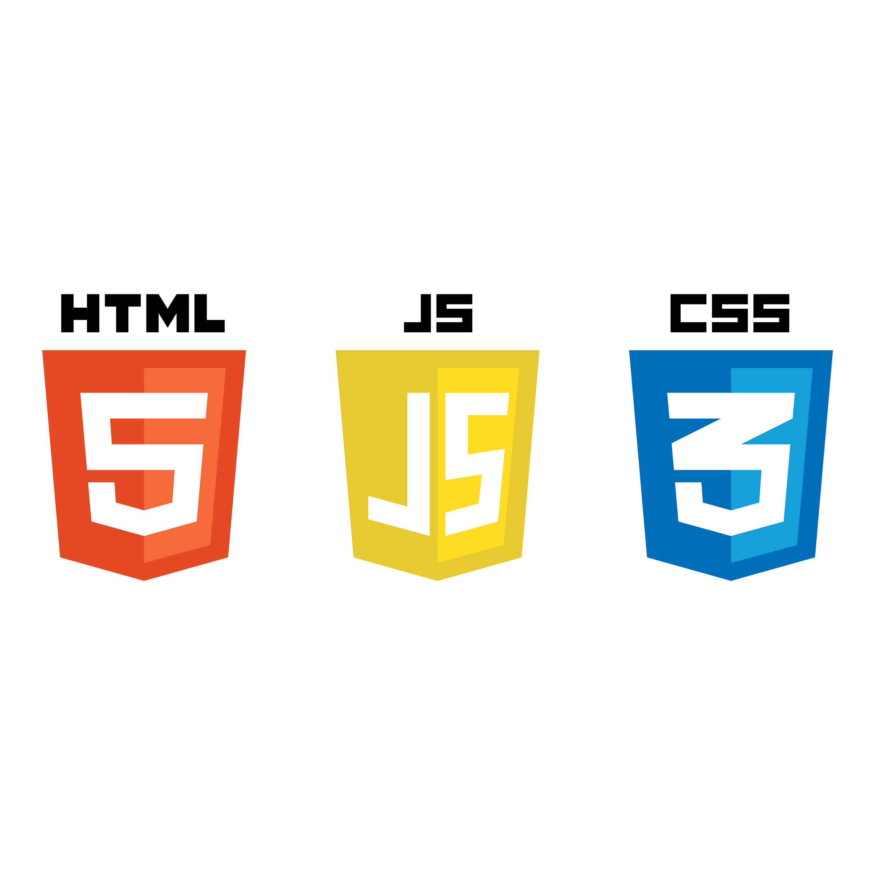
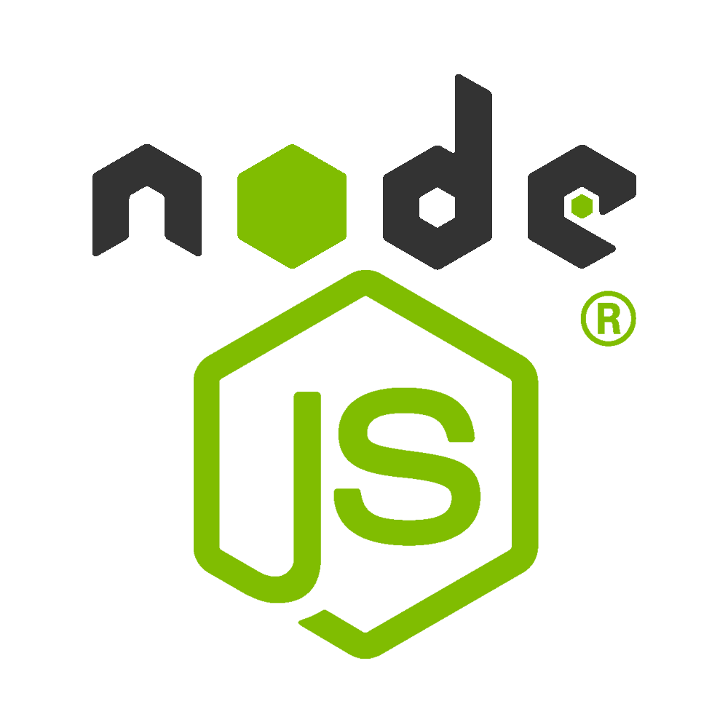






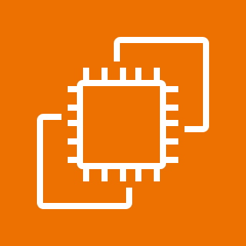


Cloud
Amazon Route 53
Virtual private cloud (VPC)
Public subnet
Private subnet
User
EC2
DB instance

