Slide 1
Early cancer prediction using miRNA expression data
kuNGS Fury team
Alexander Andreev
Peter Zhurbenko
Eugenia Ivanova
Margarita Komarova
Karina Sogomonyan
Dasha Khaleneva

Slide 2
Task 1
Aim:
Select a limited number of differentially expressed miRNA genes and try to develop models predicting MYCN amplification.
Normalization
Prediction models
Differential expression analysis
Mean Cq normalization
By Cq of one housekeeping gene
By mean Cq of 3 housekeeping genes with NormiRazor
Limma
Mann-Whitney test
Logistic regression
Random Forest
k Nearest Neighbours

Slide 3
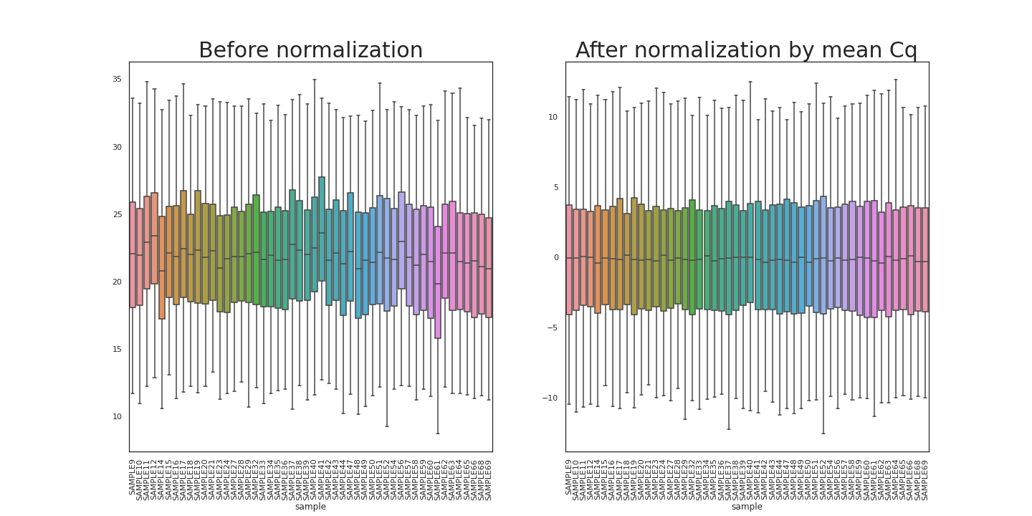
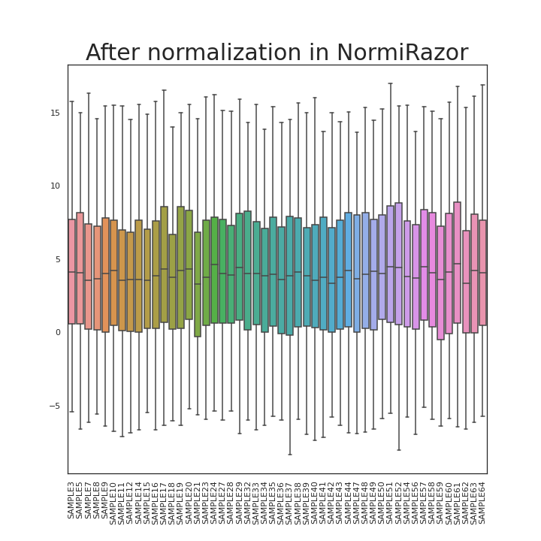
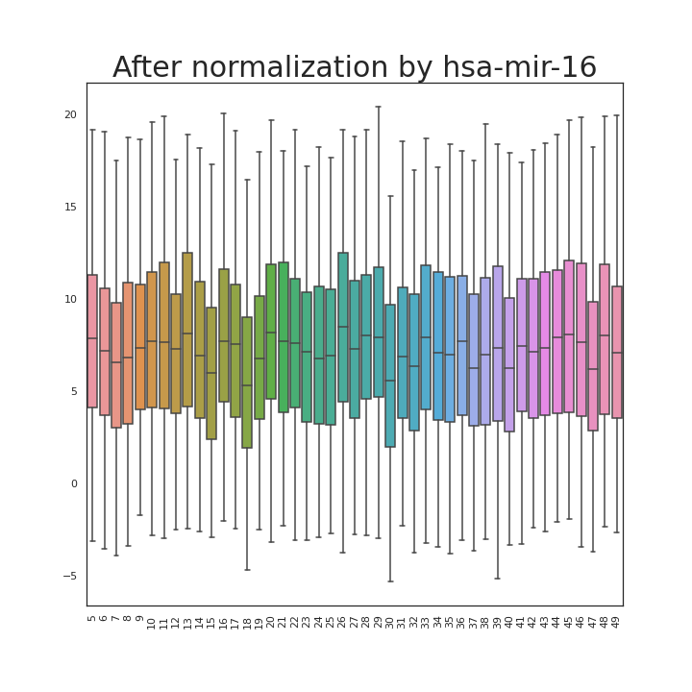
Normalization
Normalization by mean Cq and with NormiRazor appeared to be good, and was used for differential expression analysis.

Slide 4
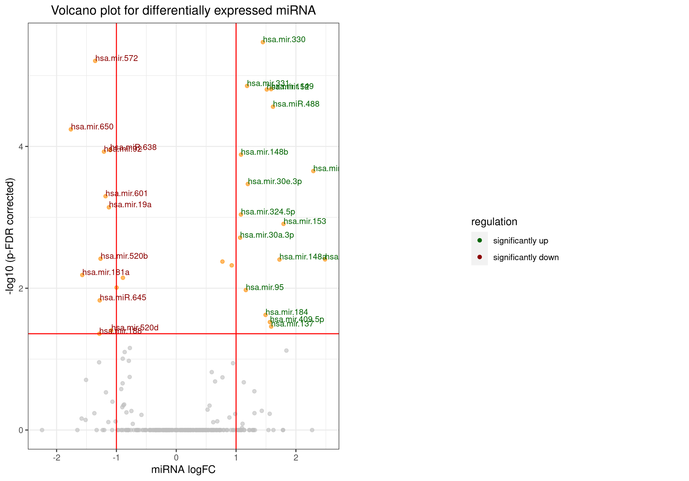
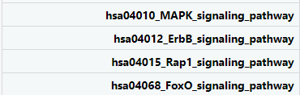
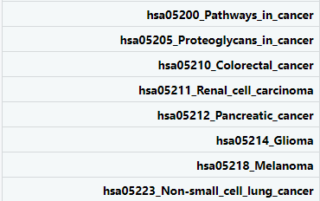
Differential expression analysis in Limma
Various signal pathways activation

Slide 5
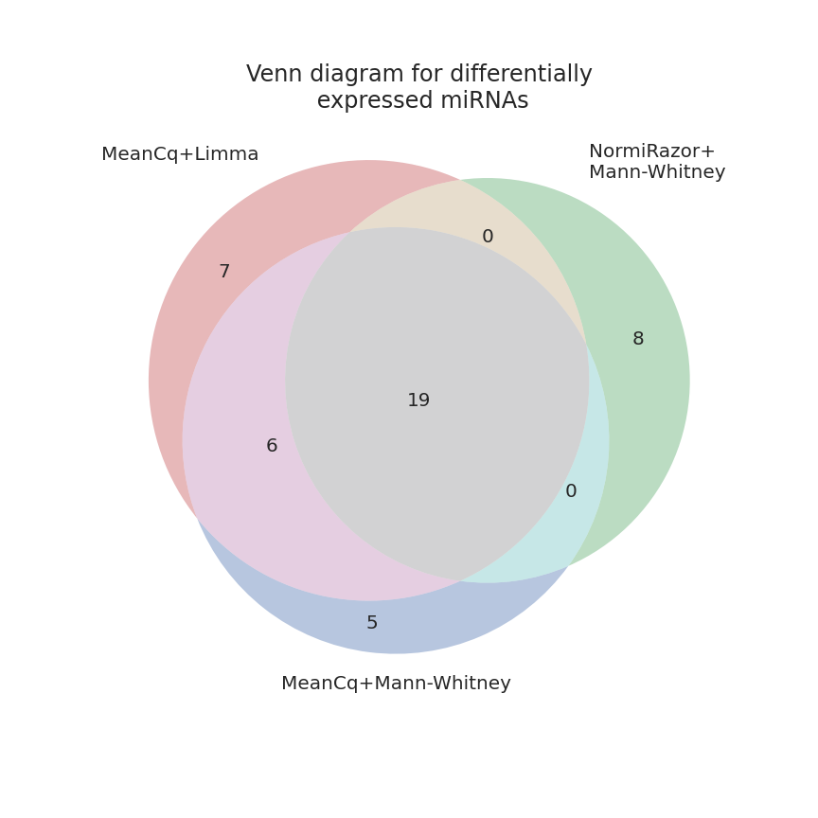
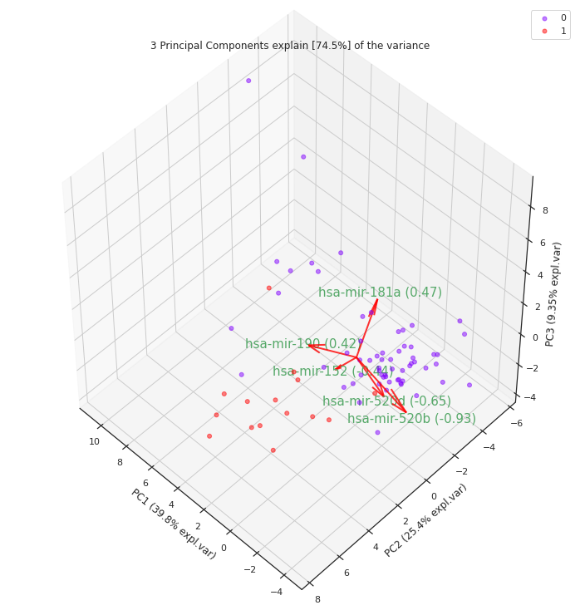
Feature selection
Class 0 - cancer status without MYCN amplification
Class 1 - cancer status with MYCN amplification

Slide 6
Machine learning. Results for different models
Class 0 - cancer status without MYCN amplification
Class 1 - cancer status with MYCN amplification
 | LASSO logistic regression | K-Nearest Neighbors | Random Forest
Accuracy | 0.89 | 0.89 | 0.84
Precision, class “0” | 0.88 | 0.93 | 0.92
Precision, class “1” | 1.0 | 0.80 | 0.67
Recall, class “0” | 1.0 | 0.93 | 0.86
Recall, class “1” | 0.6 | 0.80 | 0.80
F1-score, class “0” | 0.93 | 0.93 | 0.89
F1-score, class “1” | 0.75 | 0.80 | 0.73

Slide 7
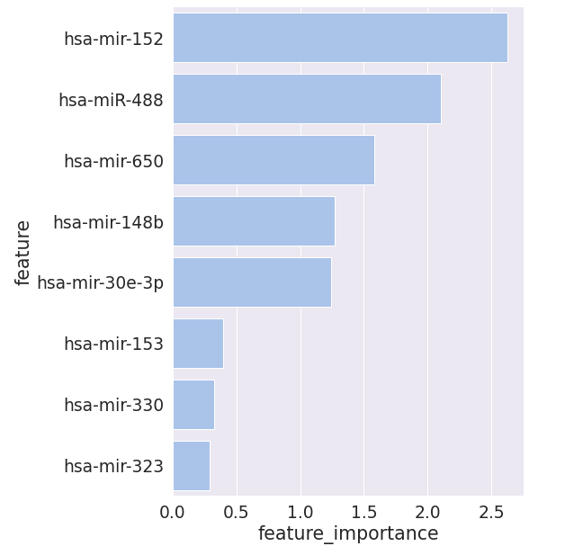
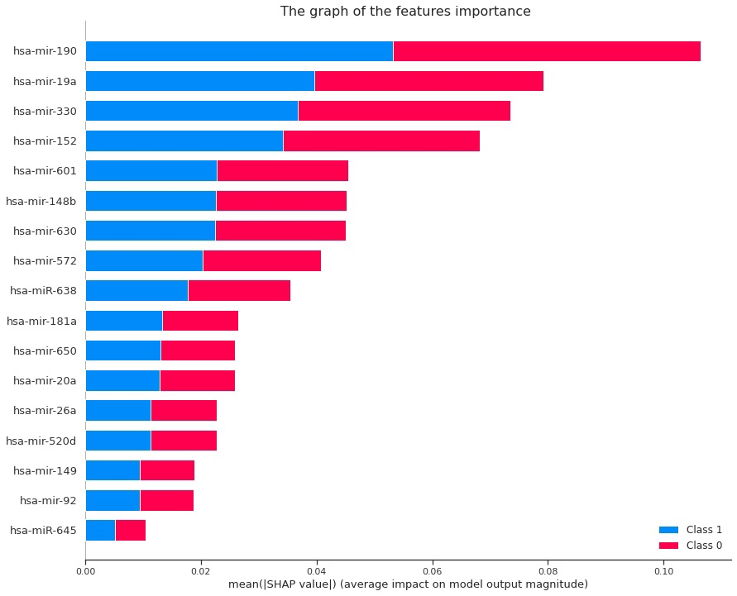
Most important features
Class 0 - cancer status without MYCN amplification
Class 1 - cancer status with MYCN amplification
Logistic regression Random forest

Slide 8
Task 2
Aim:
Select limited number of differentially expressed miRNA genes by two cohorts of RNA-seq data.
Objectives:
data filtration
batch effect correction
DEG identification using DESeq2
pathway analysis

Slide 9
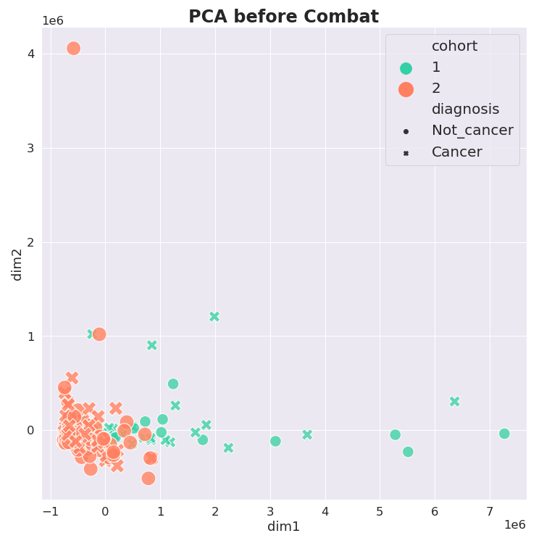
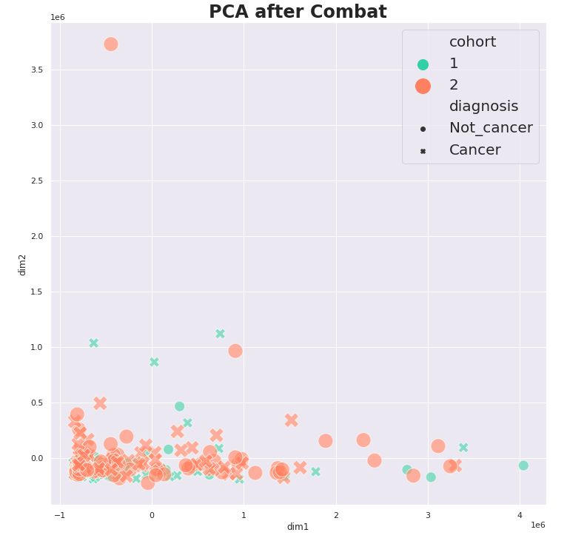
Batch effect correction

Slide 10
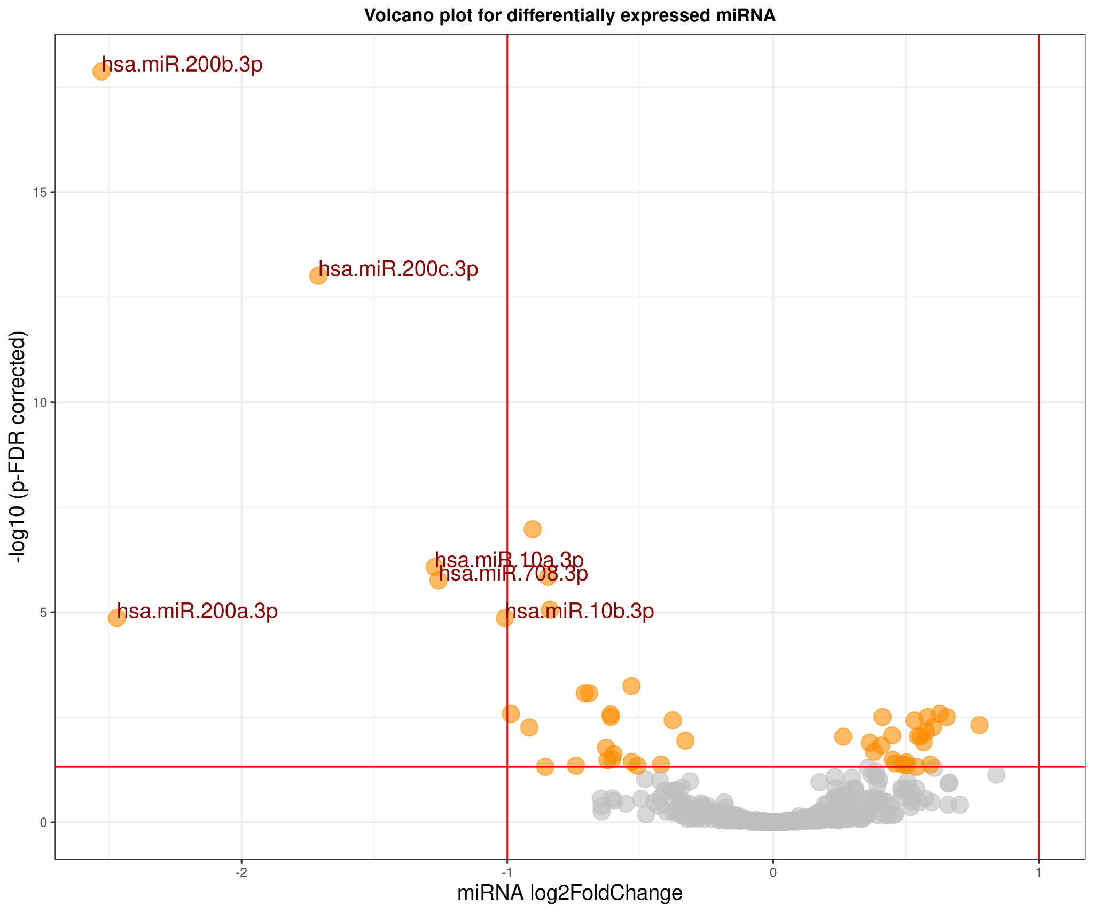
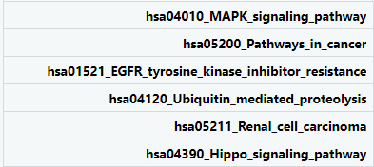
Differential expression analysis with DESeq2
Among 381 miRNA only 6 show high downregulation pattern in cancer
DEG condition: p.value < 0.05 and |log2FC| > 1
hsa.miR.10a.3p
hsa.miR.10b.3p
hsa.miR.200a.3p
hsa.miR.200b.3p
hsa.miR.200c.3p
hsa.miR.708.3p
← significantly DE miRNAs
activated signal → pathways

Slide 11
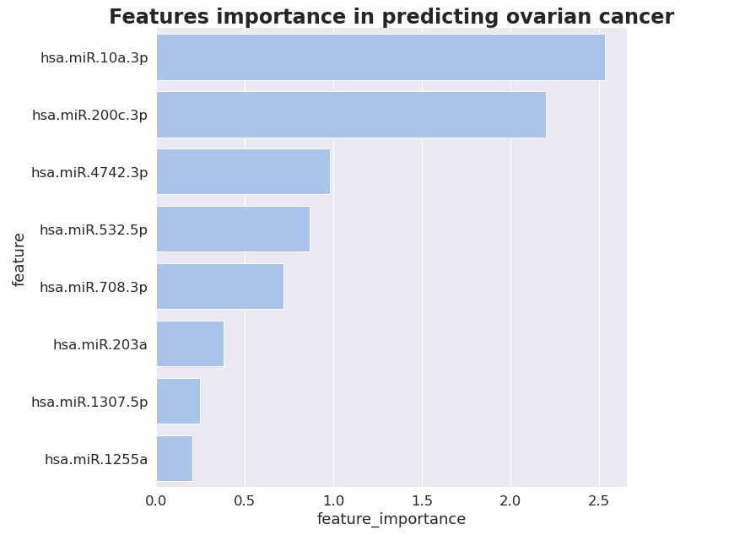
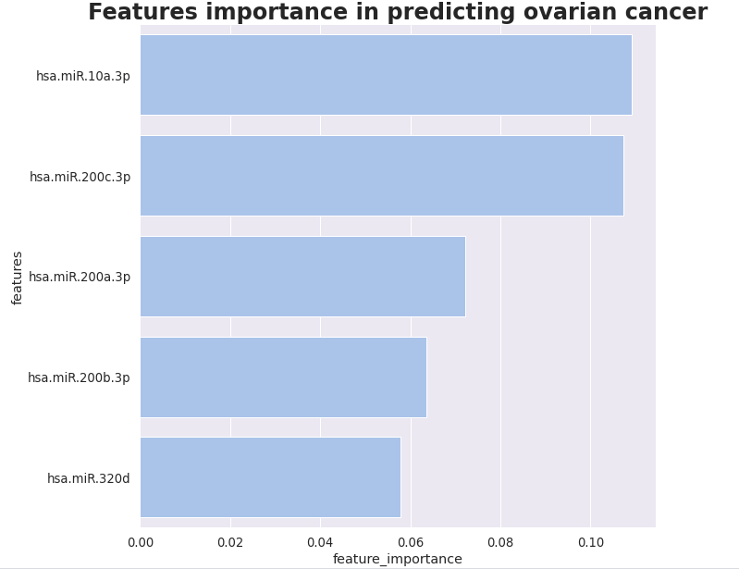
Lasso logistic regression by DE miRNA after DESeq2
Logistic regression Random forest

Slide 12
Machine learning. Results for different models
 | LASSO logistic regression | Random Forest
Accuracy | 0.72 | 0.70
Precision, class “no cancer” | 0.67 | 0.62
Precision, class “cancer” | 0.77 | 0.80
Recall, class “no cancer” | 0.70 | 0.78
Recall, class “cancer” | 0.74 | 0.65
F1-score, class “no cancer” | 0.68 | 0.69
F1-score, class “cancer” | 0.75 | 0.71

Slide 13
Thank you for your attention!

