Slide 1


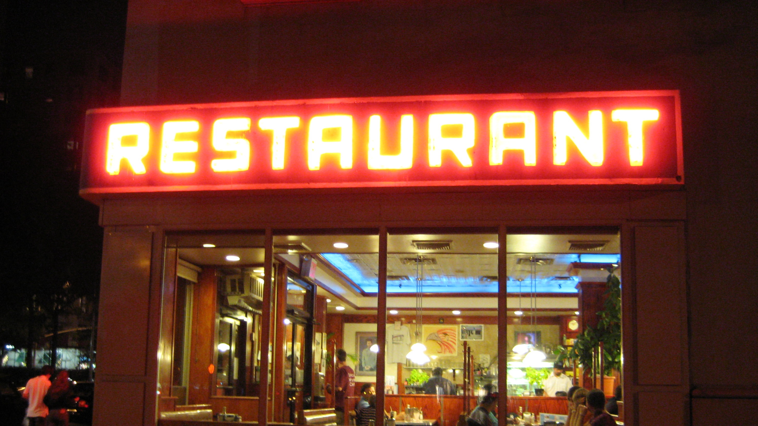
The Battle of Neighborhoods: Indian Restaurants in NYC
This Photo by Unknown Author is licensed under CC BY-SA

Slide 2
Problem Description
New York City's demographics show that it is a large and ethnically diverse metropolis. It is the largest city in the United States with a long history of international immigration. New York City was home to nearly 8.5 million people in 2014, accounting for over 40% of the population of New York State and a slightly lower percentage of the New York metropolitan area, home to approximately 23.6 million. Over the last decade the city has been growing faster than the region. The New York region continues to be by far the leading metropolitan gateway for legal immigrants admitted into the United States.
With its diverse culture, comes diverse food items. There are many restaurants in New York City, each belonging to different categories like Chinese, Indian, French etc. So, as part of this project, we will find out:
What is best location in New York City for Indian Cuisine? (Best Place to stay)
Which all areas lack Indian Restaurants? (Market Potential)

Slide 3
DATA
For this project we need the following data:
New York City data that contains list Boroughs, Neighbourhoods along with their latitude and longitude.
Data Source: https://cocl.us/new_york_dataset
Description: This data set contains the required information. And we will use this data set to explore various neighbourhoods of New York city.
Indian restaurants in each neighbourhood of New York city.
Data Source: Foursquare API
Description: By using this API we will get all the venues in each neighbourhood. We can filter these venues to get only Indian restaurants.

Slide 4
APPROACH
Collect the New York city data from https://cocl.us/new_york_dataset
Using Foursquare API we will find all venues for each neighbourhood
Filter out all venues that are Indian Restaurants
Visualize the ranking of neighbourhoods based on availability of restaurants

Slide 5
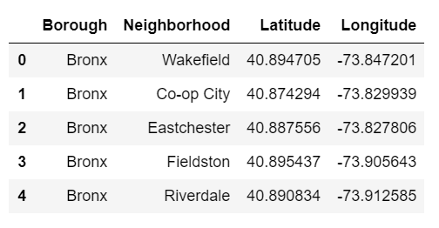
DATASET

Slide 6
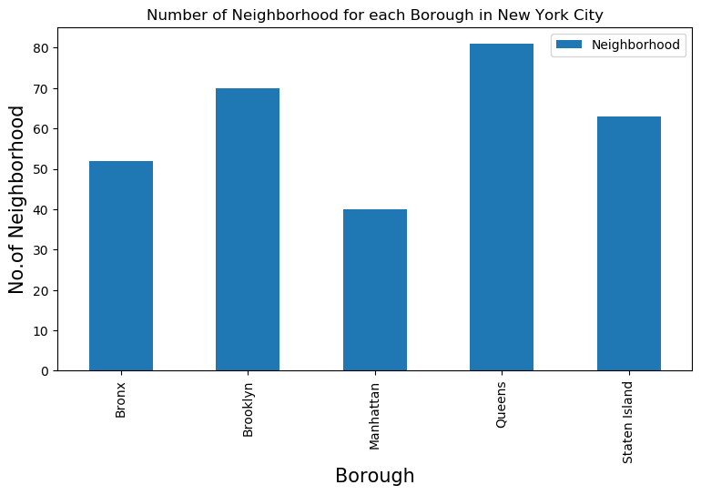
DATA VIZ

Slide 7
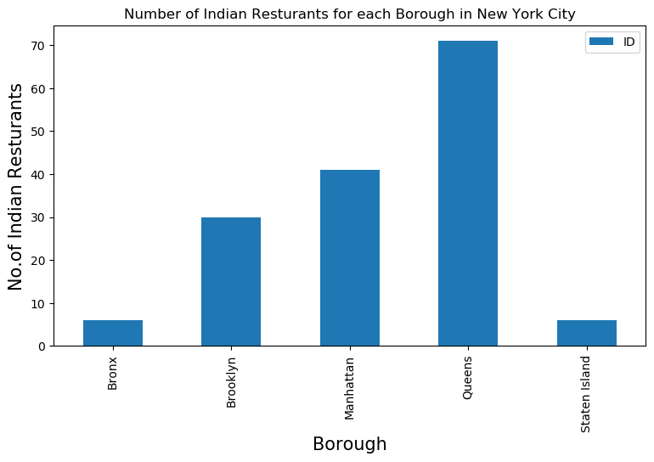
RESULTS

Slide 8
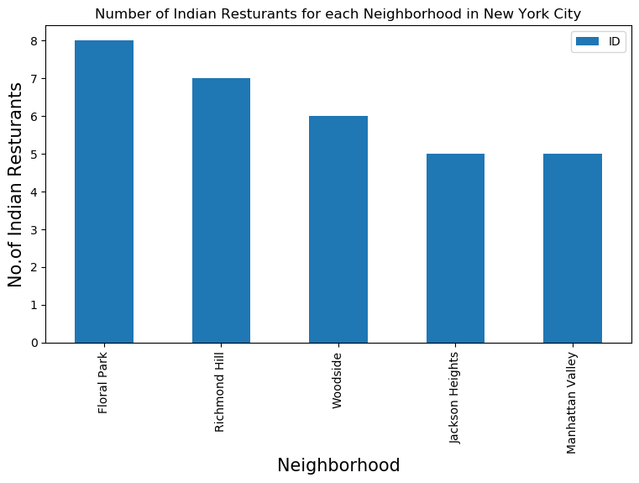
RESULTS

Slide 9
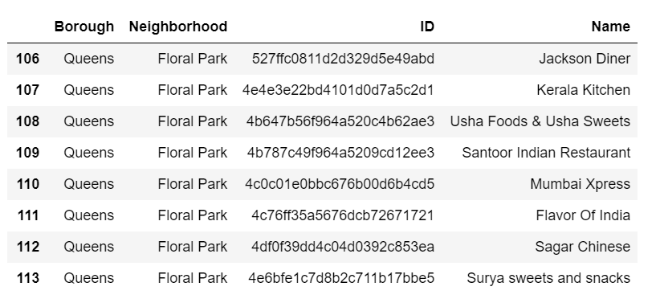
RESULTS

Slide 10
CONCLUSION
Queens and Manhattan are the best Borough with the highest number of Indian Restaurants!
Floral Park, Richmond Hill, Woodside, Jackson Heights, Manhattan Valley are the best neighborhoods to live in if you fancy Indian Cuisine.
Brooklyn seems to have market potential that can be harnessed by setting up an Indian Restaurant in the Borough.

Slide 11
THANK YOU

