Slide 1
Progress of minimum wage from 1968 to 2017
Our Story:
Economic hard time ahead of us.
Poverty statistics and how it relates to minimum wage.
Minimum wage hasn’t increased since 2009 (7.25 per hour).
Presented by:
Ivan and Ritika

Slide 2
Data finding and analysis
Searching on google to find minimum wage, poverty data.
Found minimum wage for each state between 1968 to 2017 on Kaggle.
Found poverty data for each state between 1998 to 2017 on api.census.gov.
Raw data from Kaggle:
"Year","State","Table_Data","Footnote","High.Value","Low.Value","CPI.Average","High.2018","Low.2018"
"1968","Alabama","...","","0","0",34.78333333,0,0
"1968","Alaska","2.10","","2.1","2.1",34.78333333,15.12,15.12
"1968","Arizona","18.72 - 26.40/wk(b)","(b)","0.66","0.468",34.78333333,4.75,3.37
"1968","Arkansas","1.25/day(b)","(b)","0.15625","0.15625",34.78333333,1.12,1.12
"1968","California","1.65(b)","(b)","1.65","1.65",34.78333333,11.88,11.88

Slide 3
Data clean-up
Steps taken to clean-up data :
Raw data load in data frame and updated Nan.
Data dictionary for filling missing data
API call to get poverty data
Merging Data (updated raw and poverty data)
Used Latitude and Longitude csv file for US States and merged with above data.
Final clean-up and saving data in csv.
Final updated data
State,Latitude,Longitude,Year,Minimum Wage,CPI Average,Wage equivalent in 2018,Poverty Rate
Alabama,32.806671,-86.79113000000001,2012,7.25,229.5939167,7.93,19
Alabama,32.806671,-86.79113000000001,2013,7.25,232.95708330000002,7.82,18.9
Alabama,32.806671,-86.79113000000001,2014,7.25,236.73616669999998,7.69,19.2
Alabama,32.806671,-86.79113000000001,2015,7.25,237.017,7.68,18.5
Alabama,32.806671,-86.79113000000001,2016,7.25,240.0071667,7.59,17.2
Alabama,32.806671,-86.79113000000001,2017,7.25,245.11958330000002,7.43,16.9

Slide 4
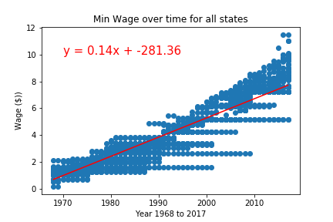
Data Dive – All states min wage
rvalue = .94

Slide 5
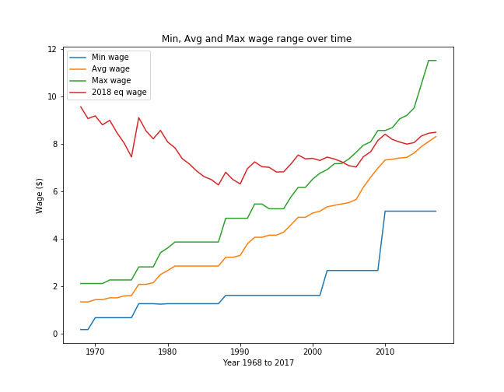
Min, avg and max wage change overtime

Slide 6
Data Analysis for 3 states with min and max wage change
Analyzed all states to find which states had minimum and maximum wage change between 1968 to 2017.
Used statistics to find correlation between minimum wage and poverty rate for the states (shown below)
State | Change Type | Change amount | Avg poverty rate | Correlation Factor
Georgia | Min Change | $3.55 | 15.45 | 0.55
Wyoming | Min Change | $3.95 | 10.715 | -0.14
Virginia | Min Change | $5.65 | 10.36 | 0.9
Massachusetts | Max Change | $9.40 | 10.27 | 0.57
Washington | Max Change | $9.40 | 11.69 | 0.64
District of Columbia | Max Change | $10.10 | 17.85 | 0.19

Slide 7
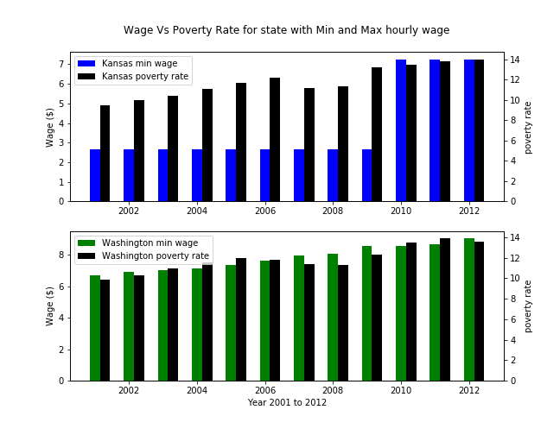
Data Analysis for stateS that has min and max wage

Slide 8
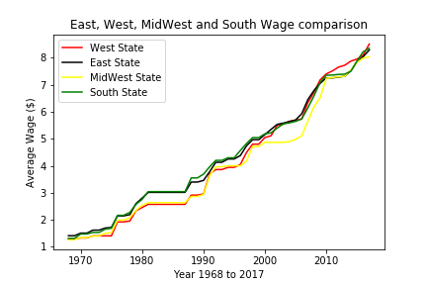
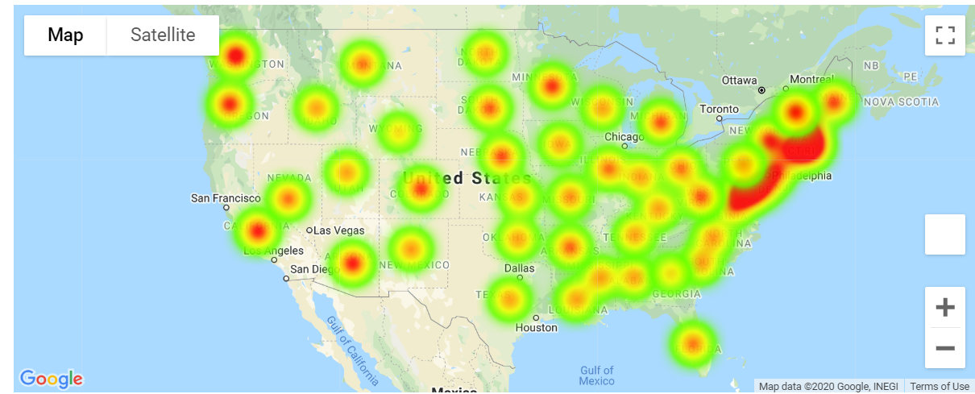
US regions and wages
US 4 region comparison
Coastal vs other States comparison

Slide 9
Conclusions & future work
Conclusion:
It takes recession or big event for minimum wage adjustment.
Even though min wage varied over time the poverty rate stayed same
The equivalent 2018 wages has stayed same over time
Future Work:
Add more dimension in analysis (state index, average household income).
Include income by gender.
Add employment/unemployment rate.

Slide 10
Thank you!!! Questions??

