Slide 1
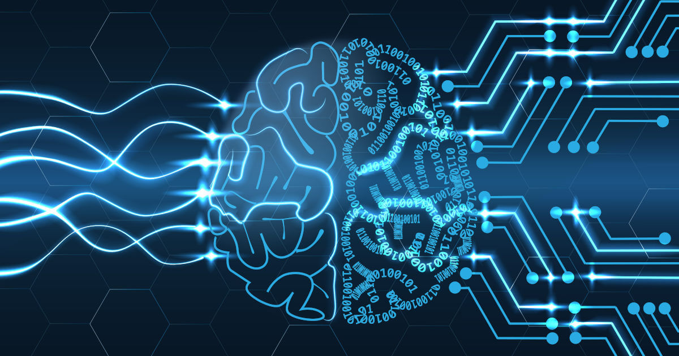
Introduction to Keras
Ivan Reyes

Slide 2

Introduction
Keras is a deep learning framework for Python
https://keras.io/
Notes:
Las aves del mismo plumaje vuelan juntas.

Slide 3
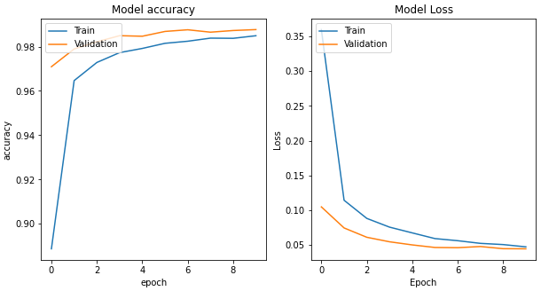
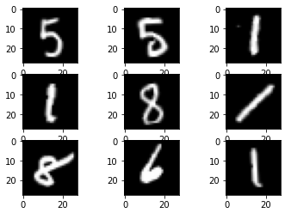
Pipeline
MNIST
Data Collection
Preprocessing
Model
Evaluation
Fashion MNIST
CIFAR10
MLP
CNN

Slide 4

Activity
https://colab.research.google.com/

Slide 5
Thanks!
Ivan Reyes

