Slide 1
San Diego Schools The Health of Education is in the Data
Michael Galarnyk
Jillian Jarrett
Orysya Stus
Ivan Stus

Slide 2
DESCRIPTIVE ANALYSIS

Slide 3
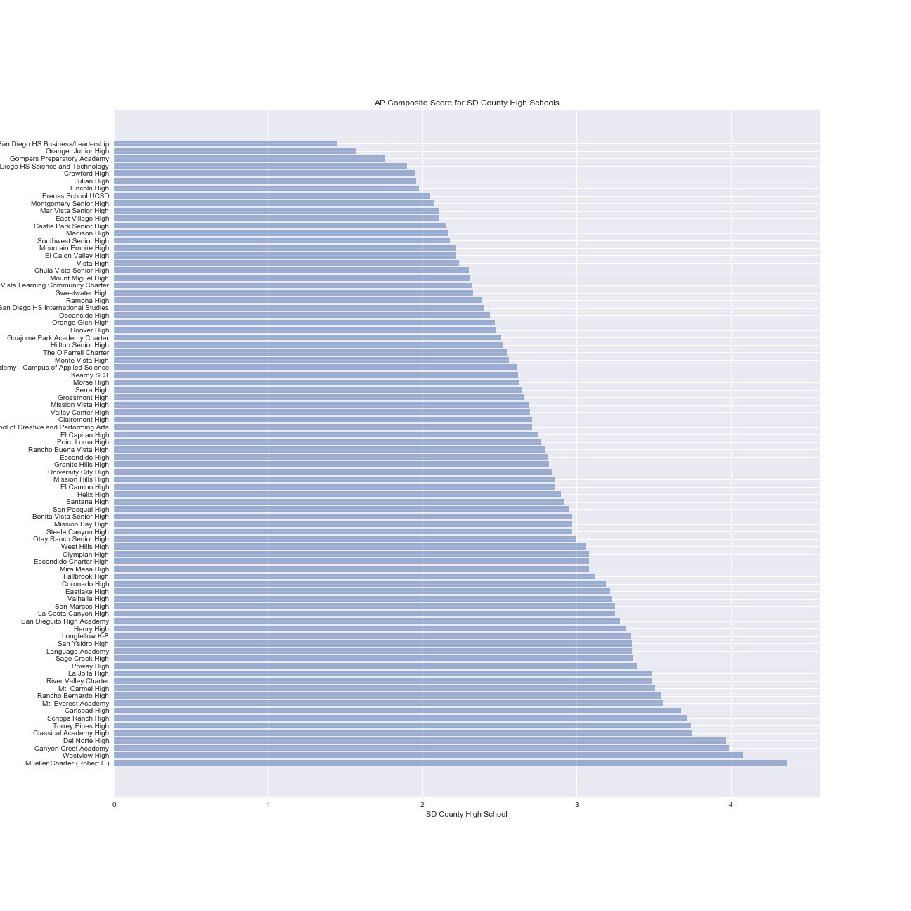
Composite AP Score by School
Highest Composite Scores:
Mueller Charter (Robert L.): 4.36
Westview High: 4.08
Canyon Crest Academy: 3.99
Lowest Composite Scores:
San Diego HS Business/Leadership: 1.45
Granger Junior High: 1.56
Gompers Preparatory Academy: 1.76

Slide 4
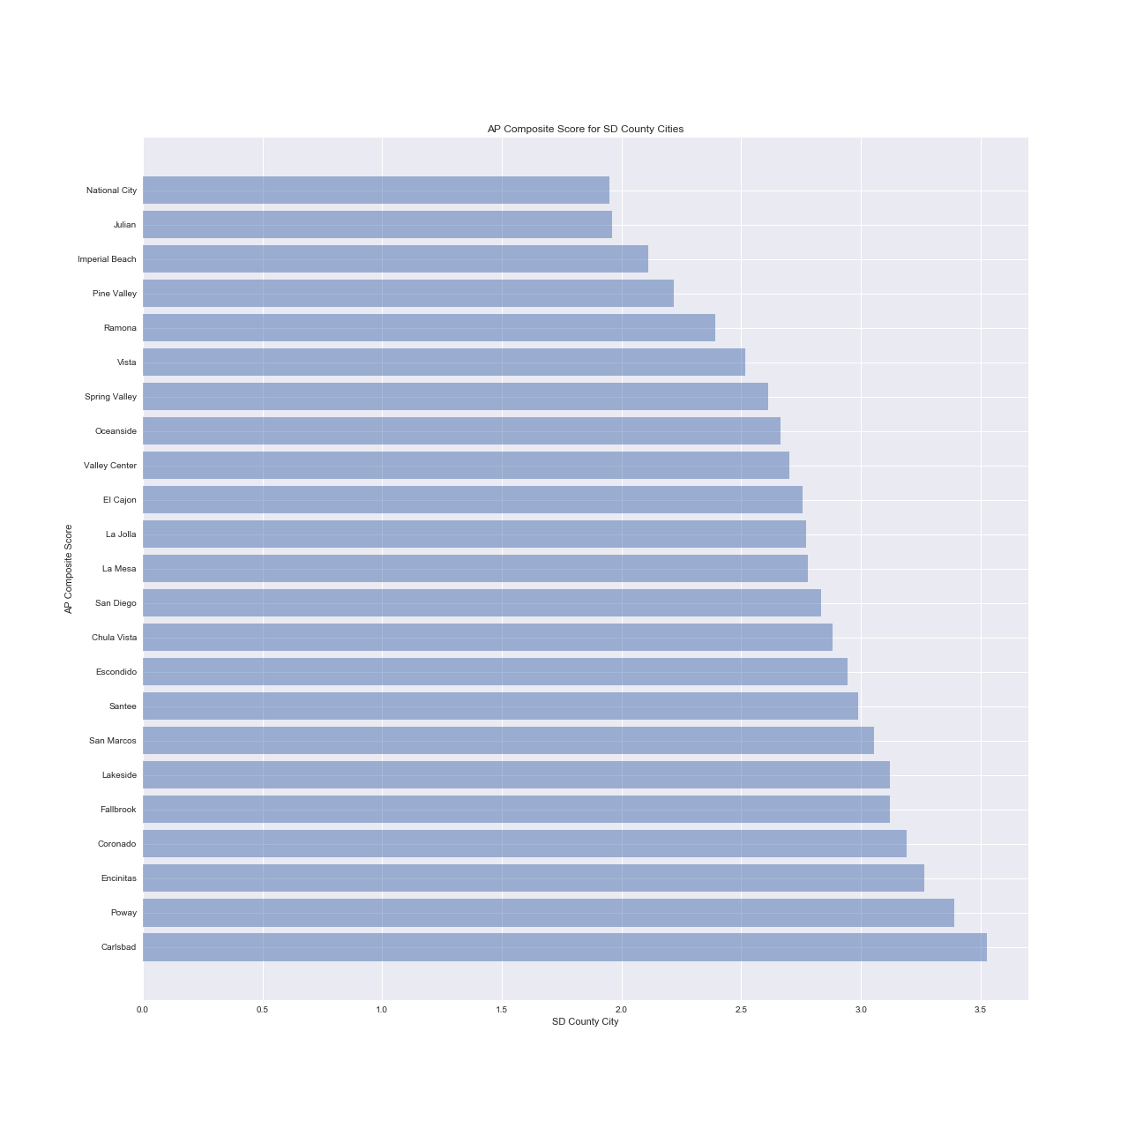
Composite AP Score by City
Highest Composite Scores:
Carlsbad: 3.525
Poway: 3:39
Lowest Composite Scores:
National City 1.95
Julian: 1.96

Slide 5
CORRELATIONAL ANALYSIS

Slide 6
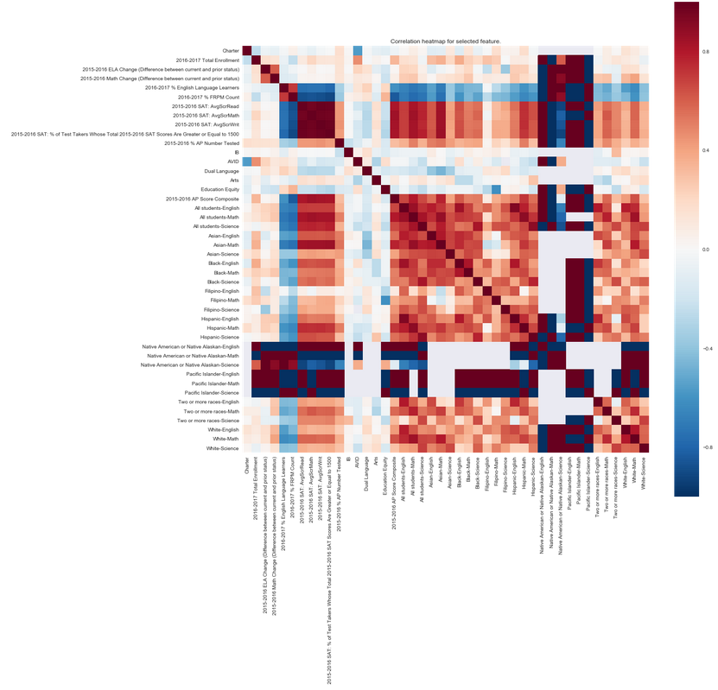
Heatmap of feature correlations

Slide 7
Correlation Heatmap Analysis
AP Composite Score is negatively correlated with English Language Learners and FRPM (free or reduced lunch meal) Count, showing that those that are learning English or have lower economic status do not have high AP composite scores.
AP Composite Score is positively correlated with any of the SAT scores, showing that success in one type of an exam in success in others.
FRPM was also negatively correlated with SAT scores, showing that this group of individuals do not score as high as their counterparts.
AVID and Charter and negatively correlated, meaning that there are less AVID programs in Charter schools.

Slide 8
PREDICTIVE ANALYSIS

Slide 9
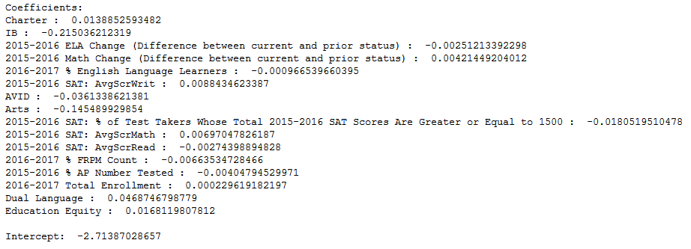
Predictive Model: Linear Regression
Accuracy Metric: Mean Squared Error (MSE) = 0.153885892918
Features used in our model and their coefficients are detailed below:
Interestingly, if the school is a Charter school and the schools 2015-2016 SAT: AvgScrWrit scores high, the Composite AP Score increases, while if the school has an IB or Arts program this decreases the Composite AP Score

Slide 10
Conclusions and Future Directions
Through this project, our team was able to access additional data, GreatSchools, which provided another perspective of the health of San Diego’s education system. We highlighted the differences between high school composite AP scores, interpreted a correlation heatmap, and recommended a predictive model to be used for estimating future Composite AP Scores.
In order to reinforce our findings, additional data can be used to further understand the year to year trends of San Diego high schools.

