Slide 1
KA PLAYGROUND
Features & Test Catalogue
A production platform for enrolment, consent, money, teams and finance — Armour Academy (Kings Network).
Built & tested — with an honest map of what is live, what is engine-ready, and what is next.

Slide 2
OVERVIEW
One platform, three hard problems solved together
• Child safety by construction
Consent that must be signed against the right document; guardian identities that never leak; deny-by-default access.
• Financial integrity
Gapless receipts, immutable order lines, segregation of duty on every manual payment and refund — enforced at the database, not just the screen.
• Multi-party workflow
Students, guardians, teachers, schools and the academy — self-registration, two-decision linkage, and team formation (成團) with real seat capacity.

Slide 3
THE STORY
Three pillars carry the demo
CHILD SAFETY
consent · privacy · isolation
FINANCIAL INTEGRITY
receipts · SoD · no partial pay
MULTI-PARTY WORKFLOW
register · link · 成團

Slide 4
HONEST STATUS
What is live, what is engine-ready, what is next
Enrolment & Consent
BUILT + UI
Admin Cockpit & Platform
BUILT + UI
Team Formation (成團)
BUILT + UI
Bulk Enrolment & Batch Intake
BUILT — no UI yet
Financial Integrity
BUILT + UI
School-Settled Invoicing
BUILT — no UI yet
Onboarding & Linkage
BUILT + UI
Team-Project Finance
BUILT — no UI yet
Anonymous & Child-Safety
BUILT + UI
Learning Delivery
BUILT — no UI yet
6 of 10 pillars have a real UI today. 4 are a tested engine with the screen still to come — shown as such, never as finished.

Slide 5
PROOF
Two independent proof layers
449
automated tests
70
test files
58
reconciliation assertions (nightly)
10
BI invariants DB-enforced
The 449 unit/feature tests and the 58 nightly reconciliation assertions are SEPARATE proofs — a green test suite and a self-reconciling ledger. We never merge them into one flattering number.

Slide 6
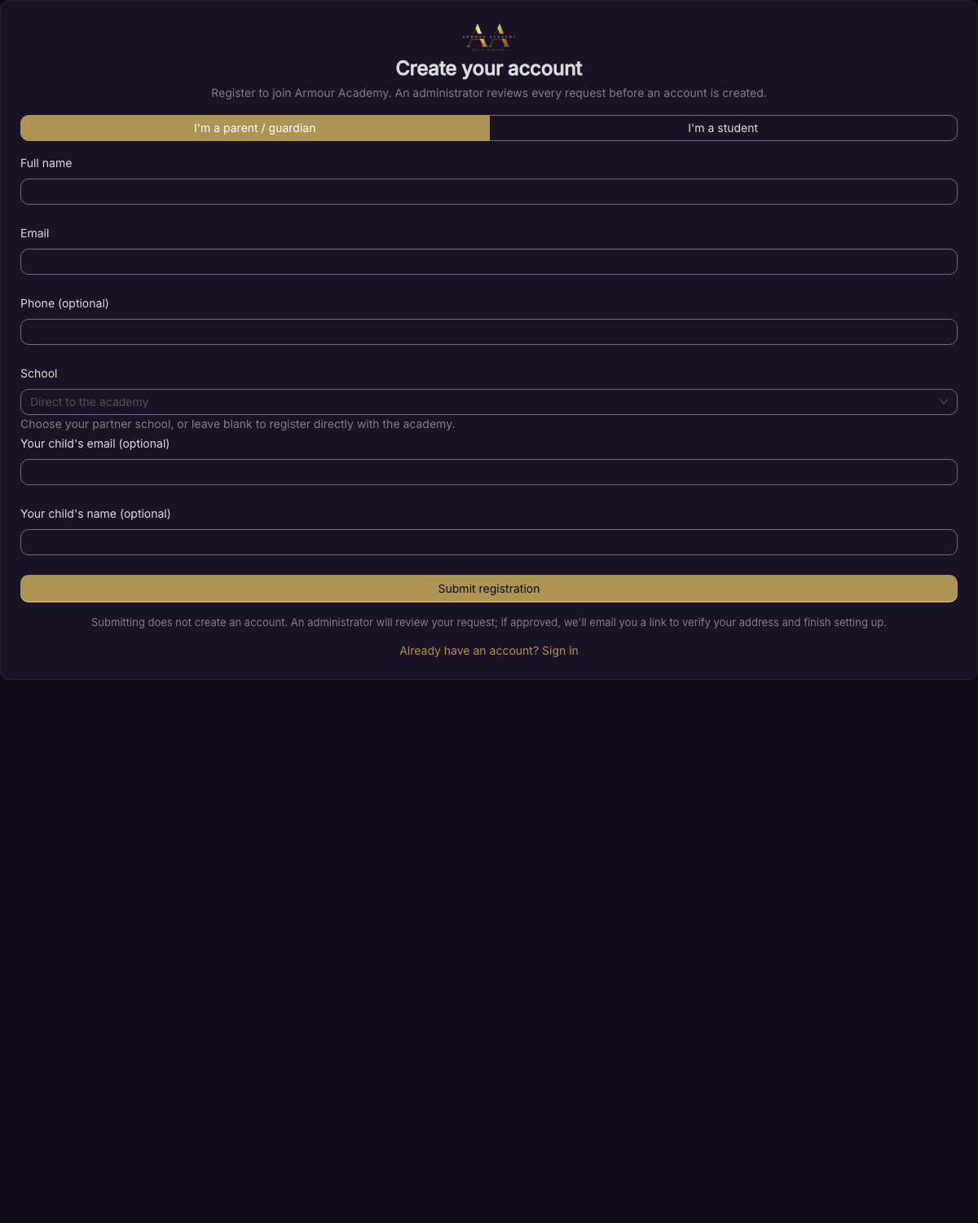
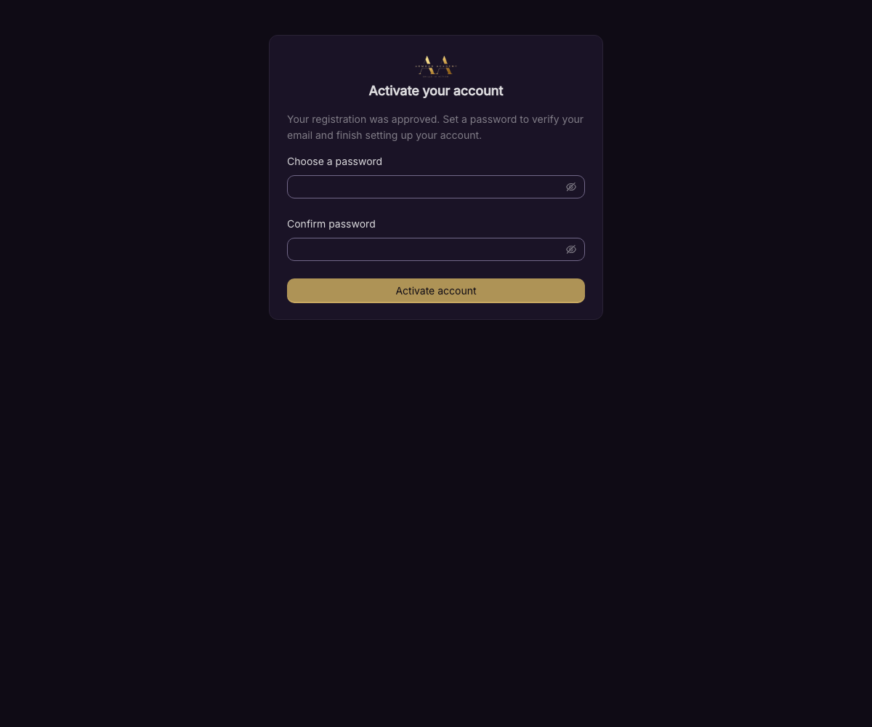
DEMO · ONBOARDING
Self-registration → approval → verify
Public self-registration (anonymous, no enumeration)
Email verification before first login

Slide 7
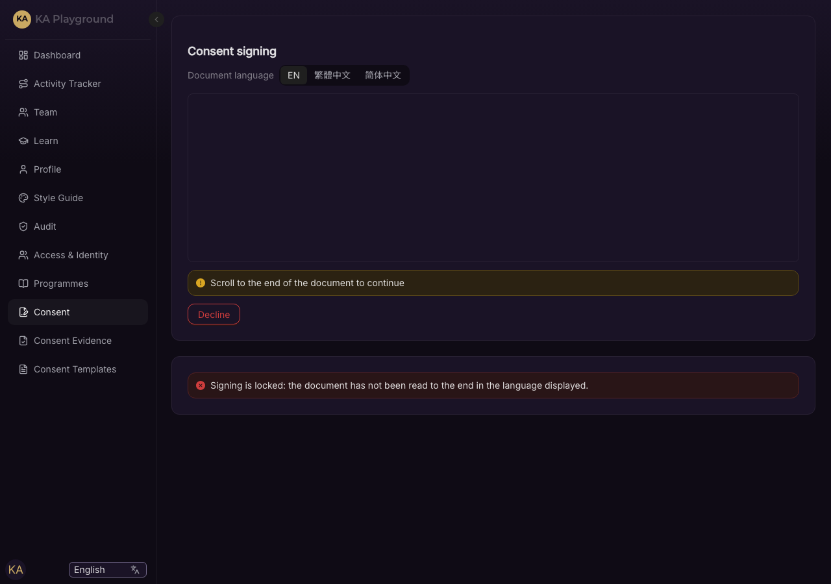
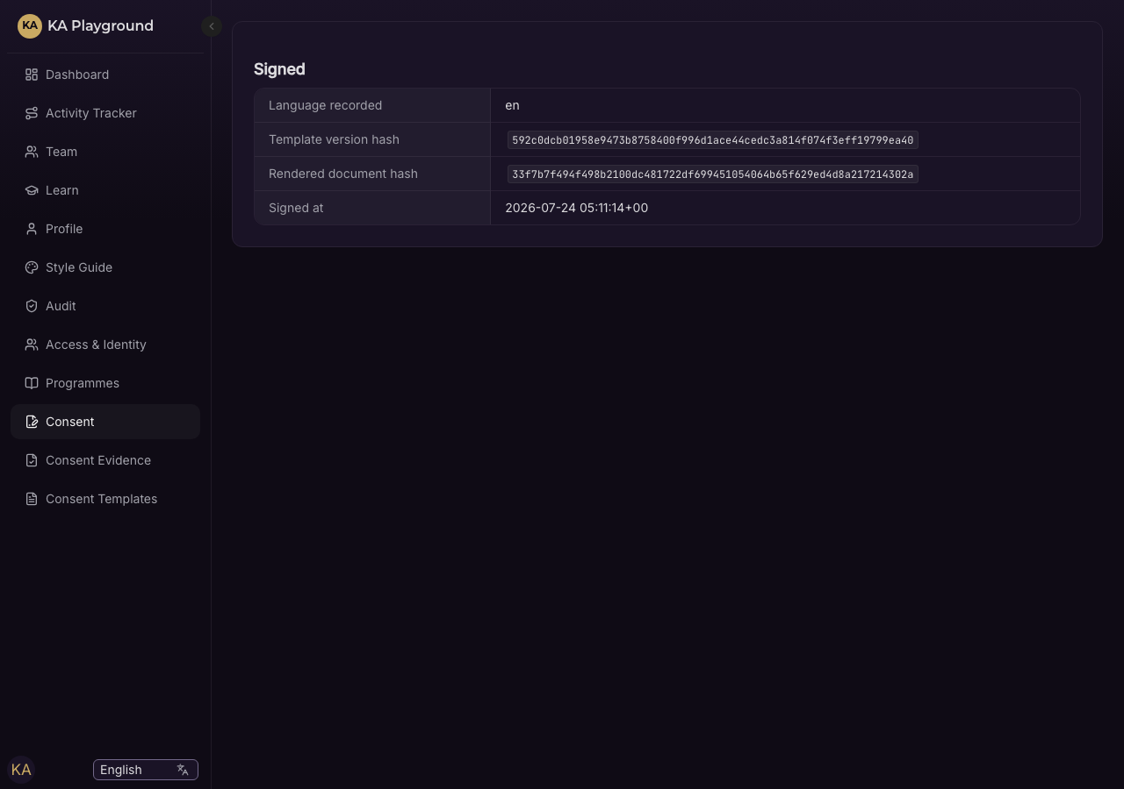
DEMO · CONSENT
In-house e-sign against the right document (BI-6)
Gate unmet — signing is blocked
Signed — hashed to the language-scoped template

Slide 8
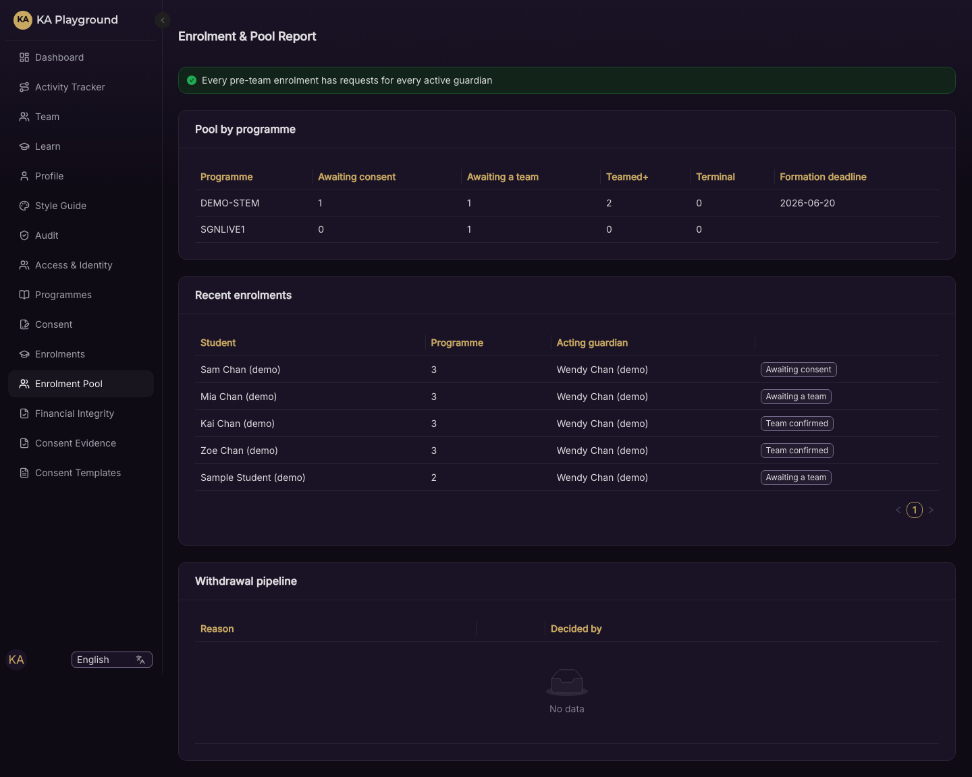
DEMO · ENROLMENT
Enrolment is intent; the awaiting-a-team pool
Consented, unteamed students wait in a pool (no waitlist)

Slide 9
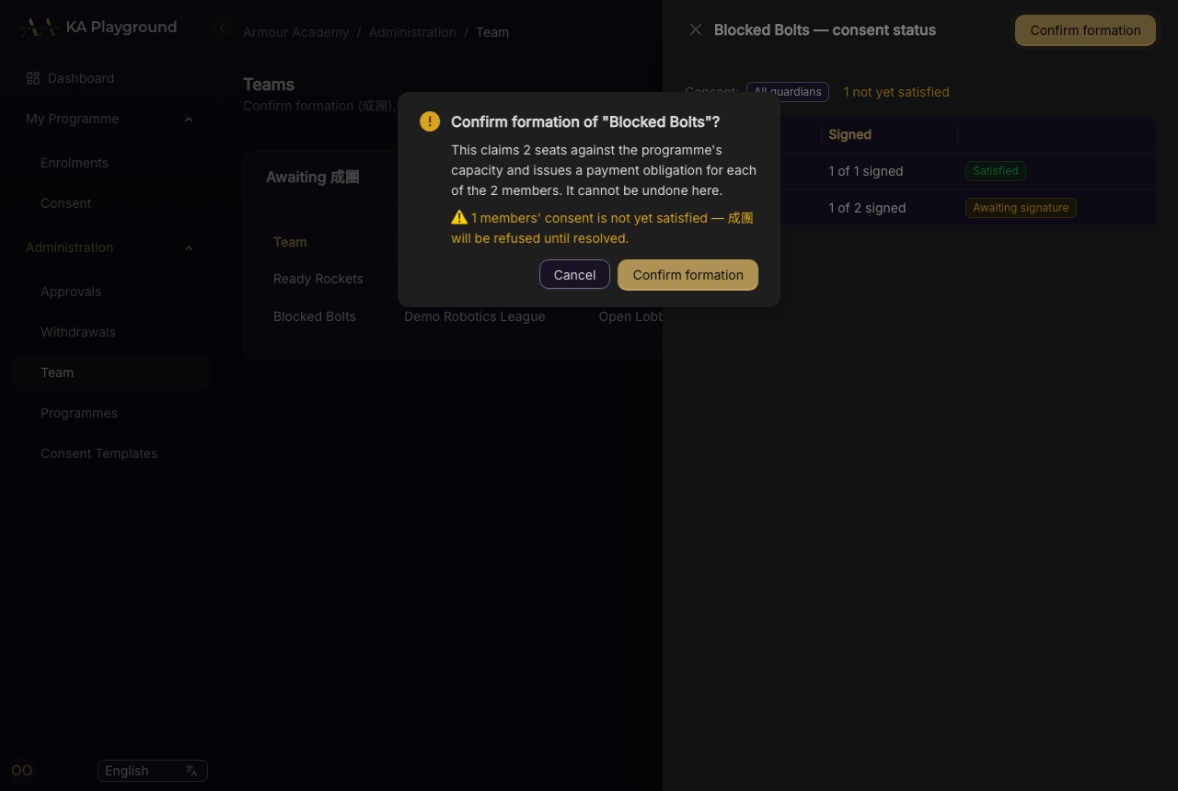
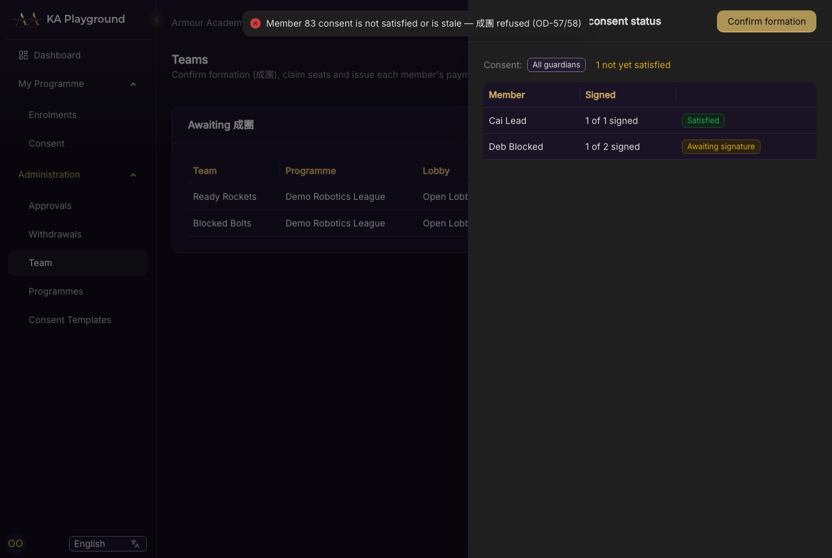
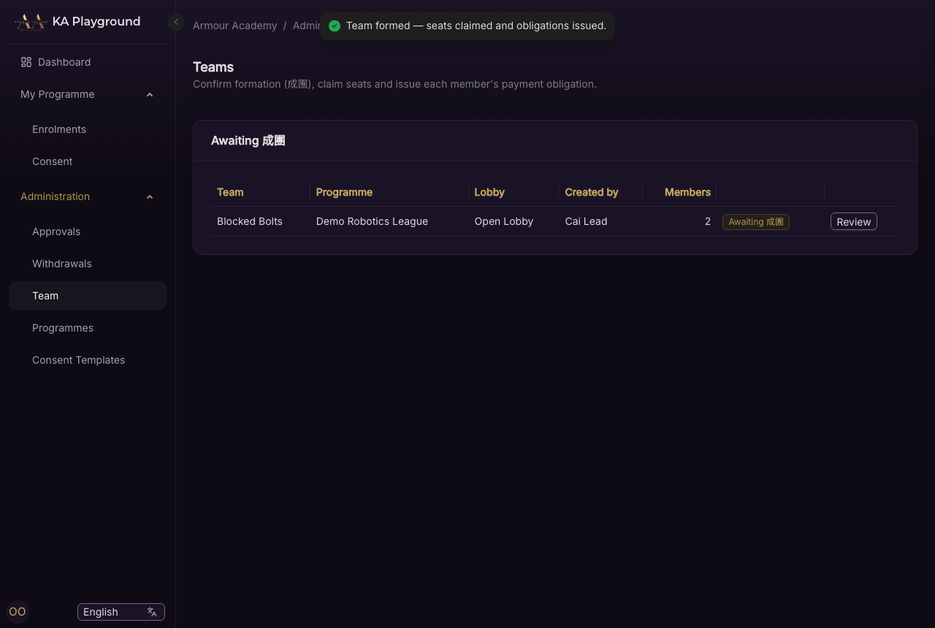
DEMO · TEAM FORMATION (成團)
Advisory confirm, server-authoritative refusal
Advisory over a blocking member
Server refuses (422) — shown, not hidden
Clean 成團 — seats claimed, obligations issued

Slide 10
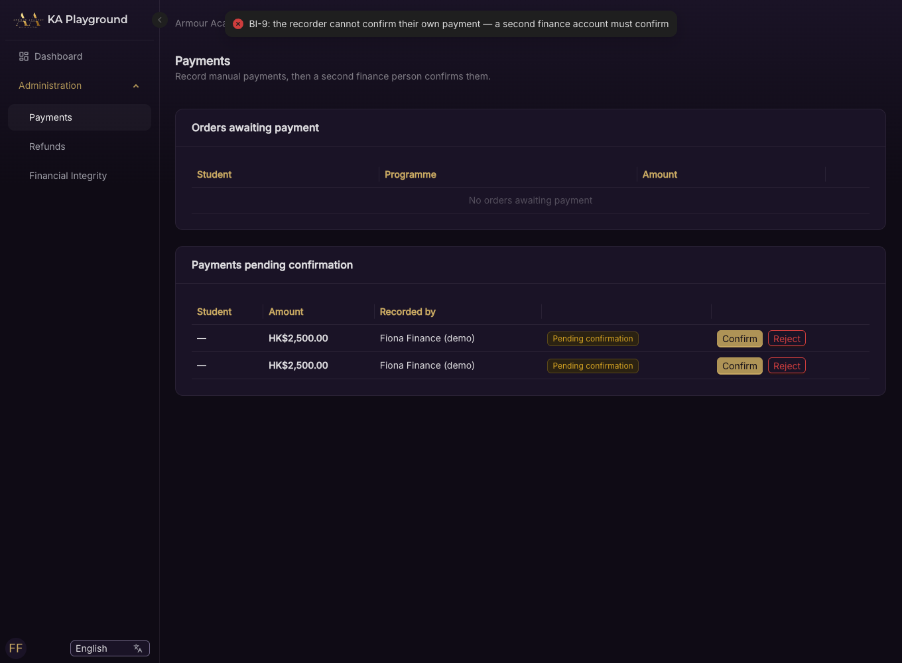
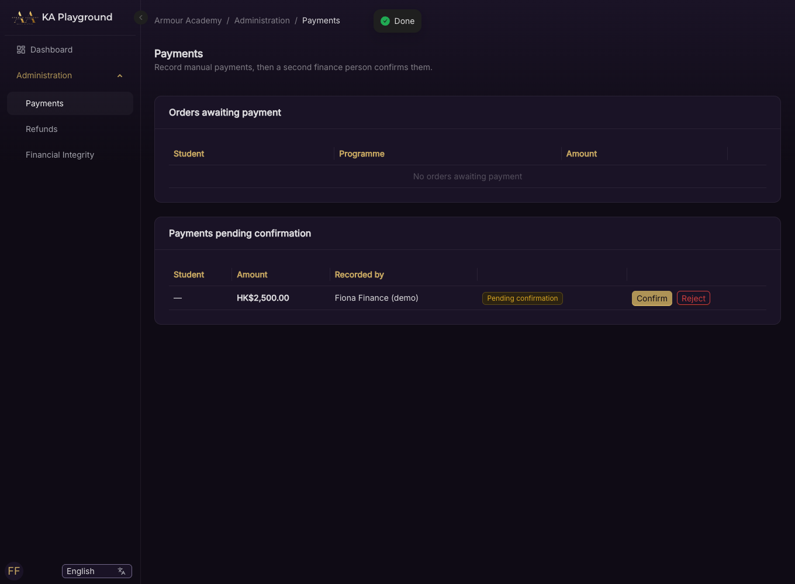
DEMO · FINANCIAL INTEGRITY
Segregation of duty (BI-9), enforced at the database
Recorder cannot confirm their own payment (403)
A second finance user confirms

Slide 11
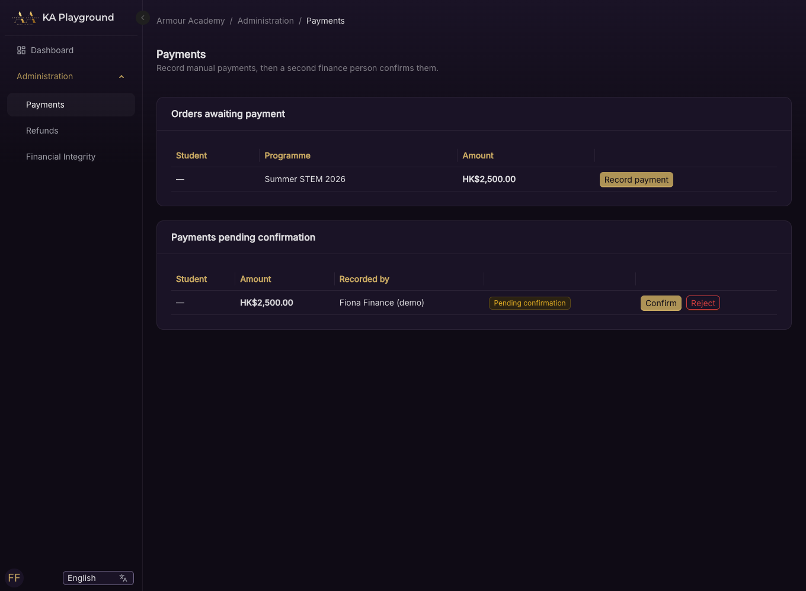
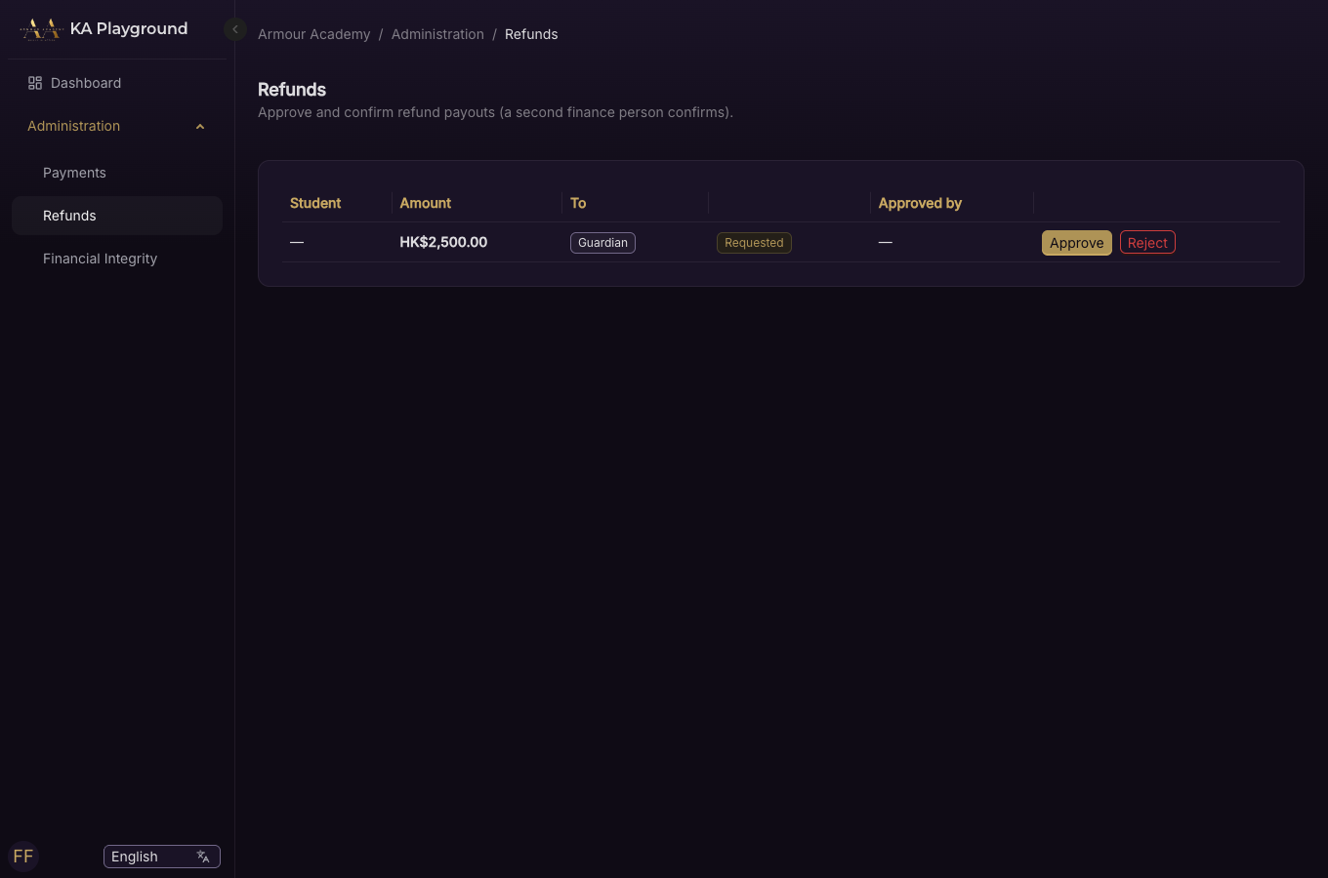
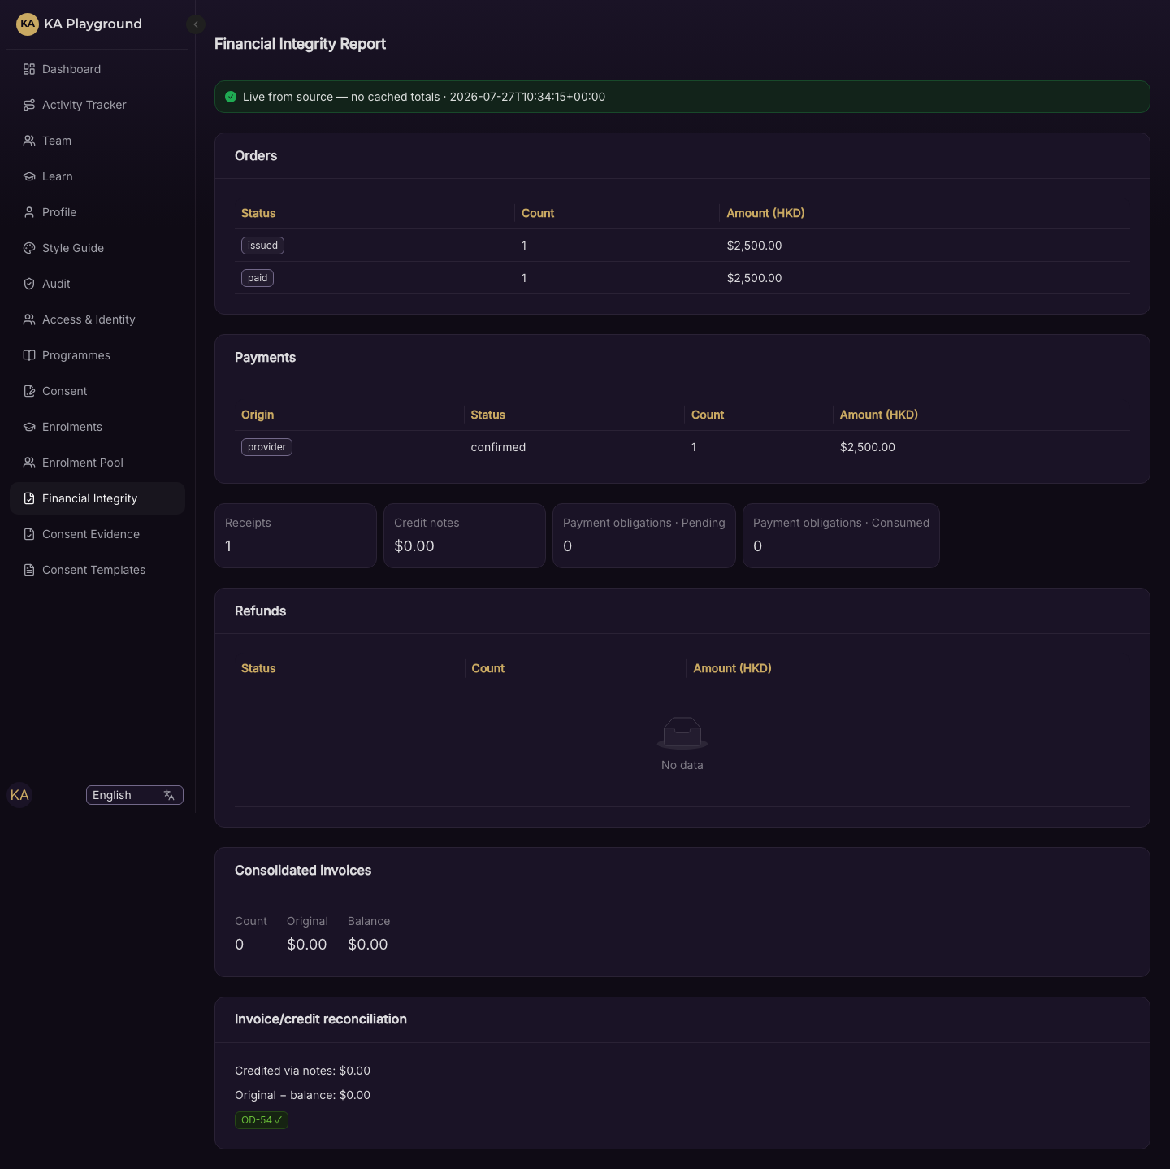
DEMO · FINANCIAL INTEGRITY
Family payments & refunds
Refunds (approve ≠ confirm)
Payments queue
Financial-integrity report

Slide 12
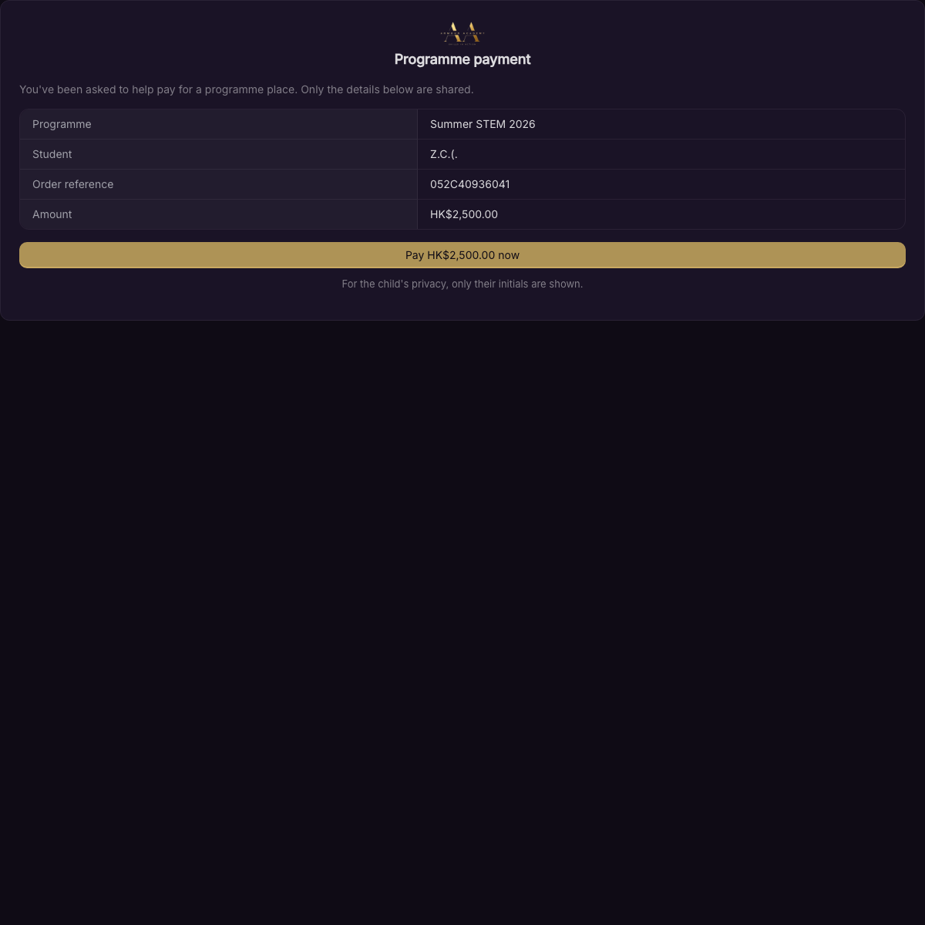
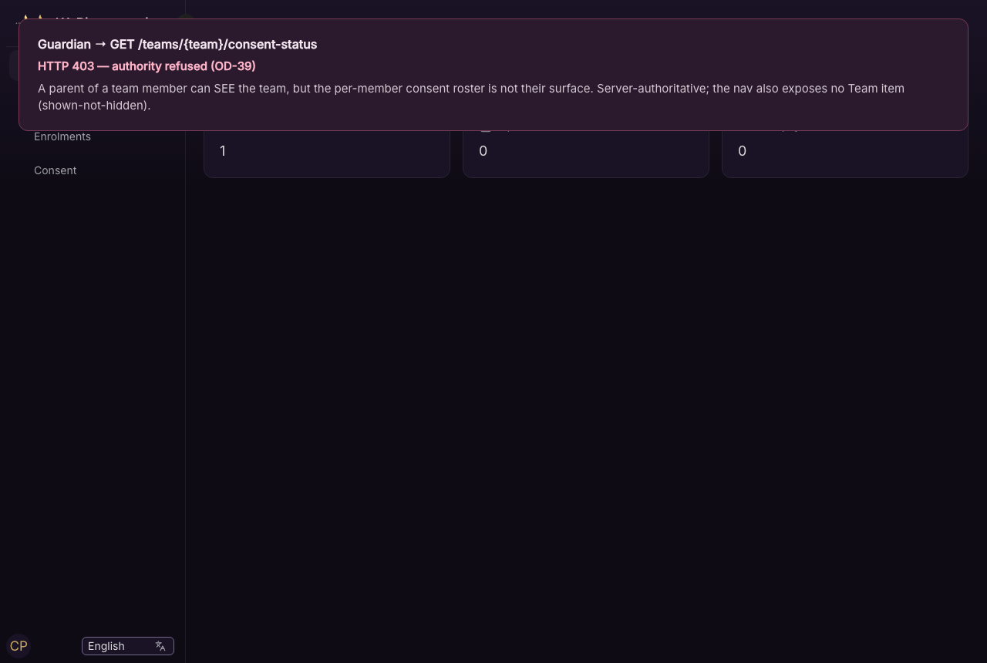
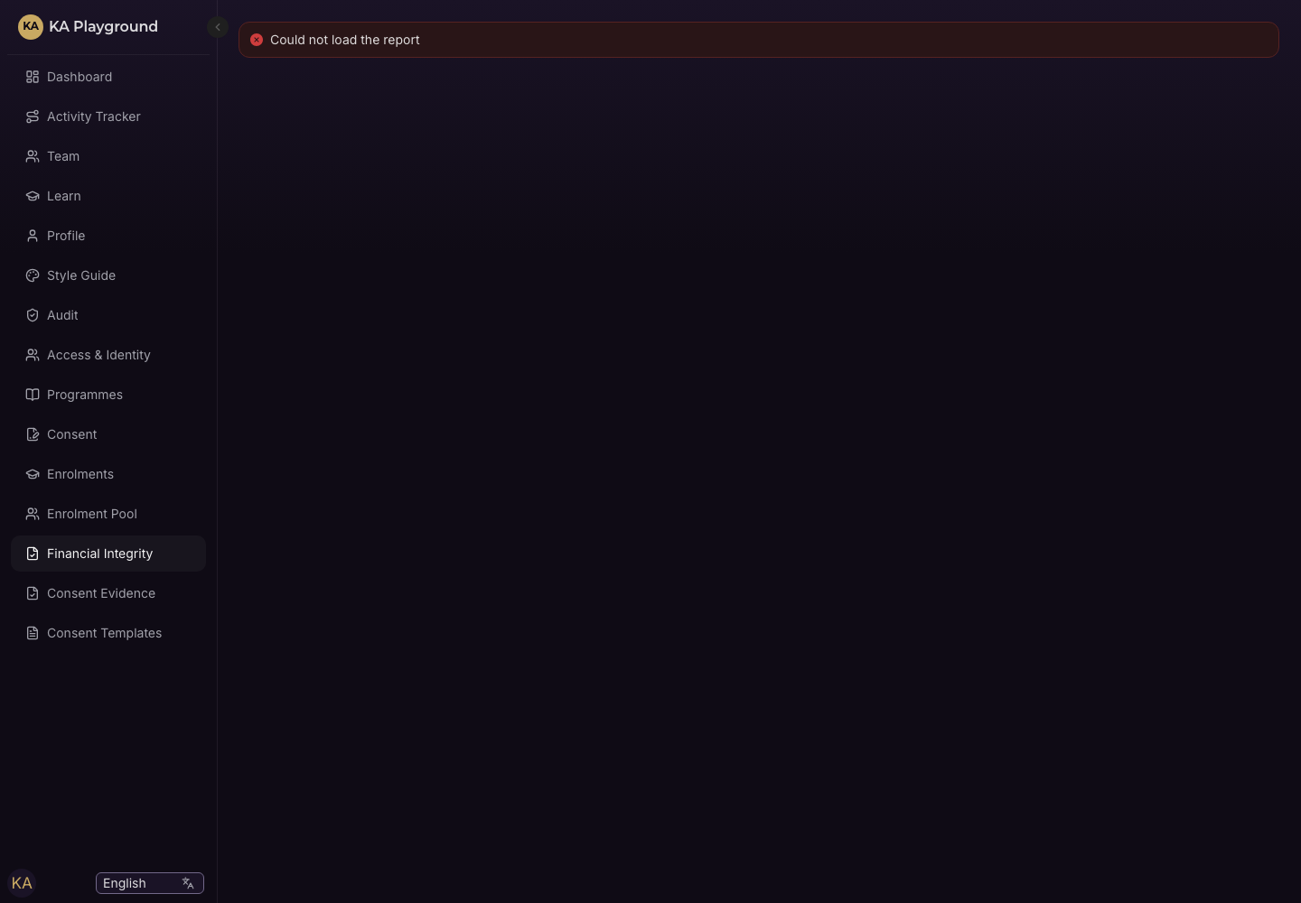
DEMO · CHILD SAFETY
Anonymous pay, privacy & deny-by-default
Guardian denied the roster (403)
Scoped user denied another family's money
Forwardable /pay — initials only, no PII

Slide 13
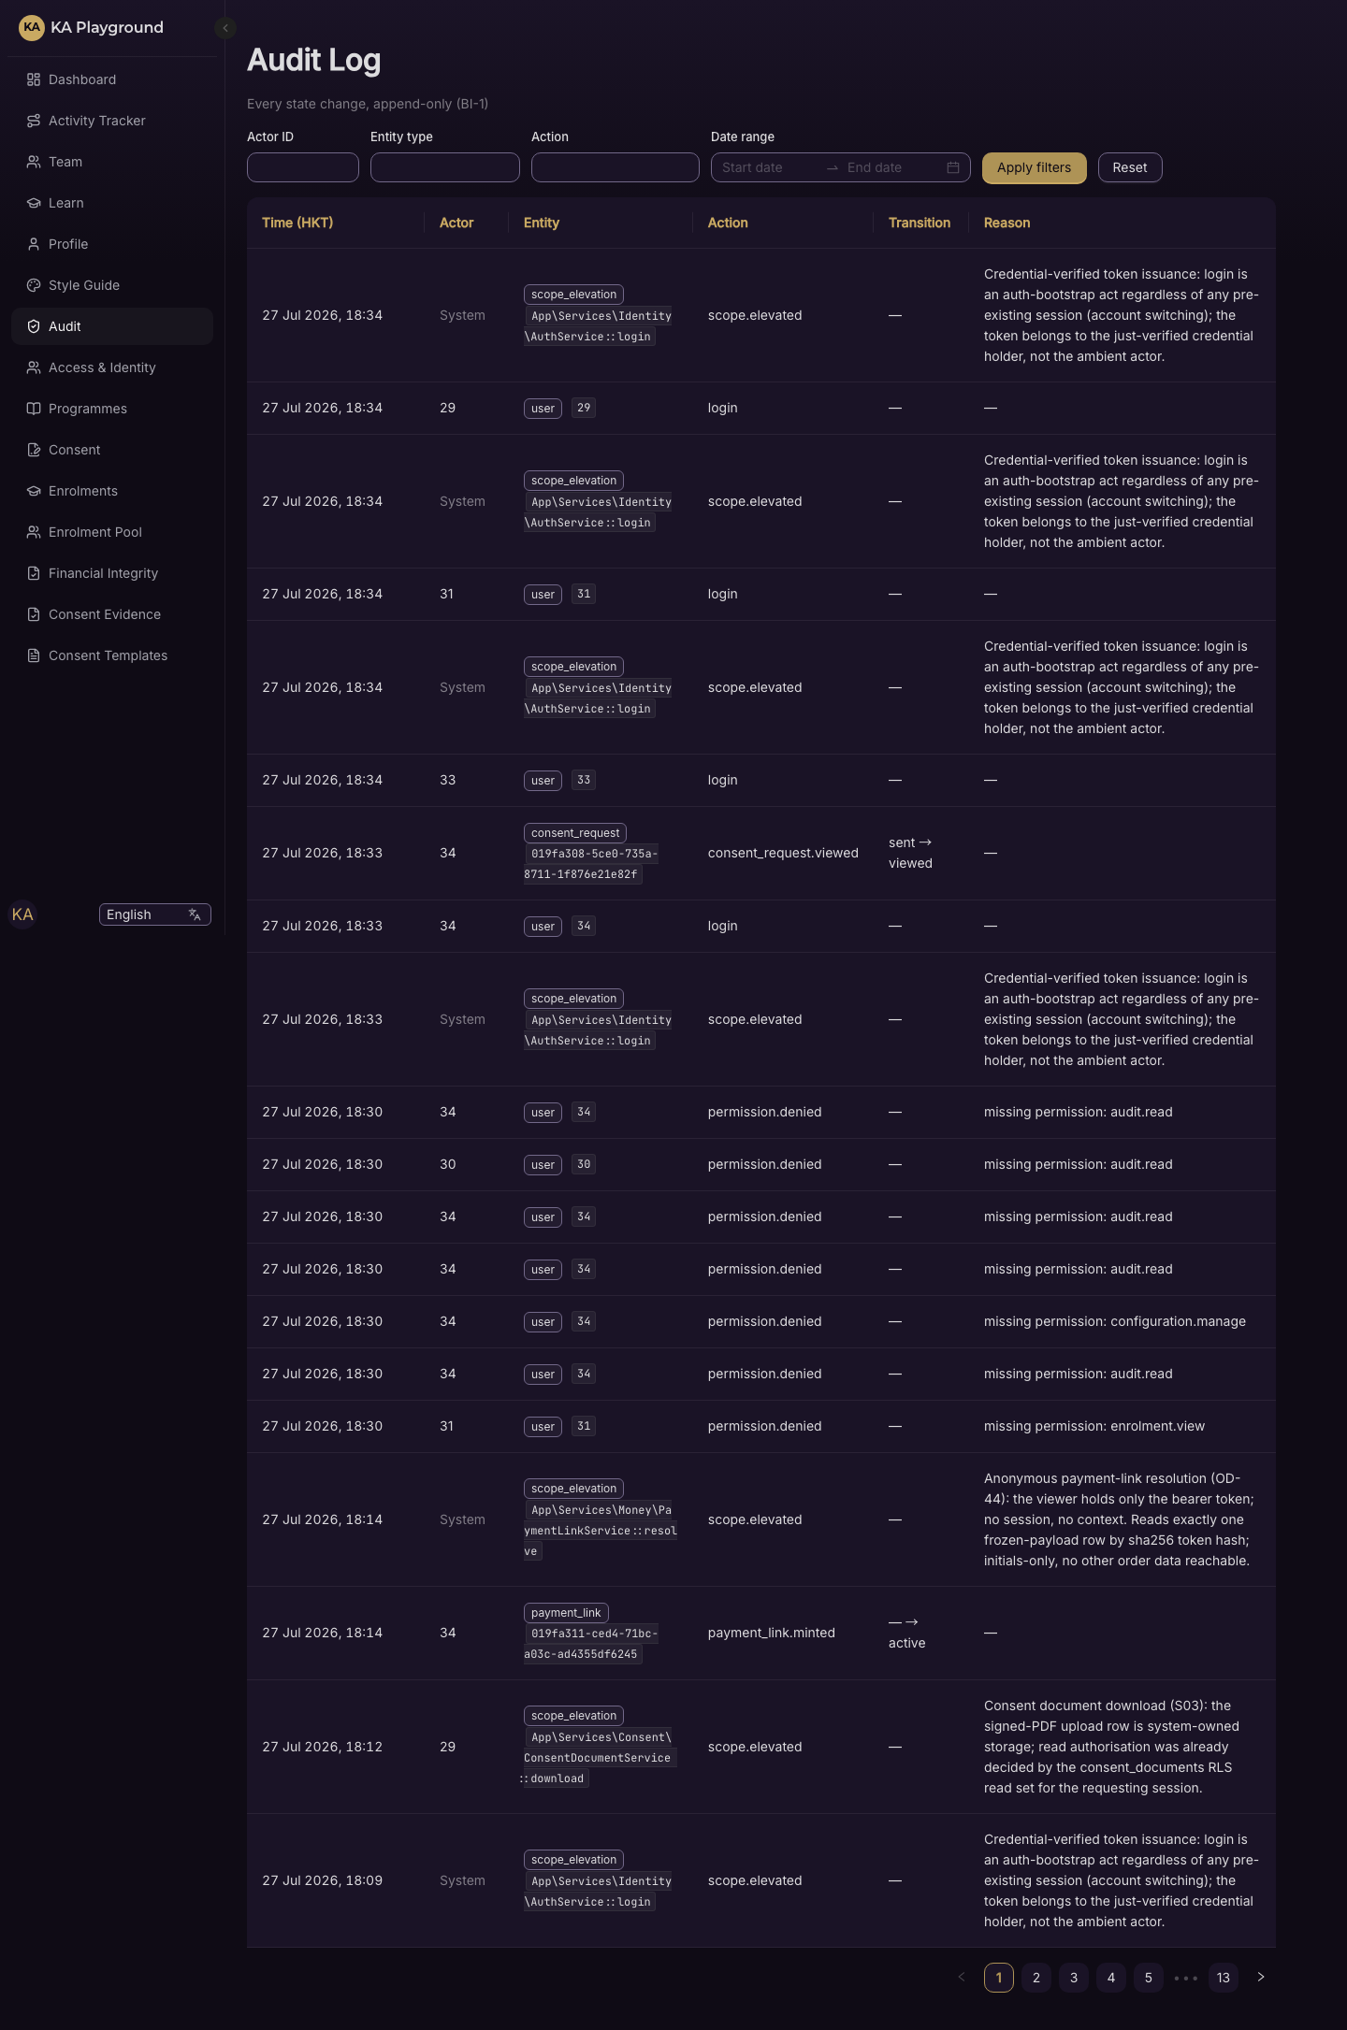
DEMO · ADMIN COCKPIT
Append-only audit spine for the client
Every status transition writes an actor-carrying audit event

Slide 14
BUILT — NO UI YET
Four pillars are a tested engine, screen still to come
• Bulk Enrolment & Batch Intake (S04E)
Scan-gated CSV intake, batch commit as intent, batch dashboard — 18 automated tests, no screen yet.
• School-Settled Invoicing (S04F)
Consolidated invoices where the school is payer, never collector; aging with no silent overdue — 16 automated tests, no screen yet.
• Team-Project Finance (S07)
Record-only budgets, verified transactions with evidence, charity guardrails — 17 automated tests, no screen yet.
• Learning Delivery (S06)
Activation, sessions/attendance, Learn gate, assessment, Member surfaces — 34 automated tests, no screen yet.
These are shown here truthfully — no mock screen stands in for a screen that does not exist.

Slide 15
Technical appendix
Coverage · Build invariants · The reconciliation battery · Elevation & privacy discipline

Slide 16
APPENDIX · COVERAGE
Per-category coverage (three maturity states)
Category | State | Feat | Auto tests | Manual UAT | No-UI
Enrolment & Consent | UI | 10 | 100 | 7 | 0
Team Formation (成團) | UI | 7 | 55 | 3 | 0
Financial Integrity | UI | 8 | 40 | 6 | 0
Onboarding & Linkage | UI | 10 | 96 | 3 | 0
Bulk Enrolment & Batch | engine | 3 | 18 | 0 | 3
School-Settled Invoicing | engine | 3 | 16 | 0 | 3
Team-Project Finance | engine | 4 | 17 | 0 | 4
Learning Delivery | engine | 5 | 34 | 0 | 5
Anonymous & Child-Safety | UI | 6 | 38 | 3 | 0
Admin Cockpit & Platform | UI | 8 | 35 | 1 | 0
TOTAL |  | 64 | 449 | 23 | 15
Plus 58 reconciliation assertions (nightly battery) — a separate proof layer, not in the Auto-tests column.

Slide 17
APPENDIX · INVARIANTS
Build invariants — DB-enforced guarantees
BI-1 audit_events is INSERT-only, enforced at the database — no write path bypasses the audit service.
BI-2 Receipt numbers are gapless, assigned inside the issuing transaction.
BI-3 Every capacity change runs in one transaction with SELECT…FOR UPDATE on the counter row.
BI-4 Enrolment & payment creation are idempotent — a duplicate submit returns the original.
BI-5 Order lines are immutable; corrections are new records (credit notes, refunds).
BI-6 A signed consent's hash matches its language-scoped template version — no signature without a matching hash.
BI-7 Enrolment reaches Withdrawn only through the withdrawal workflow.
BI-8 Every status transition writes an audit event carrying the actor's identity.
BI-9 Segregation of duty: recorder ≠ confirmer on manual payments and refunds — server + DB enforced.
BI-10 Uploaded files are invisible until the ClamAV scan passes.

Slide 18
APPENDIX · THE SPINE
The reconciliation battery & elevation discipline
Nightly reconciliation — 58 assertions, all green
A self-reconciling ledger: every receipt, obligation, invoice, budget and capacity counter must balance to its audited history. A red assertion is a stop, never a 'known-failing' skip.
Elevation discipline — deny by default
Postgres row-level security is FORCEd. The few places that read across scope use an allowlisted elevation (caller + exact reason), and a test enumerates every one — nothing bypasses the audit. The team consent-status read returns booleans and counts only; a guardian's identity never leaves it.

Slide 19
ROADMAP
Pending / not yet built (clearly separate from built)
• UI still to come: Team roles & resolution (S-UX3-3a STEP 3–4), student team formation (S-UX3-3b), attendance (S-UX3-4), and further UX cards (S-UX3-5/6/7, S-UX4).
• Recognition: badges from completed tenures (S08), avatars (S-AVATARS).
• Platform: notifications / dashboards / reporting (S09), hardening & UAT (S10), Logto identity migration (S11).
• Payments: QFPay adapter — Phase 2, gated by the merchant application (the interface is already built).
• Small item: audit label-resolver (friendly labels for raw audit codes).
None of the above has code or tests yet — it is roadmap, never counted as built.

Slide 20
KA Playground
A tested engine you can trust before the screen exists — and an honest map of the rest.
Catalogue: docs/deliverables/KAP-CATALOGUE.xlsx · Deck: docs/deliverables/KAP-PRESENTATION.pptx

