Slide 1
Final Project
Ivar Boström( 2202283)

Slide 2
Original Problem: Project Euler 917
RNG formula
+ seed
Matrix
Number series
Pathfinding
Final cost
Not very interesting
Can’t be materialized
Optimized Problem:
Number series
[...]
Final cost

Slide 3
Problem Details:
Input: Two pseudo random integer arrays A and B, of size N
Imagine a N✕N matrix M such that M[a][b]=A[a]+B[b]
Traverse M from [0][0] to [N-1][N-1], increasing either index by 1 at each step, and summing every traversed position
Find the lowest cost possible for such a path
966774091 | 430987900 | 626947469
1526351690 | 990565499 | 1048653137
1104646022 | 568859831 | 626947469
966774091 | 430987900 | 626947469
1526351690 | 990565499 | 1048653137
1104646022 | 568859831 | 626947469
102022661, 661600260, 239894592
864751430, 328965239, 387052877

Slide 4


Ultra-naive solution: Separately calculate every path
Length of paths
Number of paths
Way too many additions
General purpose state of the art: Dynamic programming
Reasonably effective for small N
The Euler problem asks for N=10000000
We want fast computation for any input the memory can handle
The goal is O(N), requiring a heavily specialized algorithm.

Slide 5
First realization:
We know every row and column must be traversed at least once
Thus, we can preemptively sum up the cost of all columns and rows
Then, at traversal, add the cost of the row or column stayed on
966774091 | 430987900 | 626947469
1526351690 | 990565499 | 1048653137
1104646022 | 568859831 | 626947469
102022661, 661600260, 239894592
864751430, 328965239, 387052877
864751430 328965239 387052877
102022661
661600260
239894592
2584287059

Slide 6
Second realization:
We can also preemptively add the cost of fully traversing the cheapest row and cheapest column.
This allows us to subtract the cost of the cheapest row from all rows, and the cheapest column from columns.
864751430 328965239 387052877
102022661
661600260
239894592
2584287059
535786191 0 58087638
0
559577599
137871931
3446262859

Slide 7
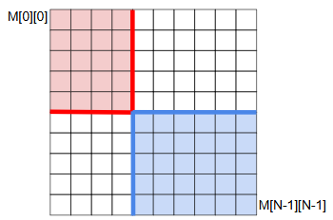
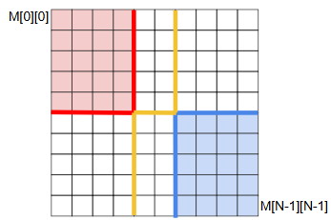
Third realization:
The cheapest row(s) and column(s) are now free.
Traversal can be split into reaching either of them from the start and end.
In these images, we want to reach a red line from the start, and a blue line from the end.
The cost of traversing the remaining gap will always be 0.

Slide 8
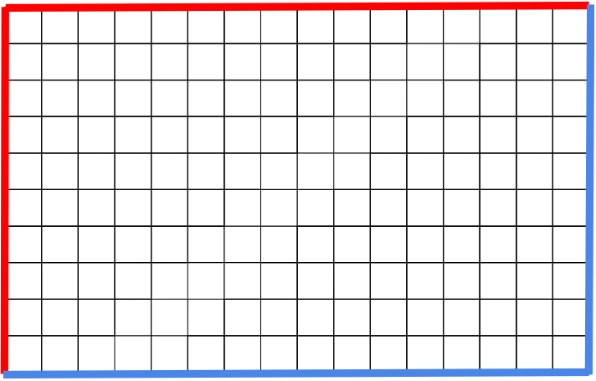
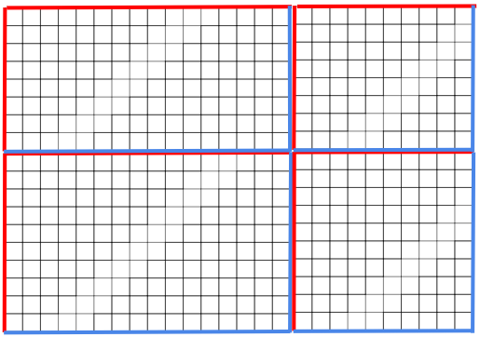
Fourth realization:
Either subproblem can be split into smaller grids.
In each grid, the top left perimeter is the second cheapest row and column, and the bottom right is the cheapest.
Starting from the top left corner the cheapest way to anywhere on the perimeter is to follow the perimeter.
As such, exiting the grid always means passing through another corner.
Once the corner is reached however, this marks the start of a new such subgrid.
This means we only consider turning once reaching a new column or row that is the cheapest so far.

Slide 9

Complexity and threading:
Summing values, normalizing, finding increasingly smaller values. O(N)
4 threads, one for each array in each direction. More threads by chunking.
4 threads for consolidating the chunks. O(ln(N))
2 Threads for final pathfinding, one per subproblem. O((ln(N))²)

Slide 10
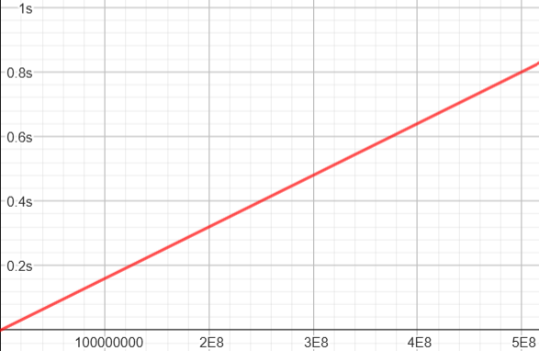
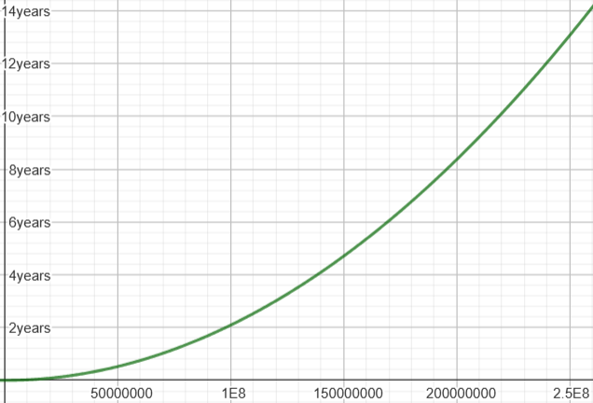
Results:
Code implementation is valid for N=1,2,10 which are the control values provided by the Euler Problem.
On my device running with N=10⁸ takes 0.16s with 8 threads, or 0.65s with 1 thread.
As computationally, parallelization is near perfect in the costly segment, the algorithm is likely memory bound.
Extrapolating based on tests where N=10²,10³,10⁴, a dynamic programming approach is expected to take 2 years.
My device does not allow running for N=2.5*10⁸, likely due to hardware memory limitations.
At N=5*10⁸, the code does not compile due to memory guardrails.
As such, we can extrapolate sub-second speeds for every possible input size.

Slide 11
Executables:
MatrixTraversal: Calculates and prints the cost for N=10⁸
MatrixTraversalAccuracy: Prints calculated and expected values for N=1,2,10
MatrixTraversalTiming: Times the code with and without threading for N=10⁸
MatrixTraversalComparison: Times this solution, and dynamic programming for N=10²,10³,10⁴
Thank you!

