Slide 1

1
LIVING LAB
🤗
Hands On Session
🤖
AI-Spielplatz 6th of May 2025
Oliver Welz (ScaDS.AI)
These slides can be reused under the terms of the CC-BY 4.0 license.

Slide 2
LIVING LAB
🤔
What‘s it all about?
💭 Intro to Materials & Resources (own) Setup and how to start
…no worries: it can be overwhelming first but we‘ll do this together and be sure you‘ll learn a lot

Slide 3
LIVING LAB
Intro to general setup, resources, software
Login to PC, WiFi, Cloud-Folder
Overview of software we‘ll use:
Msty (your connection to LLMs that are here to help)
Jupyter/Colab (place where you can program stuff)
GitHub Repository (here you‘ll find materials & resources)
Overview over hardware we‘ll use:
What is a Raspberry Pi? How to start & connect via VNC…
How to apply a sensor?
Which Sensors do we have?
Audio
Camera
[1/2]
🧮 What we‘ll do in this 1st Hands On Session…

Slide 4
LIVING LAB
Hands-On:
Let‘s build our first simple project together
Try or tutorials:
Beginners: Advanced
What is GitHub, Python? - Interact with OpenAIs API
How to use Jupyter/Colab? - Attach a Sensor to RPis GPIO
What is an API?
Dream Big:
First ideas of what you could do? Let‘s discuss!
[2/2]
🧮 What we‘ll do in this 1st Hands On Session…

Slide 5
LIVING LAB
Short Question✋
…how do you feel today [handsign: 👍| 👌 | 👎],
…who tested ai and for what? 🧑‍🎓

Slide 6

LIVING LAB
Laptop Login: open one of the Laptops and login please
User: scadsai
Password: scadsai
WLAN: check & change now and set to auto-connect
SSID: ai-spielplatz
Password: ai-spielplatz
Cloud Link: https://cloud.scadsai.uni-leipzig.de/index.php/s/8TWEMX32KgfrrwF
→ Share Projects, Data, etc.
→ Link expires end of May
💻Getting started…

Slide 7
LIVING LAB
👩‍💻
💾 Software we‘ll use:
What‘s prepared on the Laptops, what could you install on your hardware…

Slide 8
LIVING LAB
🔗 msty.app
a What is Msty?
Msty is a modern AI-Chat-UI, you can use to interact with diverse LLMs – locally as well as online/remote
we have a LLM-Engine installed locally that is called ollama
as LLM provider we use OpenAI (GPT-4o & 4o-mini are available)
Simple usage of local and remote models
Offline-First, Online-Ready: Msty is optimized for offline-usage
Great model compatibility: compatible with models from HuggingFace, Ollama, Open Router, etc.​
Data Privacy (offline mode!): Personal information & chat data won‘t leave the device
Msty
Why Msty Pro / Contra

Slide 9
LIVING LAB
🔗 msty.app
a
✅ Pros
✔ Flexible – use local & remote AI-models
✔ Data Privacy (offline mode!) – Data won‘t leave the device ✔ Features, like RAG (Chat with Documents), Websearch, etc.
❌ Cons
✖ Freemium: „always free“ Version for private usage and premium-subscriptions ✖ Closed Source – not an Open-Source-Project https://docs.msty.app
Msty
Why Msty Pro / Contra

Slide 10
LIVING LAB
Short Demo 📺
…repeating is learning 🧠

Slide 11
LIVING LAB
🔗 jupyter.org
🧠 What is Jupyter? • Jupyter is a powerful interactive coding environment • Works locally on your machine – perfect for offline experimentation • Write and run Python code in cells with immediate output • Great for data analysis, machine learning, and AI prototyping)
✅ Pros ✔ Full Control – runs on your own system, no internet needed ✔ Flexible – integrate any local tools, models, or datasets ✔ Beginner-Friendly – clear cell-by-cell execution
❌ Cons ✖ Setup Required – you need to install Python and Jupyter ✖ Limited Collaboration – not cloud-based unless manually configured
Jupyter
Why Jupyter Pro / Contra

Slide 12
LIVING LAB
🔗 colab.research.google.com
🧠 What is Google Colab? • Colab is a cloud-based Jupyter Notebook platform by Google • No installation needed – runs entirely in your browser • Comes with free GPU support for AI/ML experiments • Perfect for sharing code, collaborating, and quick starts
✅ Pros ✔ Instant Start – works directly in the browser ✔ Free Hardware Acceleration – GPU/TPU for heavy AI models ✔ Easy Collaboration – share notebooks like Google Docs
❌ Cons ✖ Online Only – requires internet access ✖ Session Timeouts – limited runtime for free version ✖ Data Privacy – data is stored on Google’s servers
Google Colab
Why Colab Pro / Contra

Slide 13
LIVING LAB
Short Demo 📺
…repeating is learning 🧠

Slide 14
LIVING LAB
🔗 github.com
🧠 What is GitHub? • GitHub is a platform for sharing and managing code • Enables version control using Git – track changes, collaborate easily • Ideal for team projects, open-source sharing, and code backups
✅ Pros ✔ Collaboration-Friendly – work together on shared code ✔ Version History – track every change over time ✔ Public or Private – control who sees your work ✔ Integrated with Colab & Jupyter – open notebooks directly
❌ Cons ✖ Learning Curve – Git/GitHub can be confusing at first ✖ Requires GitHub Account – to contribute or manage projects
Git-What?
Why GitHub Pro / Contra

Slide 15
LIVING LAB
🔗 github.com/IvaroEkel/AI-Spielplatz
🗂️ Repository Structure [💡… important ]
📁 Warming-Up/ Introductory exercises to get started with AI concepts.​
📁 Tutorials/ Step-by-step guides for various (AI) projects. 💡 most important to start​
📁 Projects/
Your AI projects.​
📁 Data/ Datasets used in tutorials and projects.​
📁 Other_Resources/ Additional materials and references. Not relevant…
📁 Slides/ Presentation slides used during the workshop. 💡always check back here 📁 website/ Files related to the workshop's informational website on GitHub. Not relevant…
Our Repo:
Ai Spielplatz

Slide 16
LIVING LAB
🧑‍🔧
🛠️ Hardware we prepared:
What‘s hardware is prepared, how to start where?

Slide 17
LIVING LAB
🧯
🛠️ Hardware we prepared:
Disclaimer:
Don‘t worry: you can‘t break anything but if 💩happens, it‘s no problem.
You are here to try & learn.
Also: we tried to prepare everything in detail but it happens that we missed something. Feel free to inform us if anything isn‘t working.

Slide 18

LIVING LAB
🔗 raspberrypi.com
🧠 What is Raspberry Pi? • Raspberry Pi is a small, affordable single-board computer • Originally designed for learning programming & electronics • Perfect for AI experiments, robotics, sensors, and creative projects • Runs Linux (e.g. Raspberry Pi OS) – can be used like a tiny PC • Can be used with Python, Jupyter, and local LLMs
✅ Pros ✔ Low Cost – powerful but super affordable ✔ Beginner-Friendly – huge community & tons of tutorials ✔ Flexible Use – AI, smart home, media server, etc. ✔ Offline & Portable – ideal for secure, mobile AI setups
❌ Cons ✖ Basic Setup Needed – install OS on SD card and connect peripherals ✖ Limited Power – not suitable for very large AI models or heavy compute tasks
Raspberry Pi?
What is it & How to start…

Slide 19
LIVING LAB
🔗 raspberrypi.com
🧠 What is GitHub? • GitHub is a platform for sharing and managing code • Enables version control using Git – track changes, collaborate easily • Ideal for team projects, open-source sharing, and code backups
✅ Pros ✔ Collaboration-Friendly – work together on shared code ✔ Version History – track every change over time ✔ Public or Private – control who sees your work ✔ Integrated with Colab & Jupyter – open notebooks directly
❌ Cons ✖ Learning Curve – Git/GitHub can be confusing at first ✖ Requires GitHub Account – to contribute or manage projects
Raspberry Pi?
What is it & How to start…

Slide 20
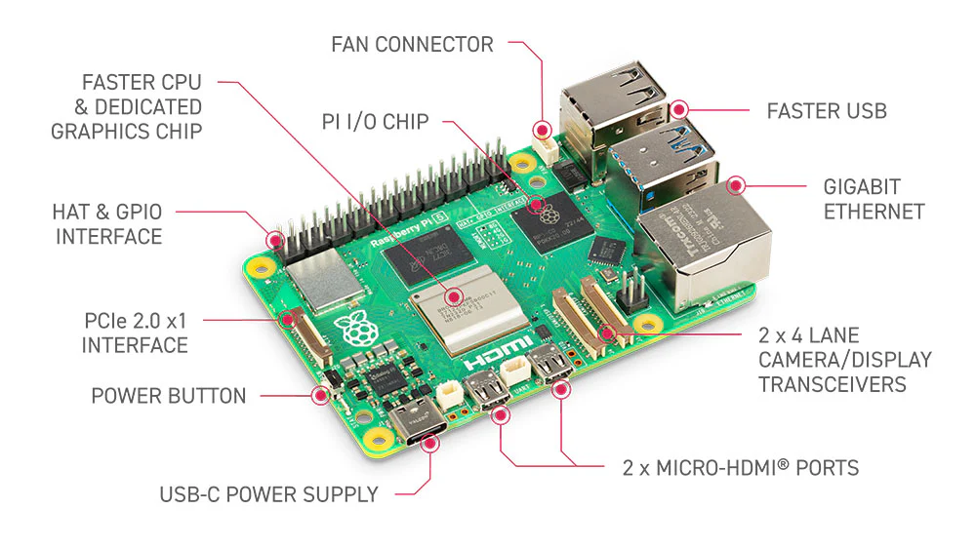
LIVING LAB
🔗 raspberrypi.com
Connectors (for Cameras and so on…)
Raspberry Pi?
What is it & Applying electronics

Slide 21
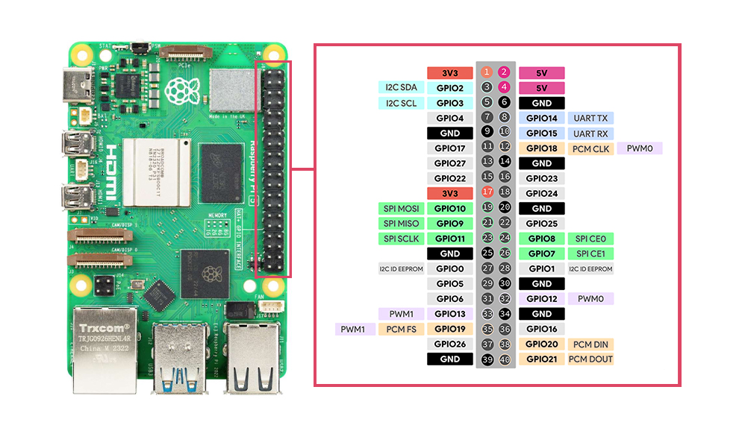
LIVING LAB
🔗 raspberrypi.com
GPIO Pins (General Purpose Input/Output)
➕ What about GPIOs?
• GPIO Pins allow the Raspberry Pi to interact with the physical world → You can connect LEDs, sensors, motors, buttons, etc.
• Ideal for learning about electronics & physical computing → Combine AI + hardware: e.g. control a light with a model prediction
• Easy to start with Python libraries like gpiozero or RPi.GPIO
→ We will apply e.g. the audio-hat here. 🎵
Raspberry Pi?
What is it & Applying electronics

Slide 22
LIVING LAB
🔗 raspberrypi.com
GPIO Pins (General Purpose Input/Output)
➕Pro Tip: always double check power connectors!
Raspberry Pi?
What is it & Applying electronics

Slide 23
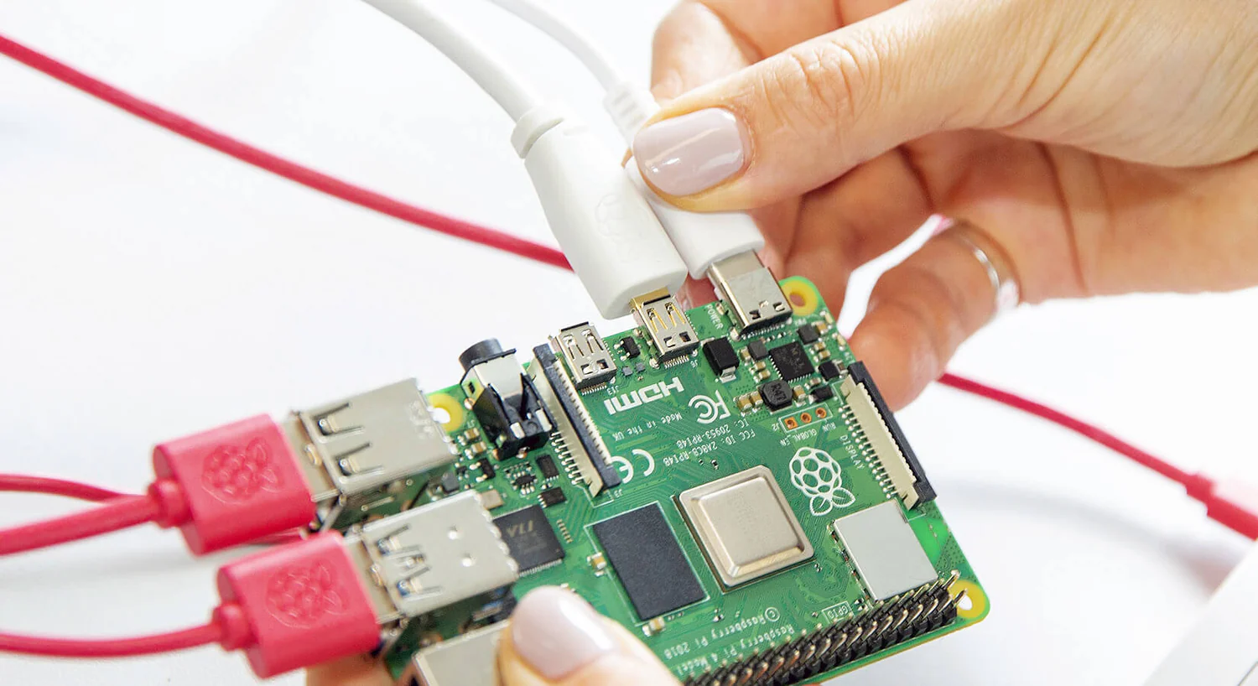

LIVING LAB
🔗 raspberrypi.com
Plug-in the power cable:
No credentials needed
sudo password: rpi5a,b,c or d
How to connect:
We‘ll use VNC (Virtual Network Computing) to login remotely to the Pi via the workshop laptops. Check for the icon of RealVNC in the taskbar.
What you need to connect:
IP-address (see next slide)
Credentials: rpi5a,b,c or d
Troubleshoot
- Check if you are in the correct network (ai-spielplatz)
Raspberry Pi?
Let‘s start it and
connect

Slide 24
LIVING LAB
IP-Addresses:
rpi5a - inet 192.168.0.136
rpi5b - inet 192.168.0.149
rpi5c - inet 192.168.0.188
rpi5d - inet 192.168.0.113
Raspberry Pi?
Let‘s start it and
connect
…Cool! Now we should have remote access to our RPis
Any problems so far? How is the pace?

Slide 25
LIVING LAB
🎛️
🛠️ …speaking Sensors:
Which Sensors do we have?

Slide 26
LIVING LAB
🎧
🛠️ …speaking Sensors:
Audio Hat

Slide 27
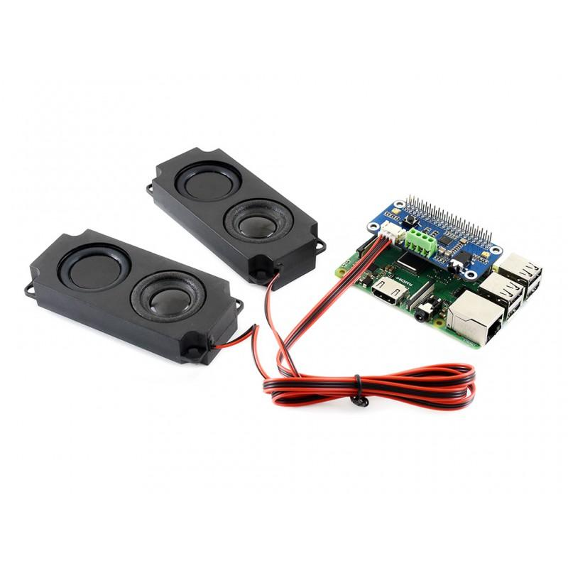
LIVING LAB
Waveshare WM8960 Audio HAT 🎧
Hi-Fi Stereo Sound Card for Raspberry Pi
🧠 What is it?
A compact, low-power audio expansion board for Raspberry Pi
Enables high-quality stereo playback and recording
Ideal for AI voice assistants, audio processing, and audio recognition​
🔧 Key Features
WM8960 stereo CODEC with I2S audio interface
Dual MEMS microphones for stereo recording
3.5mm headphone jack and dual speaker outputs
Compatible with Raspberry Pi's 40-pin GPIO header​
⚙️ Setup Requirements
Install drivers provided by Waveshare [Wiki]
Utilize I2C for control and I2S for audio data
Supports libraries like pyalsaaudio for using it with python
🛠️ …speaking Sensors:
Audio Hat

Slide 28
LIVING LAB
🎦
🛠️ …speaking Sensors:
RPi Camera

Slide 29
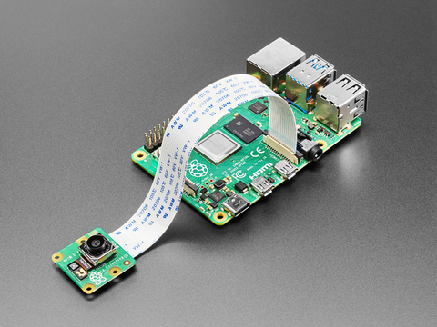
LIVING LAB
Raspberry Pi Camera Module 3 📸
High-Quality Imaging for AI Projects
🧠 What is it?
A compact, high-resolution camera designed for Raspberry Pi
Features a 12MP Sony IMX708 sensor with HDR and autofocus
Ideal for Computer Vision, machine learning (data collection / inference), object detection, robotics & automation tasks
🔧 Key Features
12MP resolution (4608 × 2592 pixels)
Connects via 15-pin MIPI CSI-2 interface
⚙️ Setup Requirements
Compatible with all Raspberry Pi
Utilizes the libcamera library for image capture and control​, usable with opencv-python
🛠️ …speaking Sensors:
RPi Camera

Slide 30
LIVING LAB
AI Cheatsheet 🧠
Best Practices & Practical Trade-Offs
📌 Core AI Principles
• Start simple → Test ideas with basic models first • Data > Model → High-quality data beats fancy algorithms • Avoid overfitting → Your model should generalize, not memorize • Evaluate properly → Always use training and test sets • Explainability matters → Know why your model makes decisions
• Keep it reproducible & document it → Use version control, and logging
Now…
What about AI?

Slide 31
LIVING LAB
📊 Typical Trade-Offs
✅ Do This | ❌ Instead of This | Why?
Use Pretrained Models | Build from Scratch | Saves time & compute
Clean & Label Data Well | Add More Data Unfiltered | Quality > Quantity
Use Baseline Model First | Jump to Deep Nets | Know your baseline!
Simpler, Interpretable Models | Complex, Black-Box Models | Easier debugging & trust
Open-Source Tools (e.g. scikit-learn, Hugging Face Transformers, pytorch) | Custom from Scratch | Faster development & better support incl. pretrained model support
Now…
What about AI?
💡 Pro Tip: Don’t aim for perfection first. Fail fast, learn faster, then iterate with better models and cleaner data.

Slide 32
LIVING LAB
Core AI Concepts 🔁
From Data to Inference – How AI Works
📊 1. Data Collection • Everything starts with data – images, text, numbers, sensors... • The better the data, the better the model
🧹 2. Data Preprocessing • Clean, structure, and prepare the data • Remove noise, fill missing values, normalize formats
🧠 3. Model Training • The model learns patterns from labeled data • Adjusts internal parameters to reduce errors • Example: "This is a cat" vs. "This is not a cat"
A day in the life of an AI model

Slide 33
LIVING LAB
Core AI Concepts 🔁
From Data to Inference – How AI Works
🔍 4. Model Testing / Validation • Check performance on unseen data • Helps detect overfitting or underfitting • Use separate validation and test sets
🎛️ 5. Model Tuning • Adjust settings like learning rate, architecture, etc. • Called hyperparameter tuning
📈 6. Evaluation • Use metrics like accuracy, precision, recall, F1-score • Helps understand real-world performance
🚀 7. Inference • Final model is deployed to make predictions on new data • Fast and efficient – runs in apps, servers, or on edge devices like Raspberry Pi
A day in the life of an AI model

Slide 34
LIVING LAB
1️⃣ Ask your Question(s)! Discuss… 🗣
2️⃣ You can‘t break anything, no worries! 📎
3️⃣ Have Fun 🎉
So then, let‘s go!
Learning by do-ing

Slide 35
LIVING LAB
🤹‍♀️
🧑‍🎓
Let‘s get
practical!
🤼

Slide 36
💭
LIVING LAB
Dream Big…
Let‘s discuss ideas.

