Slide 1
Data science interview task

Slide 2
Preprocessing
See exploration.ipynb and visualisation.ipynb

Slide 3
Feature manipulation
I began preprocessing the dataset by examining the number of observations and unique variables in each column
I dropped 7 columns from the dataset due to their non-informative nature
'EBS_JOB_NUMBER' and 'ID' possessed the same number of unique variables as they did observations
'SNAPSHOT_NUMBER' and 'RM_INVENTORY' only had one unique variable each
'PLANT' was a duplicate of 'Plant'
'Job Coverage' and 'LMS' were already present in one-hot encoded form
data = data.drop(columns=['EBS_JOB_NUMBER', 'ID', 'SNAPSHOT_NUMBER', 'RM_INVENTORY', 'PLANT', 'Job Coverage', 'LMS'])

Slide 4
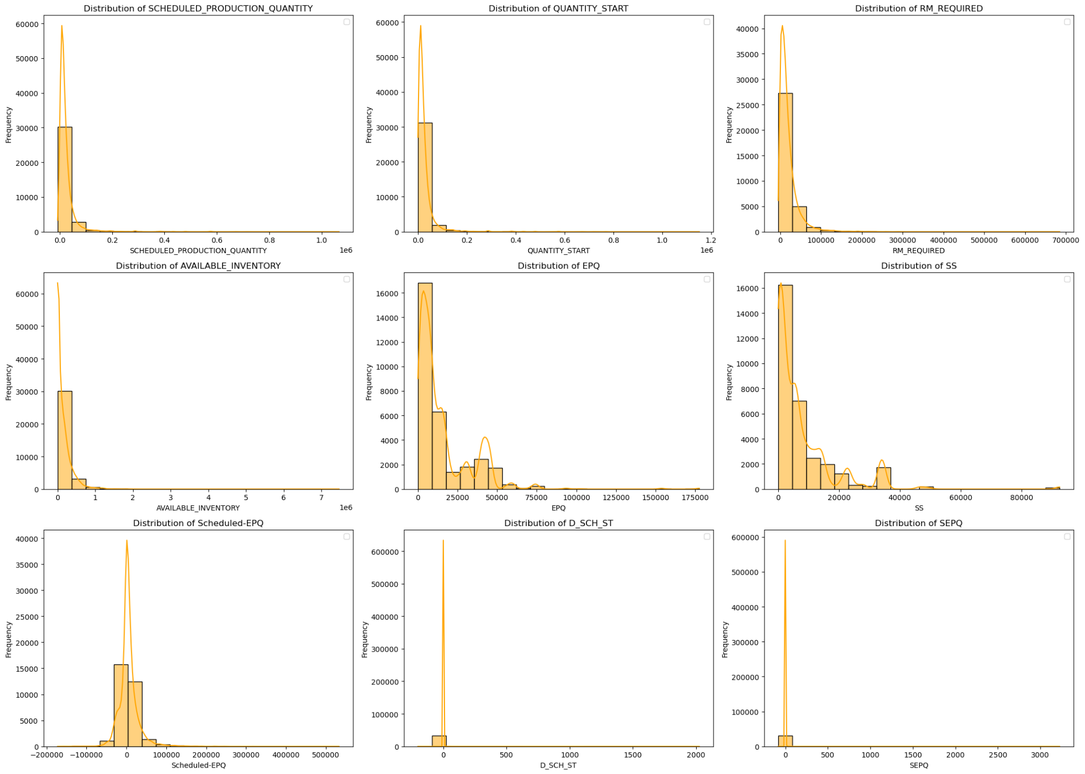
Visualisation
I did not rely on visualisation as my primary method of analysing the data, although I did plot histograms for most numerical continuous features and some scatterplots
From the categorical variables I used to colour the scatterplots, only LMS seemed to provide valuable categorisation information, so I only included those plots here in the slides

Slide 5
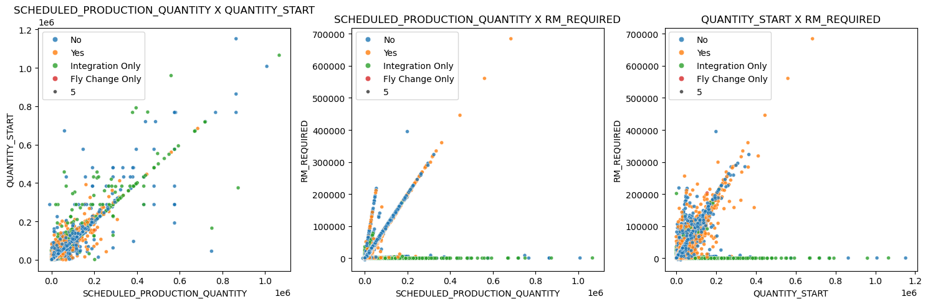
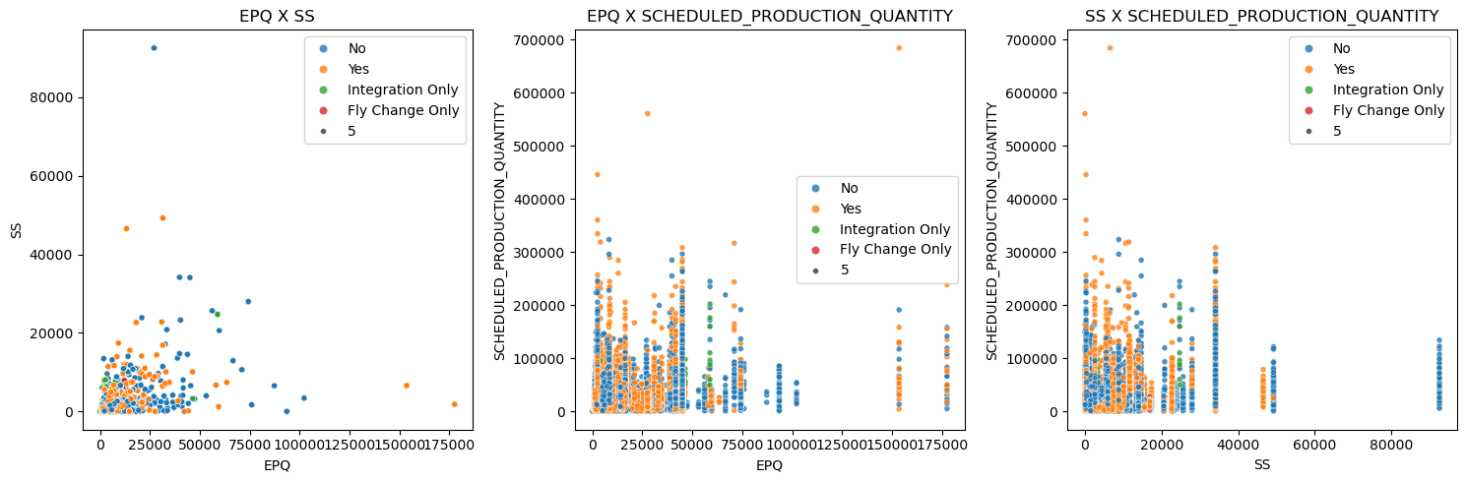

Slide 6
Descriptive statistics
I examined the distribution of the variables in the dataset using common statistical measure - mean, median, standard deviation, etc., as well as checking the value counts and the number of unique variables when dealing with categorical columns
I used them to choose the most appropriate imputation strategy, in order to ensure that the original distribution would be preserved as faithfully to the original as possible post-imputation
I have not included the descriptive statistics in the slides, but they can be found in exploration.ipynb

Slide 7
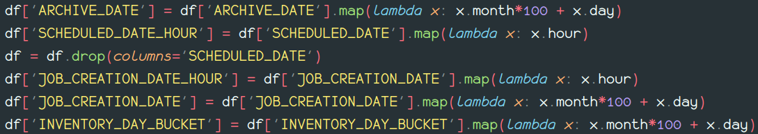
Feature manipulation
Then, I converted the date columns into a proper datetime format and sought out to extract the most relevant information from each
Due to the mismatch between the date formatting - some were entered as simple strings in the yyyy/mm/dd format, others as datetime objects in the yyyy-dd-mm format, pd.to_datetime() struggled to convert all of them to a singular format and some tinkering was necessary
Next, I extracted the unique information from each datetime column - date or hour (the week column already covered the week numbers from ‘ARCHIVE_DATE’ and ‘SCHEDULED_DATE’ and I decided against adding any further week columns)

Slide 8
Feature manipulation
After dealing with the dates, I one-hot encoded the categorical columns with few unique variables and made sure that the rest of the categorical columns contained only strings in order to work with TargetEncoder
Then, I split the data into training and testing datasets with a 4:1 train:test ratio
df = pd.get_dummies(df, columns=['JOB_STATUS', 'JOB_CREATION_FLAG', 'RM Item Coverage'], dtype='int64')

Slide 9
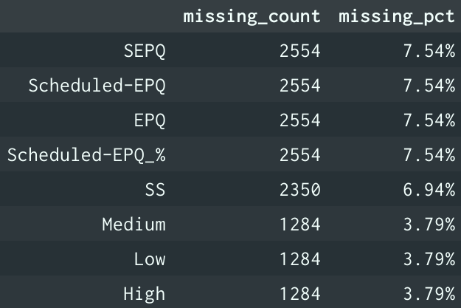
Feature manipulation
Next, I checked the number of missing observations in each column
I used a simple proportional imputation strategy for ‘Low’, ‘Medium’ and ‘High’, as the percentage of missing observations was low enough to not warrant more complex imputation
I intended to implement a ProportionalImputer (see commented code in preprocessing.py) class for usage in a pipeline alongside IterativeImputer and TargetEncoder, but the unnecessary complexity in preserving the column order after using ColumnTransformer made me decide against it. Nevertheless, such a preprocessing pipeline may be implemented later if need arises.
The numerical columns were imputed using IterativeImputer after evaluating how well it, KNNImputer (k={3, 5, 10}) and different simple imputing strategies preserved the original distribution

Slide 10
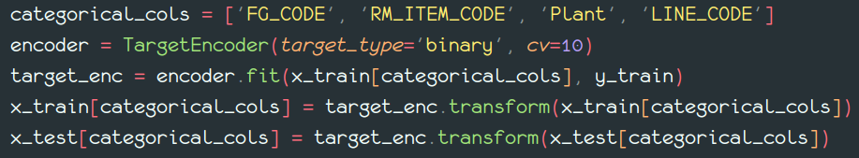
Feature manipulation
I encoded the remaining categorical variables using target encoding with 10-fold cross-validation

Slide 11
Feature manipulation
Considerations and things to be improved:
Although the way I chose to encode the dates from [‘ARCHIVE_DATE’, ‘JOB_CREATION_DATE’, ‘INVENTORY_DAY_BUCKET’] does preserve the uniqueness of each date, it still suffers from the garbled order stemming from improper input. Therefore, the order is not as well preserved, which could diminish the potential impact it could have on the model. This type of encoding is akin to label encoding, which is not the best fit for serialised data.
I was on the edge of dropping ‘SCHEDULED-START’, ‘SCHEDULED-EPQ’ and ‘SEPQ’ because in the case of the former two those differences were already standardised as percentages in the columns to their right, while ‘SEPQ’ simply repeats ‘SCHEDULED-EPQ’ but as absolute change instead, but I ultimately decided against, as I inferred that in certain cases absolute differences might have a higher impact on the final outcome than relative ones.
I want to reimplement the imputation and encoding steps into a full-fledged pipeline

Slide 12
Classification

Slide 13
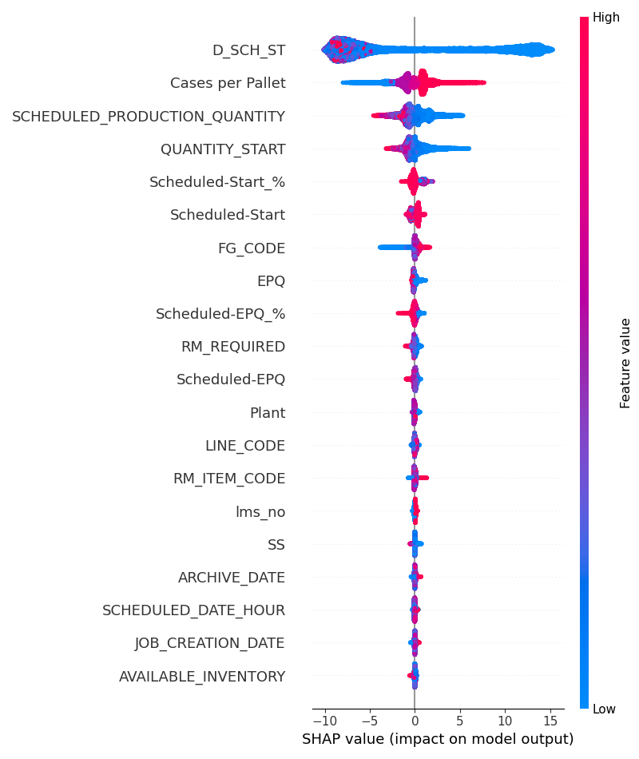
Feature selection
For feature selection, I opted for XGBoost or LightGBM classifiers (XGBoost in the final version) and used the SHAP explainer and RFECV from Scikit-learn to rank the features based on their contribution to the model
The hyperparameters were optimised using Optuna
As can be noted from the plot to the right generated from the SHAP explainer values, only the topmost 4 to 6 columns contribute heavily to the model
The features outputted by RFECV generally coincided with the first 5 or 6 from SHAP through most runs, and I experimented with combining the top n RFECV and SHAP features to no improvement, so I simply chose to isolate the top 5 SHAP features instead and reduce the dataset to them, which led to excellent results
Top 20 features generated by SHAP.Explainer using LightGBM

Slide 14
Feature selection
Generally, the top five or six RFECV and SHAP features were chosen from the top seven features in the plot to right, with ‘D_SCH_ST’, ‘Cases per Pallet’, ‘SCHEDULED_PRODUCTION_QUANTITY’ and ‘QUANTITY_START’ being invariably present
Top 20 features generated by SHAP.Explainer using LightGBM

Slide 15
Classification
For classification, I went with two approaches - logistic regression, mainly as a baseline, and four decision tree-based algorithms - simple decision trees, random forests, gradient-boosted decision trees, XGBoost and LightGBM
I also intended to run a Gaussian process classifier, but I couldn’t manage to do so on any machine without it exploding RAM usage
The columns I included in the reduced dataset used for the results presented here are [‘D_SCH_ST’, ‘Cases per Pallet’, ‘SCHEDULED_PRODUCTION_QUANTITY’, ‘QUANTITY_START, ‘Scheduled-Start_%’]
As with feature selection, I optimised the hyperparameters using Optuna
The results are presented on the next slides

Slide 16
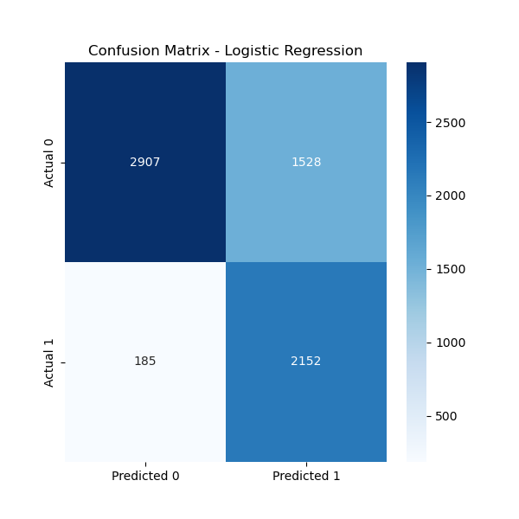
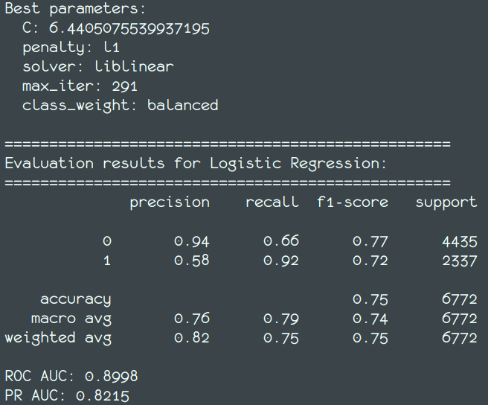
Classification - Logistic regression

Slide 17
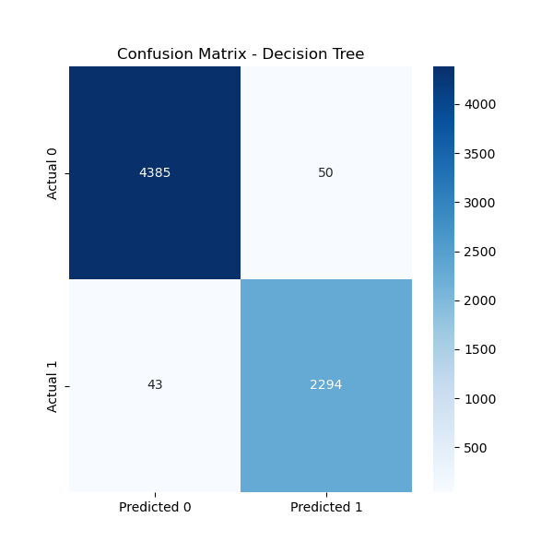
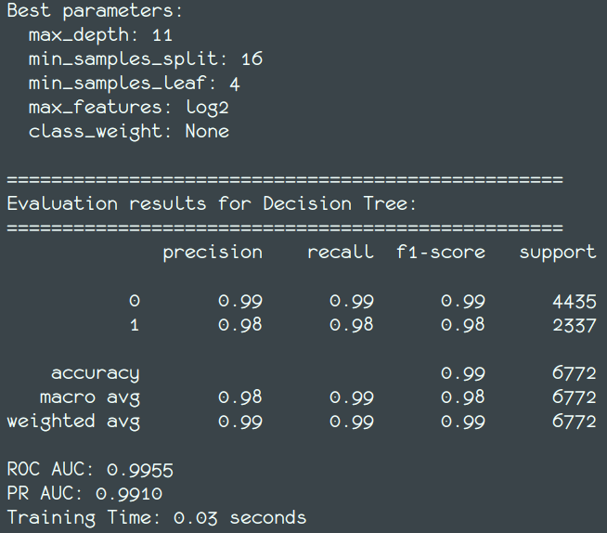
Classification - Decision trees

Slide 18
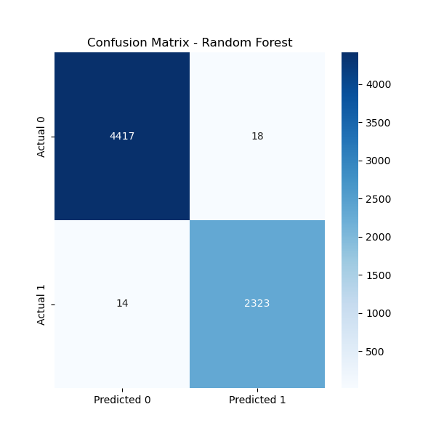
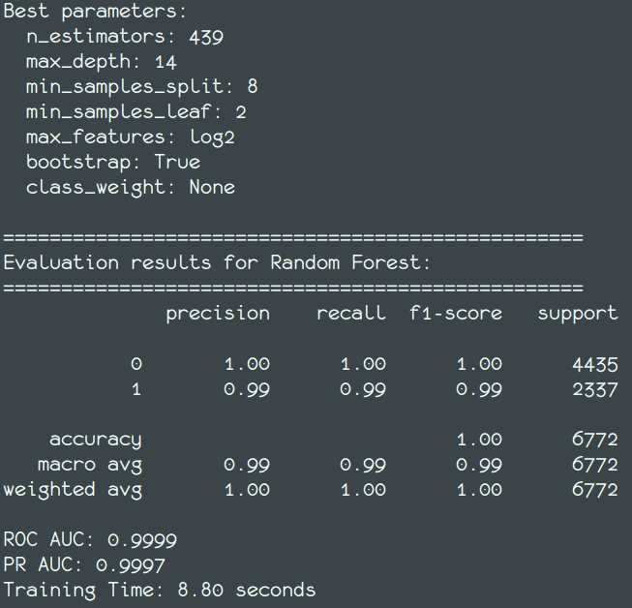
Classification - Random forests

Slide 19

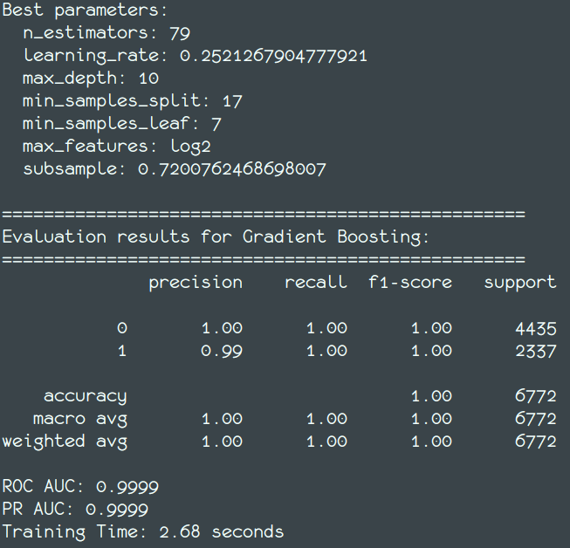
Classification - Gradient boosting

Slide 20

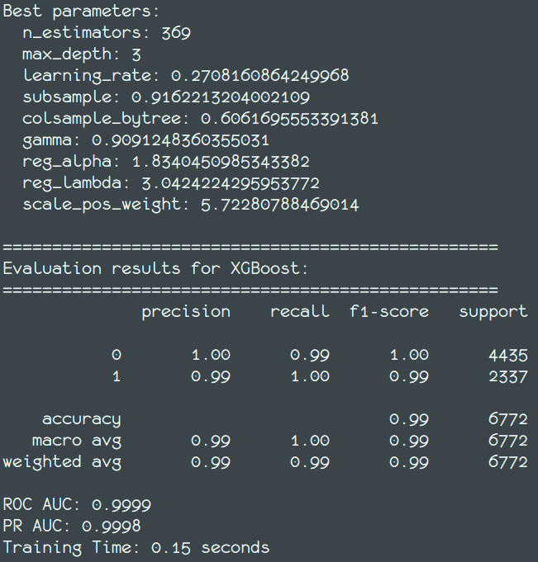
Classification - XGBoost

Slide 21

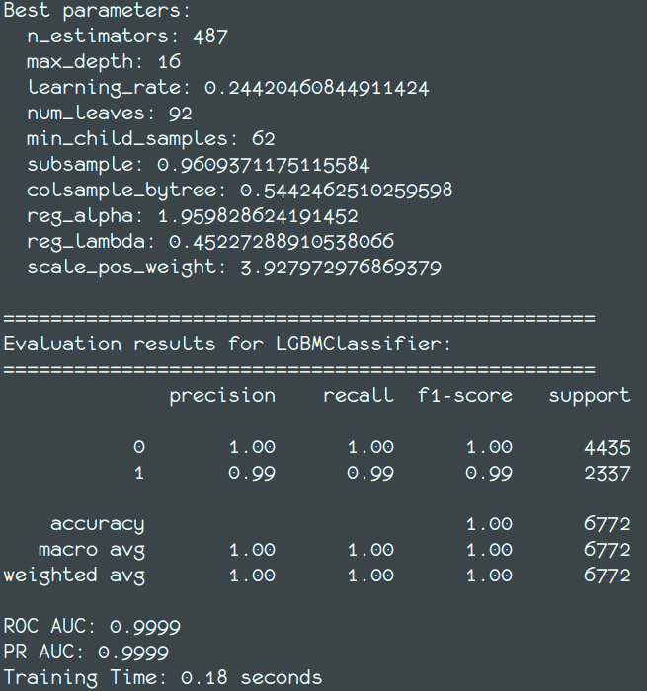
Classification - LightGBM

Slide 22
Results - Conclusion
As can be seen from the results, all tree-based algorithms outperformed logistic regression significantly
For the specific run I included here, gradient-boosted decision trees performed best, although the differences between them, random forests, XGBoost and LightGBM are negligible
The best performing model may change between gradient boosting, LightGBM and XGBoost from run to run depending on which features were selected and the number of optimisation trials, but nevertheless, all three provide excellent accuracy, with XGBoost and LightGBM being significantly faster than gradient boosting

Slide 23
Architecture & Deployment

Slide 24
Organisation
code/
│
├── main.py/
├── preprocessing.py/
├── classification.py/
├── requirements.txt/
├── config/
│ └── best_params_logistic.pkl # etc.
├── …misc files (mostly for deployment)
└── README.md

Slide 25
Architecture & Deployment
I decided to save the best parameters for each model as .pkl files
I justify this decision due to them being simple dictionaries which do not warrant more complex formats, as opposed to, for example, neural network models
The models can be retrained fairly quickly whenever need arises, e.g. whenever there are major changes in logistics, supply or demand
From this point onwards, I assume that a good scheme for packaging and deployment would involve:
Poetry or Setuptools for packaging the code
Docker for containerisation
FastAPI for deployment
Cron or Prefect for automatisation and scheduling

Slide 26
Architecture & Deployment - Concerns
However, I had no prior experience at all using the tools listed on the previous slide, so I had to rely on generous help from AI assistants to guide me through selecting and implementing the most suitable tools for my use case. As you may notice in the code directory, the code is not ready for production at all and the dockerfile, app.py (for FastAPI) and pyproject.toml (generated by Poetry) might contain various errors. I need to read up on the strategies and tools used for deploying data science projects.

Slide 27
Final thoughts
To sum up, there is definitely room for improvement as far as this project is concerned. The most urgent issues in my opinion currently are:
Dealing with incorrectly entered dates the proper way
Integrating the imputation and encoding steps into a pipeline
(maybe) testing additional models
And most importantly, reading up on how to properly package and deploy data science projects into production

