Slide 1
Architecture of Computer Networks
What are the differences between PPPoE and DHCP
hw2_group1_5
：侯云曦、谢伊凡、钟恒恺
2023/10/20

Slide 2
01
Definition
Differences
02
03
Correlation
Glossary
04

Slide 3
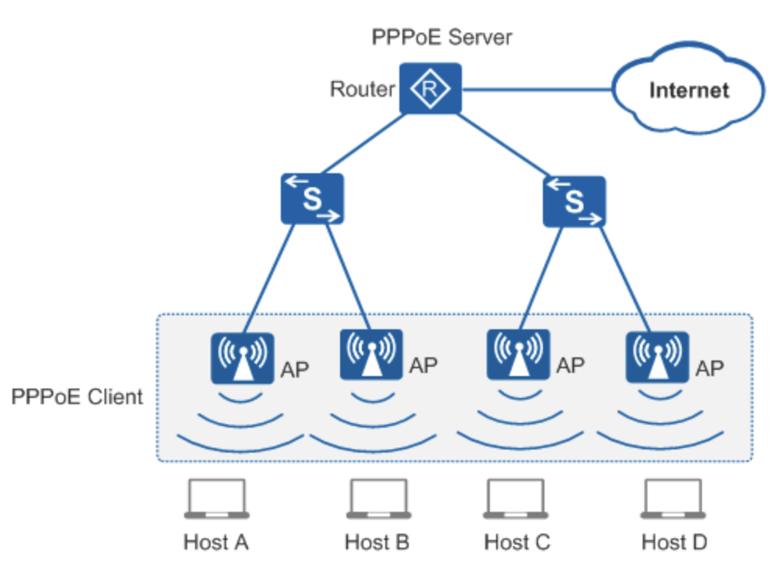
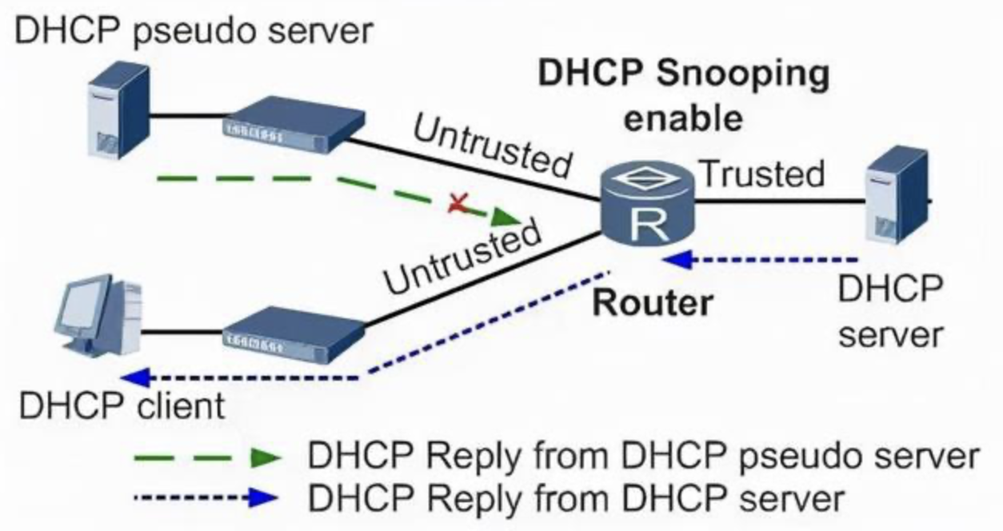
01 Definition
PPPoE（Point-to-Point Protocol over Ethernet）.
It is a network protocol that is commonly used to establish a direct connection between a client computer and an Internet Service Provider (ISP) using an Ethernet connection.
DHCP（Dynamic Host Configuration Protocol）.
It is a network protocol used to automatically assign IP addresses and other network configuration parameters to devices on a TCP/IP network.
Point-to-Point Protocol
Ethernet
Authentication
Dial-Up-like Connection
Connection Session
IP Address Assignment
Automatic Configuration
Configuration Parameters
Dynamic Allocation
Leases

Slide 4
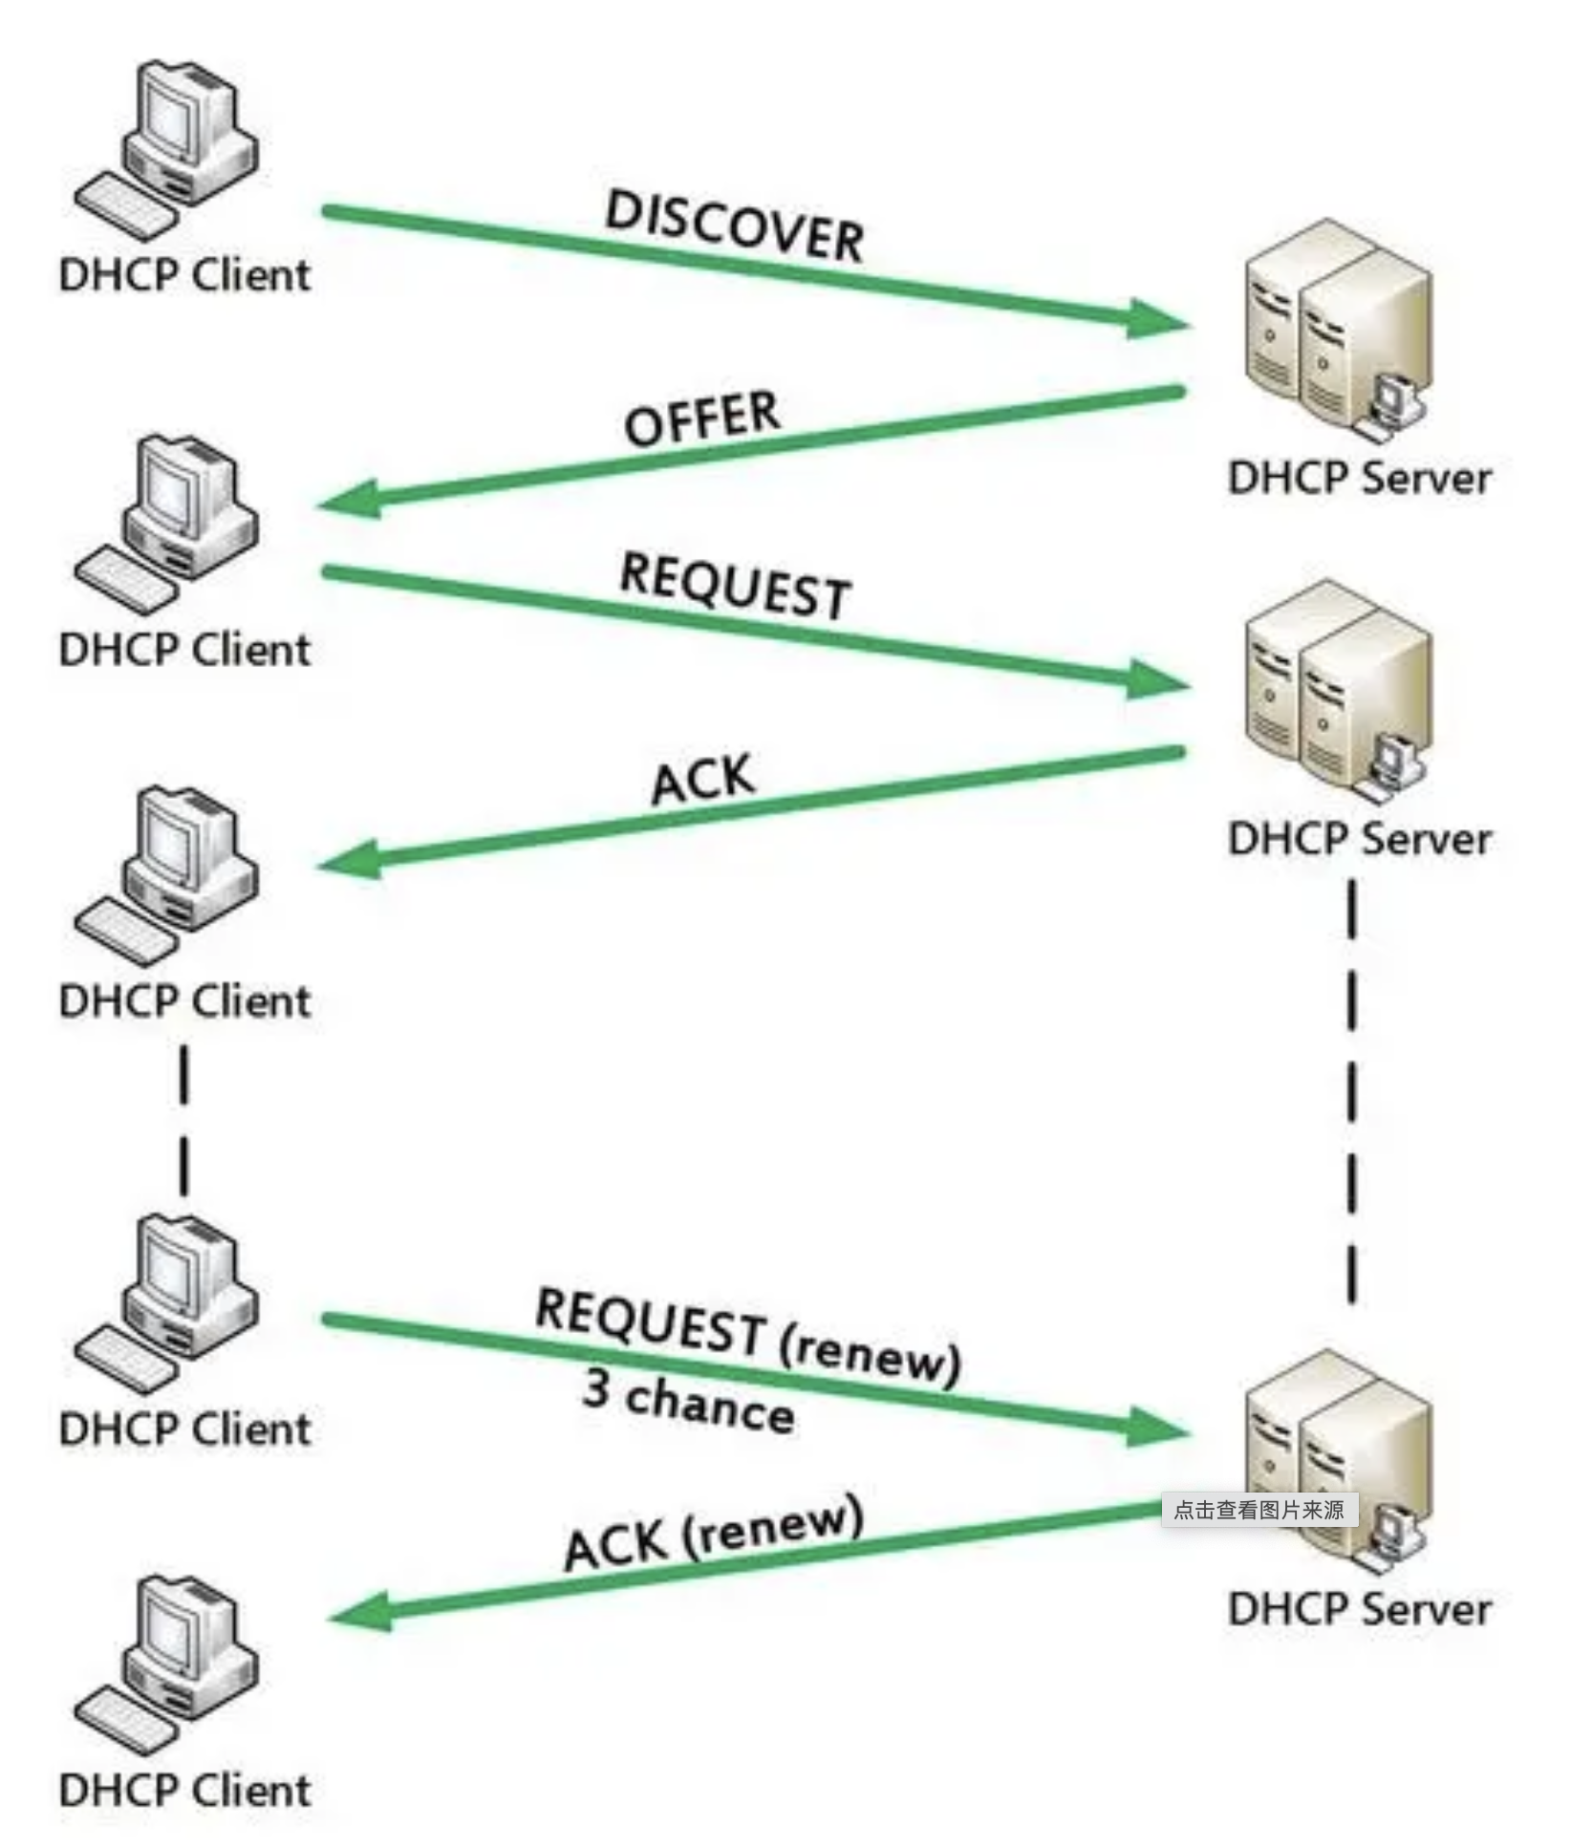
02 Differences
PPPoE and DHCP are both network protocols, but they serve different purposes and operate at different layers of the networking stack.
Purpose
Authentication
Connection Type
PPPoE: To establish a direct connection between a client and an ISP over an Ethernet connection.
DHCP: Automatically assign IP addresses and other network configuration parameters to devices on a network.
Layer
PPPoE: often involves an authentication step where the client provides credentials to the ISP.
DHCP: typically does not involve authentication for IP address assignment.
PPPoE: Often used for broadband Internet connections, where users connect to the Internet using a username and password.
DHCP: Used for assigning IP addresses and network configuration parameters within a local network.
PPPoE: Operates at the data link layer (Layer 2) of the OSI model.
DHCP: Operates at the application layer (Layer 7) of the OSI model when used by client devices.

Slide 5
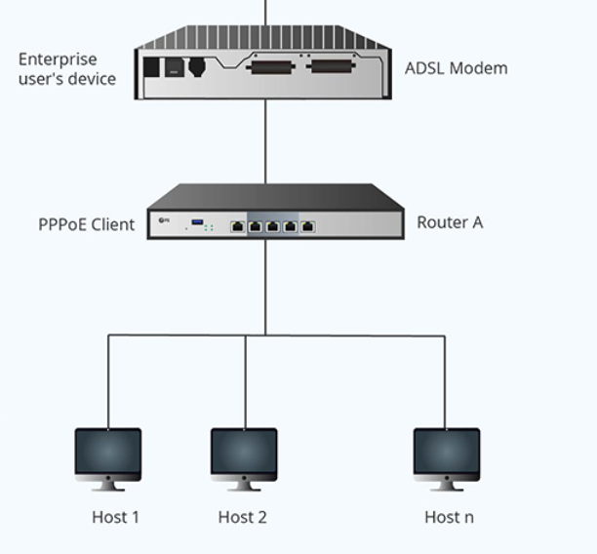
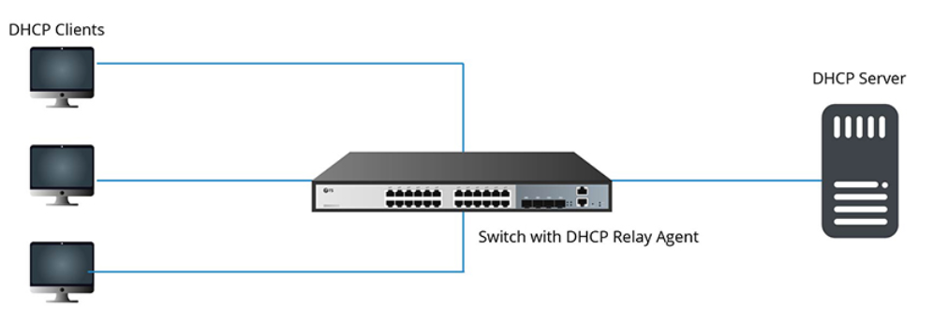
03 Correlation
In some cases, PPPoE is used as the underlying connection protocol, while DHCP is used to dynamically assign IP addresses and other network settings to the devices connected via PPPoE.
This combination allows for efficient management of broadband connections while automating the IP address allocation process.
Combination

Slide 6
04 Glossary

