Slide 1
Design pattern

Slide 2
Design pattern
A software design pattern is a general, reusable solution to a common problem in software design.
It’s not a finished design that can be transformed directly into code; rather, it’s a template for solving a specific design issue that occurs frequently in software development.

Slide 3
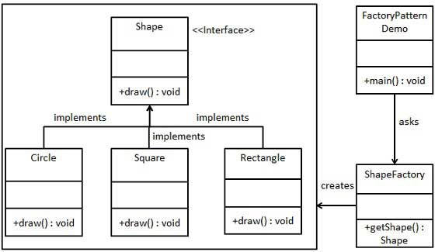
Design pattern examples

Slide 4
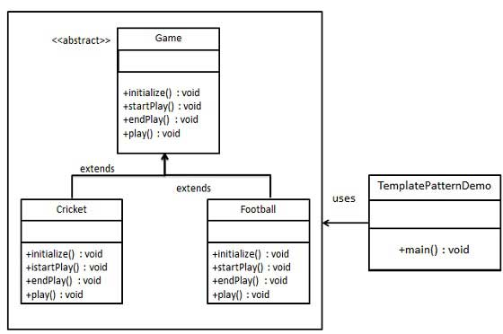
Design pattern examples

Slide 5
History of Design pattern
The concept of software design patterns was popularized by Erich Gamma, Richard Helm, Ralph Johnson, and John Vlissides, collectively known as the "Gang of Four" (GoF).
They published the seminal book "Design Patterns: Elements of Reusable Object-Oriented Software" in 1994, which documented 23 foundational patterns for object-oriented programming.
These patterns addressed recurring design issues in software development, providing standardized, reusable solutions for building robust and efficient systems.

Slide 6
Creational Patterns
Focus on object creation mechanisms. These patterns help manage how objects are created, ensuring they are suitable for the given situation.
Examples: Singleton, Factory Method, Abstract Factory, Builder, Prototype

Slide 7
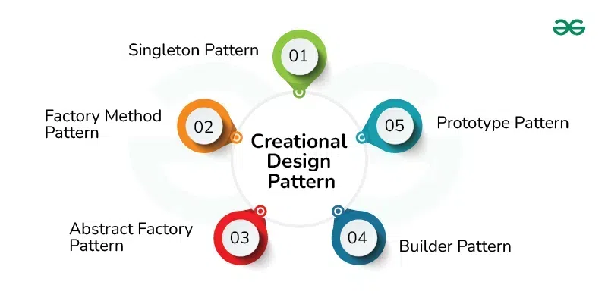

Slide 8
Structural Patterns
Deal with object composition and relationships, helping organize classes and objects to form larger structures.
Examples: Adapter, Composite, Decorator, Facade, Flyweight, Proxy

Slide 9
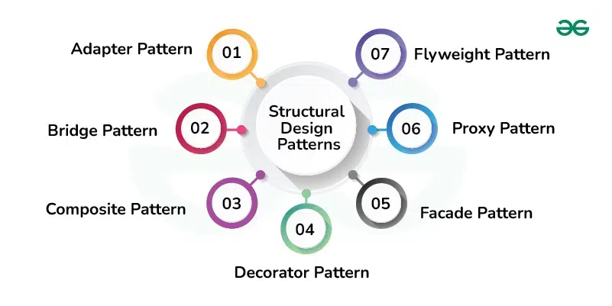

Slide 10
Behavioral Patterns
Focus on communication between objects, defining how they interact and share responsibilities.
Examples: Observer, Strategy, Command, Iterator, State, Template Method

Slide 11
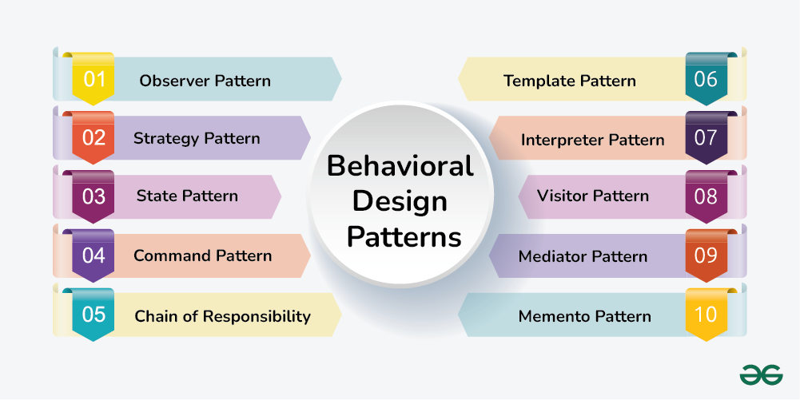

Slide 12
Design pattern
Most design use either
Abstract Class
Interface

Slide 13
Abstract class
Abstract classes are a common feature in many object-oriented programming languages, allowing developers to define templates for subclasses that enforce certain methods without providing full implementations
Some popular programming language that supports abstract class – Java, C++, C#, Python, PHP, Swift, Ruby, Typescript.

Slide 14
Abstract class example (JAVA)
public abstract class Animal {
public abstract void sound();
}

Slide 15
Abstract class example (C++)
class Shape
{
public: virtual void draw() = 0; // Pure virtual function
};

Slide 16
interface
In many object-oriented programming languages, an interface is a construct that defines a contract for classes without providing any implementation
An interface specifies a set of methods that implementing classes must define.
Unlike abstract classes, interfaces generally cannot hold any state (like instance variables) and typically don’t contain any method implementations (though modern languages may allow default methods in interfaces).

Slide 17
Interface example (JAVA)
public interface Animal {
void sound();
void sleep();
}

Slide 18

Example of implementation

Slide 19
Declaring the abstract class
public abstract class Game {
abstract void initialize();
abstract void startPlay();
abstract void endPlay();
//template method
public final void play(){
//initialize the game
initialize();
//start game
startPlay();
//end game
endPlay();
}
}

Slide 20
Declaring the concrete class
public class Cricket extends Game {
@Override
void endPlay() {
System.out.println("Cricket Game Finished!");
}
@Override
void initialize() {
System.out.println("Cricket Game Initialized! Start playing.");
}
@Override
void startPlay() {
System.out.println("Cricket Game Started. Enjoy the game!");
}
}

Slide 21
Use the Game's template method play()
public class TemplatePatternDemo {
public static void main(String[] args) {
Game game = new Cricket();
game.play();
}
}

