Slide 1


THE SUCCESS STORY OF GRAB
Member Name:
Iven Nyam Jia Yang
Chan Yu Heng
Lai Zhen Hong
Ong Khang Chean

Slide 2
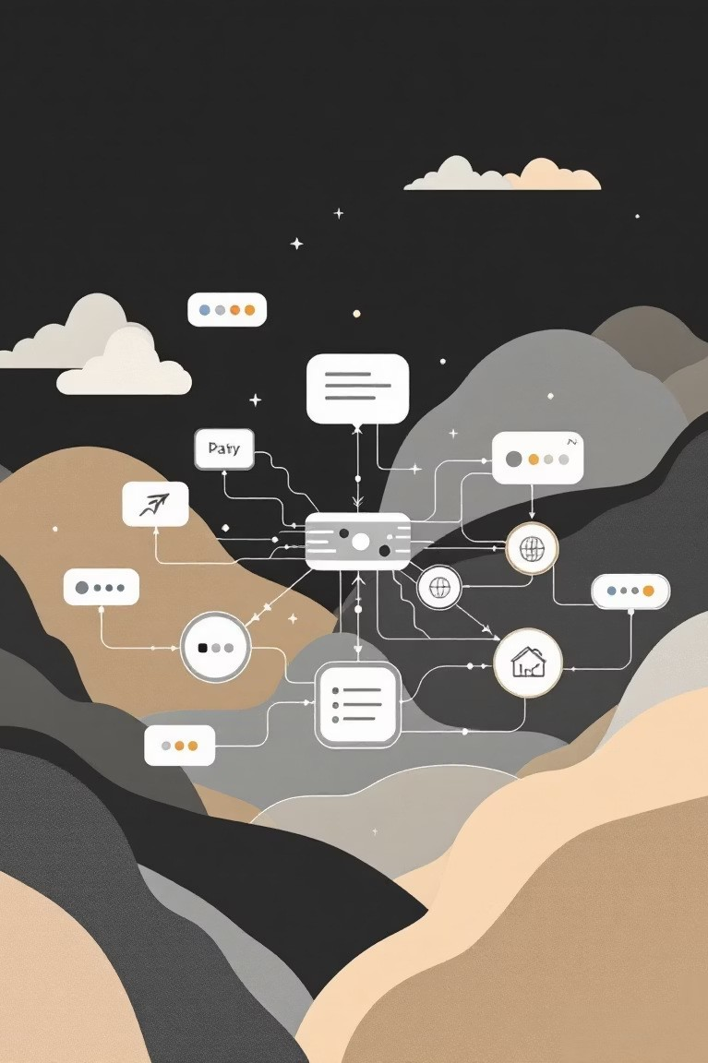
THE SUPER-APP BUSINESS MODEL
MULTI-SERVICE PLATFORM
Single app for transportation, food delivery, payments, and financial services across Southeast Asia
NETWORK EFFECTS
Each service strengthens others - drivers serve multiple verticals, users engage more frequently
DATA MONETIZATION
User behavior insights drive targeted advertising, merchant partnerships, and service optimization

Slide 3
TECHNOLOGY-DRIVEN RAPID GROWTH
AI-POWERED OPTIMIZATION
Machine learning algorithms optimize driver allocation, reduce wait times, and predict demand patterns
ADVANCED MAPPING & ROUTING
Proprietary mapping technology handles complex Southeast Asian traffic patterns and infrastructure
REAL-TIME DATA ANALYTICS
Continuous data processing enables dynamic pricing, supply-demand balancing, and personalized experiences

Slide 4
KEY SUCCESS FACTORS
1
LOCAL MARKET ADAPTATION
Customized services for each ASEAN market - cash payments in Indonesia, motorbike taxis in Vietnam
3
ECOSYSTEM INTEGRATION
Seamless user journey across services drives engagement - 73% of users use multiple Grab services monthly
2
STRATEGIC PARTNERSHIPS
Collaborations with banks, telecoms, and governments accelerated market penetration and regulatory approval
4
CAPITAL EFFICIENCY
Asset-light model with strategic investments in technology rather than physical infrastructure

Slide 5
CHALLENGES AND RISK FACTORS
REGULATORY COMPLEXITY
Navigating different regulations across 8 countries while maintaining operational efficiency and compliance
INTENSE COMPETITION
Facing local competitors like Gojek and global players entering ASEAN markets with substantial funding
PROFITABILITY PRESSURE
Balancing growth investments with investor expectations for sustainable unit economics across all verticals

Slide 6
STRATEGIC LESSONS FOR STARTUPS
01
02
START FOCUSED, THEN EXPAND
Master one core service before adding adjacent offerings - Grab dominated ride-hailing before diversifying
LEVERAGE NETWORK EFFECTS
Design services that reinforce each other - shared driver network reduces costs across multiple verticals
03
04
INVEST IN LOCAL ADAPTATION
Generic solutions fail in diverse markets - customize for local payment methods, regulations, and behaviors
BUILD STRATEGIC MOATS
Create defensible advantages through data, partnerships, and integrated user experiences

Slide 7
THANK YOU

