Slide 1

Negotiation
Skills

Slide 2
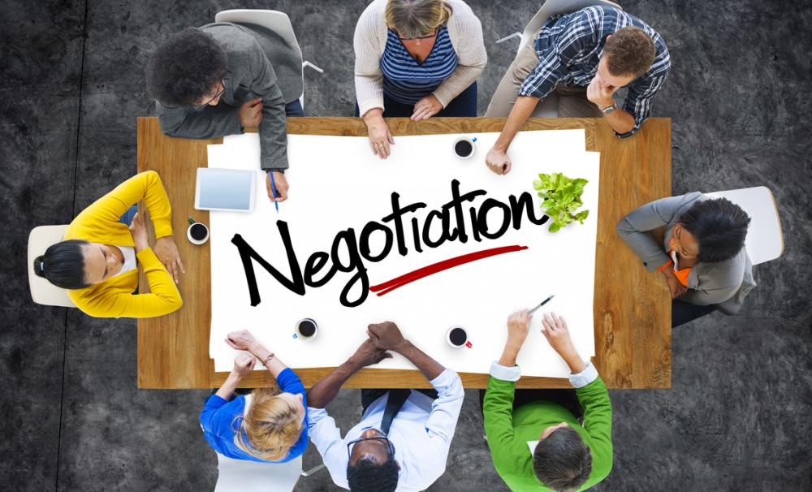

Slide 3

Negotiation Defined
Negotiation is a method by which people settle differences. It is a process by which compromise or agreement is reached while avoiding argument and dispute.

Slide 4
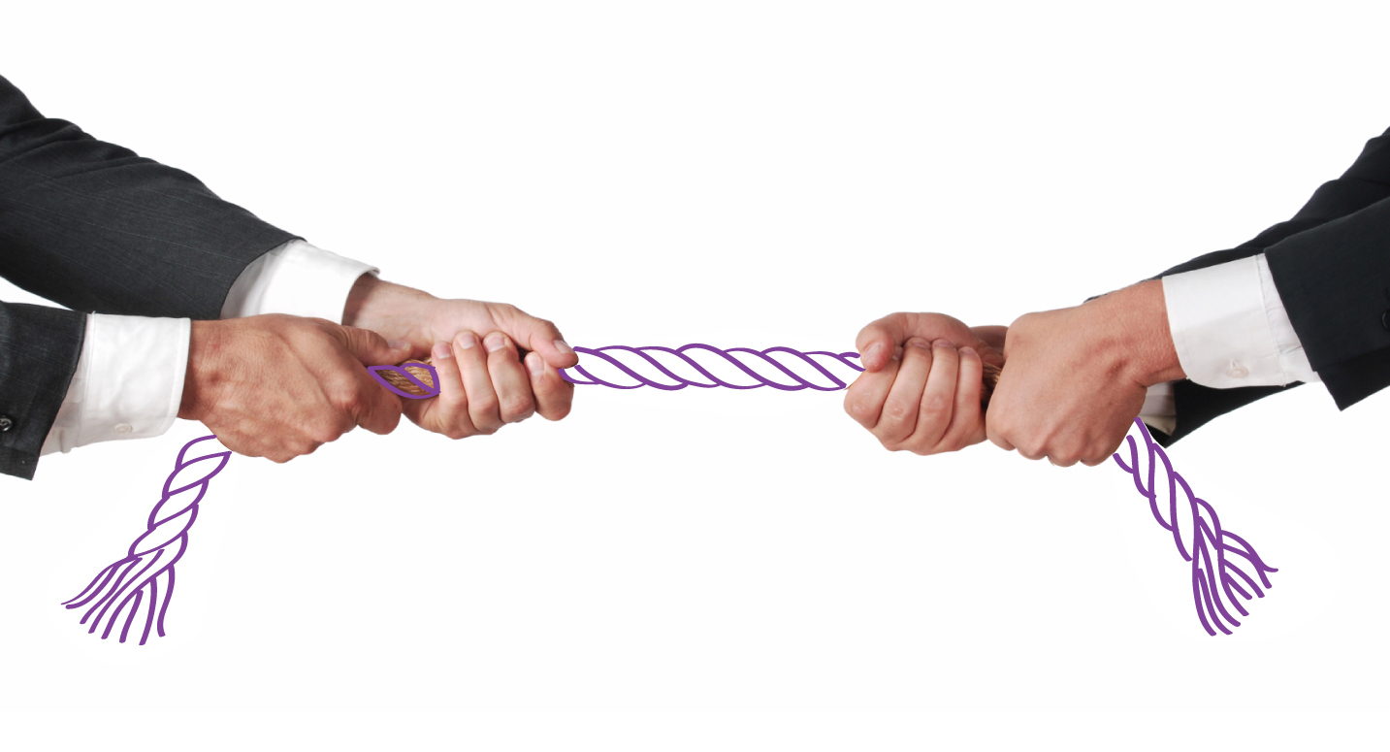

Why Negotiate?
Notes:
It is inevitable that, from time-to-time, conflict and disagreement will arise as the differing needs, wants, aims and beliefs of people are brought together. Without negotiation, such conflicts may lead to argument and resentment resulting in one or all of the parties feeling dissatisfied. The point of negotiation is to try to reach agreements without causing future barriers to communications.

Slide 5

Preparation
Before any negotiation takes place, a decision needs to be taken as to when and where a meeting will take place to discuss the problem and who will attend. Setting a limited time-scale can also be helpful to prevent the disagreement continuing.

Slide 6
Stages of Negotiation
Preparation
Discussion
Negotiate towards a Win-Win outcome
Agreement
Implementation of a course of action
Clarification of goals
Notes:
http://www.skillsyouneed.com/ips/negotiation.html

Slide 7
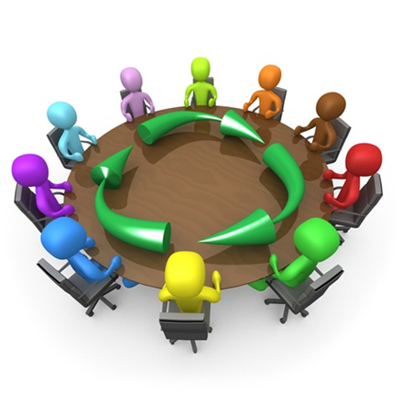
Discussion
During this stage, individuals or members of each side put forward the case as they see it, i.e. their understanding of the situation.

Slide 8

Clarifying Goals
From the discussion, the goals, interests and viewpoints of both sides of the disagreement need to be clarified.

Slide 9
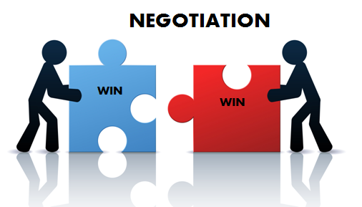
Negotiate Towards a Win-Win Outcome
This stage focuses on what is termed a 'win-win' outcome where both sides feel they have gained something positive through the process of negotiation and both sides feel their point of view has been taken into consideration.

Slide 10

Agreement
Agreement can be achieved once understanding of both sides’ viewpoints and interests have been considered.

Slide 11

Implementing a Course of Action
From the agreement, a course of action has to be implemented to carry through the decision.

Slide 12

Failure to Agree
If the process of negotiation breaks down and agreement cannot be reached, then re-scheduling a further meeting is called for. This avoids all parties becoming embroiled in heated discussion or argument, which not only wastes time but can also damage future relationships.
Notes:
At the subsequent meeting, the stages of negotiation should be repeated. Any new ideas or interests should be taken into account and the situation looked at afresh. At this stage it may also be helpful to look at other alternative solutions and/or bring in another person to mediate. Find more at: http://www.skillsyouneed.com/ips/negotiation.html#ixzz4RzjNFcpx

Slide 13

Informal Negotiation
There are times when there is a need to negotiate more informally. At such times, when a difference of opinion arises, it might not be possible or appropriate to go through the stages set out above in a formal manner.
Nevertheless, remembering the key points in the stages of formal negotiation may be very helpful in a variety of informal situations.

Slide 14
In any negotiation, the following three elements are important and likely to affect the ultimate outcome of the negotiation:
Attitudes
Knowledge
Interpersonal Skills

Slide 15

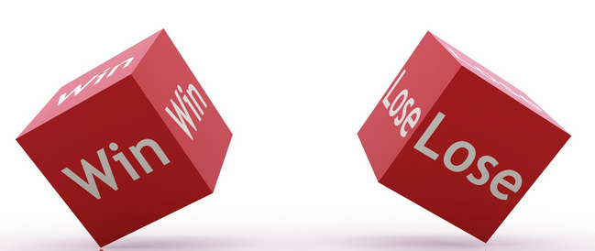
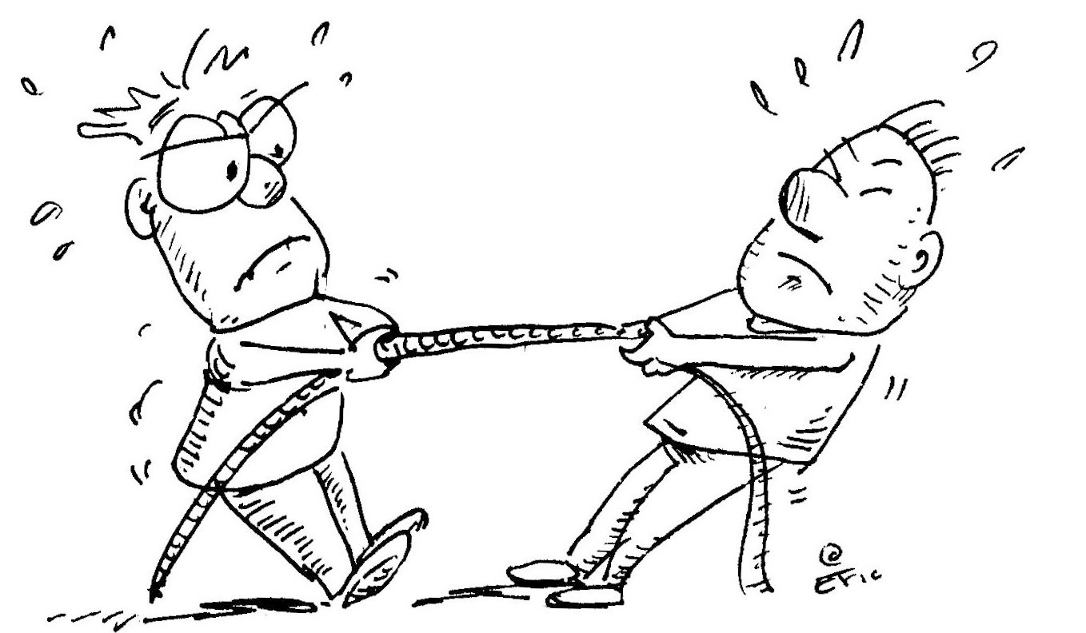
Negotiation Models
In this model no body is at less and it is the accepted model.
Eg- Customer and shopkeeper
In this model one wins and other loose
Two parties not willing to accept each others views

Slide 16
RADPAC Model of Negotiation
Rapport
Analysis
Close
Debate
Propose
Agreement

Slide 17
Top Ten Effective Negotiation Skills
Notes:
http://www.skillsyouneed.com/ips/negotiation.html

Slide 18

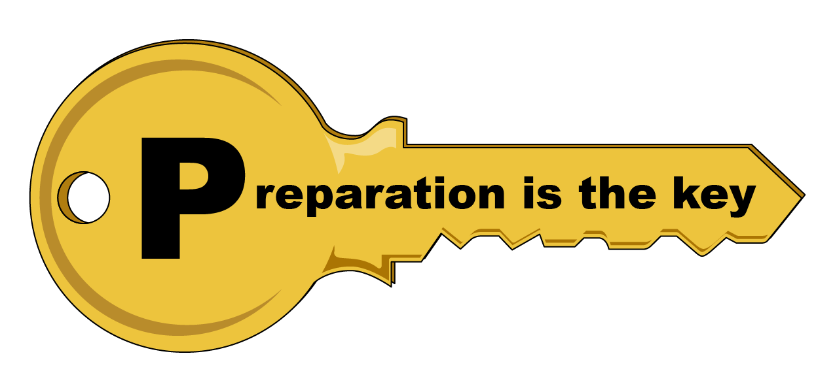
Problem Analysis
Preparation

Slide 19


Active Listening
Emotional Control

Slide 20


Verbal Communication
Collaboration and Teamwork

Slide 21


Decision Making Ability
Problem Solving

Slide 22


Interpersonal Skills
Ethics and Reliability

Slide 23


Slide 24
https://www.youtube.com/watch?v=7rzq2Bq_EsA
Lose lose model
https://www.youtube.com/watch?v=lE5ko4ZeC_Y
How to win any Negotiation
http://www.nytimes.com/2015/12/13/world/asia/korean-negotiators-falter-in-efforts-to-ease-strain-between-2-nations.html?_r=1
Live example

Slide 25
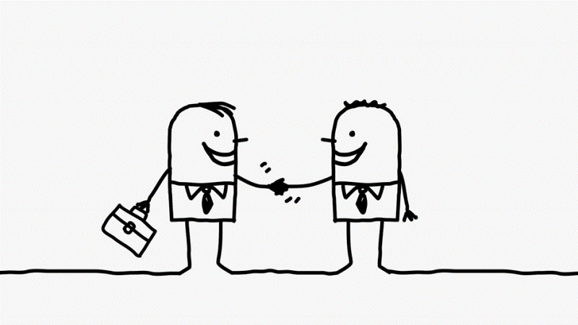
“Let us never negotiate out of fear. But let us never fear to negotiate.” – John F. Kennedy

