Slide 1

Age & the Olympics
By
Iveth
Escamilla

Slide 2
Is age a factor in order to win a gold medal in the Olympics?

Slide 3
Is age a factor in order to win a gold medal in the Olympics?
What is the difference in age between male and female athletes who have won a gold medal?

Slide 4
Is age a factor in order to win a gold medal in the Olympics?
What is the difference in age between male and female athletes who have won a gold medal?
Does the intensity of the sport and your age affect your chance to win a gold medal?

Slide 5
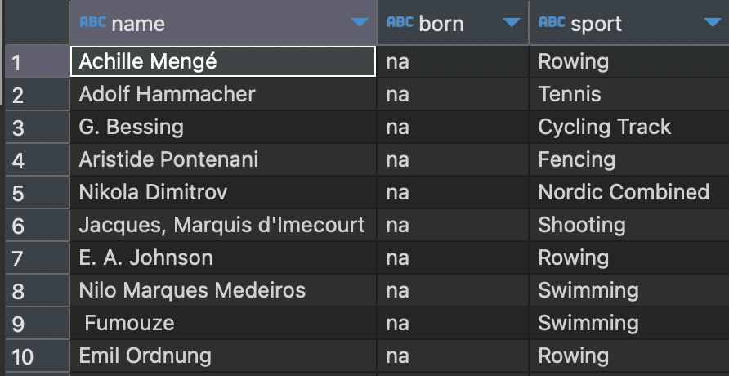
Missing Data

Slide 6

Missing Data

Slide 7
Missing Data

Slide 8
Focused on 2 Sample Sports of the Olympics

Slide 9
Focused on 2 Sample Sports of the Olympics
Biathlon:
out of 6,460 athletes only 1 birth date was missing
winter sport
endurance and precision

Slide 10
Focused on 2 Sample Sports of the Olympics
Biathlon:
out of 6,460 athletes only 1 birth date was missing
winter sport
endurance and precision
Badminton:
out of 1,727 athletes only 1 birth date was missing
summer sport
moderate to high intensity.

Slide 11
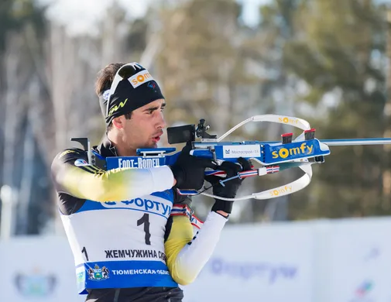
Biathlon
A biathlon consists of cross-country skiing and rifle marksmanship.
Joined the Olympics in 1960 as an official sport. Only men were allowed to compete.
Women were not included until 1992.
It has 6 different events, but they are all races where they look for speed and marksmanship.
Points are measured by time used and time is added for shots missed.

Slide 12

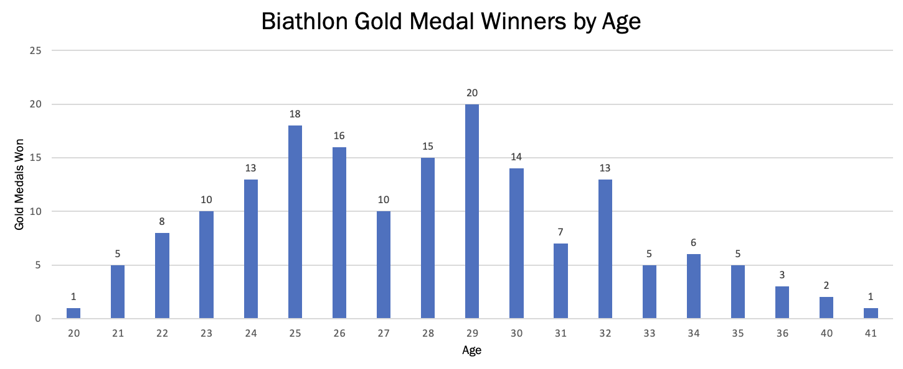
Biathlon Statistics
Is age a factor in order to win a gold medal in the Olympics?
Medals Won | Average Age | Max Age | Min Age
Gold | 28 | 41 | 20
Silver | 28 | 39 | 20
Bronze | 28 | 38 | 18
All Athletes | 28 | 45 | 18

Slide 13
Biathlon Statistics
Is age a factor in order to win a gold medal in the Olympics?
No, comparing the average age of the athletes overall to those who have won a medal. Age does not seem to be a deciding factor.
Medals Won | Average Age | Max Age | Min Age
Gold | 28 | 41 | 20
Silver | 28 | 39 | 20
Bronze | 28 | 38 | 18
All Athletes | 28 | 45 | 18

Slide 14
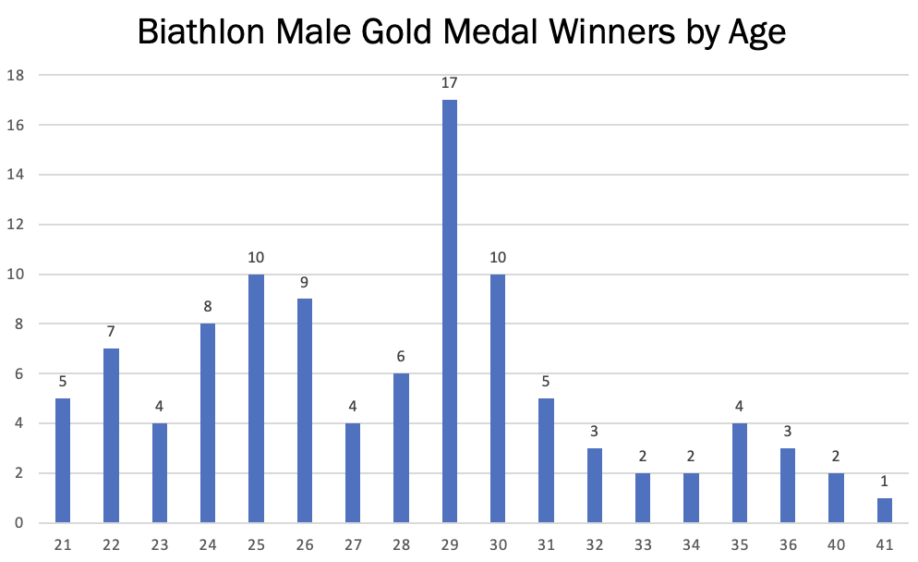
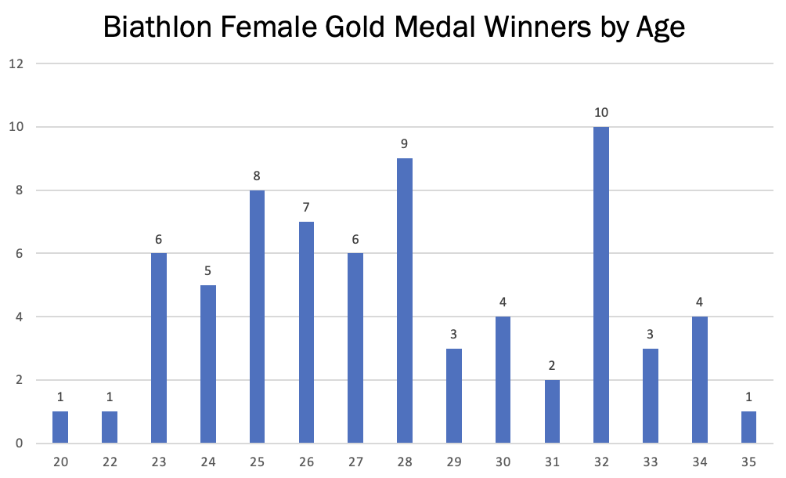
Biathlon Statistics
What is the difference in age between male and female athletes who have won a gold medal?

Slide 15
Biathlon Statistics
What is the difference in age between male and female athletes who have won a gold medal?
The range in age of gold medal winners is wide in both male and female athletes. The males appear to peak at around 29 years old. The females don’t have a significant peak like the males do, but they have a smaller range.

Slide 16
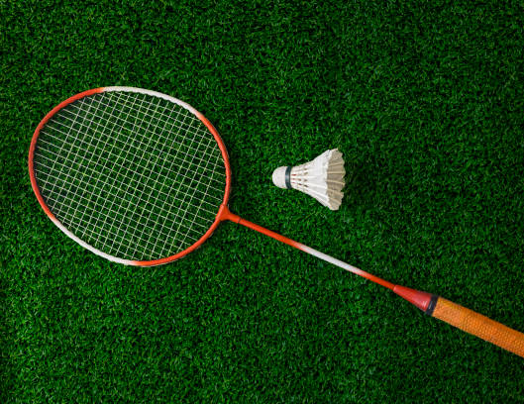
Badminton
Is a moderately intense summer sport.
Became a full medal sport in 1992.
Tournaments consists of 5 events. They include men and women, singles and doubles. They added a Mixed Doubles event in 1996.
It is an elimination sport, where each event ends in a single elimination tournament. Each match is played to the best of 3 games. Scoring 2 more points than the opponent or the first to score 30 points.

Slide 17
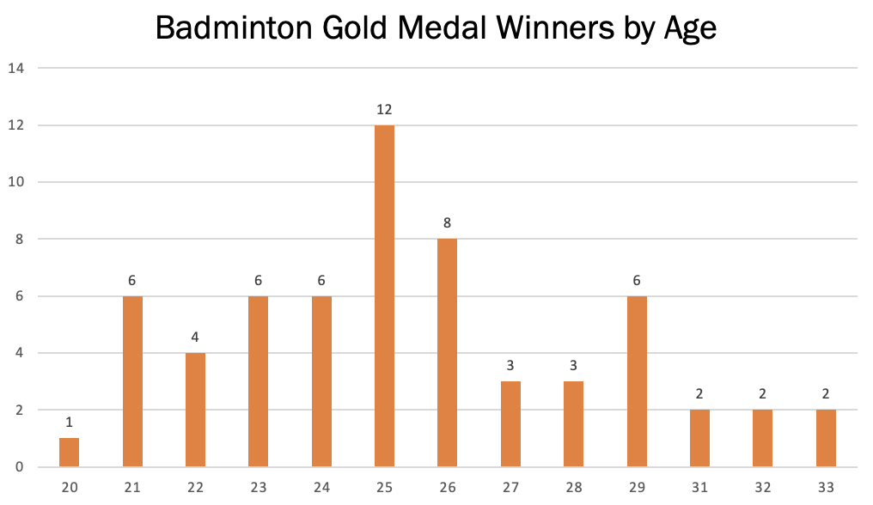
Badminton Statistics
Is age a factor in order to win a gold medal in the Olympics?
Medals Won | Average Age | Max Age | Min Age
Gold | 25 | 33 | 20
Silver | 26 | 34 | 17
Bronze | 25 | 35 | 20
All Athletes | 26 | 44 | 17

Slide 18
Badminton Statistics
Is age a factor in order to win a gold medal in the Olympics?
Yes, even though there seems to be a wide range of ages. Most of the gold medal winners tend to be close in age.
Medals Won | Average Age | Max Age | Min Age
Gold | 25 | 33 | 20
Silver | 26 | 34 | 17
Bronze | 25 | 35 | 20
All Athletes | 26 | 44 | 17

Slide 19
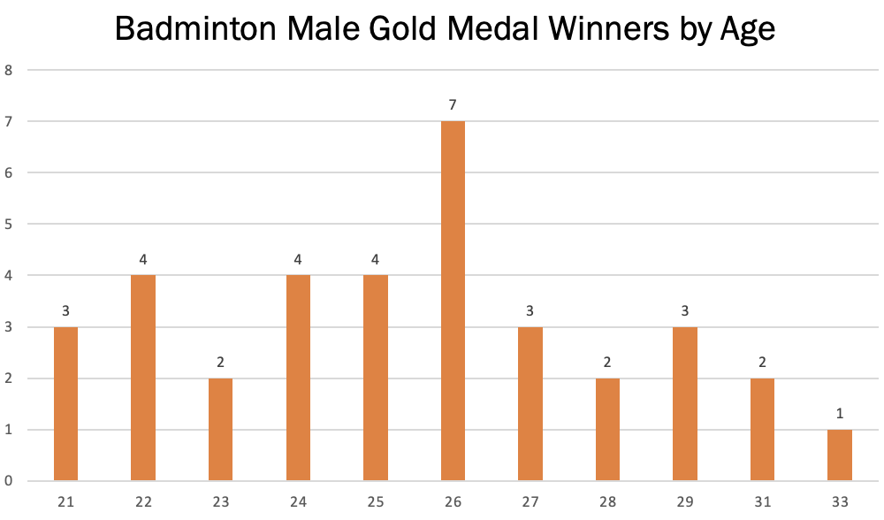
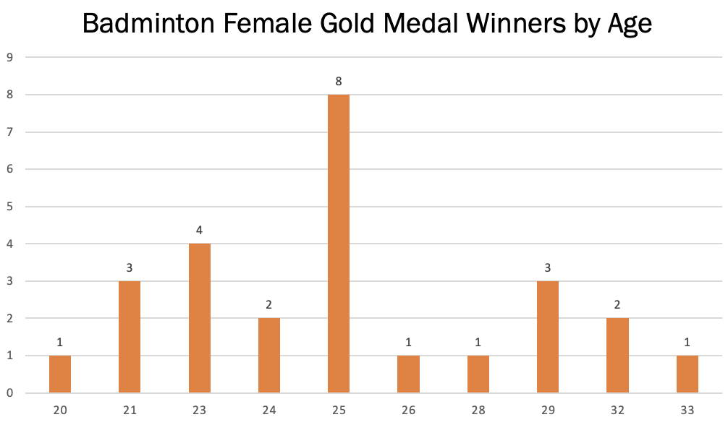
Badminton Statistics
What is the difference in age between male and female athletes who have won a gold medal?

Slide 20
Badminton Statistics
What is the difference in age between male and female athletes who have won a gold medal?
There doesn’t appear to be a difference in age as the average is 26 for males and 25 for females. They peak at about the same age.

Slide 21
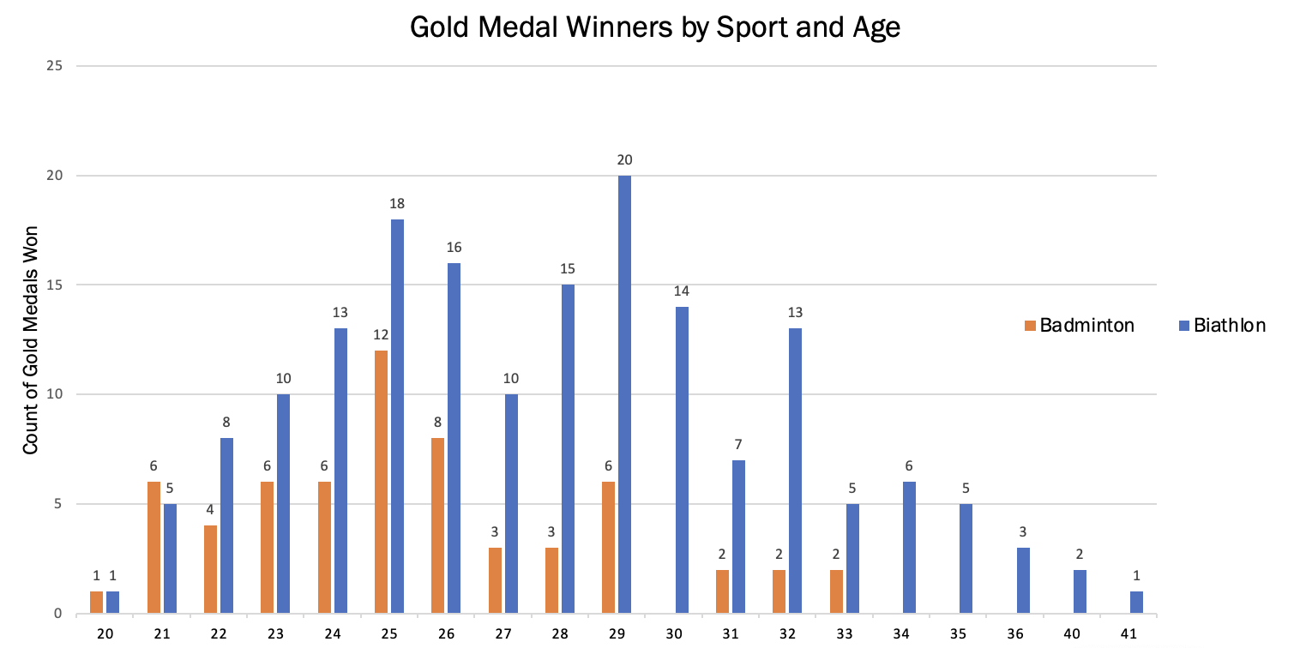
Does age and intensity of the sport affect your chance to win a Gold Medal?

Slide 22
Does age and intensity of the sport affect your chance to win a Gold Medal?
After analyzing all the data, I have concluded that yes age and intensity of the sport affect your chance of winning a gold medal. If you see the difference between the sport and the age you can determine that it is easier to win a gold medal at any age if you are competing in a Biathlon competition as opposed to Badminton.
In conclusion, if you want to win a gold medal and you are older than 28, I recommend competing in sports that are not intense.

Slide 23

Thank You

