Slide 1
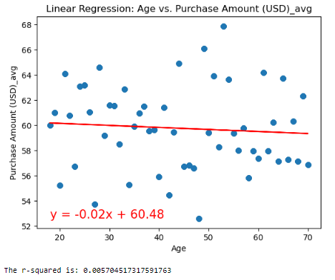
Is there a correlation between Age and Purchase Amount (USD) Average?
Hypothesis: Age impacts Purchase Amount (USD).
Results:
The regression line shows no correlation.
Correlation coefficient is zero.
No statistically significant results.
No linear trend, the line should not be used for prediction.
Limitation:
Small sample dataset
Figure 11 in reference question 3a

Slide 2
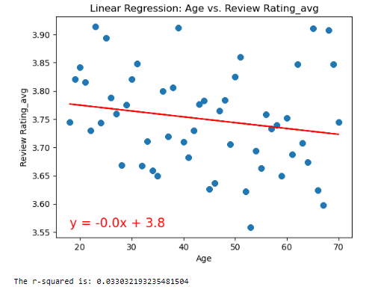
Is there a correlation between Age and Review Rating Average?
Hypothesis: Age impacts Review Rating.
Results:
The regression line shows no correlation.
Correlation coefficient is zero.
No statistically significant results.
No linear trend, the line should not be used for prediction.
Limitation:
Small sample dataset
Figure 12 in reference question 3b

Slide 3
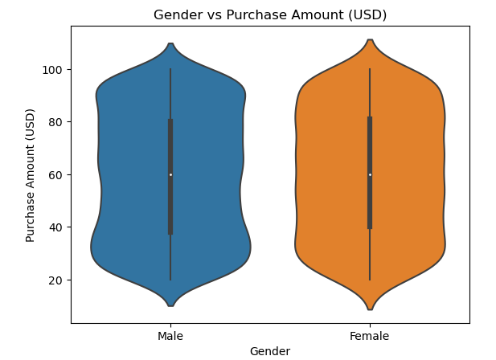

Are Gender means in Purchase Amount (USD) different?
Null Hypothesis: Gender means in Purchase Amount (USD) are equal.
Alternative Hypothesis: Gender means in Purchase Amount (USD) are not equal.
Results:
p_value = 0.38
Failed to reject the null hypothesis
Statistically not significant
Mean=59.23
Mean=60.24
Figure 5

Slide 4
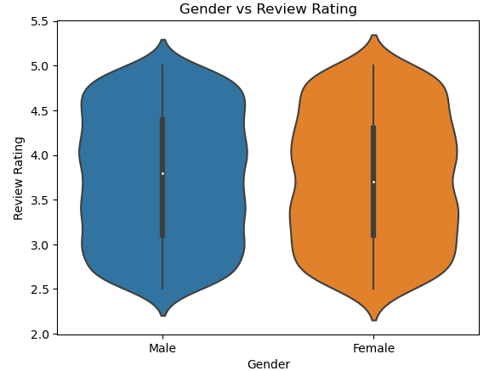
Are Gender means in Review Rating different?
Null Hypothesis: Gender means in Review Rating are equal.
Alternative Hypothesis: Gender means in Review Rating means are not equal.
Results:
p_value = 0.61
Failed to reject the null hypothesis
Statistically not significant
Mean=3.75
Mean=3.74
Figure 6

