Slide 1
Amazon Sales Performance Analysis
DATA ANALYSIS
AWS •Cloud Computing
Business Intelligence Dashboard
Grace Amolegbe
Blooming Hearts Foundation
August 2026

Slide 2
Business Problem
What does management need to understand?
How can sales data help the business make better decisions?
01
Overall sales
02
Top products
03
Sales trends
How much revenue is being generated?
Which products drive the most revenue?
When are sales strongest or weakest?
04
Regions
05
Opportunities
Which markets perform best?
Where can performance improve?

Slide 3
Data & Tools
From raw sales records to business decisions
50,000
2022–2023
Sales records
Data period
Excel
S3
QuickSight
Dashboard
Decisions
→
→
→
→
Inspect & prepare
Cloud storage
Analyse & visualise
Show insights
Take action
Excel was used to inspect and prepare the data before it was stored in S3 and analysed in QuickSight.

Slide 4
KPI Summary
A quick view of overall sales performance
$32.87M
50,000
149,970
$657.33
Total Revenue
Orders
Units Sold
Average Order Value
Key takeaway
The business generated strong overall revenue from 50,000 orders, with an average order value of $657.33

Slide 5
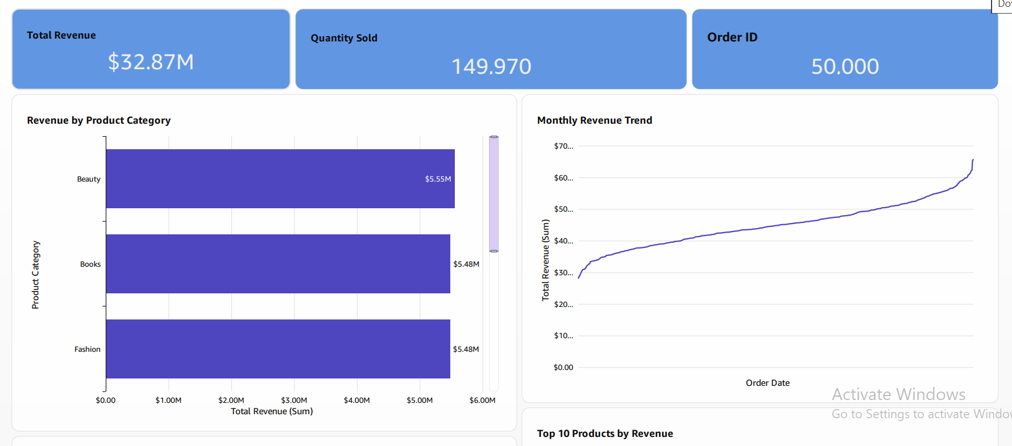
Dashboard
Amazon Sales Performance — QuickSight
INSERT FULL QUICKSIGHT DASHBOARD SCREENSHOT HERE
Use the final dashboard screenshot at full width for your presentation.

Slide 6
Key Findings
What the dashboard tells us
01
Beauty
Highest-revenue category
02
Middle East
Highest regional revenue
03
January 2023
Highest monthly revenue
04
+0.54%
2023 revenue growth vs. 2022
05
Balanced
Revenue was relatively balanced across categories and regions

Slide 7
Recommendations
Turning findings into practical actions
01
Strengthen high-performing categories
02
Investigate low growth
Keep investing in categories that already generate strong revenue
Find out why 2023 revenue grew only slightly and identify ways to improve
03
Learn from the Middle East
04
Prepare inventory
Study what works in this market and apply useful lessons elsewhere
Plan stock around high-performing months and products
05
Monitor top products
Track best-selling products closely to protect revenue
Thank You

