Slide 1
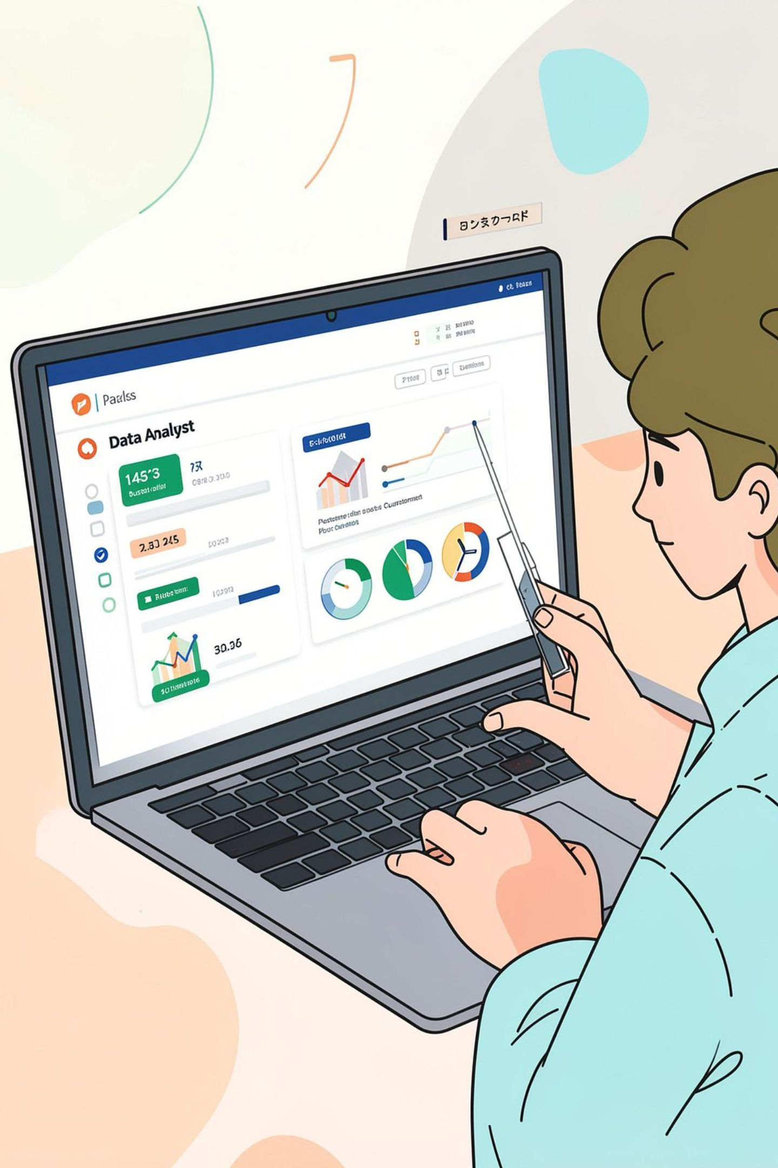
Customer Shopping Behavior Analysis
3,900 purchases · 18 features · goal: uncover spending, segments, preferences, subscriptions

Slide 2

Dataset Summary
Scale
Key Features
Rows: 3,900 · Columns: 18
Demographics, Purchase details, Behavior, Shipping, Discounts
Missing Data
37 values in Review Rating

Slide 3
Exploratory Data Analysis (Python)
01
02
03
Load & Inspect
Clean & Impute
Standardize
pandas: df.info(), describe()
Imputed Review Rating by category median
Renamed columns to snake_case
04
05
Feature Eng.
DB Load
age_group, purchase_frequency_days
Uploaded cleaned DF to PostgreSQL

Slide 4
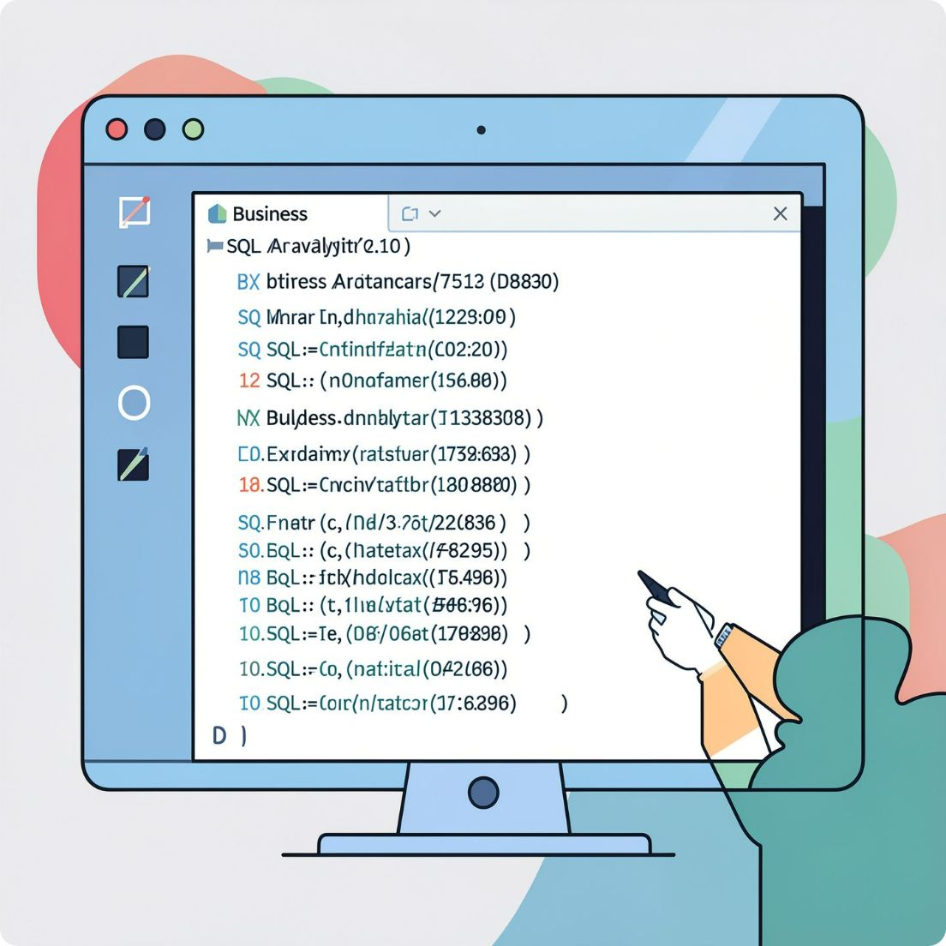
SQL Analysis — Business Questions
Revenue by gender
High-spending discount users
Top products by rating
Shipping type comparison

Slide 5
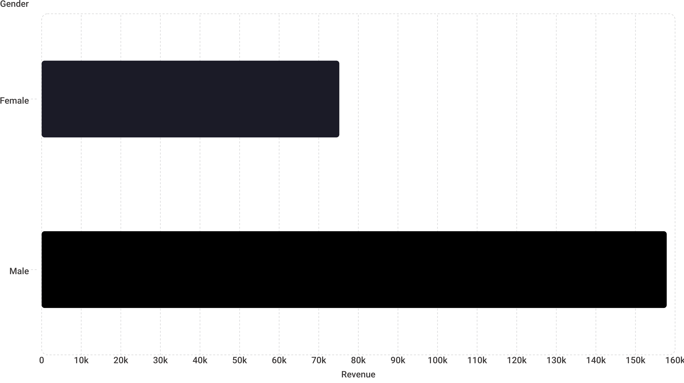
Revenue by Gender
Male revenue notably higher than female (raw totals)

Slide 6



Discounts & High-Spenders
1
High-Spending Discount Users
839 rows identified — customers using discounts but spending above average
2
Discount-Dependent Products
Top 5: Hat (50%), Sneakers (49.66%), Coat, Sweater, Pants

Slide 7
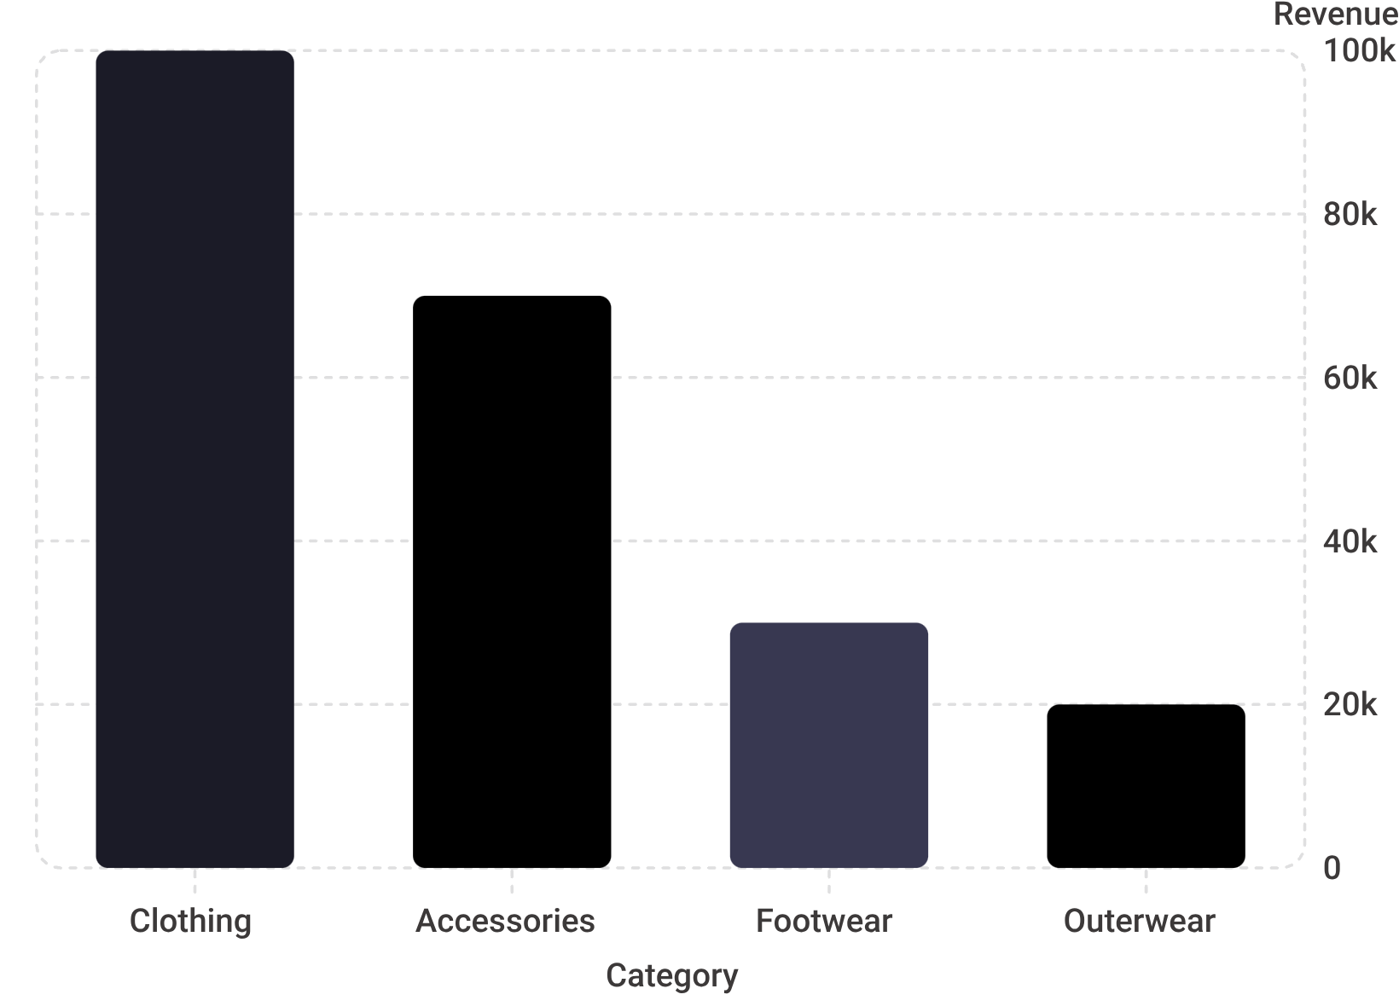
Top Products & Sales
Top-rated: Gloves, Sandals, Boots, Hat, Skirt
Top sellers by category: Jewelry, Blouse, Sandals, Jacket
Sales by category: Clothing 1,800 · Accessories 1,200 · Footwear 600 · Outerwear 300

Slide 8
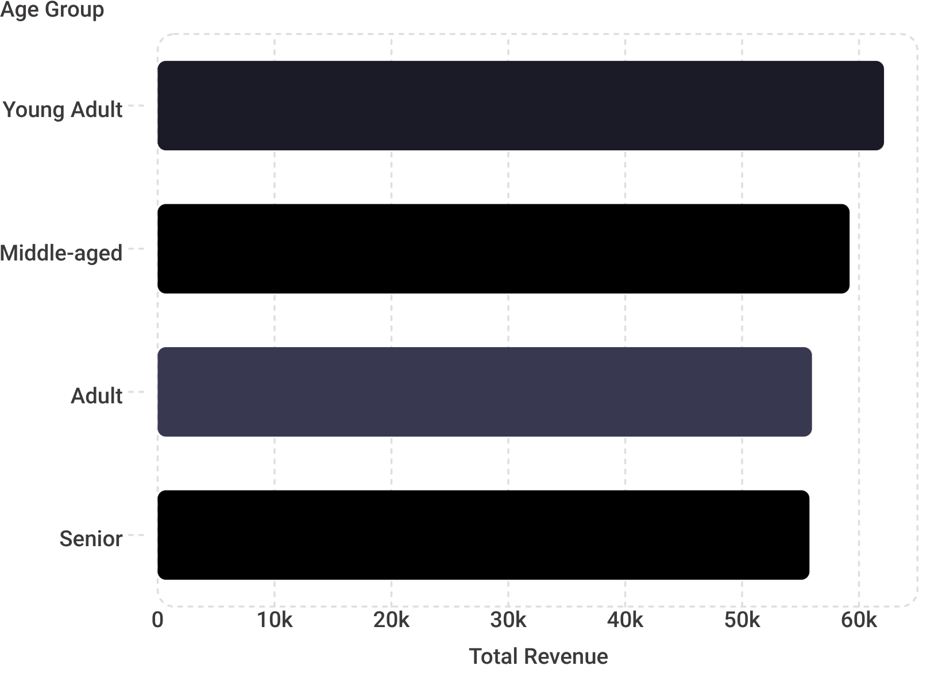
Customers & Segments
Segments: Loyal 3,116 · Returning 701 · New 83
Subscribers: Yes 1,053 (avg $59.49) · No 2,847 (avg $59.87)
Repeat buyers (>5 purchases) more likely to be non-subscribers by count

Slide 9
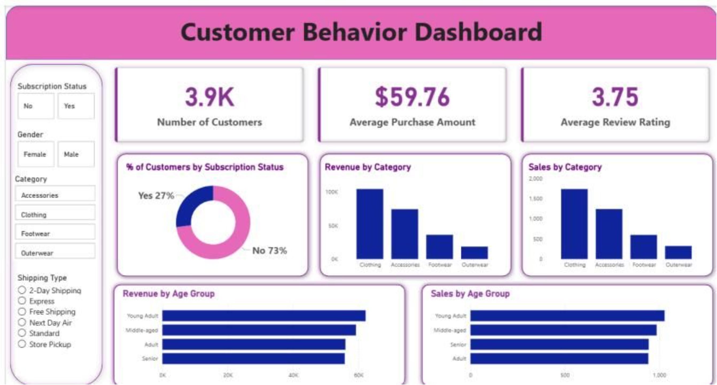
Power BI Dashboard
Interactive dashboard: 3.9K customers · Avg purchase $59.76 · Avg rating 3.75 · Subscription donut 27% yes

Slide 10
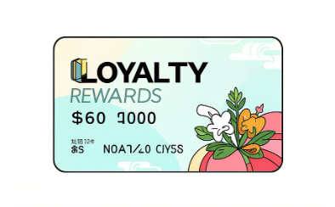

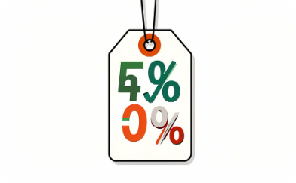


Business Recommendations
Customer Loyalty
Boost Subscriptions
Review Discount Policy
Reward repeat buyers to move them into Loyal segment
Promote exclusive subscriber benefits
Balance sales uplift with margin control
Product Positioning
Targeted Marketing
Feature top-rated and best-selling items
Focus on high-revenue age groups and express-shipping users

